Slide 1
LO: Scale Drawings
and Maps

Slide 2
Scale drawings are used to
represent real objects
drawn in proportion to
their actual sizes.
Can you think of any examples.

Slide 3
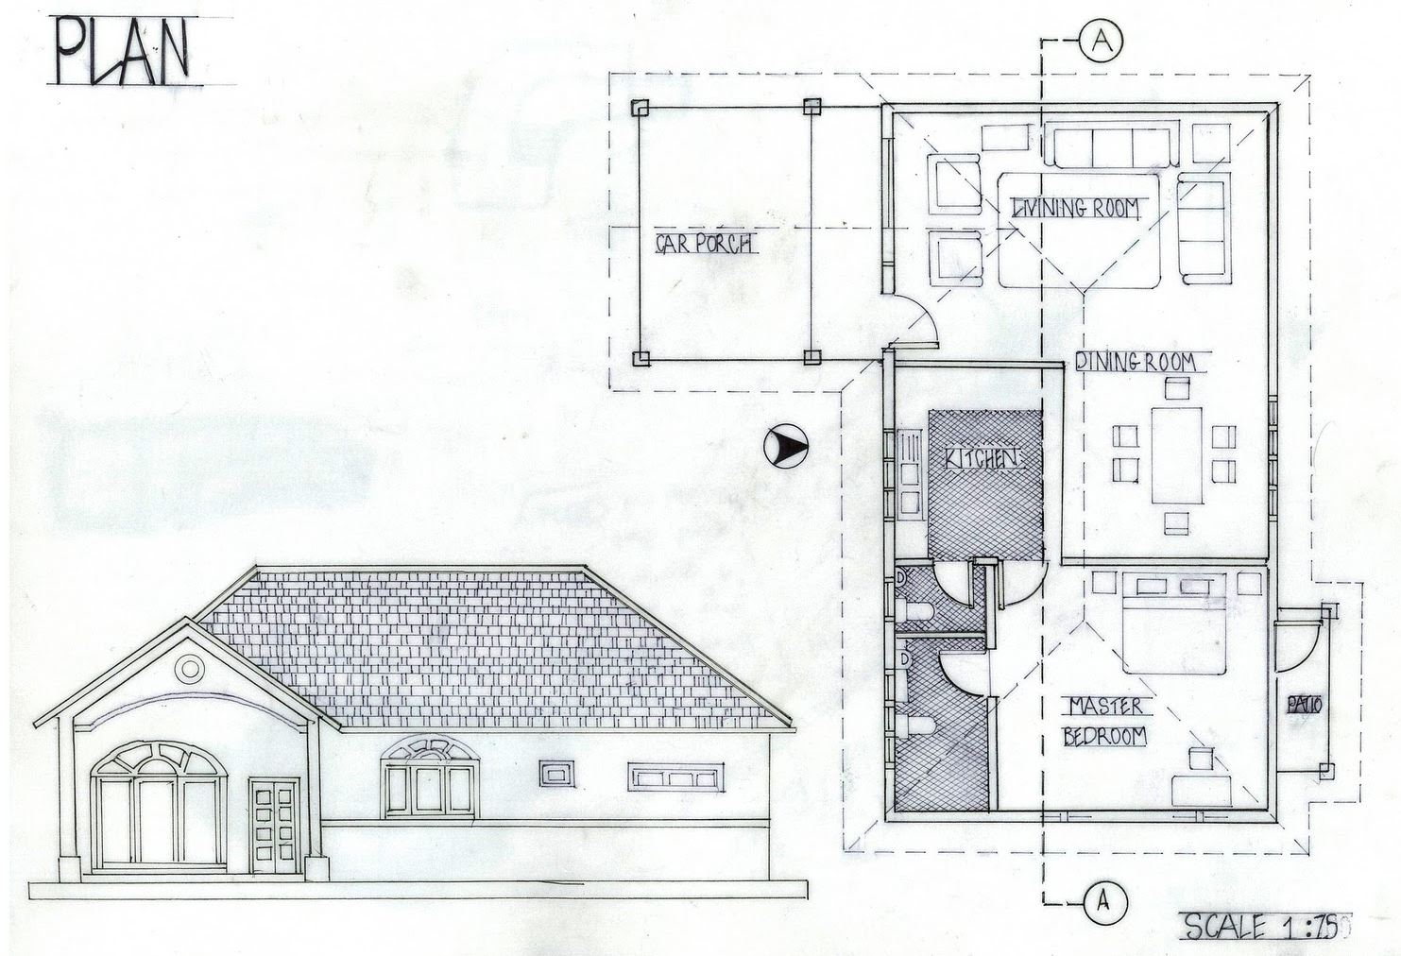
1:75
What does the
ratio tell you?
Every 1 cm in this drawing represents 75 cm in real life.

Slide 4
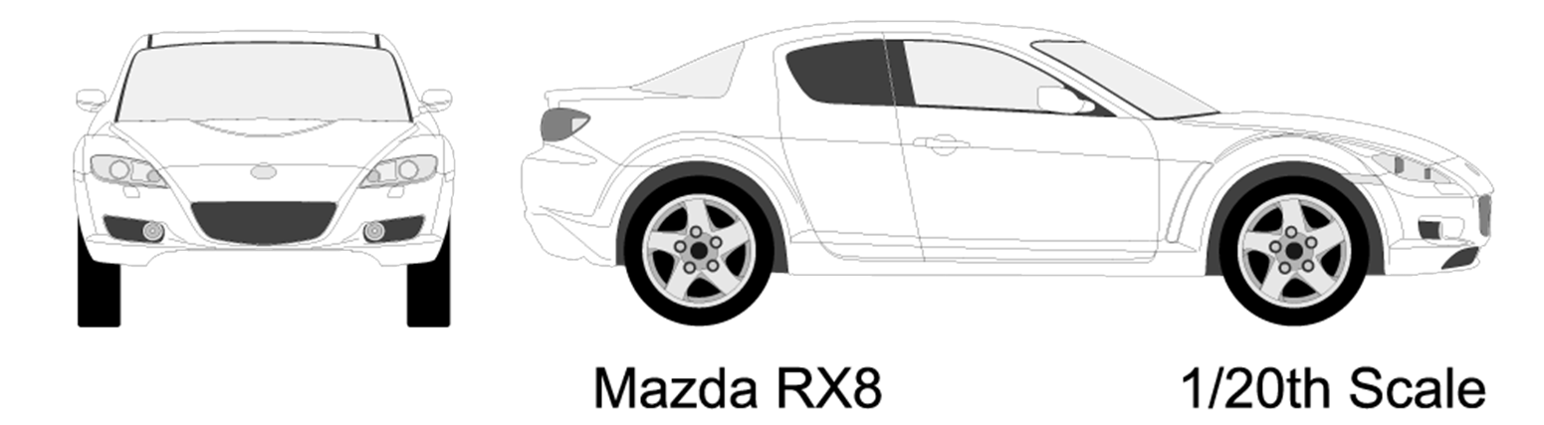
If the length of the car, in the drawing, is 12cm,
what length is the car in real life?
12 x 20 = 240cm

Slide 5
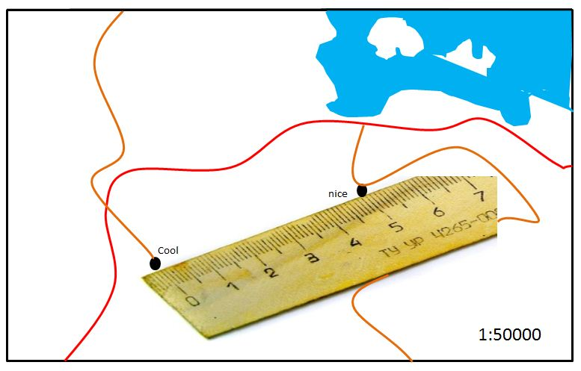
What is the distance between Cool and Nice in Kilometres?
50000 x 5cm = 250000cm
250000cm = 2500m = 2.5km

