Slide 1
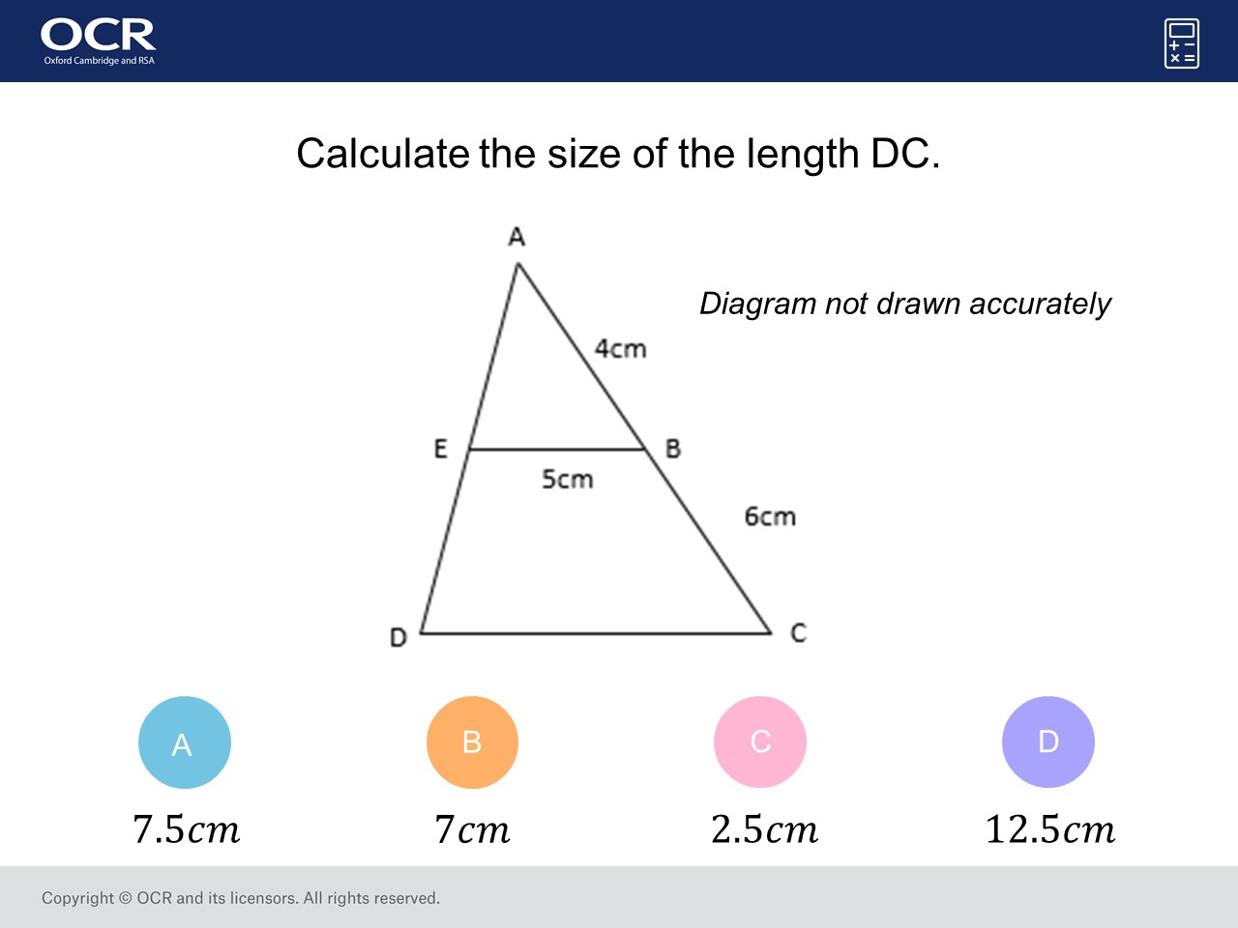
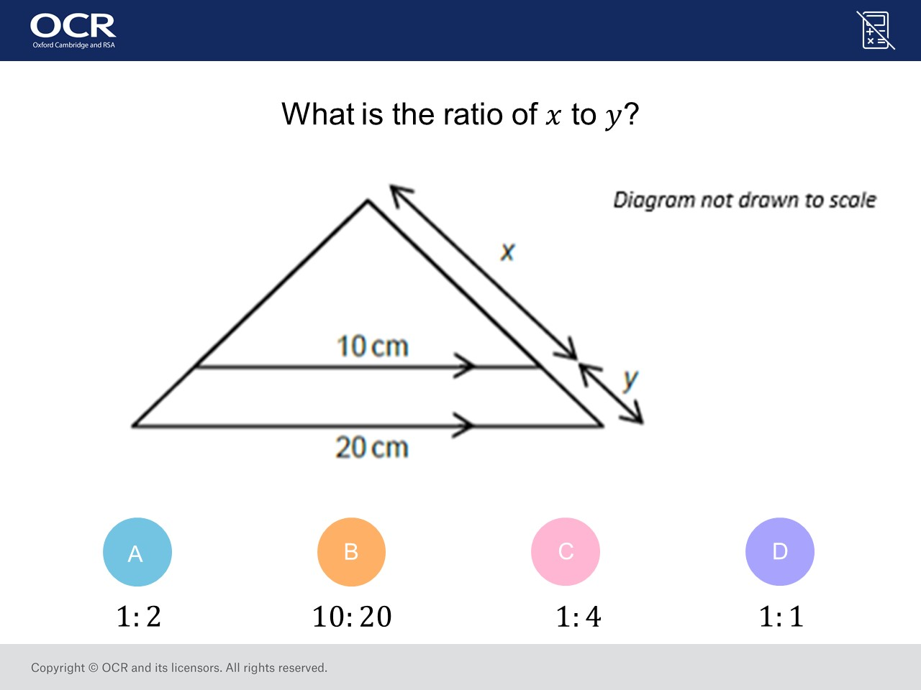
Worst answered question?
Most common wrong answer?

Slide 2
ANSWERS

Slide 3
Worst answered question?

Slide 4
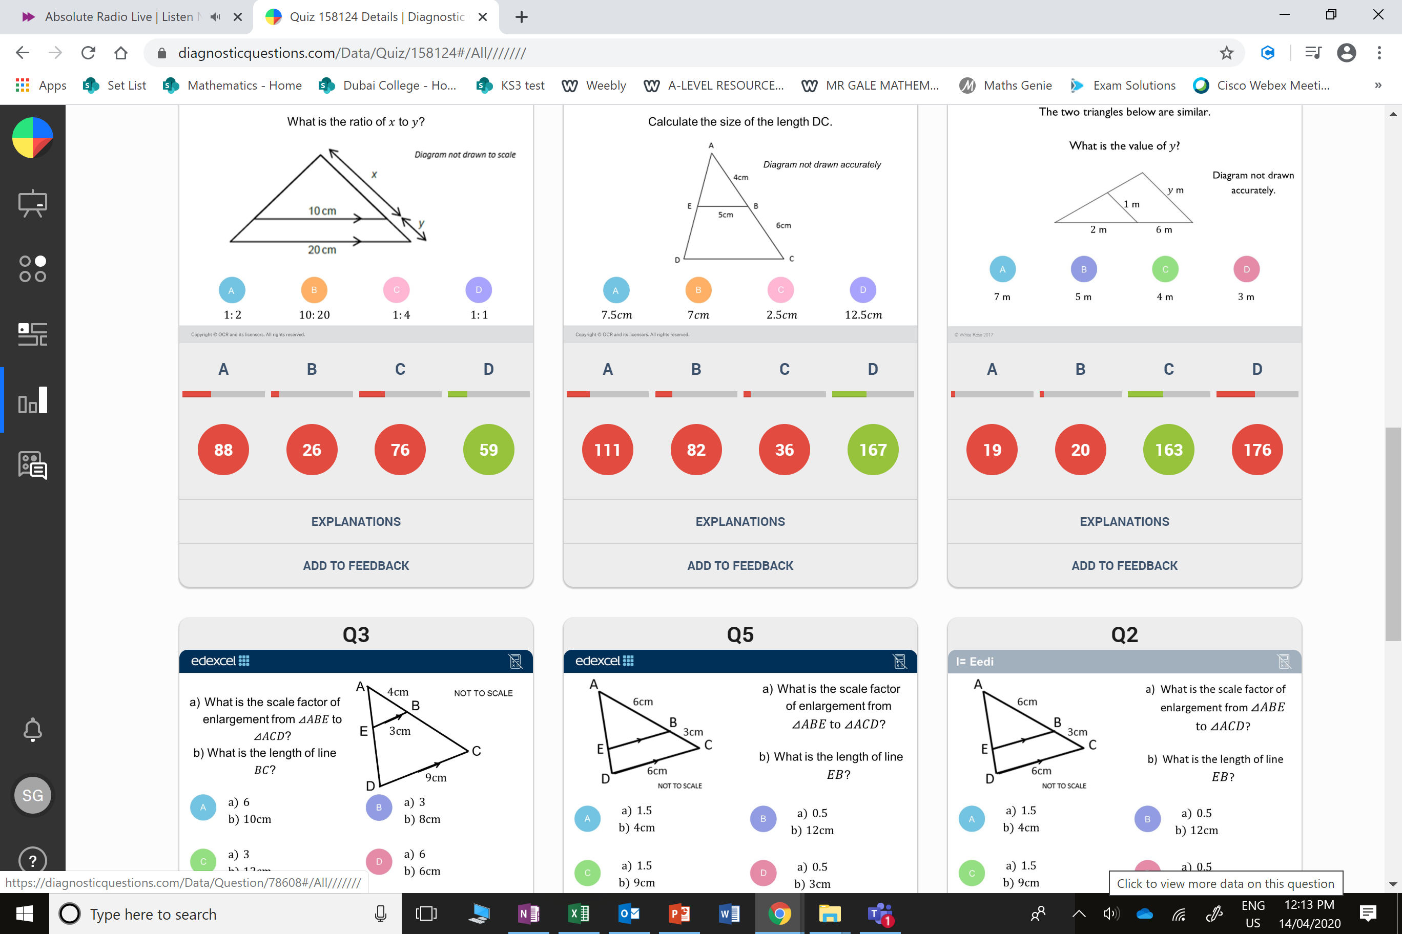
A
They did the ratio of x : x + y

Slide 5
A
The found the scale factor by doing 6 ÷ 4
Instead of 10 ÷ 4

