Slide 1
Vectors
Position Vectors
Chapter 11
(Part 3 of 4)

Slide 2
Vectors - Position Vectors
A vector used to represent a position, such as a co-ordinate,
is known as a position vector.
The position is with reference from the origin.

Slide 3
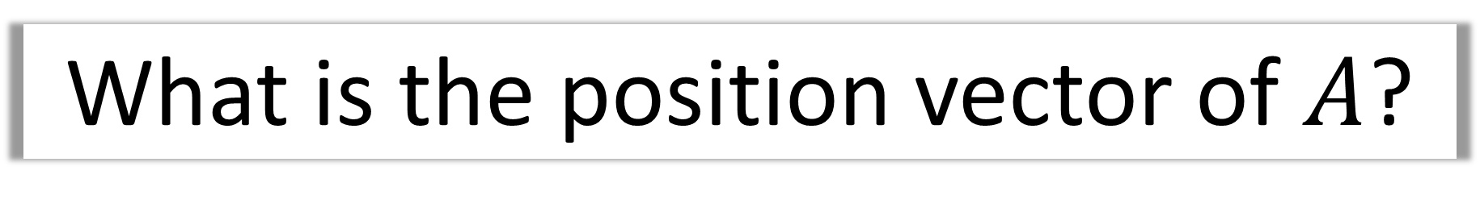
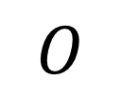
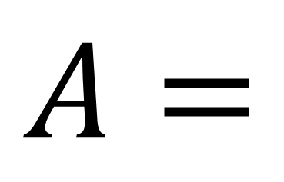
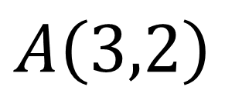
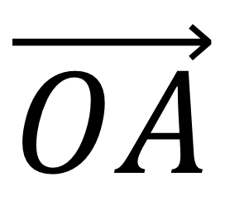
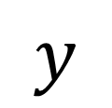
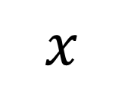
What is the position vector of $A$?
$$y$$
$$\vec{OA}$$
$$A=$$
$$A\left(3,2\right)$$
= 3i + 2j
$$O$$
$$x$$

Slide 4
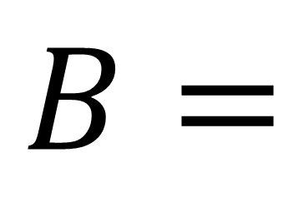
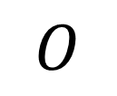
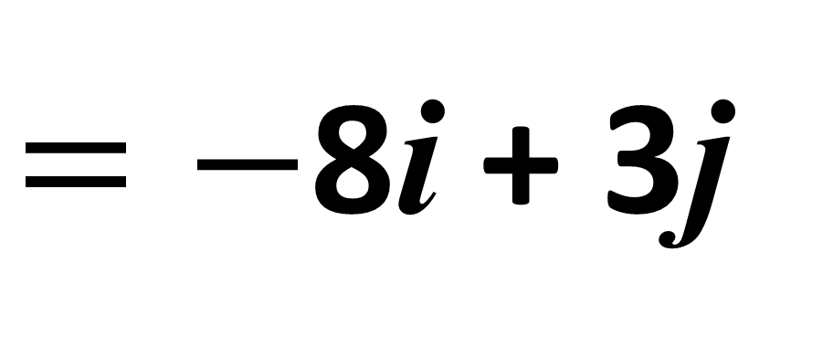
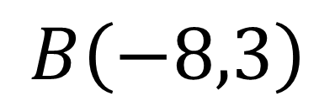
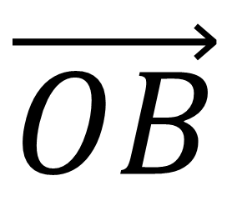
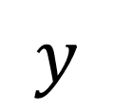
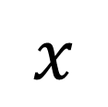
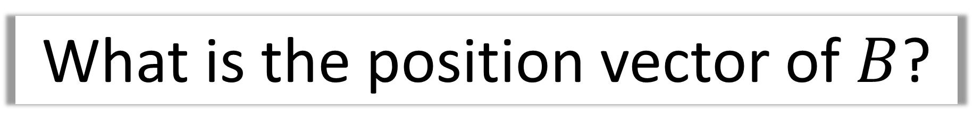
What is the position vector of $B$?
$$y$$
$$\vec{OB}$$
$$B=$$
$$B\left(−8,3\right)$$
$=−$8i + 3j
$$x$$
$$O$$

Slide 5
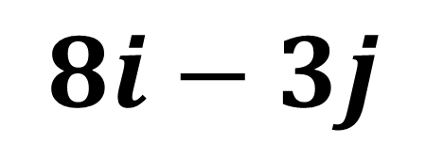
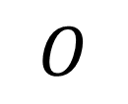
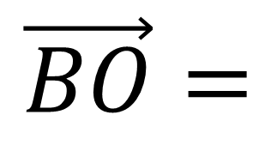
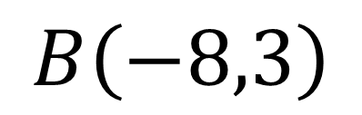
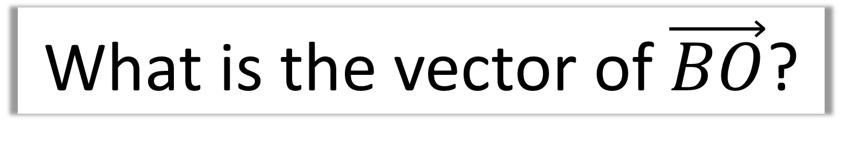
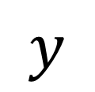
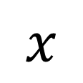
What is the vector of$\vec{BO}$?
$$y$$
$$\vec{BO}=$$
$$8i−3j$$
$$B\left(−8,3\right)$$
$$x$$
$$O$$

Slide 6

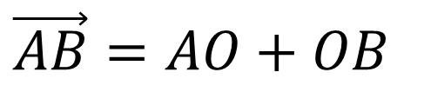


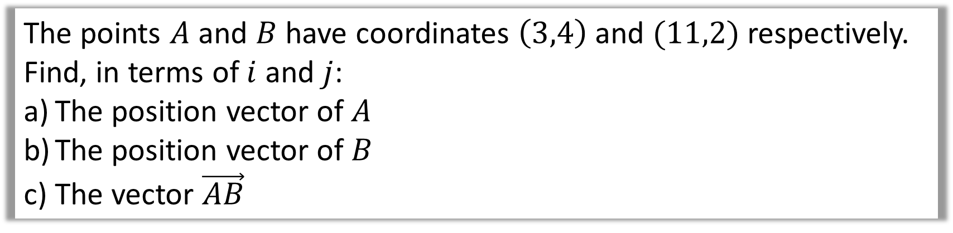

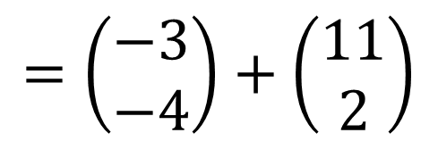

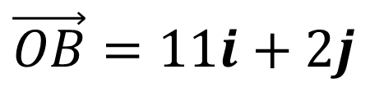

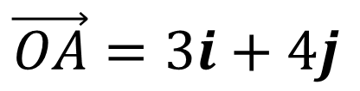
The points $A$ and $B$ have coordinates $\left(3,4\right)$ and $(11,2)$ respectively.
Find, in terms of $i$ and $j$:
The position vector of $A$
The position vector of $B$
The vector $\vec{AB}$
a)
$$\vec{OA}=3i+4j$$
$$y$$
$$A\left(3,4\right)$$
$$\vec{OB}=11i+2j$$
b)
$$B\left(11,2\right)$$
$$\vec{AB}=AO+OB$$
c)
$$=\left(\begin{matrix}−3 \\ −4\end{matrix}\right)+\left(\begin{matrix}11 \\ 2\end{matrix}\right)$$
$$O$$
$$x$$
$$=8i −2j$$

Slide 7
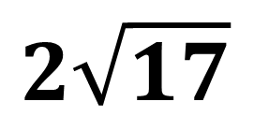
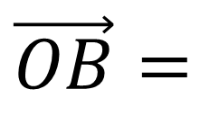
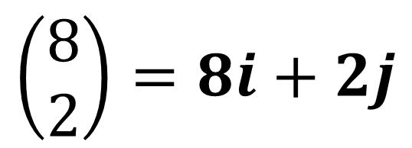
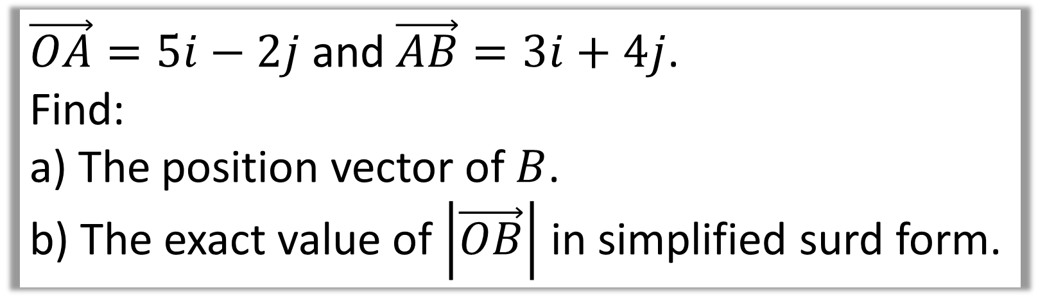
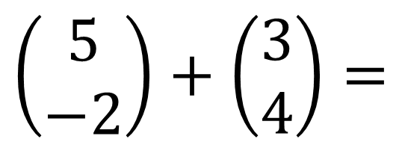
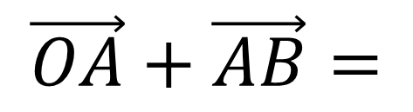
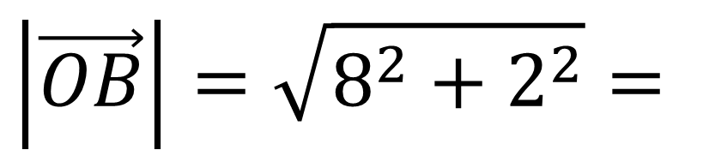
$\vec{OA}=5i−2j$ and $\vec{AB}=3i+4j$.
Find:
a) The position vector of $B$.
b) The exact value of $\left|\vec{OB}\right|$ in simplified surd form.
$$\vec{OB}=$$
$$\vec{OA}+\vec{AB}=$$
$$\left(\begin{matrix}5 \\ −2\end{matrix}\right)+\left(\begin{matrix}3 \\ 4\end{matrix}\right)=$$
$$\left(\begin{matrix}8 \\ 2\end{matrix}\right)=8i+2j$$
a)
b)
$$\left|\vec{OB}\right|=\sqrt{8^{2}+2^{2}}=$$
$$2\sqrt{17}$$

Slide 8
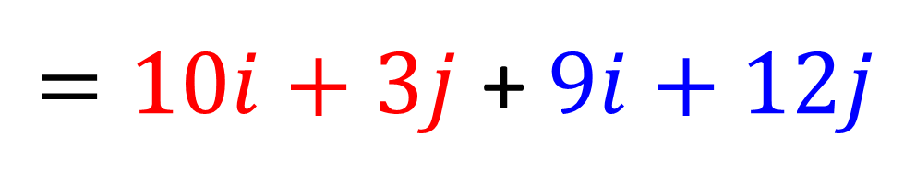

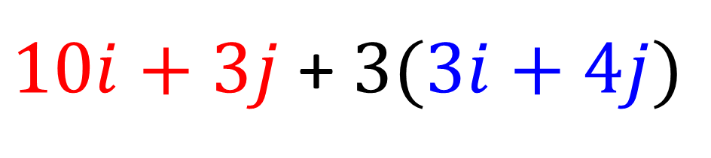



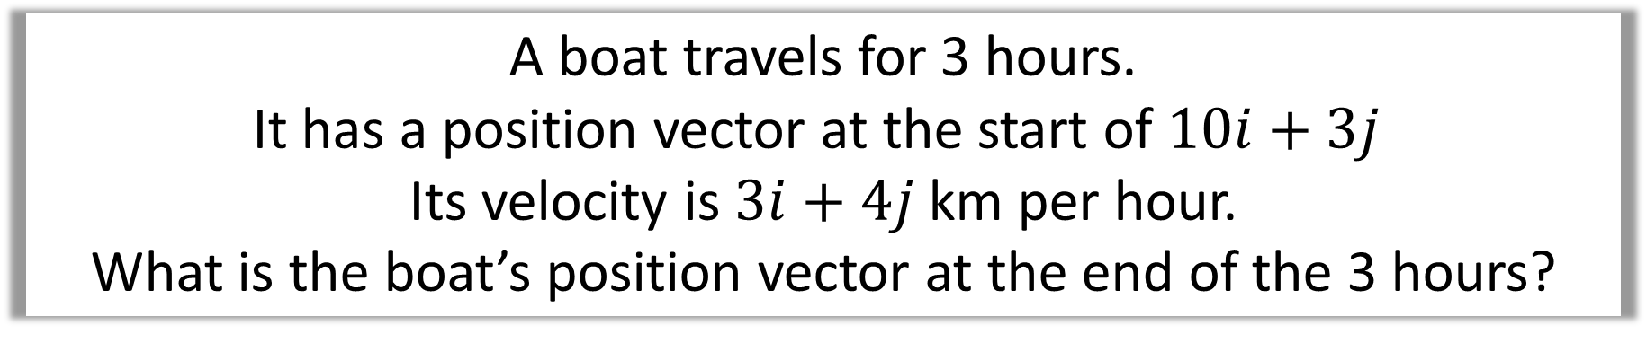

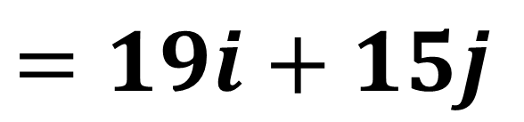
A boat travels for 3 hours.
It has a position vector at the start of $10i+3j$
Its velocity is $3i+4j$km per hour.
What is the boat’s position vector at the end of the 3 hours?
$10i+3j$+ $3(3i+4j)$
$$4$$
$=10i+3j$+ $9i+12j$
$$4$$
$$3$$
$$4$$
$$=19i+15j$$
$$3$$

