Slide 1
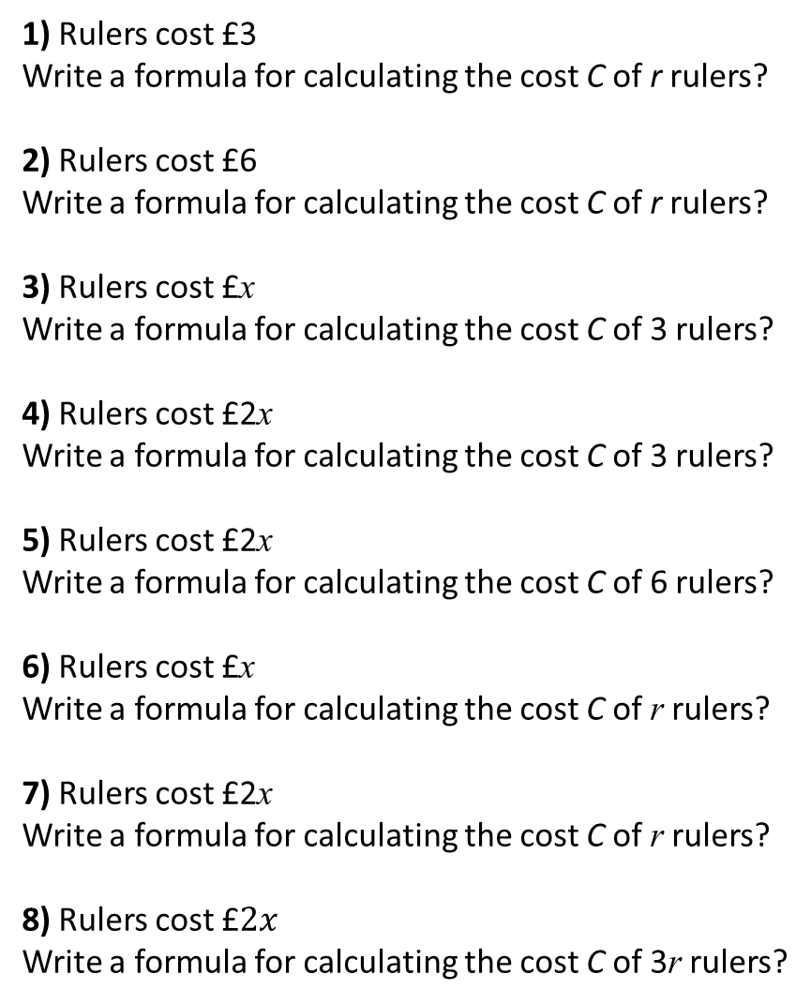
1) Rulers cost £3
Write a formula for calculating the cost C of r rulers?
2) Rulers cost £6
Write a formula for calculating the cost C of r rulers?
3) Rulers cost £x
Write a formula for calculating the cost C of 3 rulers?
4) Rulers cost £2x
Write a formula for calculating the cost C of 3 rulers?
5) Rulers cost £2x
Write a formula for calculating the cost C of 6 rulers?
6) Rulers cost £x
Write a formula for calculating the cost C of r rulers?
7) Rulers cost £2x
Write a formula for calculating the cost C of r rulers?
8) Rulers cost £$2x$
Write a formula for calculating the cost C of 3r rulers?
1) Rulers cost £3 and Pens cost 10p
Write a formula for calculating the cost C of r rulers and p pens?
2) Rulers cost £3 and Pens cost 20p
Write a formula for calculating the cost C of r rulers and p pens?
3) Rulers cost £3 and Pens cost 5p
Write a formula for calculating the cost C of r rulers and p pens?
4) Rulers cost £3 and Pens cost 5p
Write a formula for calculating the cost C of x rulers and y pens?
5) Rulers cost £r and Pens cost 5p
Write a formula for calculating the cost C of x rulers and y pens?
6) Rulers cost £r and Pens cost £p
Write a formula for calculating the cost C of x rulers and y pens?
7) Rulers cost £3r and Pens cost £2p
Write a formula for calculating the cost C of x rulers and y pens?
8) Rulers cost £3r and Pens cost £2p
Write a formula for calculating the cost C of 2x rulers and 4y pens?

Slide 2
ANSWERS

Slide 3
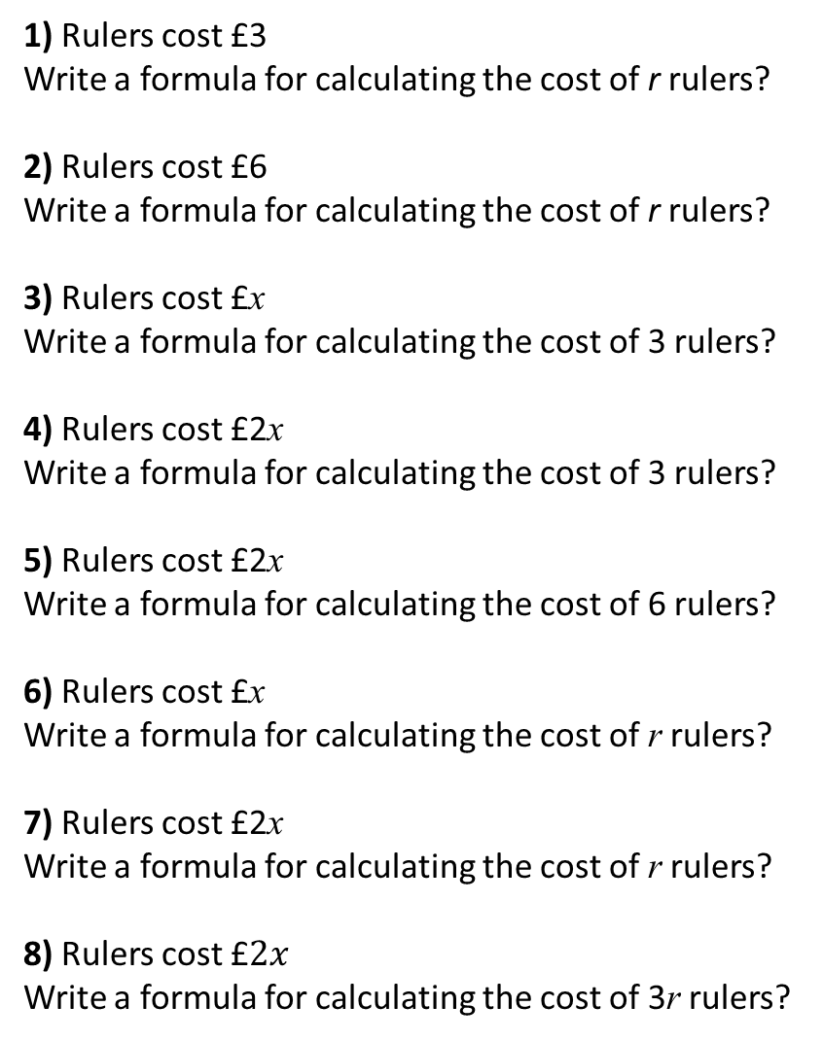
1) Rulers cost £3
Write a formula for calculating the cost of r rulers?
2) Rulers cost £6
Write a formula for calculating the cost of r rulers?
3) Rulers cost £x
Write a formula for calculating the cost of 3 rulers?
4) Rulers cost £2x
Write a formula for calculating the cost of 3 rulers?
5) Rulers cost £2x
Write a formula for calculating the cost of 6 rulers?
6) Rulers cost £x
Write a formula for calculating the cost of r rulers?
7) Rulers cost £2x
Write a formula for calculating the cost of r rulers?
8) Rulers cost £$2x$
Write a formula for calculating the cost of 3r rulers?
C = 3r
C = 6r
C = 3x
C = 6x
C = 12x
C = xr
C = 2xr
C = 6xr

Slide 4
1) Rulers cost £3 and Pens cost 10p
Write a formula for calculating the cost C of r rulers and p pens?
2) Rulers cost £3 and Pens cost 20p
Write a formula for calculating the cost C of r rulers and p pens?
3) Rulers cost £3 and Pens cost 5p
Write a formula for calculating the cost C of r rulers and p pens?
4) Rulers cost £3 and Pens cost 5p
Write a formula for calculating the cost C of x rulers and y pens?
5) Rulers cost £r and Pens cost 5p
Write a formula for calculating the cost C of x rulers and y pens?
6) Rulers cost £r and Pens cost £p
Write a formula for calculating the cost C of x rulers and y pens?
7) Rulers cost £3r and Pens cost £2p
Write a formula for calculating the cost C of x rulers and y pens?
8) Rulers cost £3r and Pens cost £2p
Write a formula for calculating the cost C of 2x rulers and 4y pens?
C = 3r + 0.1p
C = 3r + 0.2p
C = 3r + 0.05p
C = 3x + 0.05y
C = rx + 0.05y
C = rx + py
C = 3rx + 2py
C = 6xr + 8py

