Slide 1
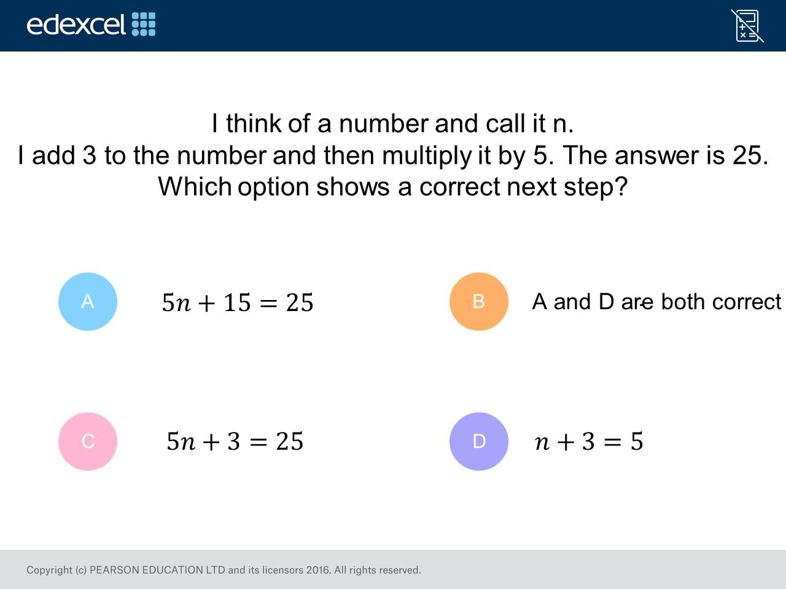
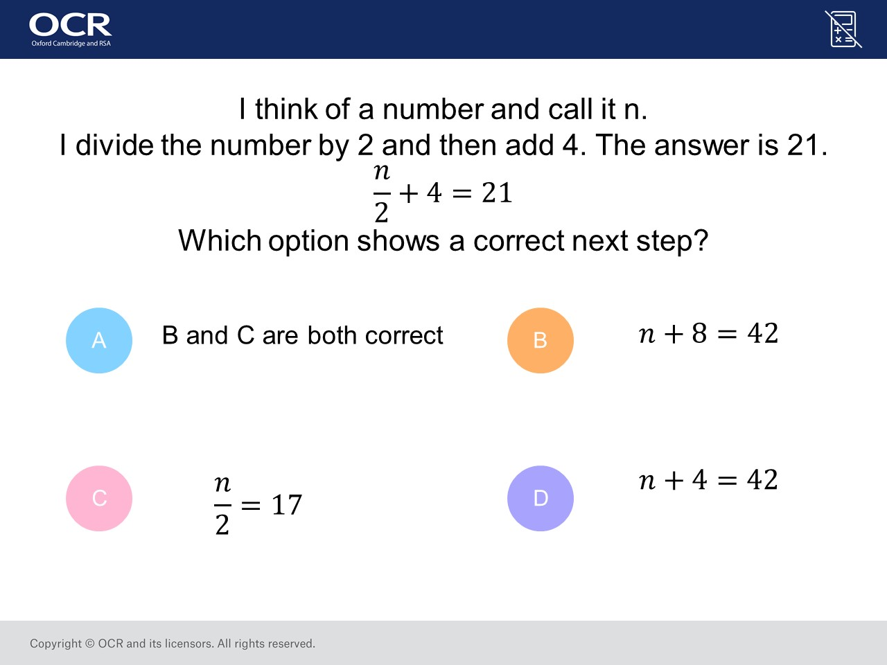
Worst answered question?
Most common wrong answer?

Slide 2
ANSWERS

Slide 3
Worst answered question?

Slide 4
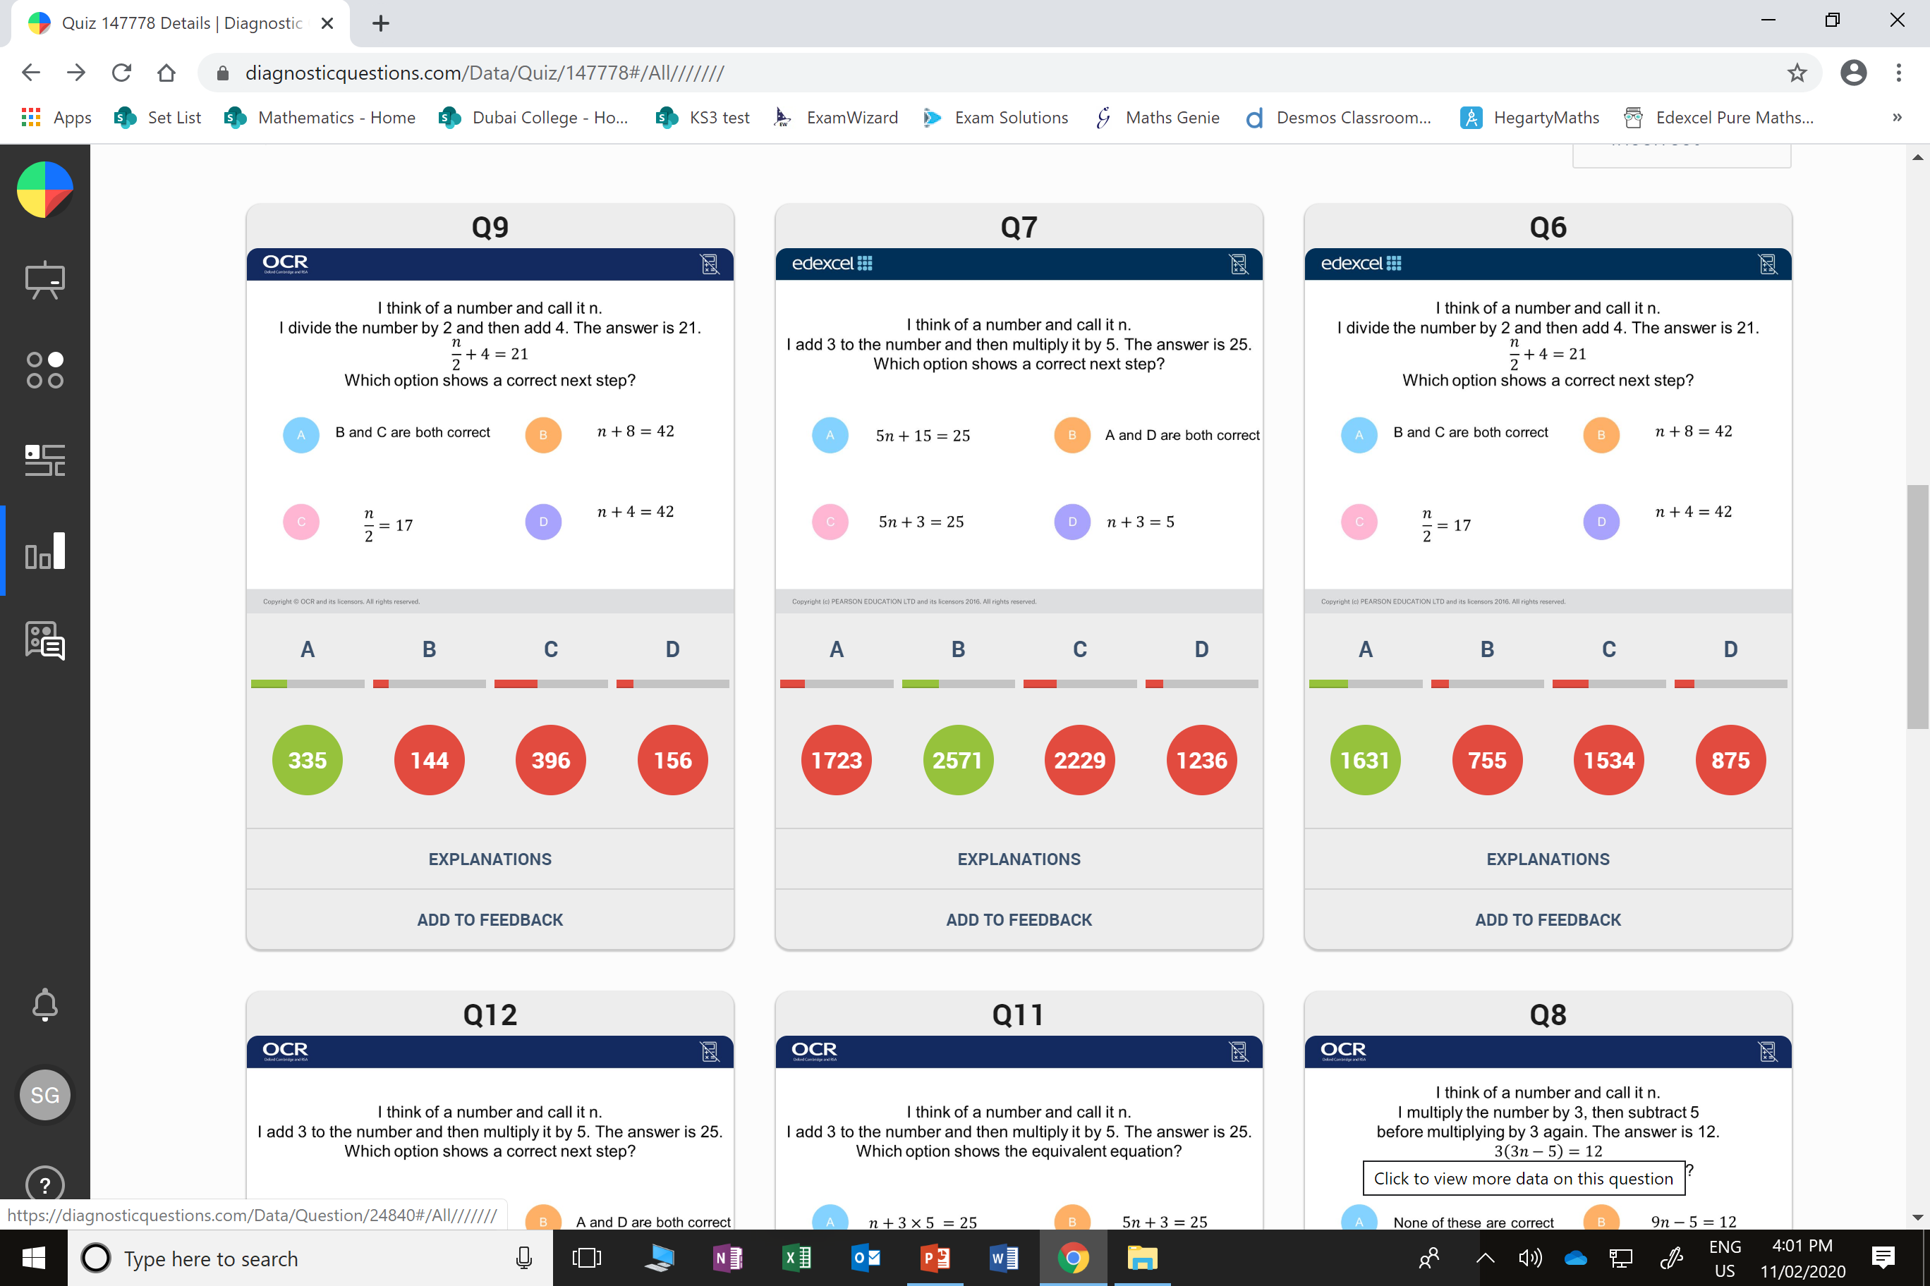
C
They did not notice you could multiply everything by 2.

Slide 5
C
They did not notice they can divide by the 5
to also get
n + 3 = 5

