Slide 1
LO: Perigal’s Dissection

Slide 2
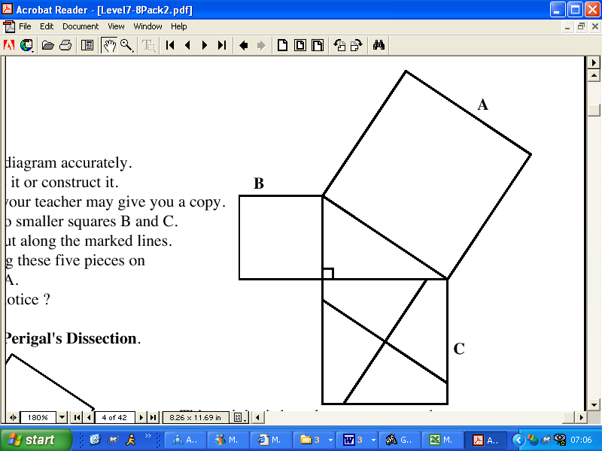
Cut out the two smaller squares B and C so that you have 5 pieces.
C
A
1
2
3
4
B
5
Now try and place the five pieces so that they fit into square A.

Slide 3
C
A
Move and rotate the 5 pieces
and place then into the big square so
that it fits inside with no pieces overlapping.
B

Slide 4
Demonstration
This shows that the area of B and C must be equal to the area of A.

