Slide 1
Forces and Motions
Pulleys
Vertical and Horizontal
Chapter 10
(Part 8 of 9)

Slide 2
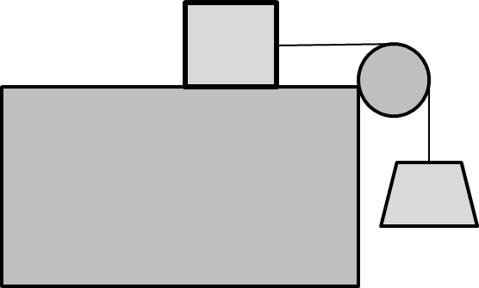
1 horizontally moving particle
1 vertically moving particle

Slide 3
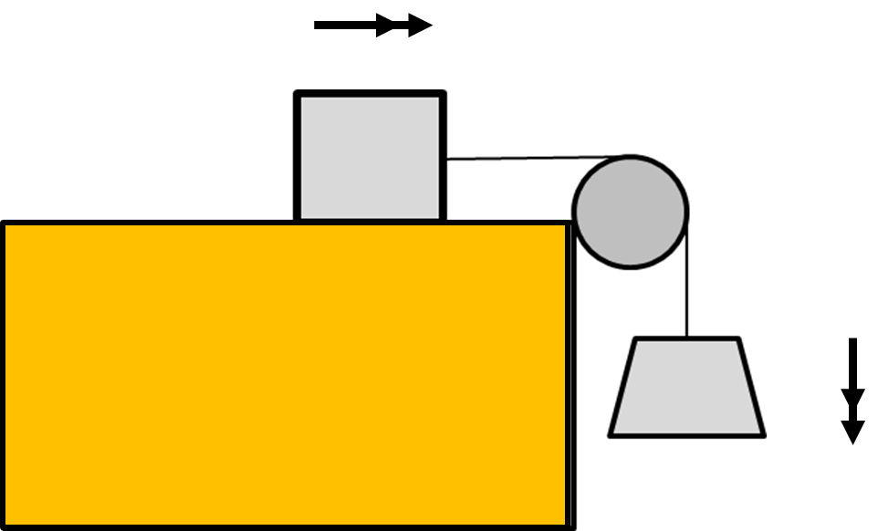
Label the forces acting on the particles.
Tension
Friction
2kg
Tension
3kg
3g

Slide 4
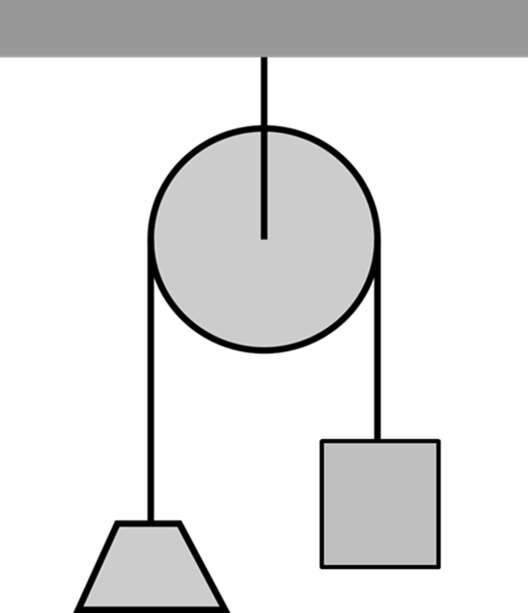
Write an F = ma equation for each particle.
T
T
F = ma
T – Friction = 2a
Friction
2kg
Friction
2kg
T
3kg
T
3g
F = ma
3g – T = 3a
3kg
3g

Slide 5
Write an F = ma equation the overall system.
T
3g
Friction
2kg
Friction
5kg
T
F = ma
3g – Friction = 5a
3kg
3g

Slide 6
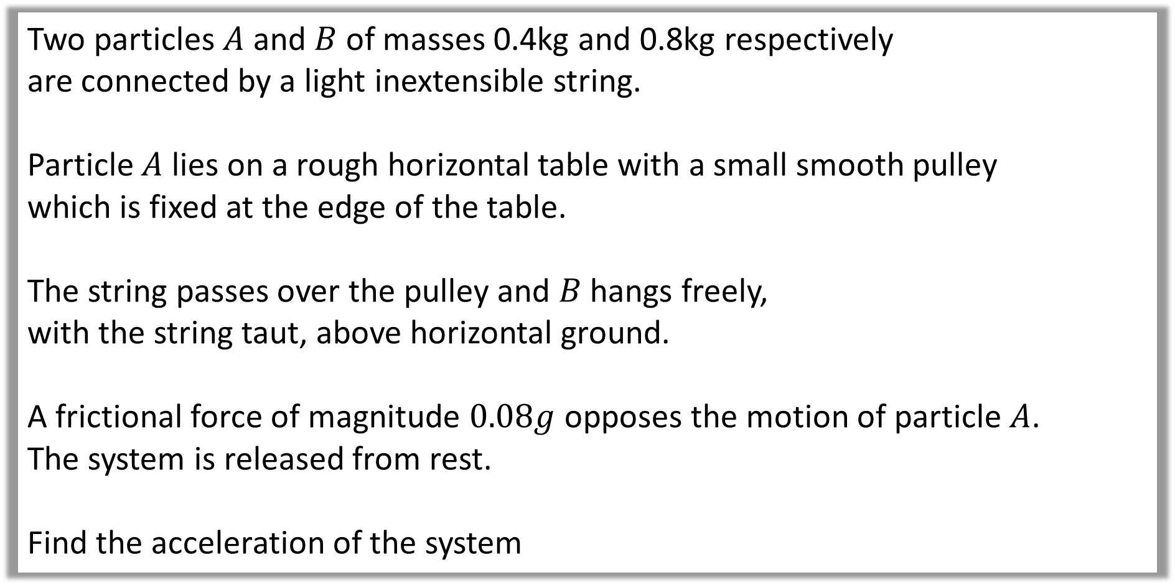
Question A
Two particles $A$ and $B$ of masses 0.4kg and 0.8kg respectively
are connected by a light inextensible string.
Particle $A$ lies on a rough horizontal table with a small smooth pulley
which is fixed at the edge of the table.
The string passes over the pulley and $B$ hangs freely,
with the string taut, above horizontal ground.
A frictional force of magnitude $0.08g$ opposes the motion of particle $A$.
The system is released from rest.
Find the acceleration of the system

Slide 7
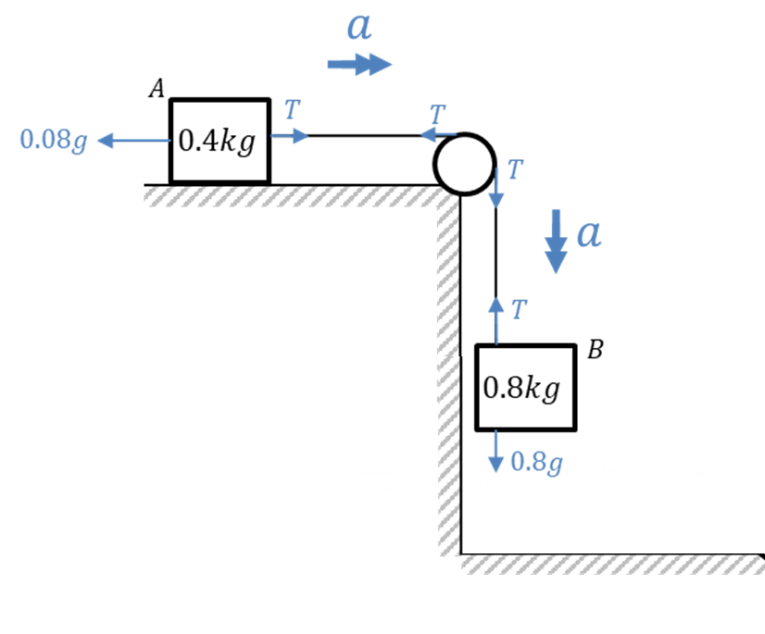


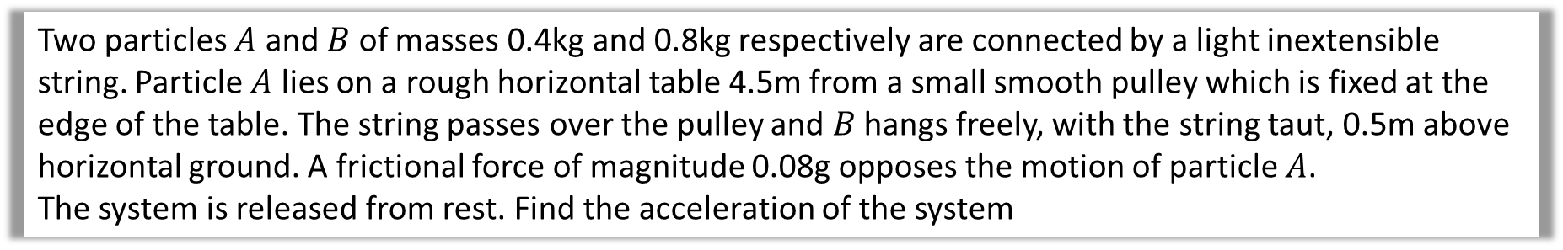



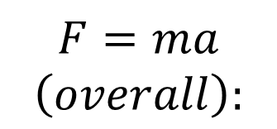


Two particles $A$ and $B$ of masses 0.4kg and 0.8kg respectively are connected by a light inextensible string. Particle $A$ lies on a rough horizontal table 4.5m from a small smooth pulley which is fixed at the edge of the table. The string passes over the pulley and $B$ hangs freely, with the string taut, 0.5m above horizontal ground. A frictional force of magnitude 0.08g opposes the motion of particle $A$.
The system is released from rest. Find the acceleration of the system
$$F=ma$$
$$\left(overall\right):$$
$$F=ma$$
$\left(→\right):$ $T−0.08g=0.4a$
$0.8g −0.08g=1.2ga$
$\left(↓\right):$ $0.8g−T=0.8a$
$$a=5.88$$
Solve Simultaneously
$$0.72g=1.2a$$
$$a=5.88$$

Slide 8
Force Exerted on a Pulley
Sometimes you will be asked to find the force
exerted on the pulley
and in which direction.

Slide 9
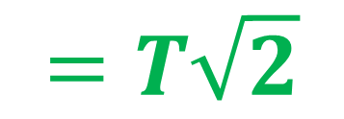

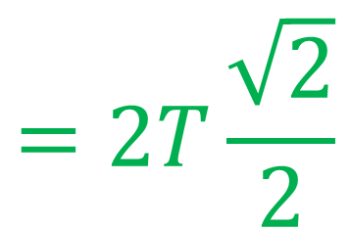

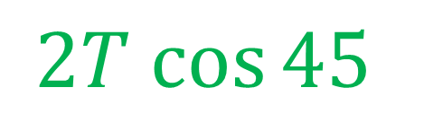
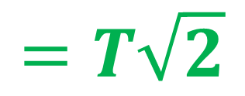

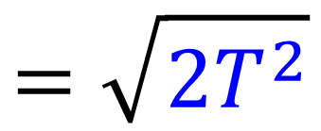

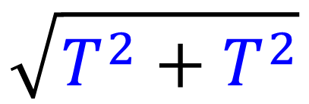
Find the force exerted on the pulley and in which direction.
$$T cos{45}$$
45°
$$T$$
$$T$$
45°
$$\sqrt{T^{2}+T^{2}}$$
45°
$$2T cos{45}$$
$$T$$
$$=2T\frac{\sqrt{2}}{2}$$
$$=\sqrt{{2T}^{2}}$$
$$=T\sqrt{2}$$
$$=T\sqrt{2}$$

Slide 10
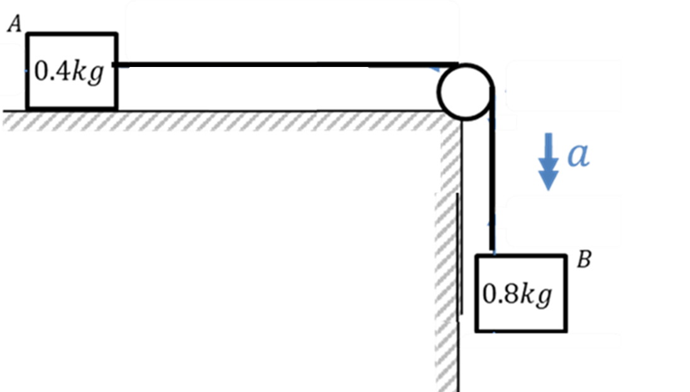






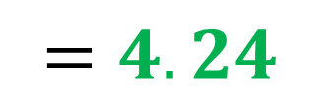
Find the force exerted on the pulley.
$$3$$
$$3N$$
$$3N$$
$$3$$
$$T\sqrt{2}$$
$$=3\sqrt{2}$$
$$=4.24$$

