Slide 1
LO: Probability Tree
Diagrams
(without replacement)

Slide 2
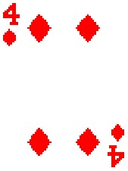
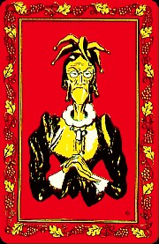
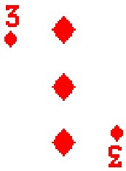
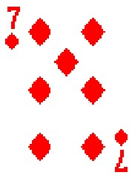
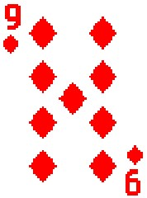
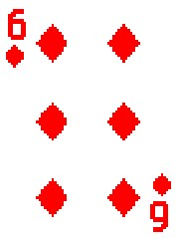
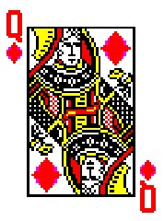
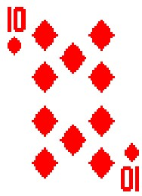
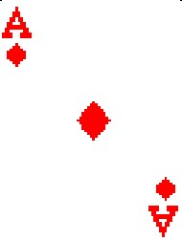
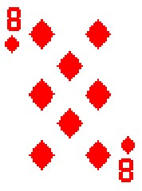
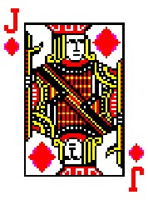
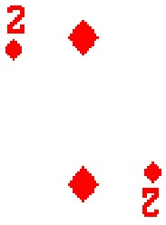
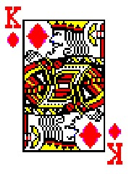
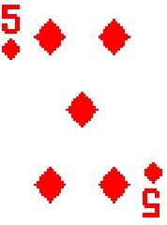
Higher or Lower
A
2
3
4
5
6
7
8
9
10
J
Q
K

Slide 3
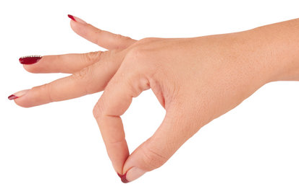
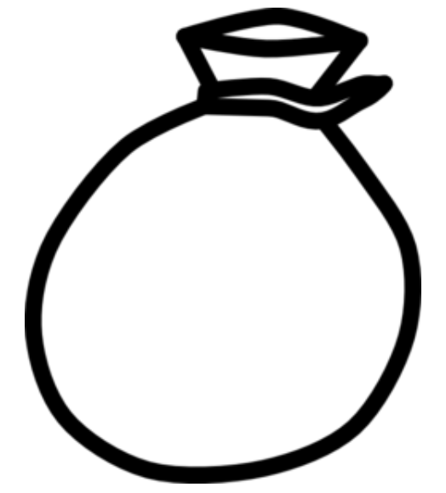




1st Pick
2nd Pick
$$\frac{3}{5}$$
$$\frac{2}{4}$$
P(Blue) =
P(Yellow) =

Slide 4


1st Pick
2nd Pick
$$\frac{4}{6}$$
$$\frac{3}{5}$$
P(Blue) =
P(Blue) =

Slide 5
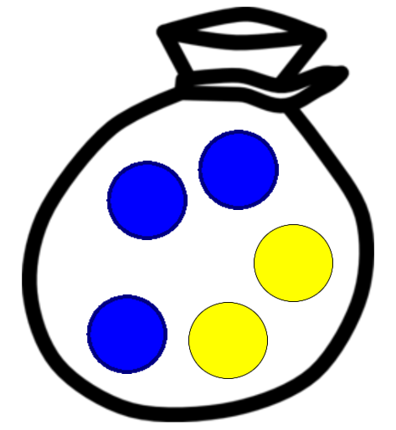

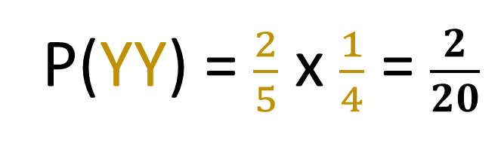

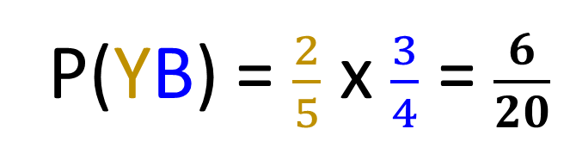
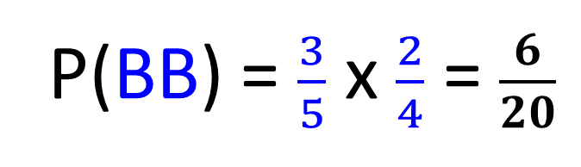

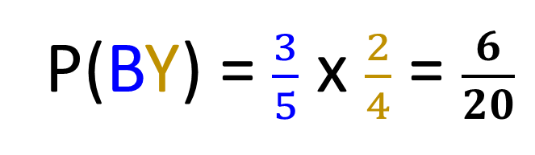



The first counter is not replaced.
$$\frac{2}{4}$$
P(BB) = $\frac{3}{5}$ x $\frac{2}{4}$ = $\frac{6}{20}$
$$\frac{3}{5}$$
$$\frac{2}{4}$$
P(BY) = $\frac{3}{5}$ x $\frac{2}{4}$ = $\frac{6}{20}$
$$\frac{3}{4}$$
P(YB) = $\frac{2}{5}$ x $\frac{3}{4}$ = $\frac{6}{20}$
$$\frac{2}{5}$$
$$\frac{1}{4}$$
P(YY) = $\frac{2}{5}$ x $\frac{1}{4}$ = $\frac{2}{20}$

Slide 6
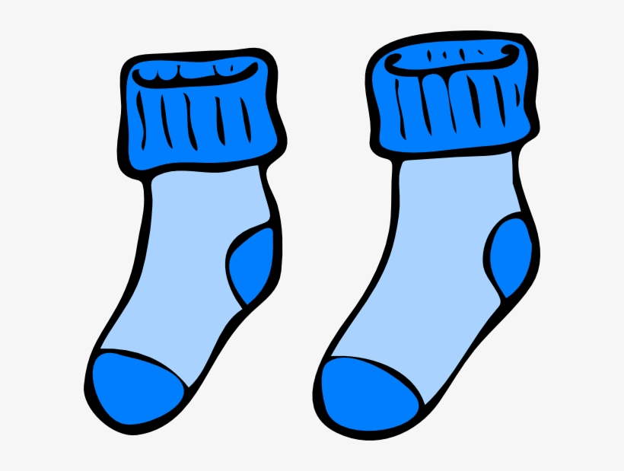
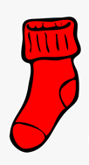
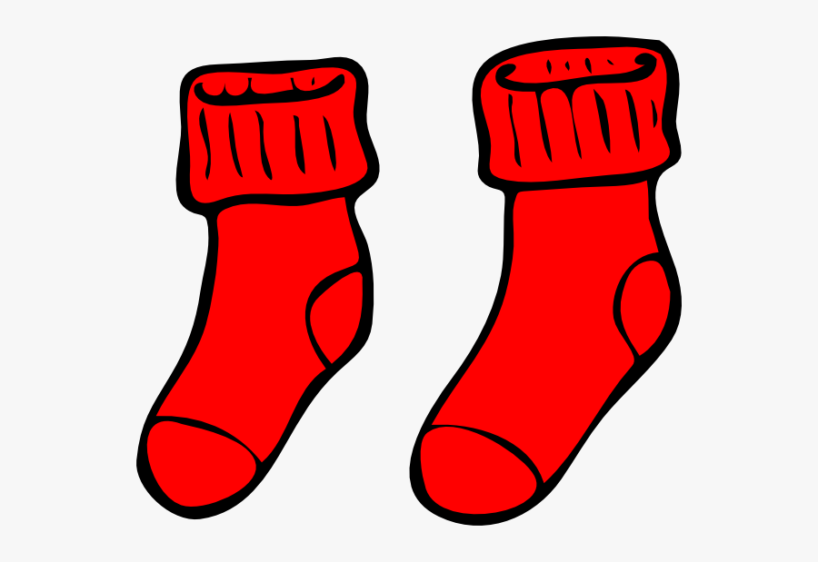

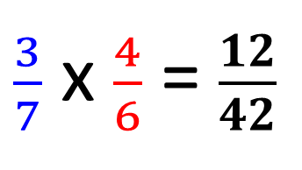


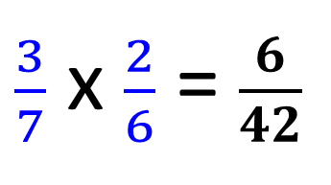


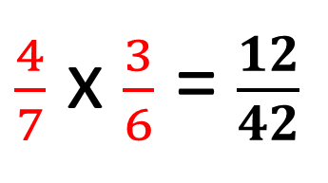

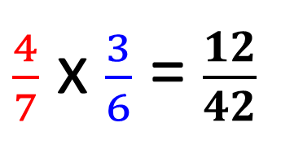
4 Reds Socks
3 Blue Socks
$$\frac{2}{6}$$
P(BB) =
$\frac{3}{7}$ x $\frac{2}{6}$ = $\frac{6}{42}$
$$\frac{3}{7}$$
P(BR) =
$\frac{3}{7}$ x $\frac{4}{6}$ = $\frac{12}{42}$
$$\frac{4}{6}$$
$$\frac{3}{6}$$
P(RB) =
$\frac{4}{7}$ x $\frac{3}{6}$ = $\frac{12}{42}$
$$\frac{4}{7}$$
P(RR) =
$\frac{4}{7}$ x $\frac{3}{6}$ = $\frac{12}{42}$
$$\frac{3}{6}$$

