Slide 1
Differentiation
Rates of Change
Chapter 9
(Part 10 of 10)

Slide 2
Differentiation is used to calculate the rate at which
one quantity varies
with another.

Slide 3
Can you think of
any examples of rates of change?

Slide 4
Gradient
the change of y
with respect to x

Slide 5
Acceleration
the change of speed with respect to time

Slide 6
Capacity
the change of volume
with respect to time

Slide 7
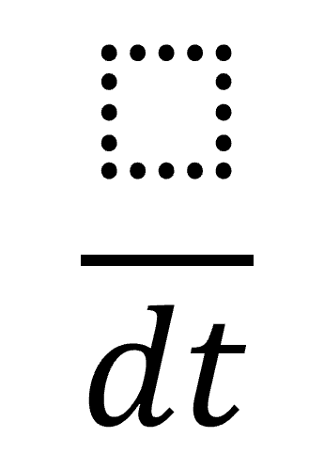
Whenever you see the word ‘rate’, think…….

Slide 8
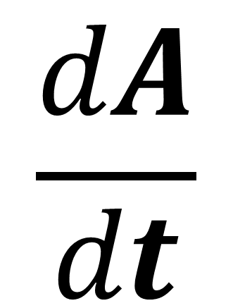
Area is changing
with time
$$\frac{dA}{dt}$$

Slide 9
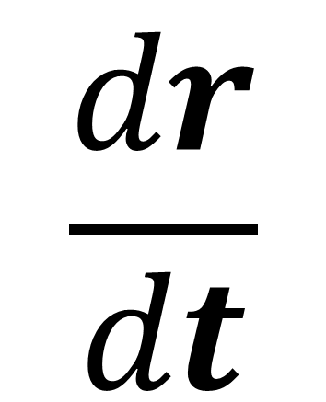
radius is changing
with time
$$\frac{dr}{dt}$$

Slide 10
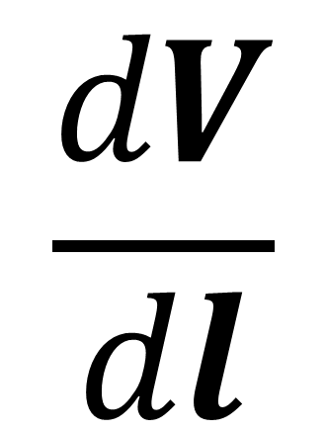
Volume is changing with length of cube
$$\frac{dV}{dl}$$

Slide 11
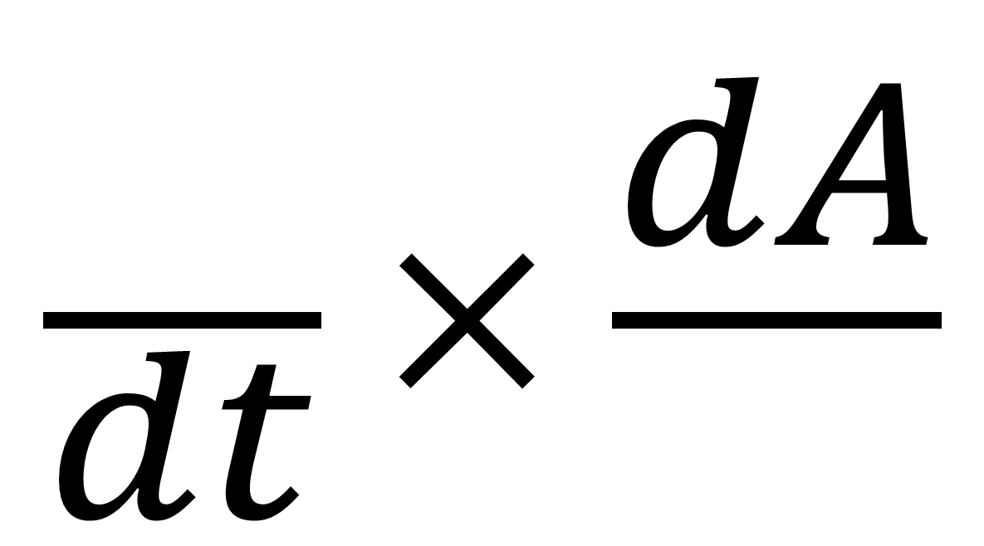
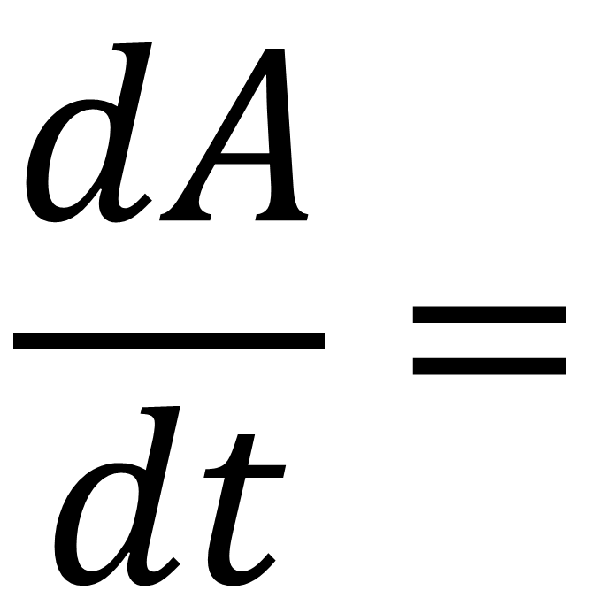


Using the chain rule to find rates of change
$$\frac{dA}{dt}=$$
$$\frac{}{dt} × \frac{dA}{}$$
$$dr$$
$$dr$$

Slide 12
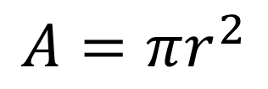
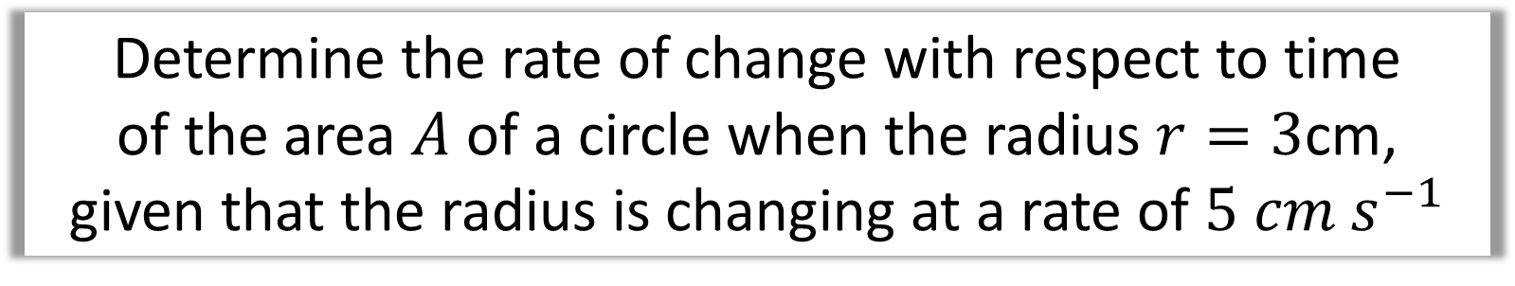
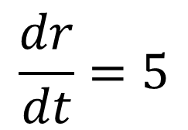
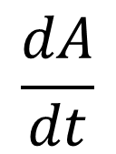
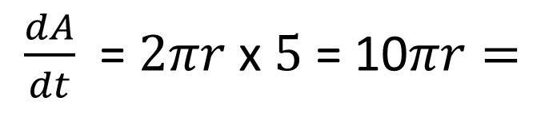
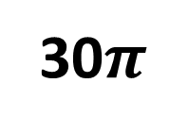
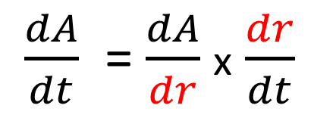
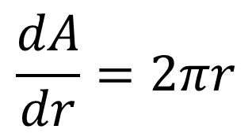
Determine the rate of change with respect to time
of the area $A$ of a circle when the radius $r=3$cm,
given that the radius is changing at a rate of $5 cm s^{−1}$
$$\frac{dA}{dt}$$
Differentiate the formula
What rate do you need to find?
$$\frac{dA}{dr}=2πr$$
$$\frac{dr}{dt}=5$$
What rates do you know?
Use the chain rule
$\frac{dA}{dt}$ = $\frac{dA}{dr}$ x $\frac{dr}{dt}$
What formulas do you know?
$$A=πr^{2}$$
$\frac{dA}{dt}$ = $2πr$ x $5$ = 10$πr=$
30$π$

Slide 13
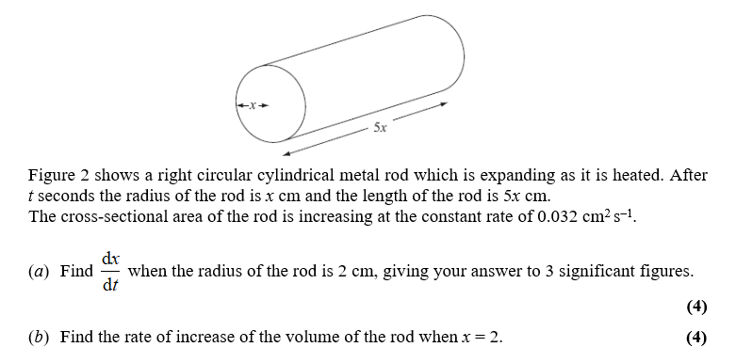

Slide 14
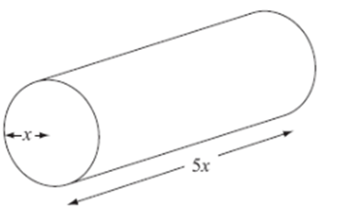
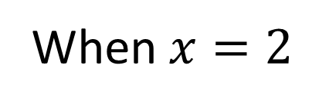

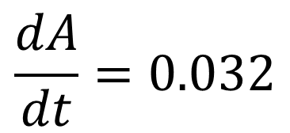
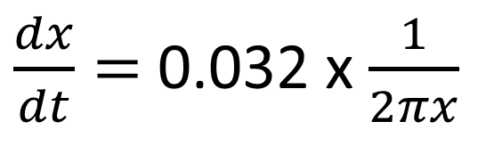
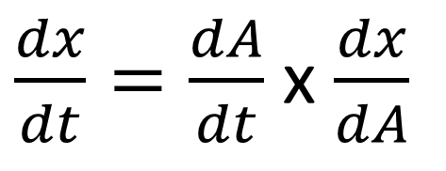
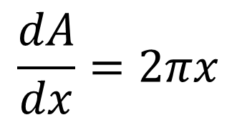
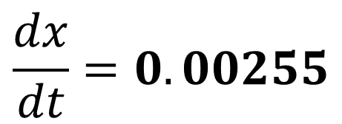
What rates do you know?
Differentiate the formula
$\frac{dx}{dt}=$ 0.032 x $\frac{1}{2πx}$
$$\frac{dA}{dt}=0.032$$
$$\frac{dA}{dx}=2πx$$
When $x=2$
What formulas do you know?
Use the chain rule
$$\frac{dx}{dt}=0.00255$$
$$A=πx^{2}$$
$\frac{dx}{dt}=\frac{dA}{dt}$ x $\frac{dx}{dA}$

Slide 15
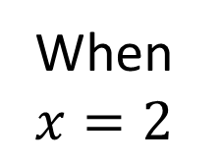
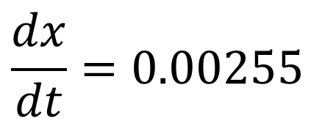
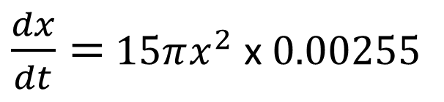
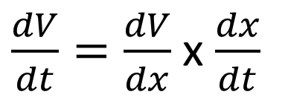
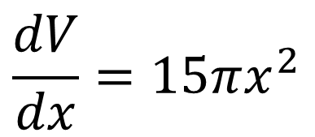

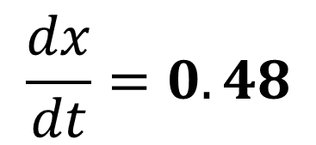
What rates do you know?
What formulas do you know?
Use the chain rule
$$\frac{dx}{dt}=0.00255$$
$$V=(5x)πx^{2}$$
$\frac{dV}{dt}=\frac{dV}{dx}$ x $\frac{dx}{dt}$
Differentiate the formula
$\frac{dx}{dt}=$ $15πx^{2}$ x$0.00255$
$$\frac{dV}{dx}=15πx^{2}$$
When
$$x=2$$
$$\frac{dx}{dt}=0.48$$

Slide 16
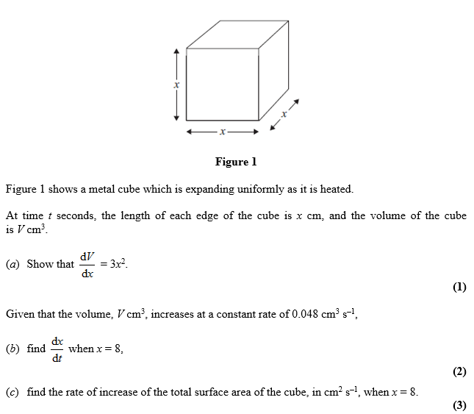

Slide 17
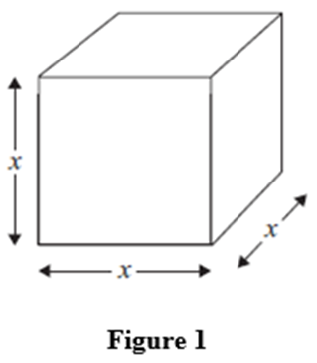
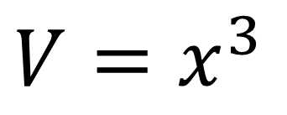
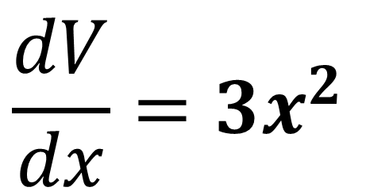
a)
$$V=x^{3}$$
$$\frac{dV}{dx}={3x}^{2}$$

Slide 18
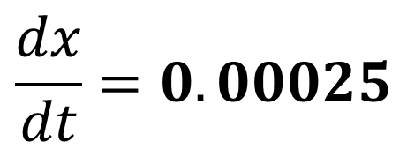
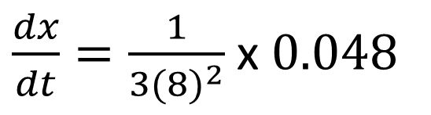
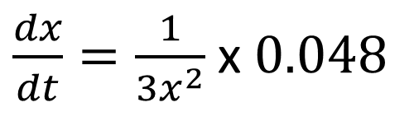
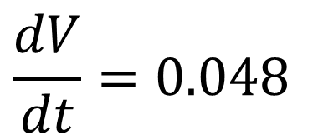
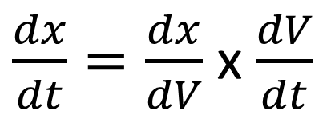
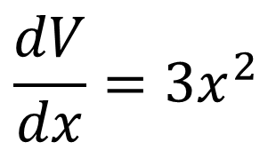
What rates do you know?
Use the chain rule
$\frac{dx}{dt}=\frac{1}{{3x}^{2}}$ x $0.048$
$$\frac{dV}{dt}=0.048$$
$\frac{dx}{dt}=\frac{dx}{dV}$ x $\frac{dV}{dt}$
$\frac{dx}{dt}=\frac{1}{{3(8)}^{2}}$ x $0.048$
$$\frac{dV}{dx}={3x}^{2}$$
$$\frac{dx}{dt}=0.00025$$

Slide 19
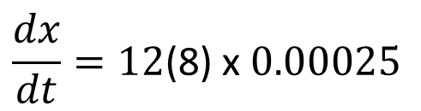
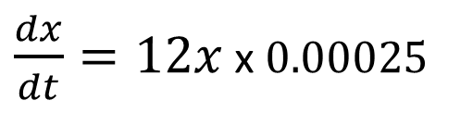
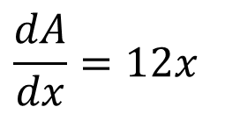
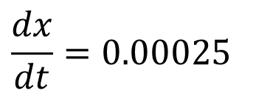

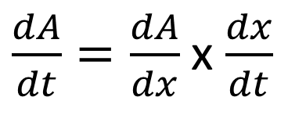
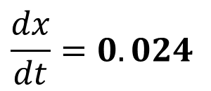
What rates do you know?
Differentiate the formula
$\frac{dx}{dt}=12x$ x $0.00025$
$$\frac{dx}{dt}=0.00025$$
$$\frac{dA}{dx}=12x$$
$$\frac{dx}{dt}=12\text{(8)} \text{x} 0.00025$$
Use the chain rule
What formulas do you know?
$\frac{dA}{dt}=\frac{dA}{dx}$ x $\frac{dx}{dt}$
$$\frac{dx}{dt}=0.024$$
$$A={6x}^{2}$$

