Slide 1
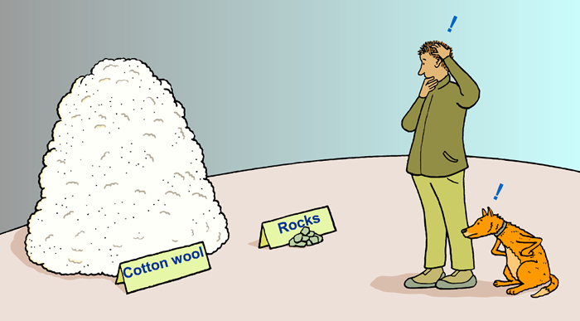
Which is heavier:
a kilogram of cotton wool or a kilogram of rocks?

Slide 2
LO: Density

Slide 3
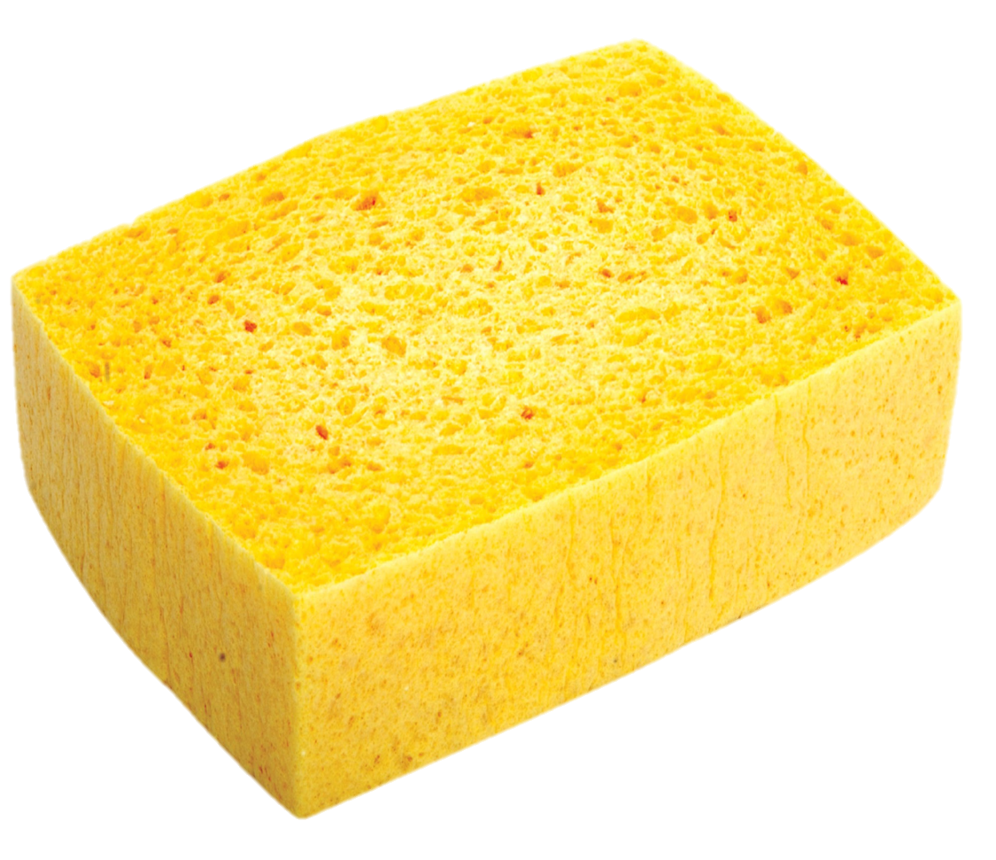
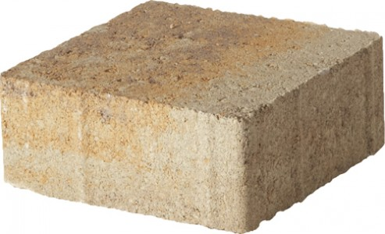
These two objects have the same volume, so why is one heavier?

Slide 4
Density is the amount of mass in a volume.
It tells us how tightly matter is packed.

Slide 5




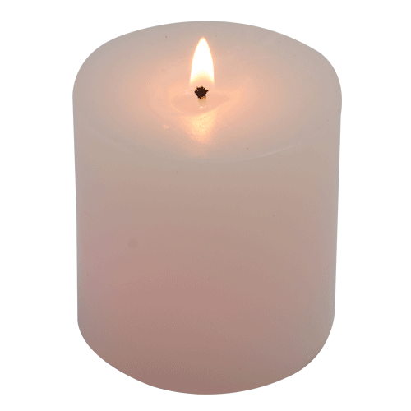
Some other densities.
Ice: 880 kg/m³
Sand: 1600 kg/m³
Blood (room temp): 1060 kg/m³
Water (room temp): 1000 kg/m³
Chalk: 1120 kg/m³
Wax: 320 kg/m³

Slide 6
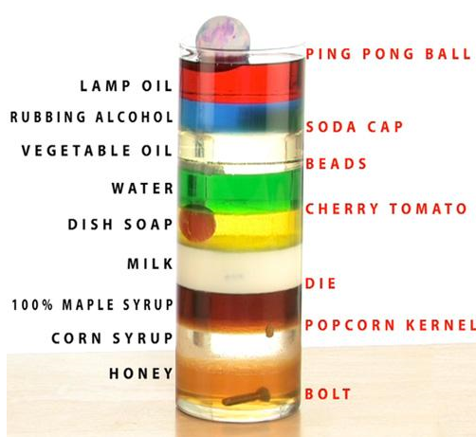
Densities in action.

Slide 7
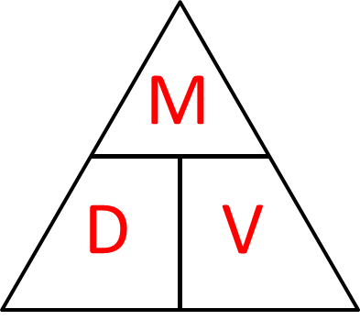
What are the 3 formula that you get form the formula triangle?
Density = Mass ÷ Volume
Volume = Mass ÷ Density
Mass = Density x Volume

Slide 8
A piece of metal weighs 40g
and has a volume of 4cm³.
What is it’s density?
D = M ÷ V
D = 40 ÷ 4
D = 10 g/cm³

Slide 9
What is the volume of a piece of rock
that has a mass of 72kg
and a density of 9 kg/m³?
V = M ÷ D
V = 72 ÷ 9
V = 8 m³

Slide 10
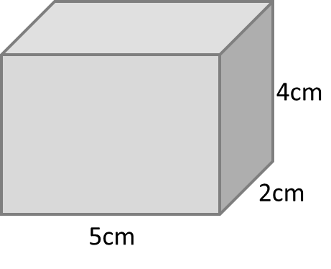
A block of ice measures 5cm by 2cm by 4cm.
Given that it’s density is 6 g/cm³,
calculate it’s mass.
V = 2 x 4 x 5
V = 40 cm³
M = D x V
M = 6 x 40
M = 240 grams

