Slide 1
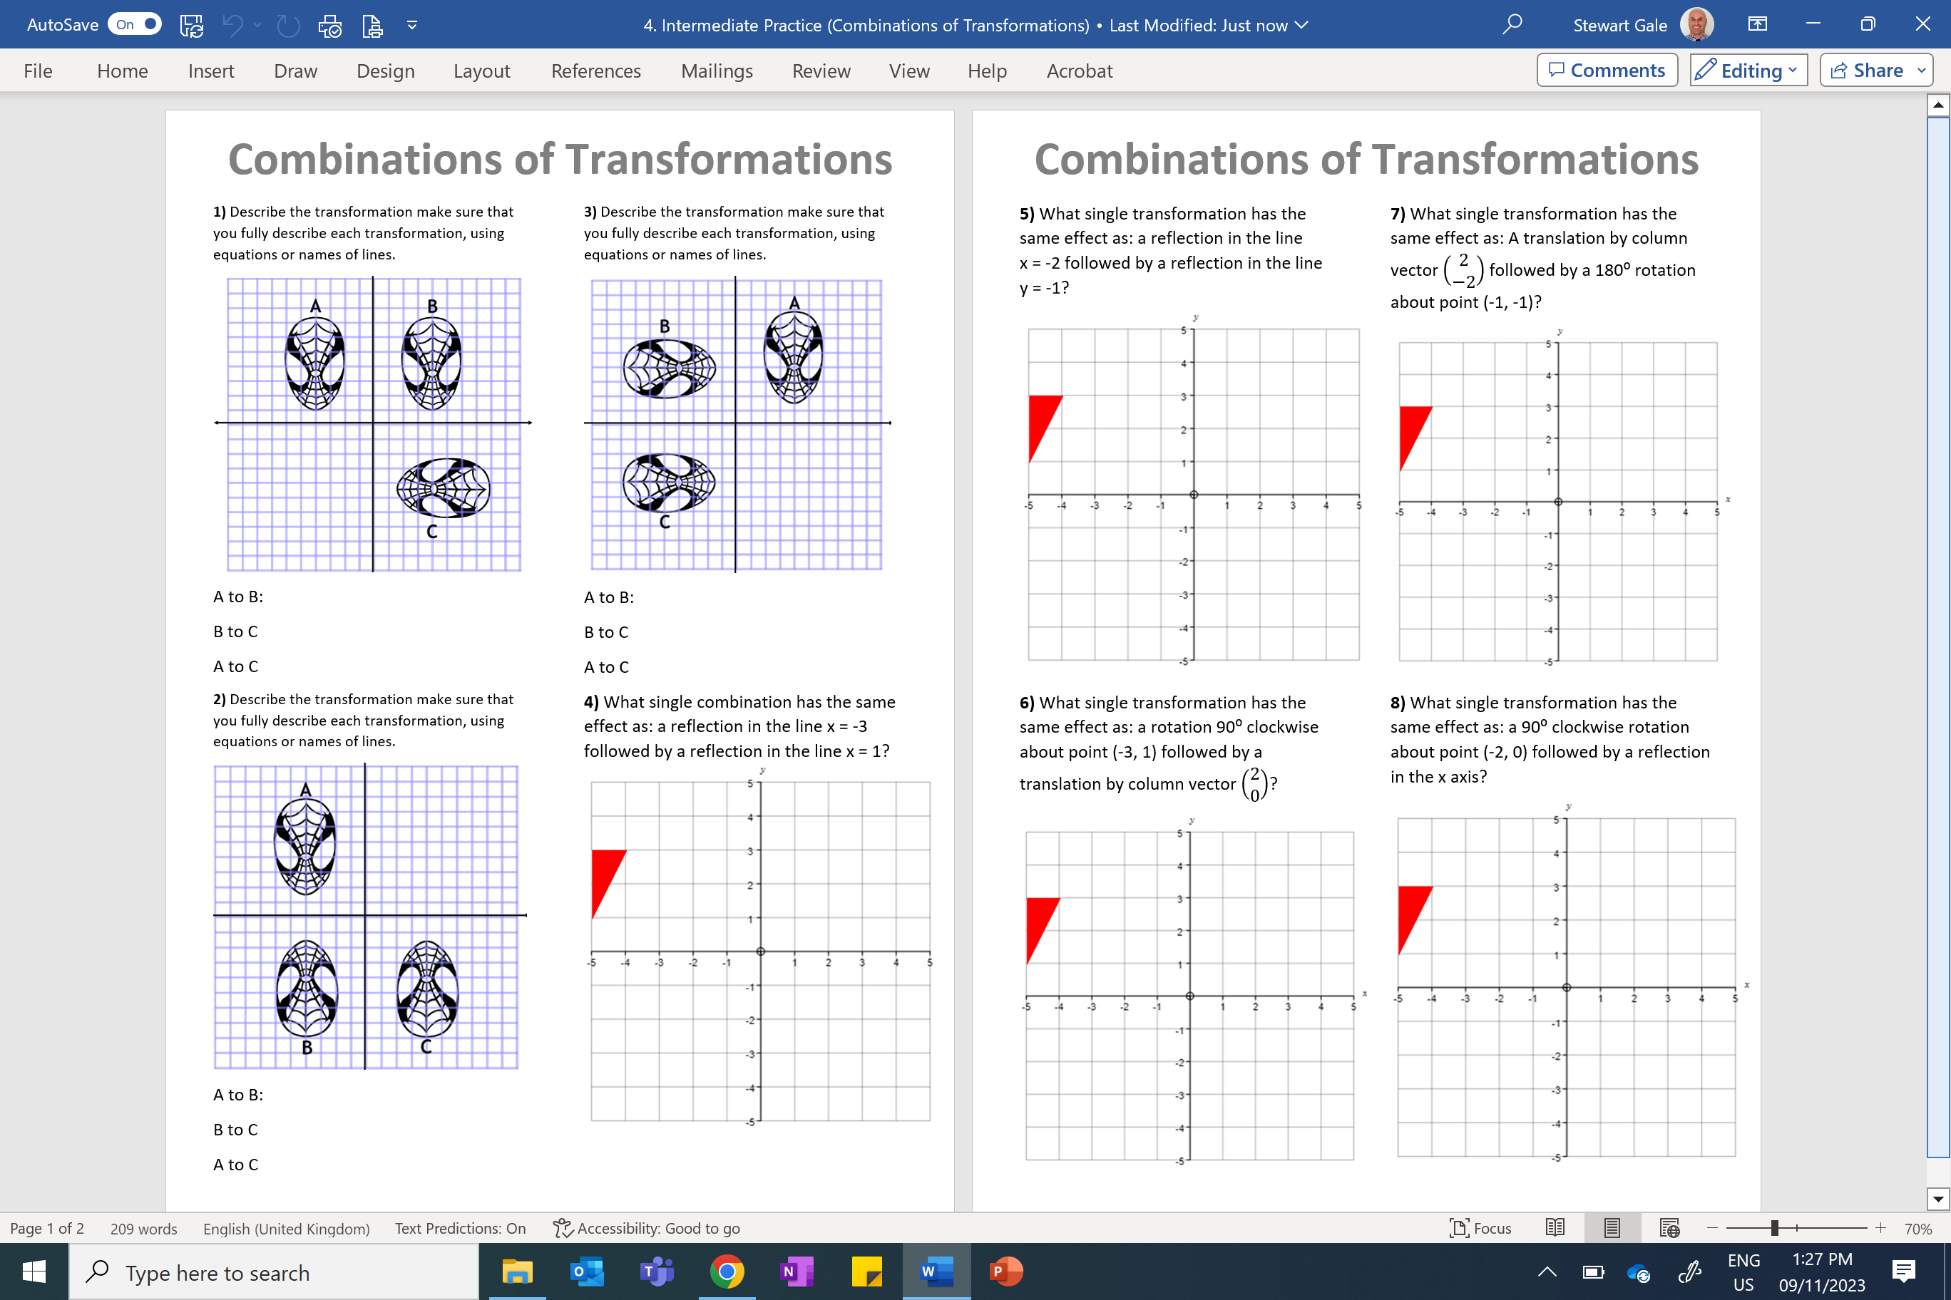

Slide 2
ANSWERS

Slide 3
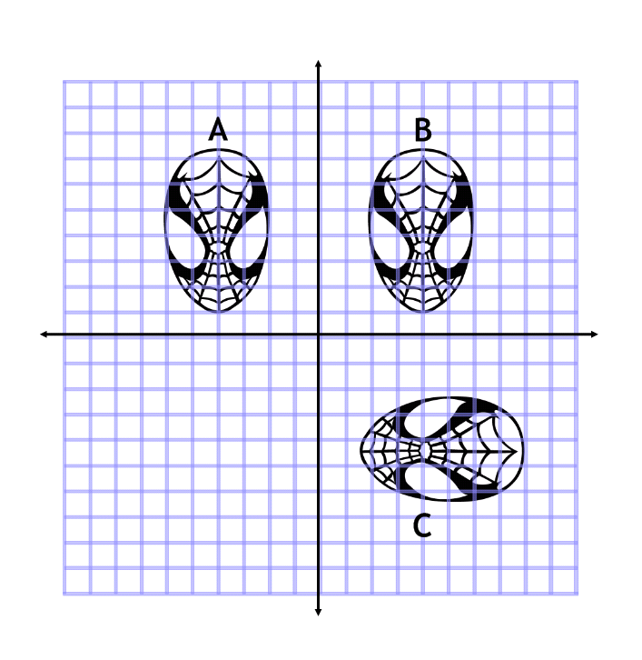
Make sure that you fully describe each transformation, using equations or names of lines.
A to B:
Reflection in the y axis
B to C:
Rotation Clockwise 90° about (0,0)
A to C:
Rotation 180° about (0,0)
Or reflection in y = x

Slide 4
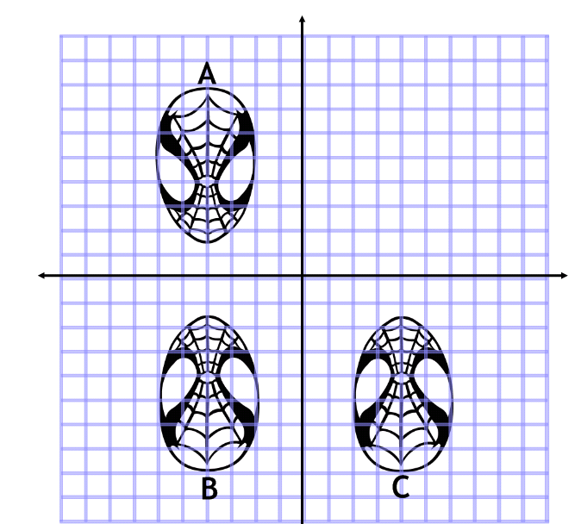
Make sure that you fully describe each transformation, using equations or names of lines.
A to B:
Reflection in the x axis
B to C:
Reflection in the y axis
A to C:
Rotation 180° about (0,0)

Slide 5
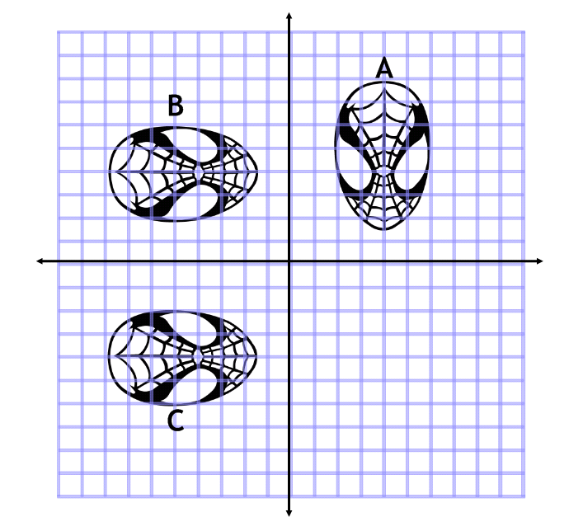
Make sure that you fully describe each transformation, using equations or names of lines.
A to B:
Rotation Anti-clockwise 90 °about (0,0)
B to C:
Reflection x axis
A to C:
Rotation 180° about (0,0)
Or reflection in y = -x

Slide 6
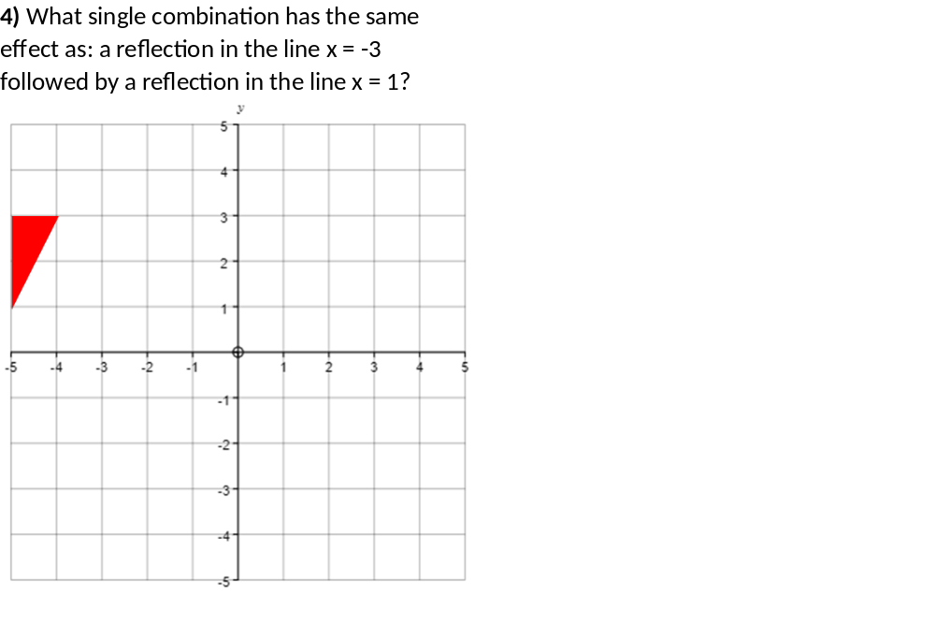
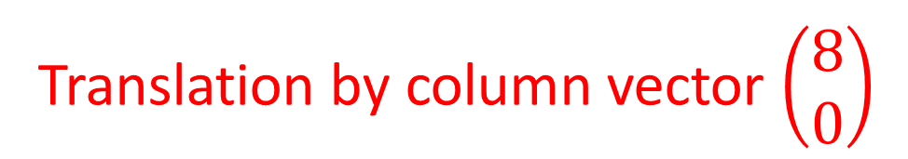
Translation by column vector $\left(\begin{matrix}8 \\ 0\end{matrix}\right)$

Slide 7
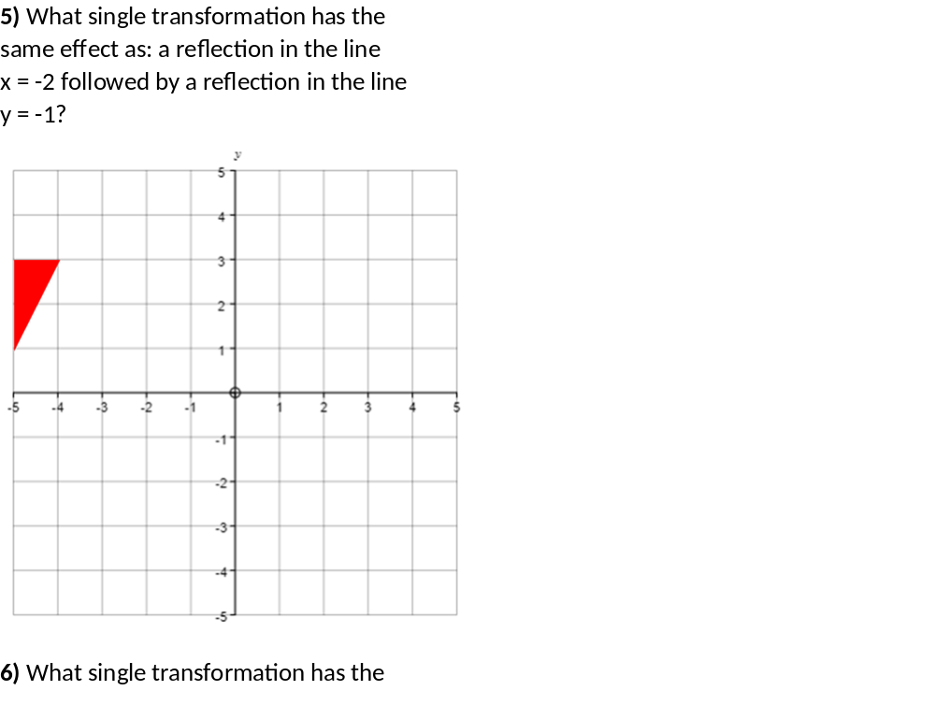
Rotation 180⁰ about point (-2, -1)

Slide 8
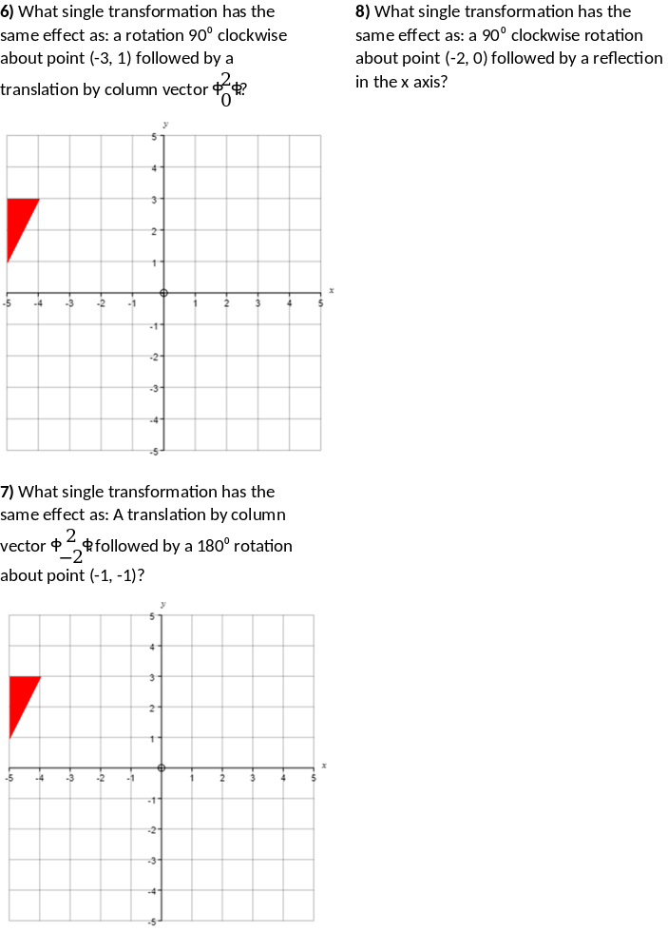
Rotation 90⁰ clockwise about point (-2, 0)

Slide 9
Rotation 180⁰ about point (-2, 0)

Slide 10
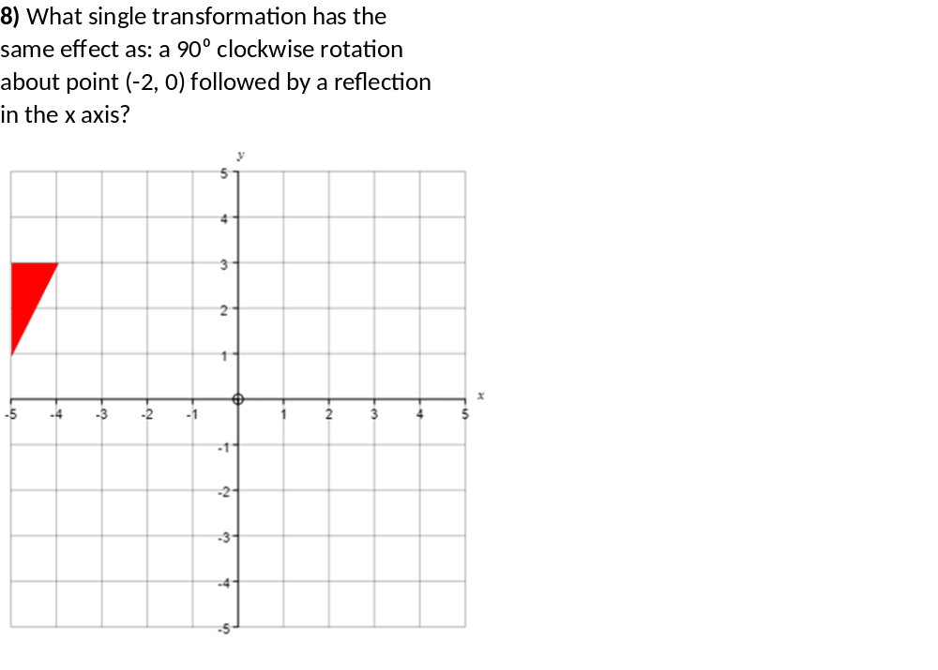
Reflection in line y = x +2

