Slide 1
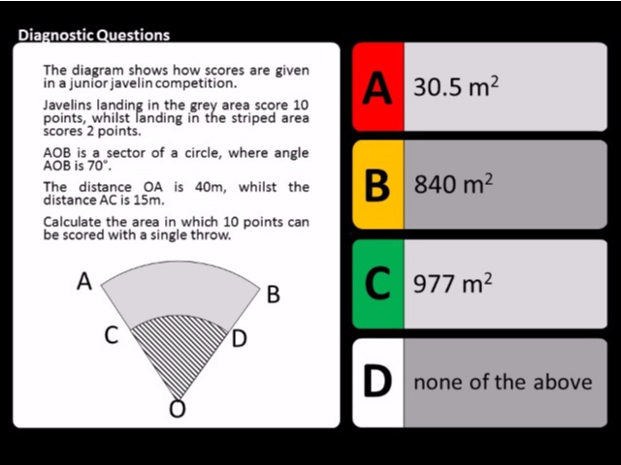
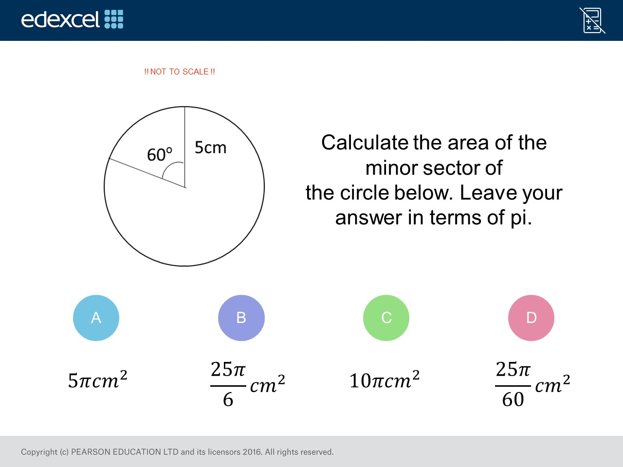
Worst answered question?
Most common wrong answer?

Slide 2
ANSWERS

Slide 3
Worst answered question?

Slide 4
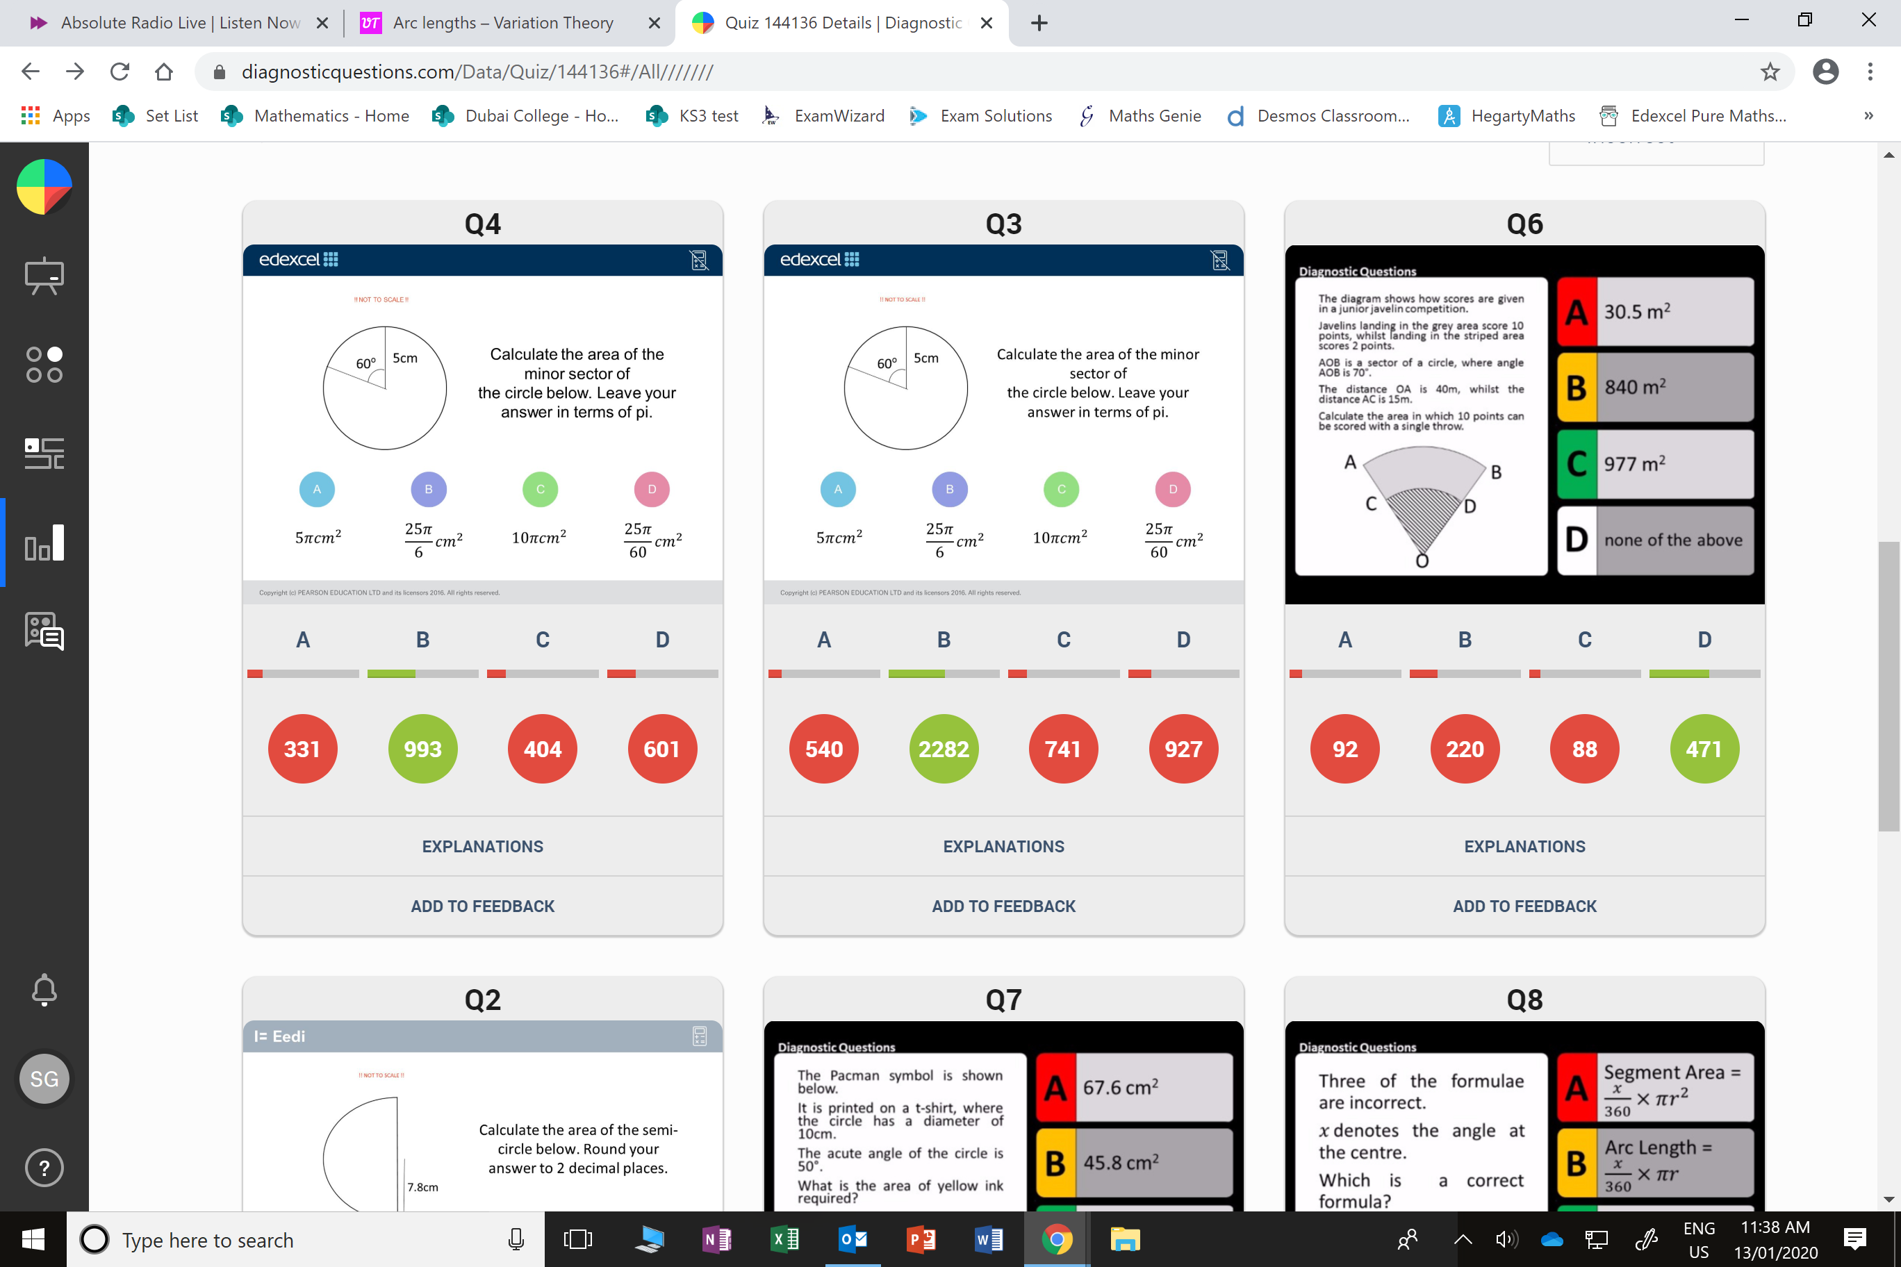
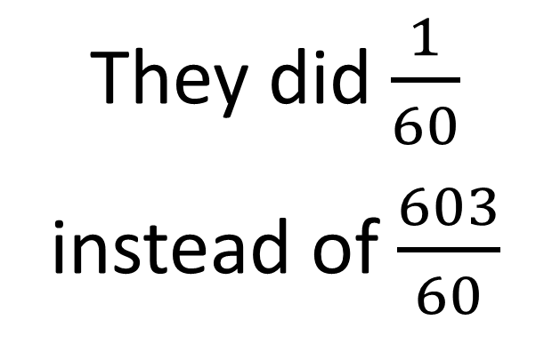
D
They did $\frac{1}{60}$
instead of $\frac{603}{60}$

Slide 5
B
The radius of the big sector is 55m not 15m.

