Slide 1
1) Find the volume and surface area of each shape
10cm
(a)
(b)
(c)
8cm
4cm
3.8cm
2) A tube of tennis balls is a cylinder with a radius of 3.8cm. It contains 3 balls which fit exactly inside it.
a) What is the volume of all 3 balls?
b) What is the Volume of the empty space in the Tube?
22.8cm

Slide 2
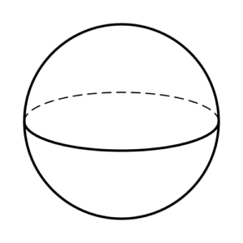
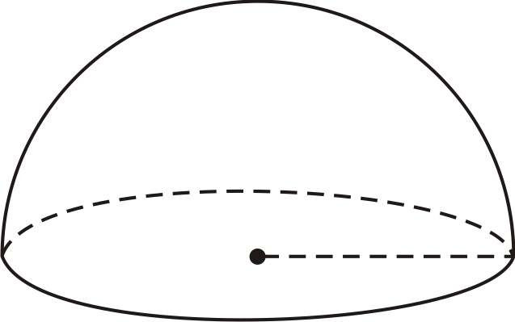
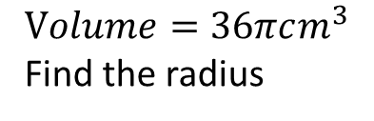



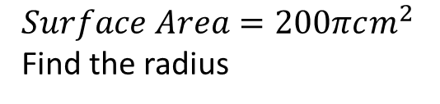

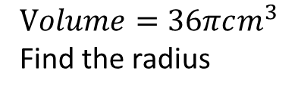
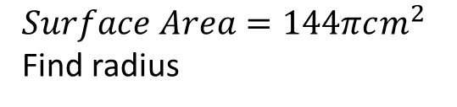



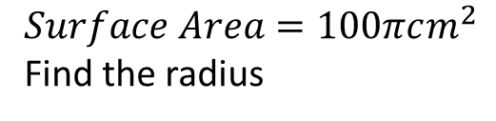

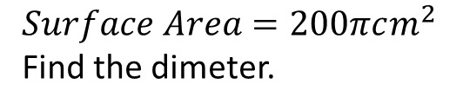
3)
$$Volume=36πcm^{3}$$
Find the radius
4)
Find volume
5)
Find the volume
$$3 cm$$
$$r cm$$
$$3 cm$$
6)
$$Volume=36πcm^{3}$$
Find the radius
7)
$$Surface Area=100πcm^{2}$$
Find the radius
8)
$$Surface Area=200πcm^{2}$$
Find the radius
$$r cm$$
$$r cm$$
$$r cm$$
9)
$$Surface Area=200πcm^{2}$$
Find the dimeter.
10)
$$Surface Area=144πcm^{2}$$
Find radius
11)
Find Surface Area in terms of pi
$$r cm$$
$$d cm$$
$$6 cm$$

Slide 3
ANSWERS

Slide 4
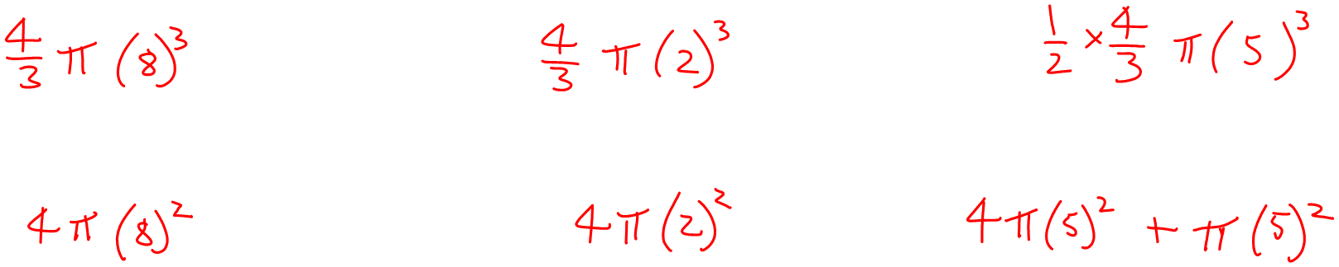
1) Find the volume and surface area of each shape
(a)
(b)
(c)
10cm
8cm
4cm
V: 2144.66cm³
V: 33.51cm³
V: 261.80cm³
SA: 804.25cm²
SA: 50.27cm²
SA: 235.62cm²

Slide 5

2) A tube of tennis balls is a cylinder with a radius of 3.8cm. It contains 3 balls which fit exactly inside it.
a) What is the volume of all 3 balls?
b) What is the Volume of the empty space in the Tube?
3.8cm
22.8cm
a) Volume of the Balls
= 3 x (⁴/₃πr³)
= 3 x (⁴/₃ x π x 3.8³)
= 689.54 cm³
b) Volume of the Cylinder
= πr² x length
= π x 3.8² x 22.8
= 1034.31cm³
Area of the space = 344.77cm³

Slide 6

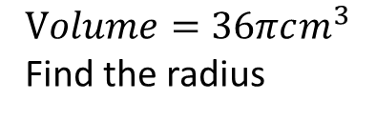





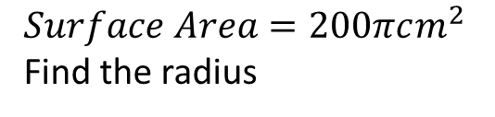

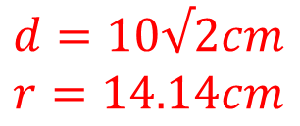
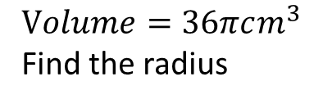
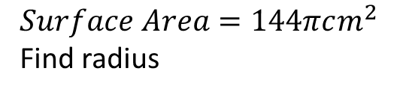


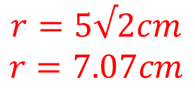



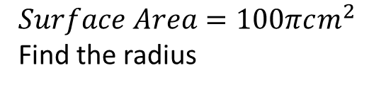


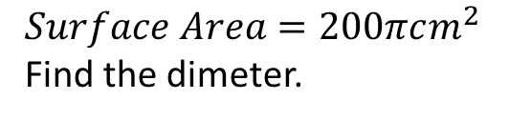


3)
$$Volume=36πcm^{3}$$
Find the radius
4)
Find volume
5)
Find the volume
$$3 cm$$
$$r cm$$
$$r=3cm$$
$$x=36πcm^{3}$$
$$3 cm$$
$$x=18πcm^{3}$$
6)
$$Volume=36πcm^{3}$$
Find the radius
7)
$$Surface Area=100πcm^{2}$$
Find the radius
8)
$$Surface Area=200πcm^{2}$$
Find the radius
$$r cm$$
$$r cm$$
$$r=5√2cm$$
$$r=7.07cm$$
$$r=3.78cm$$
$$r=5cm$$
$$r cm$$
9)
$$Surface Area=200πcm^{2}$$
Find the dimeter.
10)
$$Surface Area=144πcm^{2}$$
Find radius
11)
Find Surface Area in terms of pi
$$r cm$$
$$d cm$$
$$d=10√2cm$$
$$r=14.14cm$$
$$6 cm$$
$$r=6cm$$
$$x=108πcm^{2}$$

