Slide 1
LO: Percentage Change

Slide 2
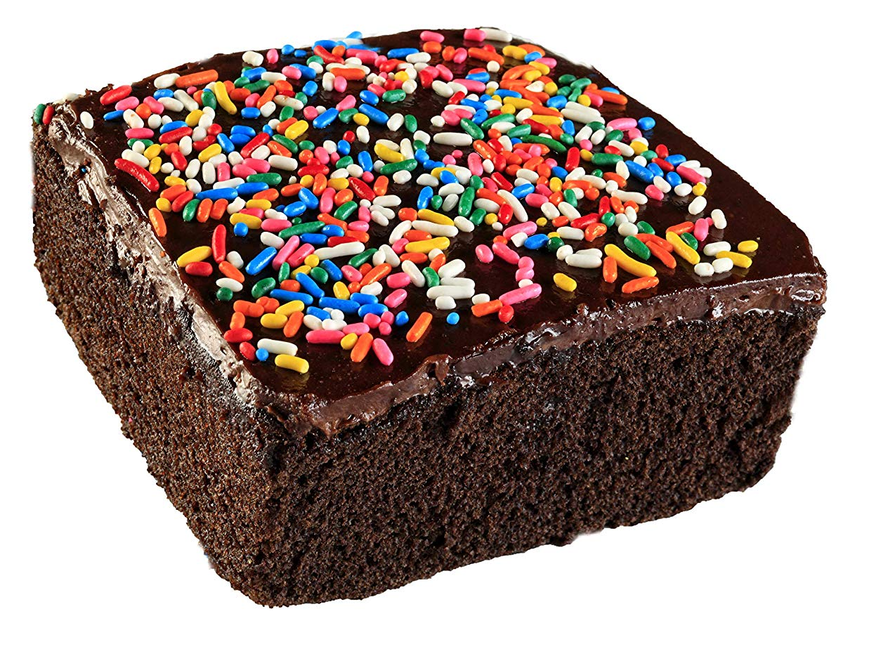
You start a cake business.
You sell your chocolate brownies for 10dhs each.
One day you sell 30 chocolate brownies.
From those sales you make a profit of 300dhs.
True or False?

Slide 3
Investment | Return | Loss or Profit | How much?
£200 | £210
Profit
£10

Slide 4
Investment | Return | Loss or Profit | How much?
£200 | £190
Loss
£10

Slide 5
Investment | Return | Loss or Profit | How much?
£200 | £200
Broke Even
£0

Slide 6
Investment | Return | Loss or Profit | How much?
£200 | £170
Loss
£30

Slide 7

Investment | Return | Fraction Profit | % Change Profit
£100 | £130
$$\frac{30}{100}$$
30%

Slide 8

Investment | Return | Fraction Profit | % Change Profit
£50 | £55
$$\frac{5}{50}$$
10%

Slide 9

Investment | Return | Fraction Loss | % Change Loss
£20 | £14
$$\frac{6}{20}$$
30%

Slide 10

Investment | Return | Fraction Profit/Loss | % Change Profit/Loss
£200 | £190
$$\frac{10}{200}$$
5%

Slide 11

Investment | Return | Fraction Profit | % Change Profit
£300 | £390
$$\frac{90}{300}$$
30%

Slide 12


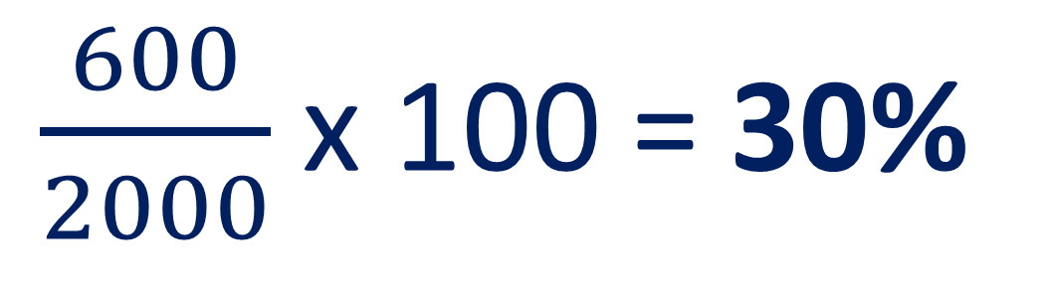
You invests £2000 in Facebook shares.
You then sell them for £2600.
What is the percentage profit?
$\frac{600}{2000}$ x 100 = 30%

Slide 13
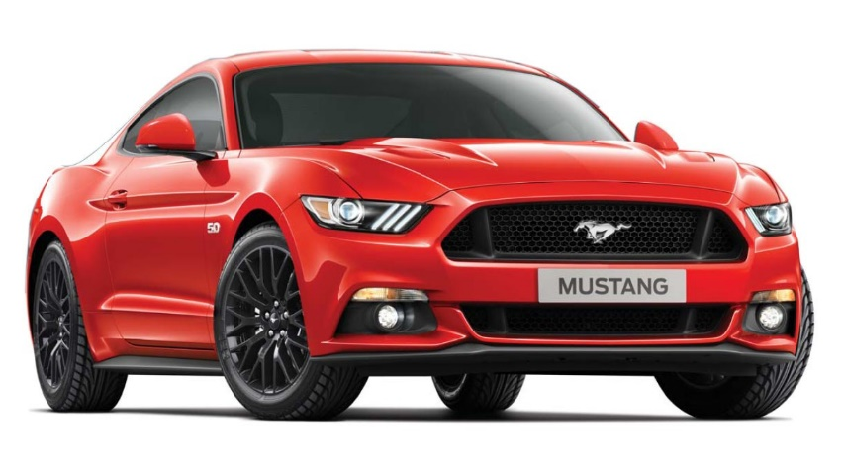
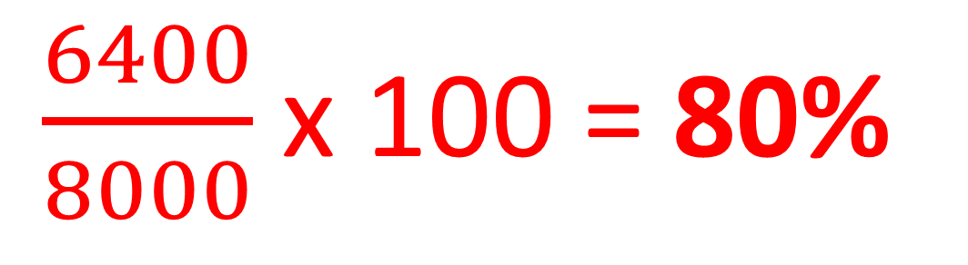
You buy a car for £8000.
You then sells the car for £1600.
What is the percentage loss?
$\frac{6400}{8000}$ x 100 = 80%

Slide 14
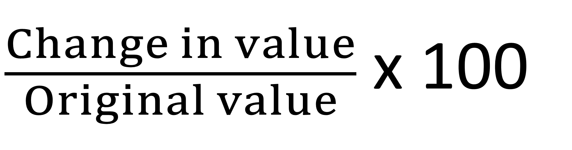
Percentage change =
$\frac{Change in value}{Original value}$ x 100

