Slide 1
LO: Angles Reasoning

Slide 2
b
a
a = b
alternate angles

Slide 3
a
b
a = b
corresponding angles

Slide 4
a
b
a + b = 180
angles on a straight line up to 180.

Slide 5
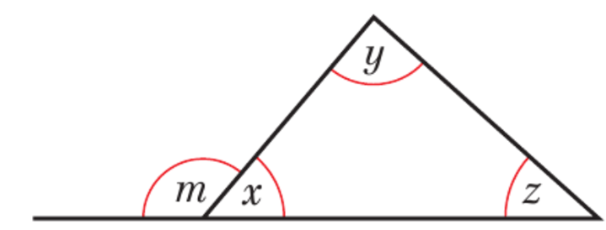
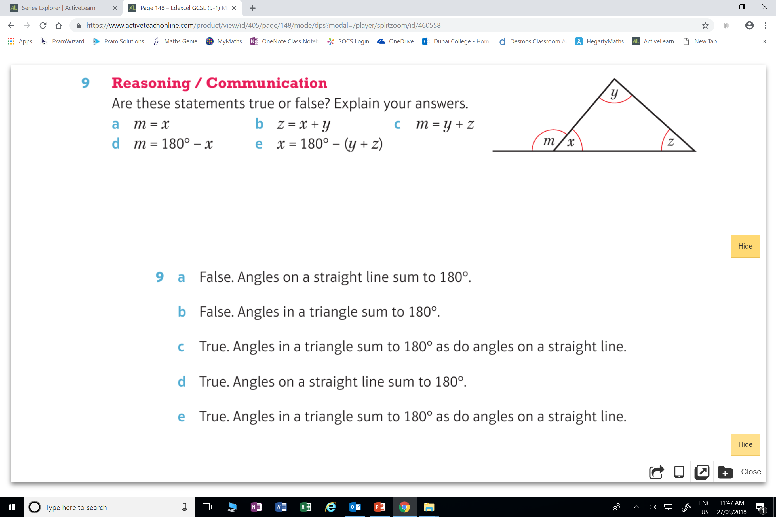
m = x
True of False?
Explain your answers.

Slide 6
z = x + y
True of False?
Explain your answers.

Slide 7
m = y + z
True of False?
Explain your answers.

Slide 8
m = 180˚- x
True of False?
Explain your answers.

Slide 9
x = 180˚- (y + z)
True of False?
Explain your answers.

Slide 10
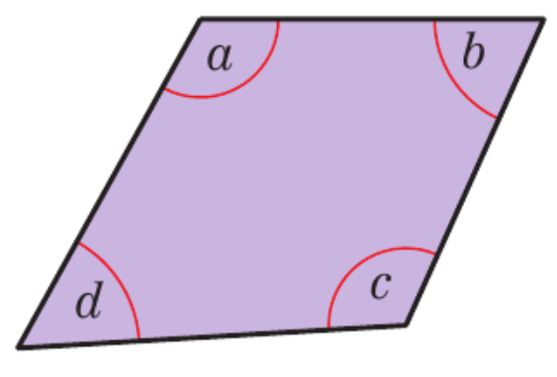
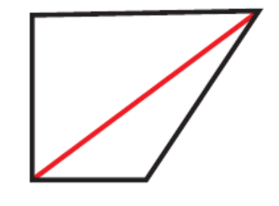
Show that for any quadrilateral that
the interior angles add to 360˚
Any quadrilateral can be split into two triangles.
The sum of angles in a triangle is 180˚
Therefore the sum of the angle in a quadrilateral is 360˚

Slide 11
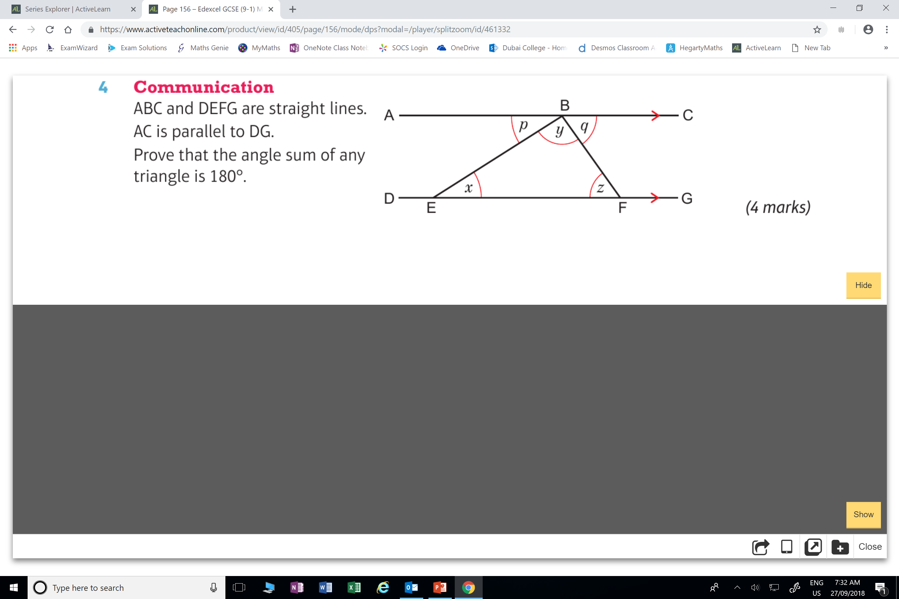
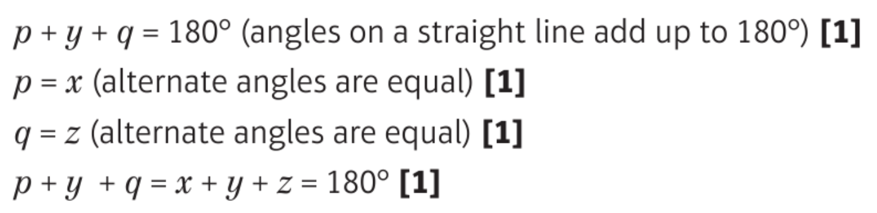
Prove that the interior angles of the triangle is 180˚

