Slide 1
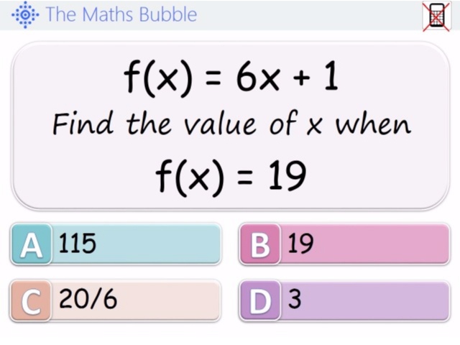
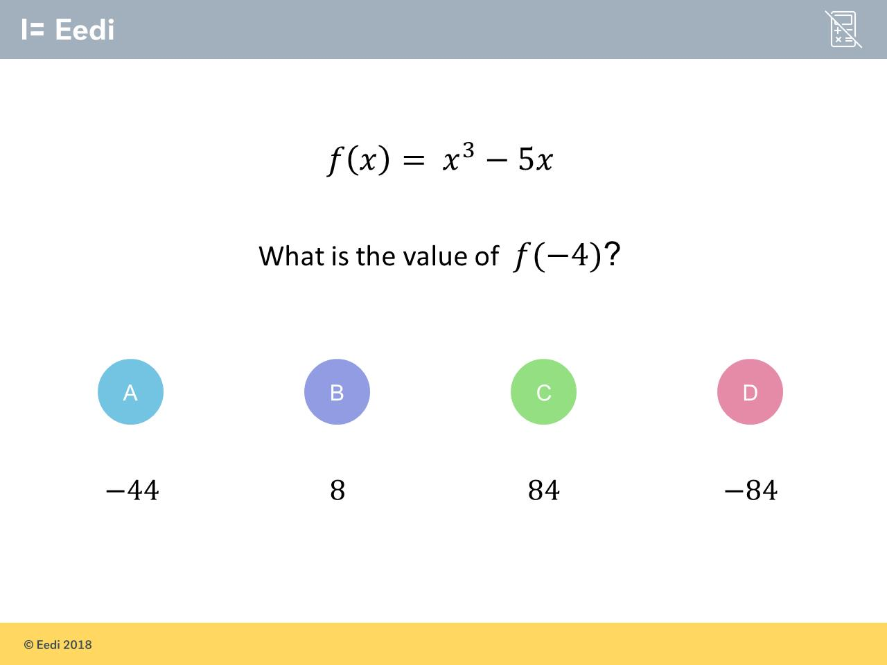
Worst answered question?
Most common wrong answer?

Slide 2
ANSWERS

Slide 3
Worst answered question?

Slide 4
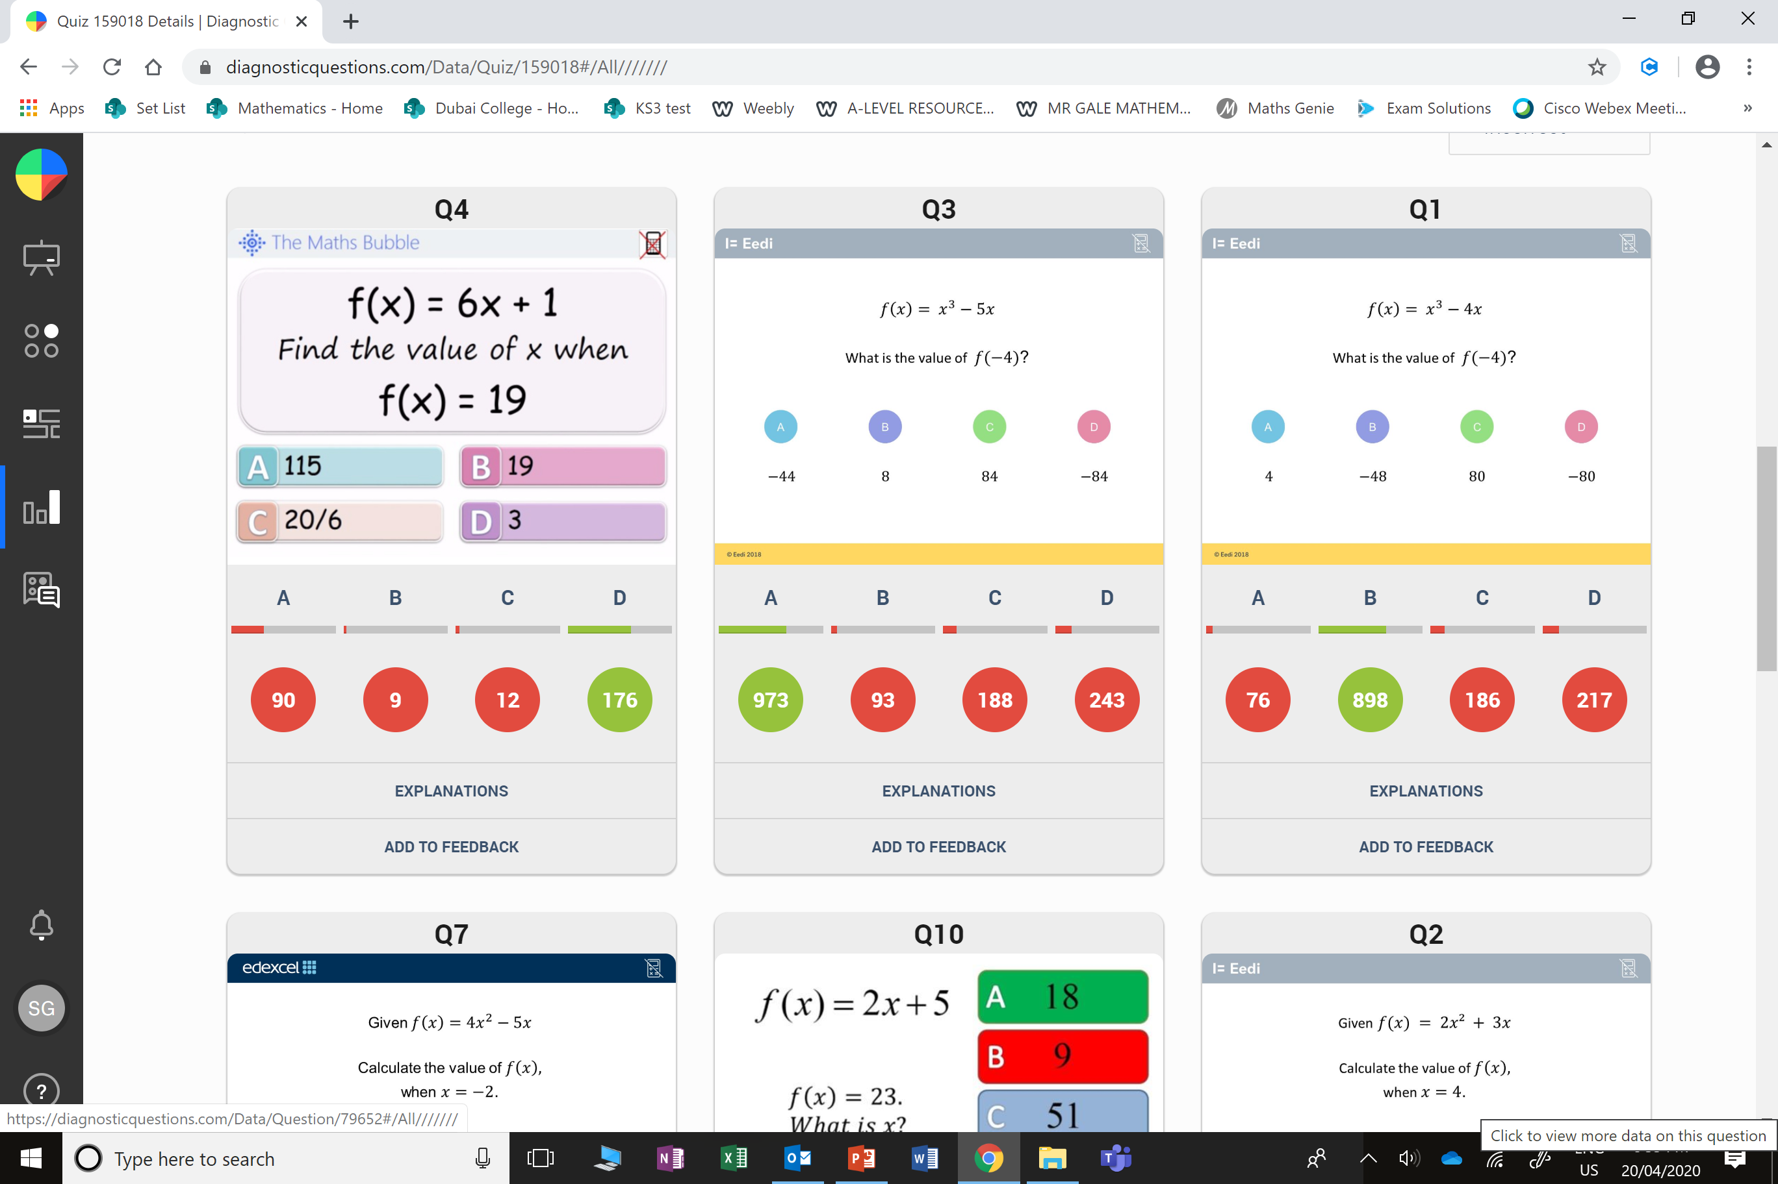
A
They substituted 19 as x

Slide 5
D
The student has added the 5x

