Slide 1
Elastic Collisions in 1D
Coefficient of Restitution and Inequalities
Chapter 4
(Part 2 of 5)

Slide 2
Harder questions often ask for an inequality.
It is sometimes tricky
to know where to start.
So, you need a checklist.

Slide 3
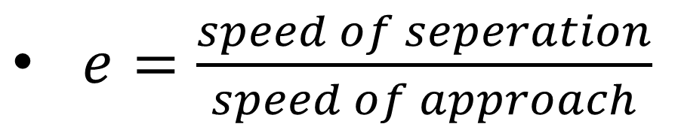
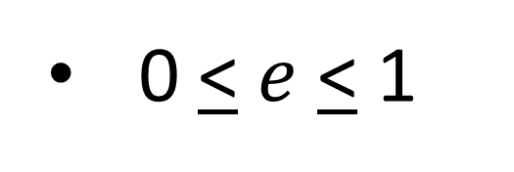
  Momentum Before $=$ Momentum After
$e=\frac{speed of seperation}{speed of approach}$
0 < $e$ < 1
  Particles moving in a straight line can’t overtake
  Particles that don’t change direct their speed must be ≥ 0

Slide 4
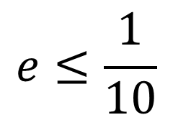
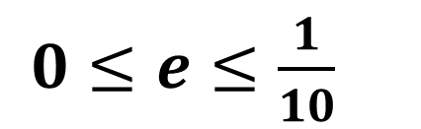

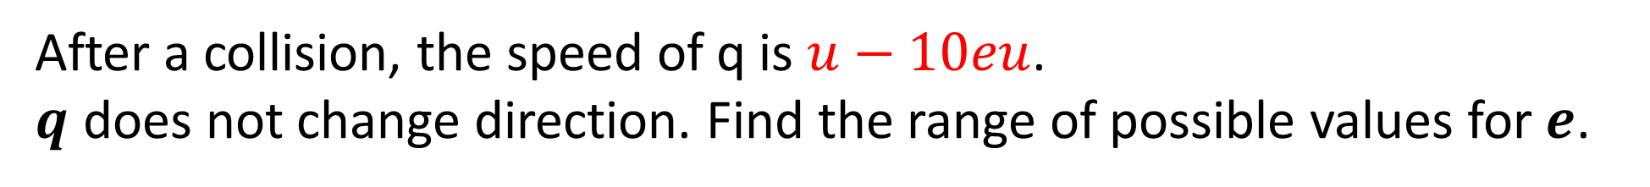
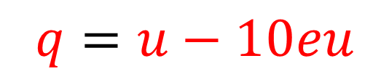




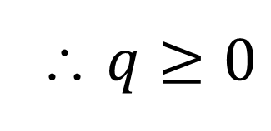
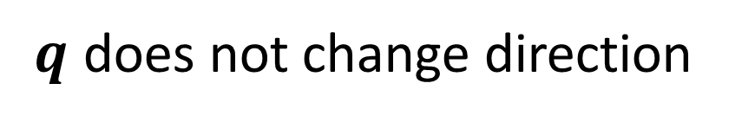
After a collision, the speed of q is $u−10eu$.
$q$ does not change direction. Find the range of possible values for $e$.
$$Q$$
$$u−10eu≥0$$
$$m$$
$$u(1−10e)≥0$$
$$q=u−10eu$$
$$1−10e≥0$$
$q$ does not change direction
$$e≤\frac{1}{10}$$
∴ $q≥0$
$0≤e≤\frac{1}{10}$

Slide 5
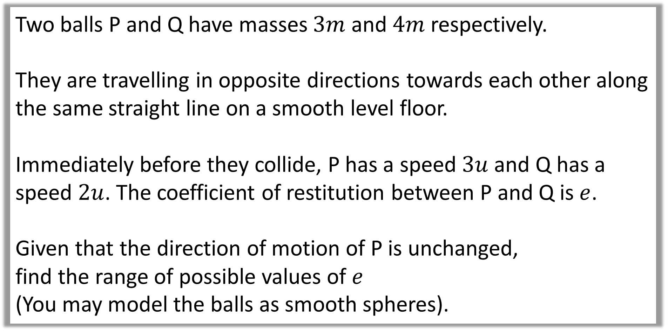
Question A
Two balls P and Q have masses $3m$ and $4m$ respectively.
They are travelling in opposite directions towards each other along the same straight line on a smooth level floor.
Immediately before they collide, P has a speed $3u$ and Q has a speed $2u$. The coefficient of restitution between P and Q is $e$.
Given that the direction of motion of P is unchanged,
find the range of possible values of $e$
(You may model the balls as smooth spheres).

Slide 6


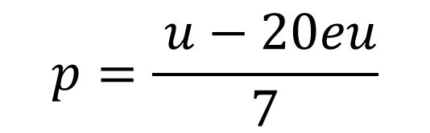
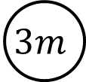







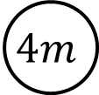







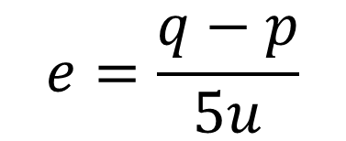

$$3u$$
$$−2u$$
Solve for $p$
$$P$$
$$Q$$
$$3m$$
$$4m$$
$$4q=u−3p$$
$$e= ?$$
X 4
$$p$$
$$q$$
$$20eu=4q−4p$$
CoM
Sub
$$9mu−8mu=3mp+4mq$$
$$20eu=u−3p−4p$$
$$u=3p+4q$$
$$20eu=u−7p$$
$$e$$
$$e=\frac{q−p}{5u}$$
$$7p=u −20eu$$
$$5eu=q−p$$
$$p=\frac{ u−20eu}{7}$$

Slide 7
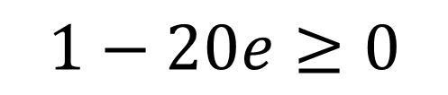
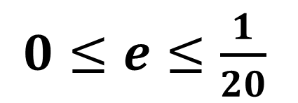
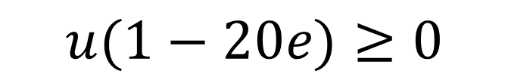
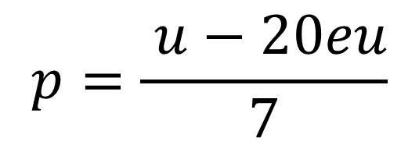
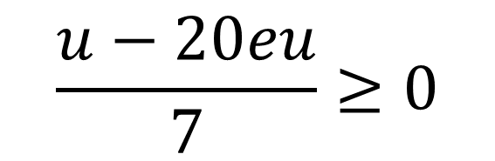
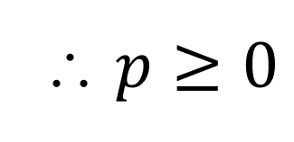

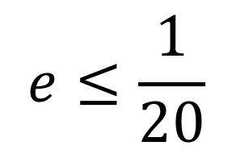
$$p=\frac{ u−20eu}{7}$$
$$\frac{u−20eu}{7}≥0$$
$p$ does not change direction
$$u(1−20e)≥0$$
∴ $p≥0$
$$1−20e≥0$$
$$e≤\frac{1}{20}$$
$0≤e≤\frac{1}{20}$

Slide 8
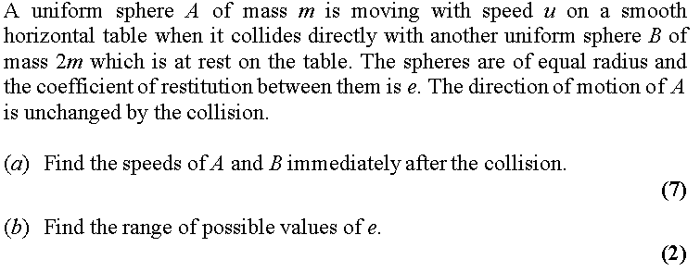
Question B
(In terms of e and u)

Slide 9



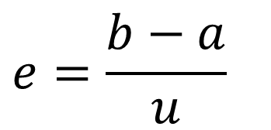
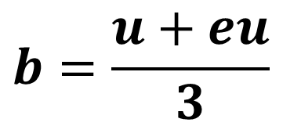
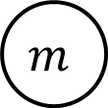




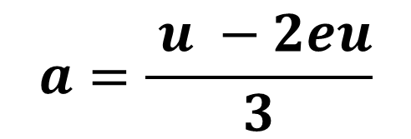




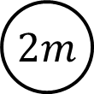





a.
Solve for $a$
$$u$$
$$0$$
$$b=eu+a$$
$$A$$
$$B$$
$$m$$
$$e$$
$$2m$$
Sub
$$u=a+2eu+2a$$
$$a$$
$$b$$
CoM
$$u−2eu=3a$$
$$um=ma+2mb$$
$$a=\frac{ u −2eu}{3}$$
$$u=a+2b$$
$$e$$
$$b=eu+a$$
$$e=\frac{b−a}{u}$$
$$b=\frac{u+eu}{3}$$
$$eu=b−a$$

Slide 10
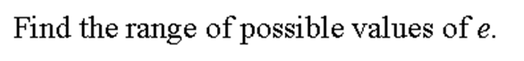



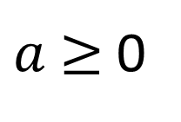





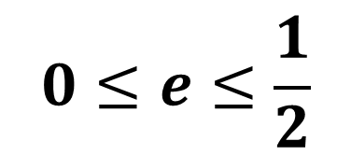




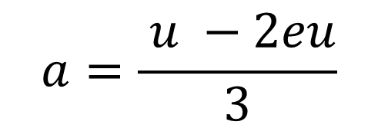
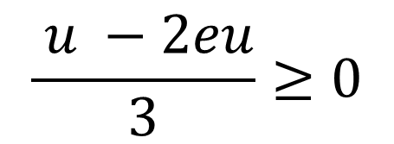
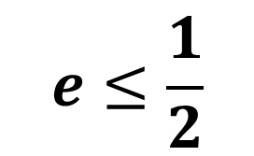

b.
$$\frac{ u −2eu}{3}≥0$$
$$u$$
$$0$$
$$A$$
$$B$$
$$u −2eu≥0$$
$$m$$
$$e$$
$$2m$$
$$u(1 −2e)≥0$$
$$a$$
$$b$$
$$1 −2e≥0$$
$$a=\frac{ u −2eu}{3}$$
$$e≤\frac{1}{2}$$
$a$ does not change direction
$$0≤e≤\frac{1}{2}$$
$a$ $≥$ 0

