Slide 1
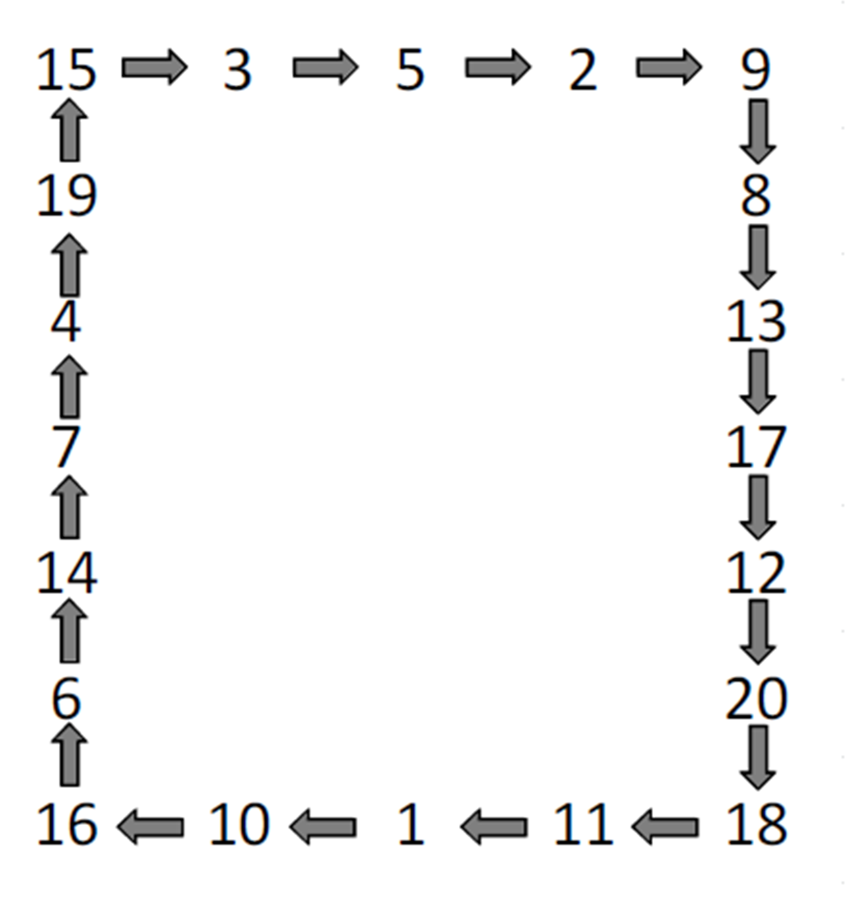
Circumference Treasure Hunt.
There 20 answers.

Slide 2
ANSWERS

