Slide 1
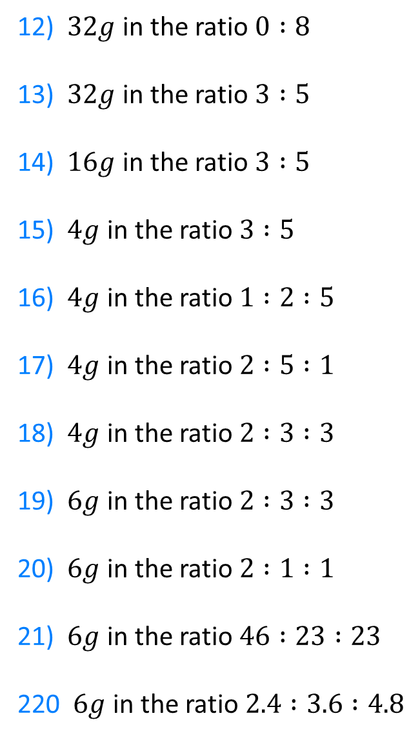
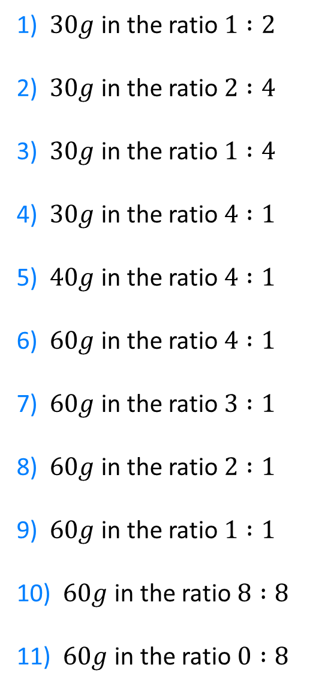
1) $30g$ in the ratio $1 :2$
2) $30g$ in the ratio $2 :4$
3) $30g$ in the ratio $1 :4$
4) $30g$ in the ratio $4 :1$
5) $40g$ in the ratio $4 :1$
6) $60g$ in the ratio $4 :1$
7) $60g$ in the ratio $3 :1$
8) $60g$ in the ratio $2 :1$
9) $60g$ in the ratio $1 :1$
10) $60g$ in the ratio $8 :8$
11) $60g$ in the ratio $0 :8$
12) $32g$ in the ratio $0 :8$
13) $32g$ in the ratio $3 :5$
14) $16g$ in the ratio $3 :5$
15) $4g$ in the ratio $3 :5$
16) $4g$ in the ratio $1 :2 :5$
17) $4g$ in the ratio $2 :5 :1$
18) $4g$ in the ratio $2 :3 :3$
19) $6g$ in the ratio $2 :3 :3$
20) $6g$ in the ratio $2 :1 :1$
21) $6g$ in the ratio $46 :23 :23$
220 $6g$ in the ratio $2.4 :3.6 :4.8$

Slide 2
1) Kate and Jack share 24 sweets in the ratio 1 : 2
How many sweets does Kate get?
2) Kate and Jack share 24 sweets in the ratio 1 : 3
How many sweets does Kate get?
3) Kate and Jack share 24 sweets in the ratio 3 : 1
How many sweets does Kate get?
4) Kate and Jack share 24 sweets in the ratio 6 : 2
How many sweets does Kate get?
5) Kate and Jack share 12 sweets in the ratio 3 : 1
How many sweets does Kate get?
6) Kate and Jack share some sweets in the ratio 3 : 1
Jack gets 12. How many does Kate get?
7) Kate and Jack share some sweets in the ratio 3 : 1
Kate gets 12. How many does Jack get?
8) Kate and Jack share some sweets in the ratio 3 : 1
Kate gets 12 more than Jack. How many does Jack get?
9) Kate and Jack share some sweets in the ratio 4 : 1
Kate gets 12 more than Jack. How many does Jack get?
10) Kate and Jack share some sweets in the ratio 4 : 1
Kate gets 15 more than Jack. How many does Jack get?
11) Kate and Jack share some sweets in the ratio 4 : 1
Jack gets 15. How many sweets do they have altogether?
12) Kate and Jack share some sweets in the ratio 4 : 1
What fraction of the sweets does Jack have?

Slide 3
ANSWERS

Slide 4
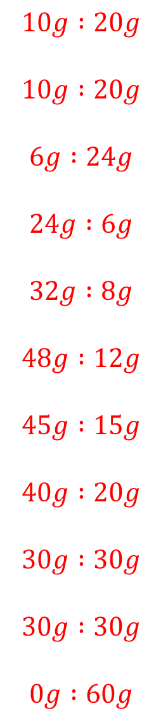
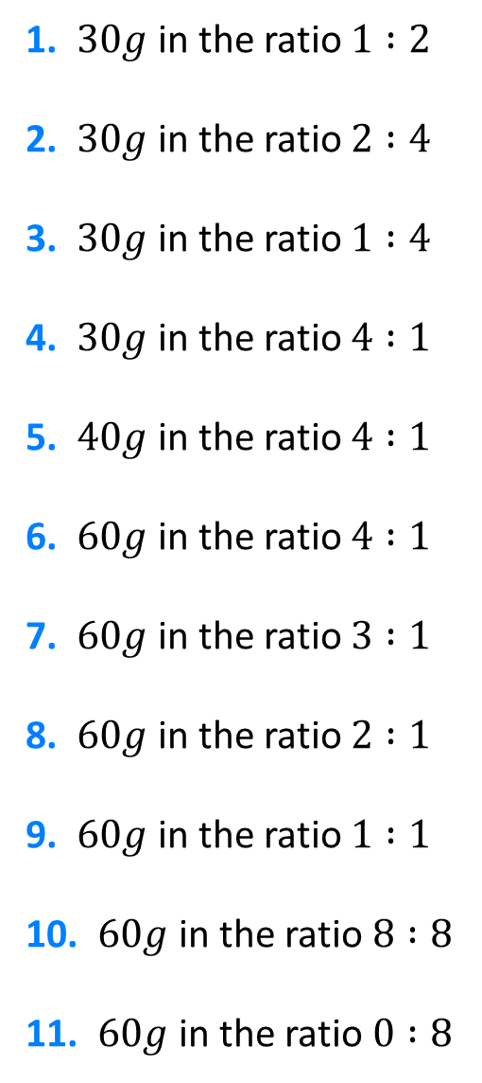
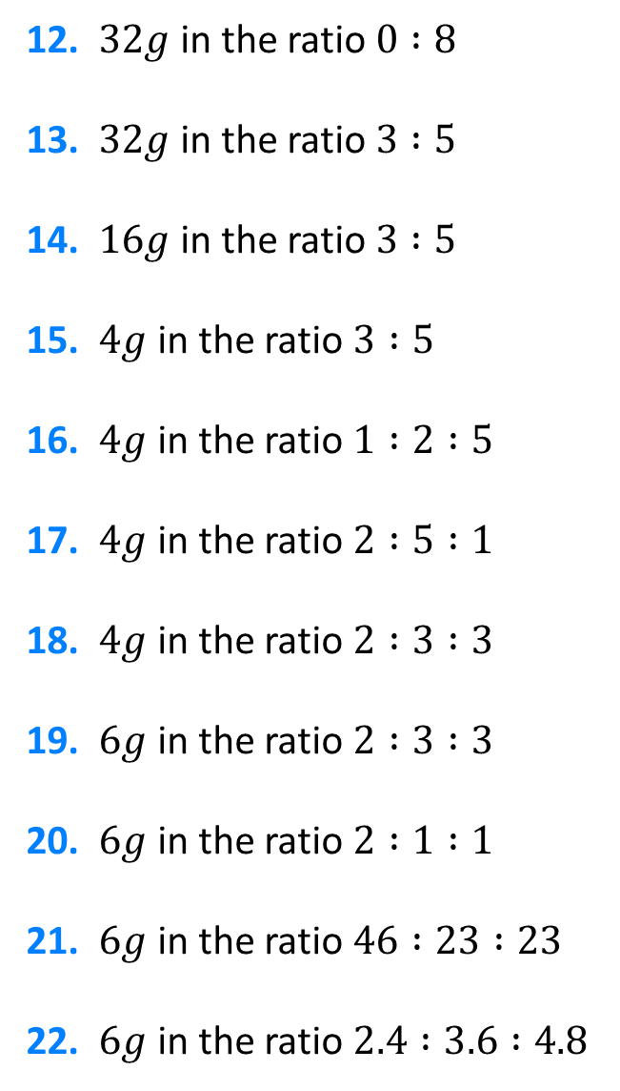
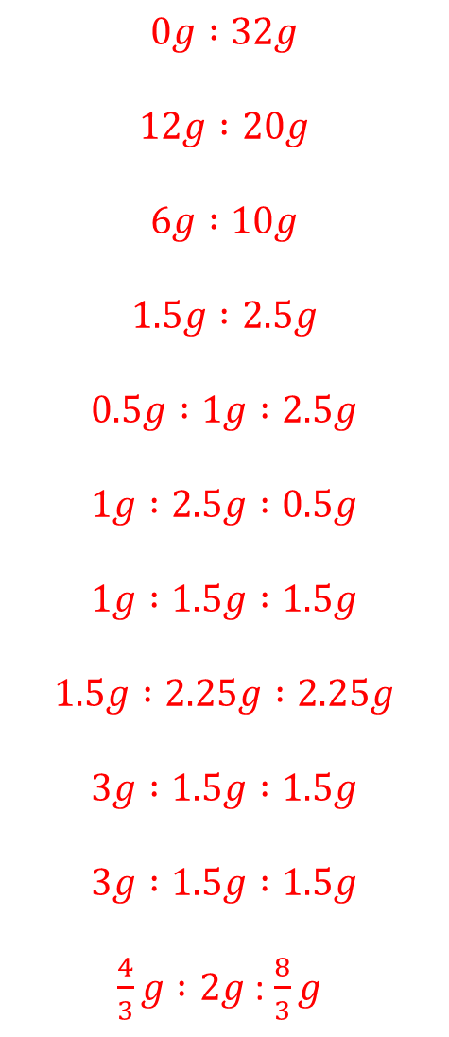
1. $30g$ in the ratio $1 :2$
2. $30g$ in the ratio $2 :4$
3. $30g$ in the ratio $1 :4$
4. $30g$ in the ratio $4 :1$
5. $40g$ in the ratio $4 :1$
6. $60g$ in the ratio $4 :1$
7. $60g$ in the ratio $3 :1$
8. $60g$ in the ratio $2 :1$
9. $60g$ in the ratio $1 :1$
10. $60g$ in the ratio $8 :8$
11. $60g$ in the ratio $0 :8$
$$10g :20g$$
$$10g :20g$$
$$6g :24g$$
$$24g :6g$$
$$32g :8g$$
$$48g :12g$$
$$45g :15g$$
$$40g :20g$$
$$30g :30g$$
$$30g :30g$$
$$0g :60g$$
12. $32g$ in the ratio $0 :8$
13. $32g$ in the ratio $3 :5$
14. $16g$ in the ratio $3 :5$
15. $4g$ in the ratio $3 :5$
16. $4g$ in the ratio $1 :2 :5$
17. $4g$ in the ratio $2 :5 :1$
18. $4g$ in the ratio $2 :3 :3$
19. $6g$ in the ratio $2 :3 :3$
20. $6g$ in the ratio $2 :1 :1$
21. $6g$ in the ratio $46 :23 :23$
22. $6g$ in the ratio $2.4 :3.6 :4.8$
$$0g :32g$$
$$12g :20g$$
$$6g :10g$$
$$1.5g :2.5g$$
$$0.5g :1g :2.5g$$
$$1g :2.5g :0.5g$$
$$1g :1.5g :1.5g$$
$$1.5g :2.25g :2.25g$$
$$3g :1.5g :1.5g$$
$$3g :1.5g :1.5g$$
$\frac{4}{3}g :2g$ : $\frac{8}{3}g$

Slide 5












1. Kate and Jack share 24 sweets in the ratio 1 : 2
How many sweets does Kate get?
2. Kate and Jack share 24 sweets in the ratio 1 : 3
How many sweets does Kate get?
3. Kate and Jack share 24 sweets in the ratio 3 : 1
How many sweets does Kate get?
4. Kate and Jack share 24 sweets in the ratio 6 : 2
How many sweets does Kate get?
5. Kate and Jack share 12 sweets in the ratio 3 : 1
How many sweets does Kate get?
6. Kate and Jack share some sweets in the ratio 3 : 1
Jack gets 12. How many does Kate get?
7. Kate and Jack share some sweets in the ratio 3 : 1
Kate gets 12. How many does Jack get?
8. Kate and Jack share some sweets in the ratio 3 : 1
Kate gets 12 more than Jack. How many does Jack get?
9. Kate and Jack share some sweets in the ratio 4 : 1
Kate gets 12 more than Jack. How many does Jack get?
10. Kate and Jack share some sweets in the ratio 4 : 1
Kate gets 15 more than Jack. How many does Jack get?
11. Kate and Jack share some sweets in the ratio 4 : 1
Jack gets 15. How many sweets do they have altogether?
12. Kate and Jack share some sweets in the ratio 4 : 1
What fraction of the sweets does Jack have?
$$8$$
$$4$$
$$6$$
$$5$$
$$18$$
$$75$$
$$\frac{1}{5}$$
$$18$$
$$9$$
$$36$$
$$4$$
$$6$$

