Slide 1
Forces and Motions
Vectors
Chapter 10
(Part 1 of 9)

Slide 2
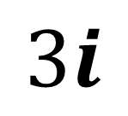

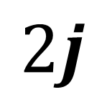
Forces as Vectors
$F=3i+2j$
$$2j$$
$$3i$$

Slide 3
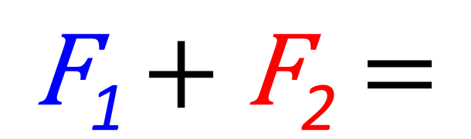
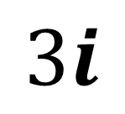
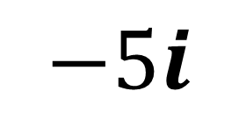

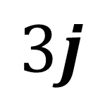
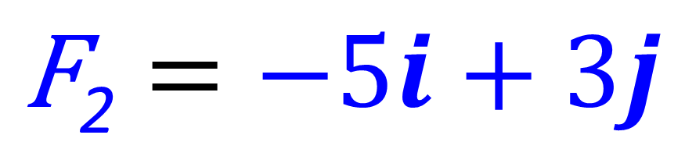
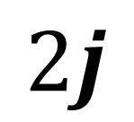
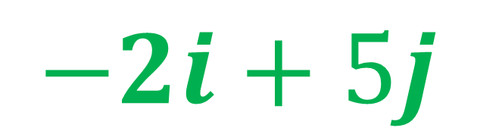
$\text{F}\text{2}=−5i+3j$
$\text{F}\text{1}=3i+2j$
$$3j$$
$$2j$$
$$−5i$$
$$3i$$
$\text{F}\text{1 }\text{+} \text{F}\text{2}$ $=$
$−2i+5j$

Slide 4
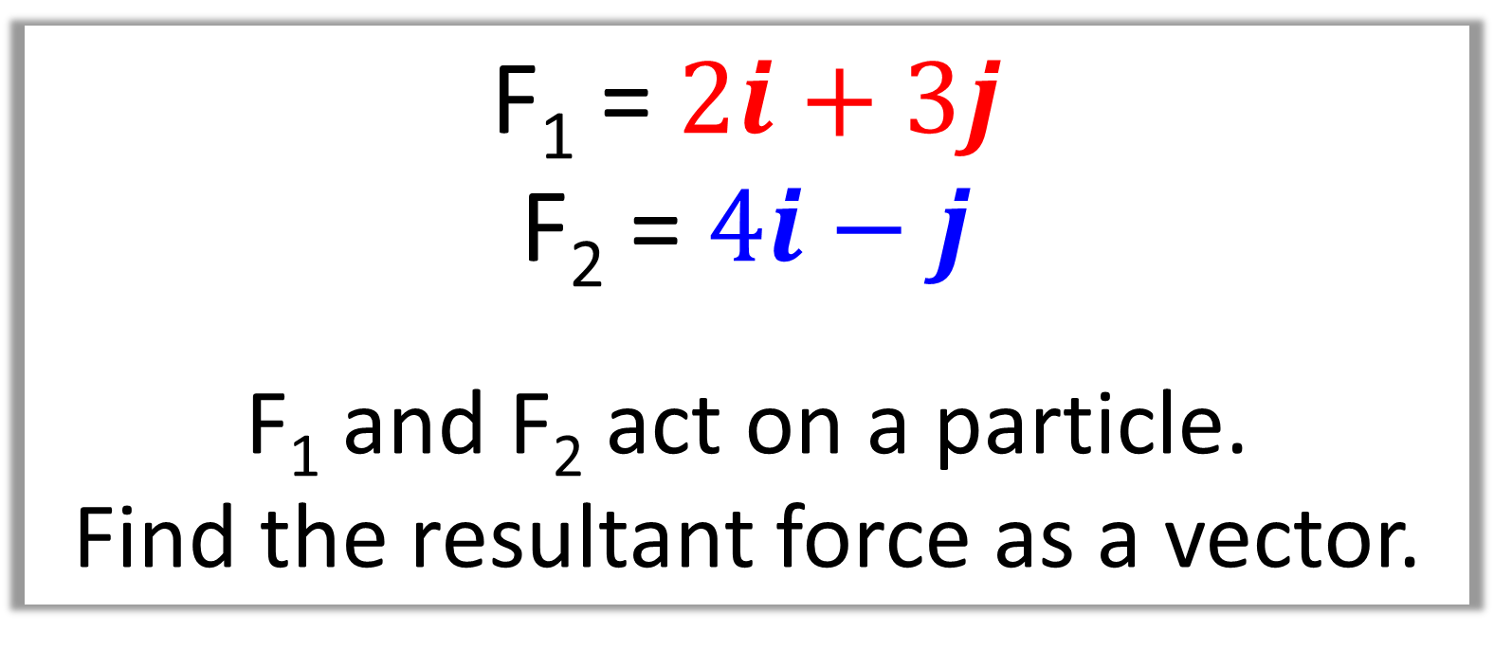
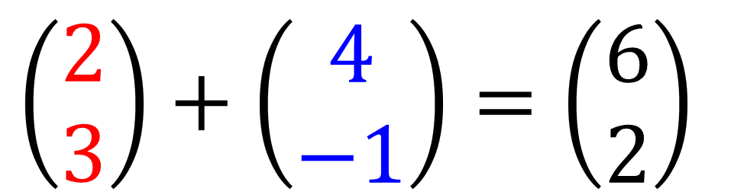
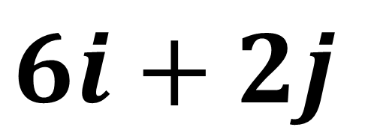
Question A
F₁ = $2i+3j$
F₂ = $4i−j$
F₁ and F₂ act on a particle.
Find the resultant force as a vector.
$$\left(\begin{matrix}2 \\ 3\end{matrix}\right)+\left(\begin{matrix}4 \\ −1\end{matrix}\right)=\left(\begin{matrix}6 \\ 2\end{matrix}\right)$$
$6i+2j$

Slide 5
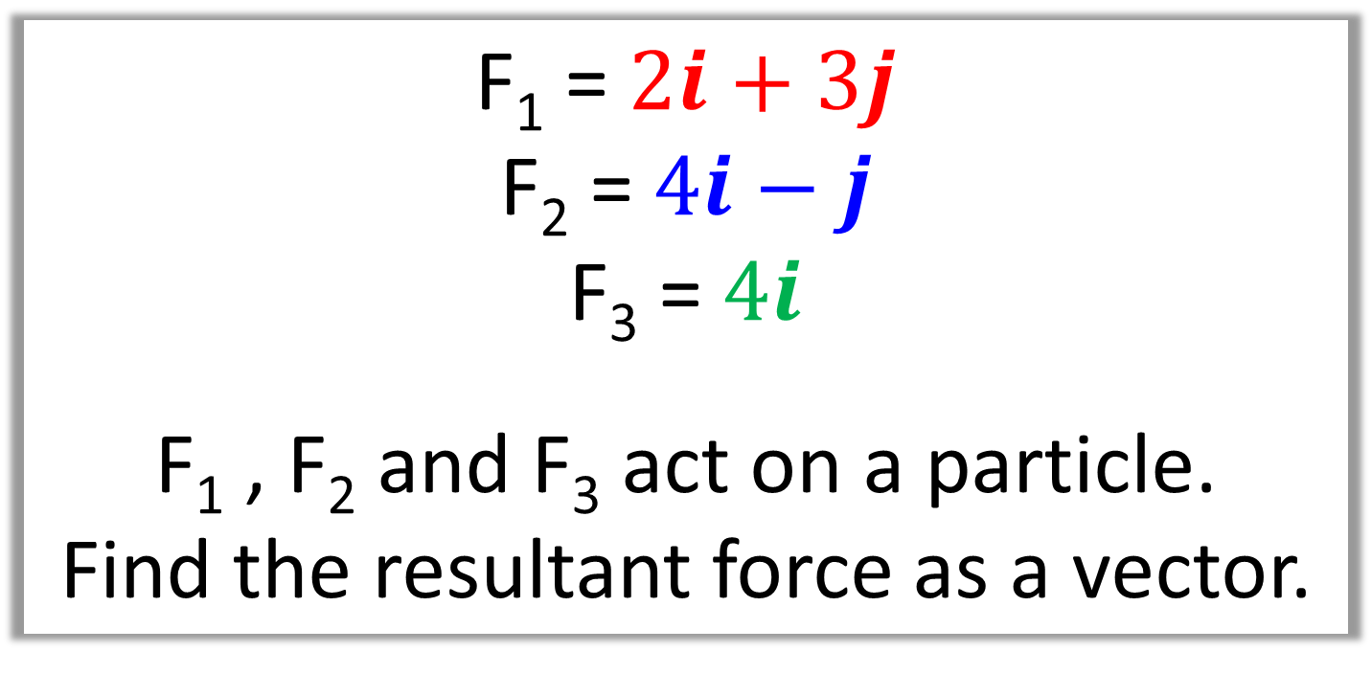
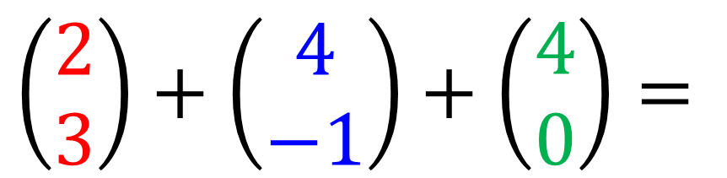
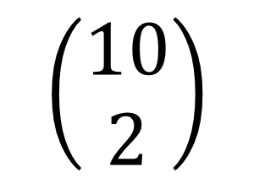
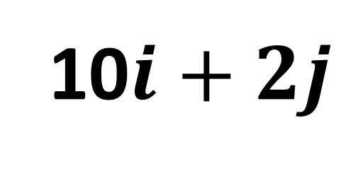
Question B
F₁ = $2i+3j$
F₂ = $4i−j$
F₃ = $4i$
F₁ , F₂ and F₃ act on a particle.
Find the resultant force as a vector.
$$\left(\begin{matrix}2 \\ 3\end{matrix}\right)+\left(\begin{matrix}4 \\ −1\end{matrix}\right)+\left(\begin{matrix}4 \\ 0\end{matrix}\right)=$$
$$\left(\begin{matrix}10 \\ 2\end{matrix}\right)$$
10$i+2j$

Slide 6
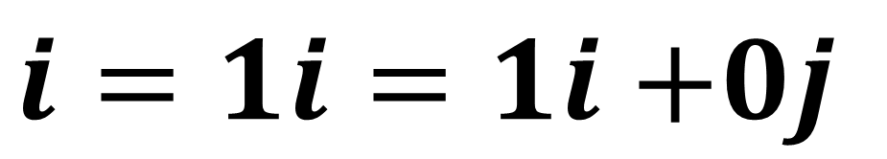

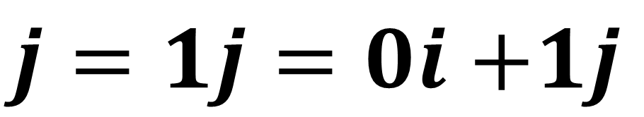

The vector $i$ is due east
$i=1i=1i$ $+0j$
The vector $j$ is due north
$j=1j=0i$ $+1j$

Slide 7
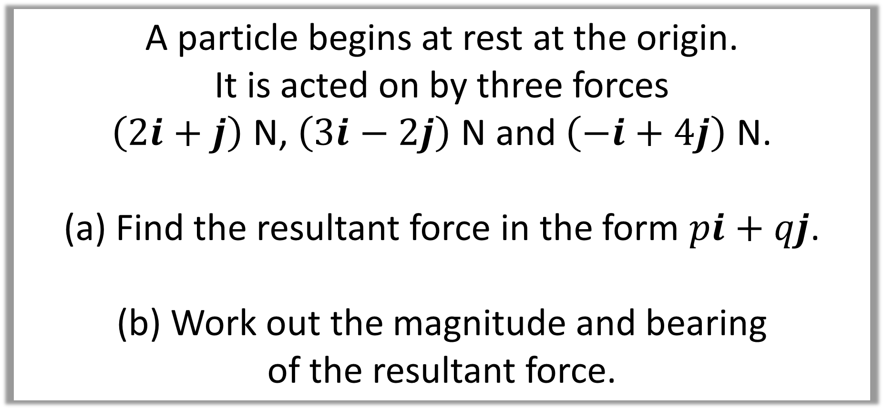
Question C
A particle begins at rest at the origin.
It is acted on by three forces
$\left(2i+j\right)$ N, $\left(3i−2j\right)$ N and $\left(−i+4j\right)$ N.
Find the resultant force in the form $pi+qj$.
Work out the magnitude and bearing
of the resultant force.

Slide 8
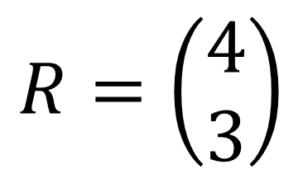
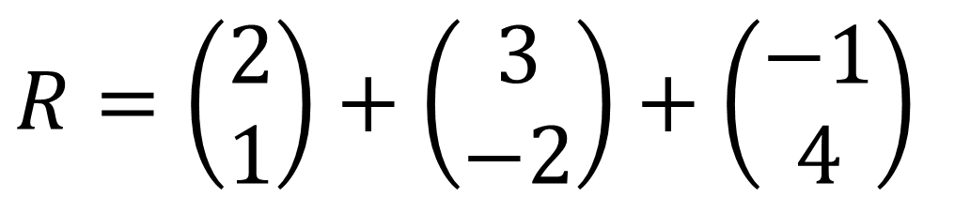
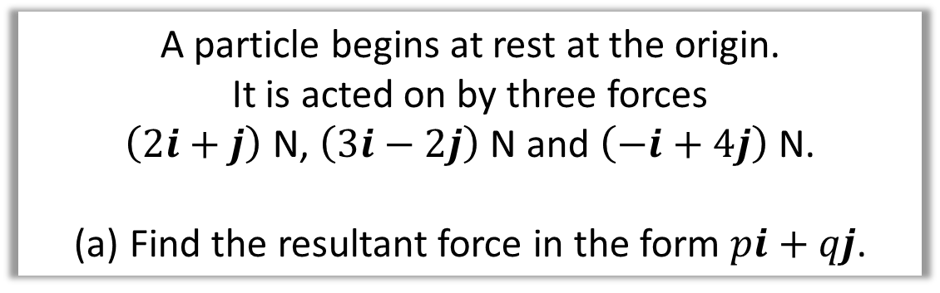
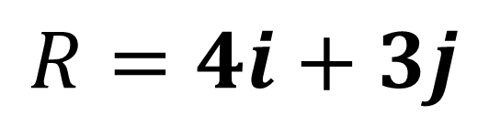
A particle begins at rest at the origin.
It is acted on by three forces
$\left(2i+j\right)$ N, $\left(3i−2j\right)$ N and $\left(−i+4j\right)$ N.
Find the resultant force in the form $pi+qj$.
a.
$$R=\left(\begin{matrix}2 \\ 1\end{matrix}\right)+\left(\begin{matrix}3 \\ −2\end{matrix}\right)+\left(\begin{matrix}−1 \\ 4\end{matrix}\right)$$
$$R=\left(\begin{matrix}4 \\ 3\end{matrix}\right)$$
$$R=4i+3j$$

Slide 9
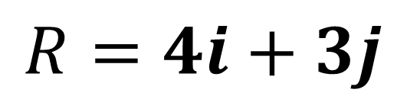
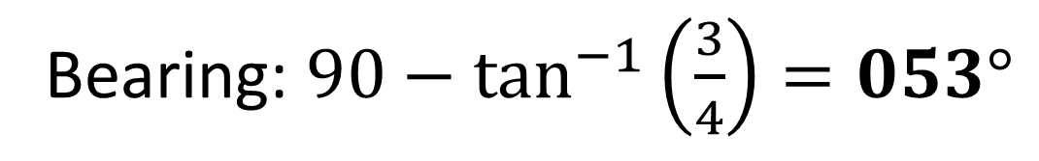
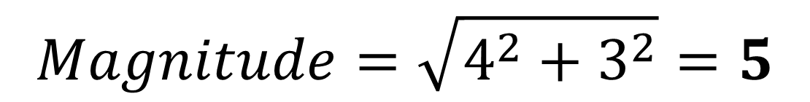
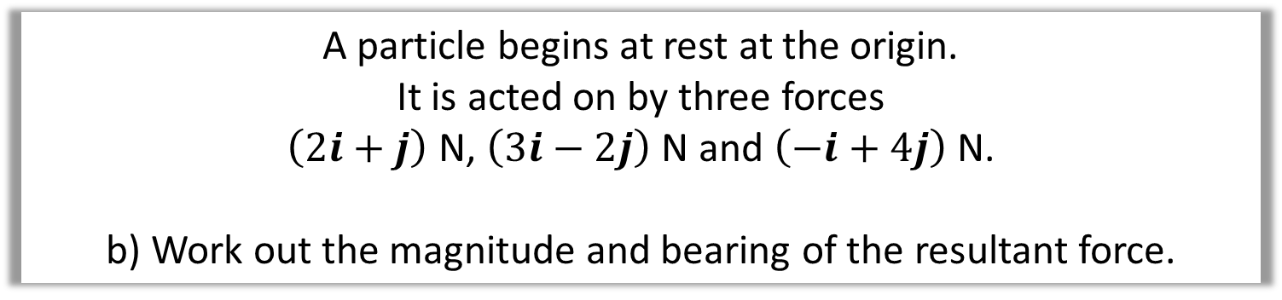

A particle begins at rest at the origin.
It is acted on by three forces
$\left(2i+j\right)$ N, $\left(3i−2j\right)$ N and $\left(−i+4j\right)$ N.
b) Work out the magnitude and bearing of the resultant force.
b.
$$R=4i+3j$$
3
$$θ$$
4
$$Magnitude=\sqrt{4^{2}+3^{2}}=5$$
Bearing: $90−\tan^{−1}\left(\frac{3}{4}\right)=053°$

Slide 10
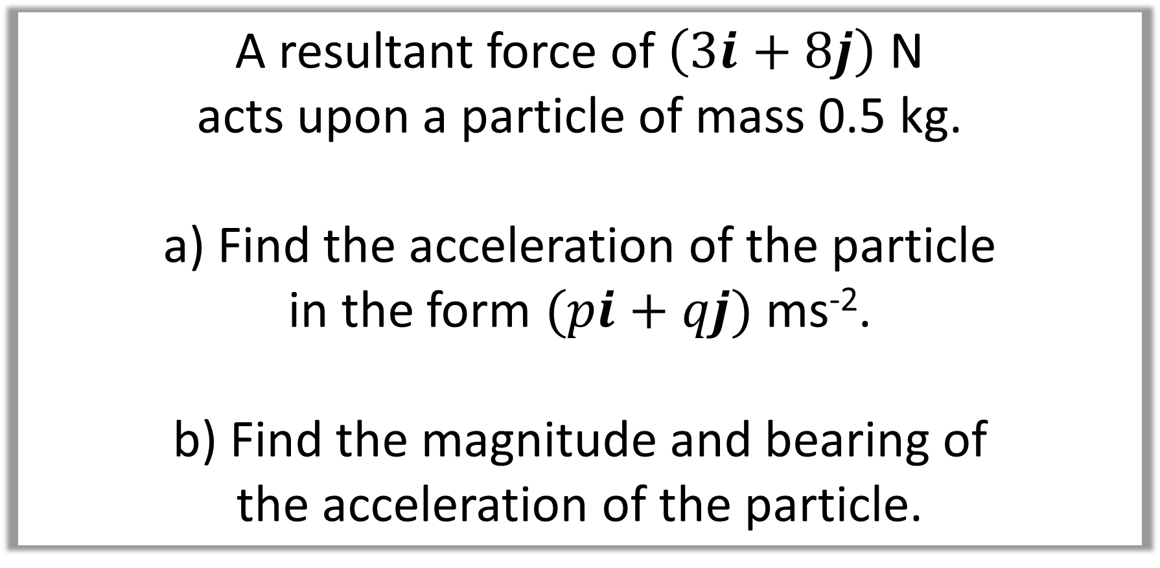
Question D
A resultant force of $\left(3i+8j\right)$ N
acts upon a particle of mass 0.5 kg.
a) Find the acceleration of the particle
in the form $(pi+qj)$ ms⁻².
b) Find the magnitude and bearing of
the acceleration of the particle.

Slide 11

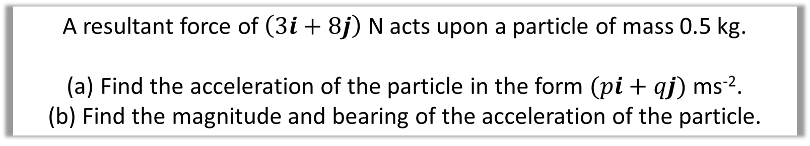
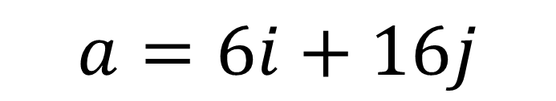
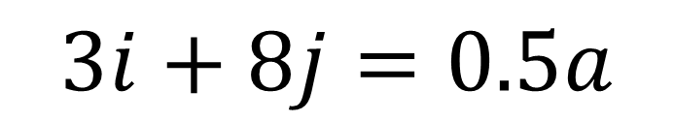
A resultant force of $\left(3i+8j\right)$ N acts upon a particle of mass 0.5 kg.
Find the acceleration of the particle in the form $(pi+qj)$ ms⁻².
Find the magnitude and bearing of the acceleration of the particle.
$$F=ma$$
a
$$3i+8j=0.5a$$
$$a=6i+16j$$

Slide 12
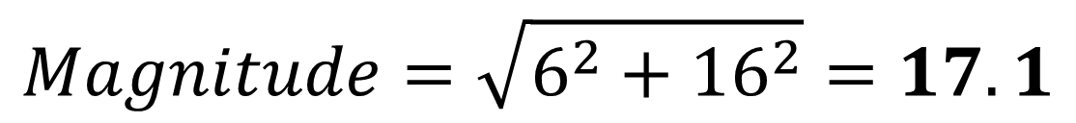
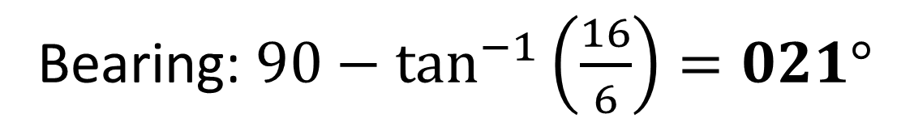
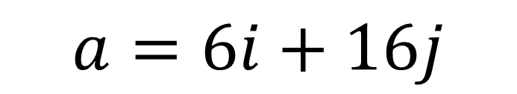
A resultant force of $\left(3i+8j\right)$ N acts upon a particle of mass 0.5 kg.
Find the acceleration of the particle in the form $(pi+qj)$ ms⁻².
Find the magnitude and bearing of the acceleration of the particle.
$$a=6i+16j$$
b
16
$$Magnitude=\sqrt{6^{2}+{16}^{2}}=17.1$$
$$θ$$
6
Bearing: $90−\tan^{−1}\left(\frac{16}{6}\right)=021°$

Slide 13
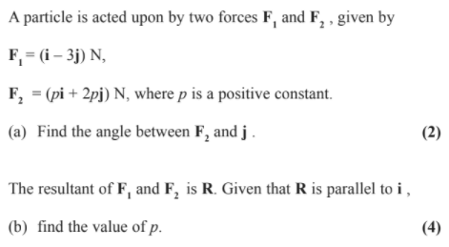
Question D

Slide 14

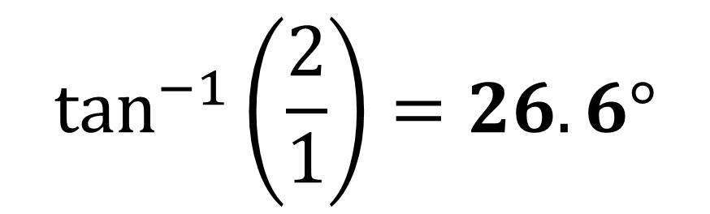
a.
$$\tan^{−1}\left(\frac{2}{1}\right)=26.6°$$
2
$$θ$$
1

Slide 15
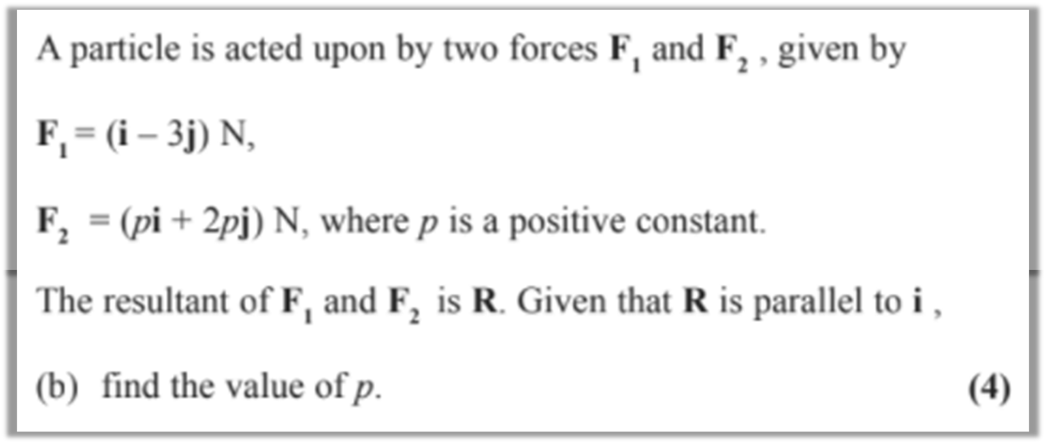
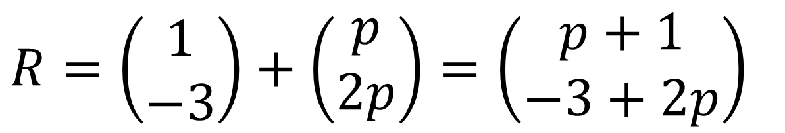
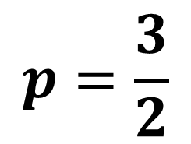
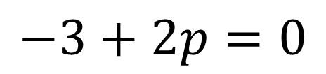
$$R=\left(\begin{matrix}1 \\ −3\end{matrix}\right)+\left(\begin{matrix}p \\ 2p\end{matrix}\right)=\left(\begin{matrix}p+1 \\ −3+2p\end{matrix}\right)$$
$$−3+2p=0$$
$$p=\frac{3}{2}$$

Slide 16
Question E
The acceleration of P is (3i + 9j) m s^{–2}.
At time t = 0, the velocity of P is (3i – 22j) m s^{–1}
Find the speed of P when t = 3 seconds.

Slide 17
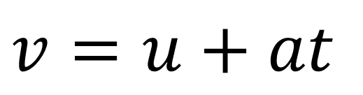
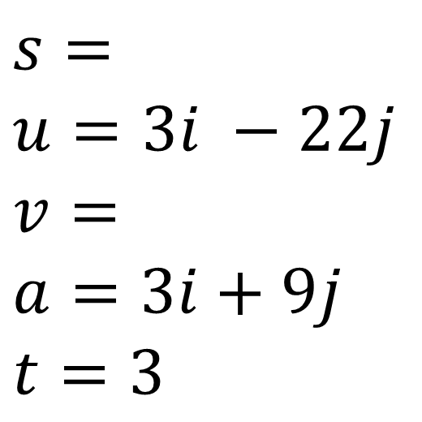
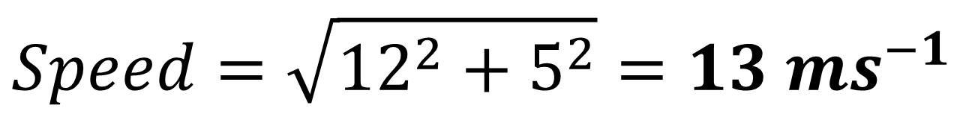
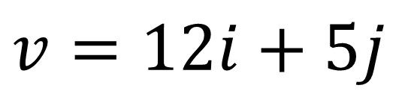
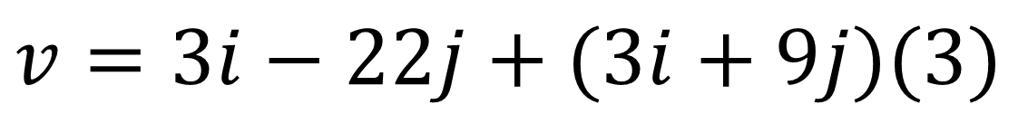
The acceleration of P is (3i + 9j) m s^{–2}.
At time t = 0, the velocity of P is (3i – 22j) m s^{–1}
Find the speed of P when t = 3 seconds.
$$s=$$
$$u=3i −22j$$
$$v=$$
$$a=3i+9j$$
$$t=3$$
$$v=u+at$$
$$v=3i−22j+(3i+9j)(3)$$
$$v=12i+5j$$
$$Speed=\sqrt{{12}^{2}+5^{2}}={13 ms}^{−1}$$

