Slide 1
LO: Writing Equations
(Worded Questions)

Slide 2
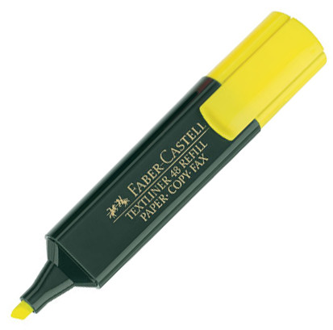
Highlight the key information.
You get a taxi from Dubai Mall to the Mall of the Emirates.
The hire charge is 5dhs and then every kilometre is 2dhs.
Write and solve an equation to work out
the total distance of the journey that cost 45dhs.

Slide 3

You get a taxi from Dubai Mall to the Mall of the Emirates.
The hire charge is 5dhs and then every kilometre is 2dhs.
Write and solve an equation to work out
the total distance of the journey that cost 45dhs.
2k + 5 = 45
k = 20

Slide 4

You have sprung a leak in the kitchen celling, so you call out a plumber.
The plumber charges a emergency call out fee of 200dhs.
He then charges 350dhs per hour.
Write and solve an equation to work out
the total hours charged when the total cost of the job was 900dhs.
350h + 200 = 900
h = 2

Slide 5
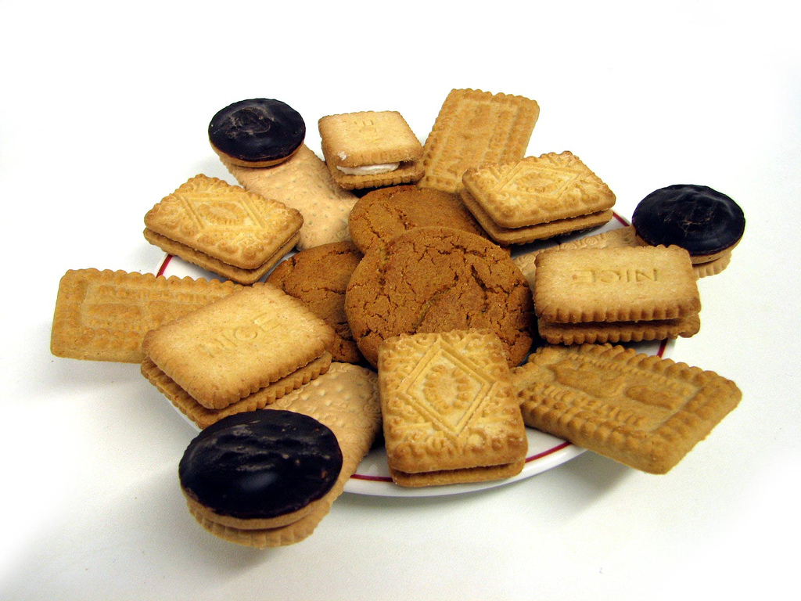
There are 26 biscuits altogether on two plates.
The second plate has 8 fewer biscuits than the first plate.
Write and solve an equation to work out
how many biscuits are there on each plate?
b + b – 8 = 26
2b – 8 = 26
b = 17

