Slide 1
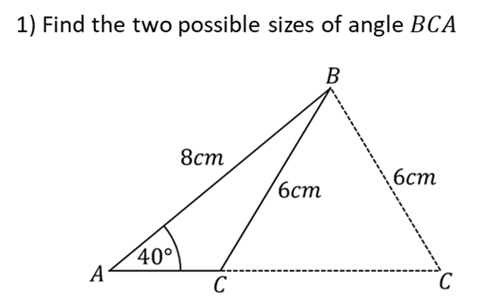
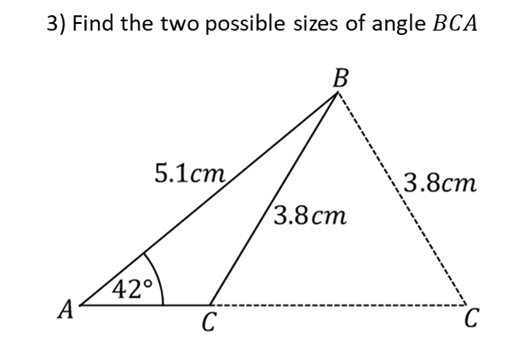
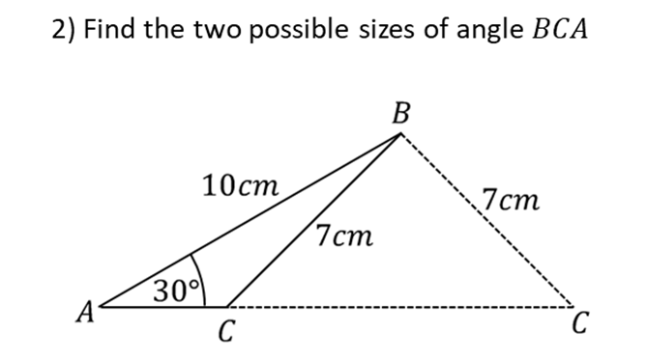

Slide 2
ANSWERS

Slide 3
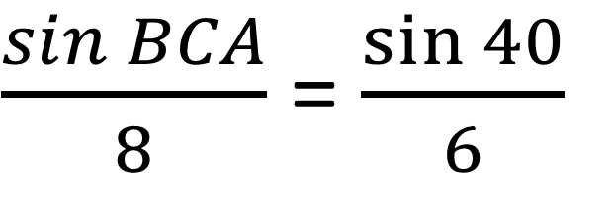
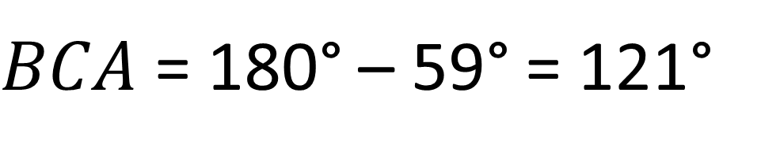
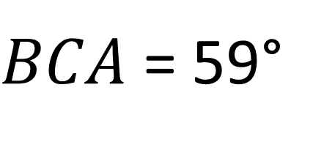
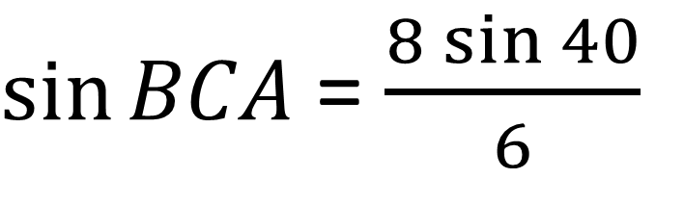
$\frac{\sin{BCA}}{8}$ = $\frac{\sin{40}}{6}$
$\sin{BCA}$ = $\frac{8\sin{40}}{6}$
$BCA$ = 59°
$BCA$ = 180° – 59° = 121°

Slide 4
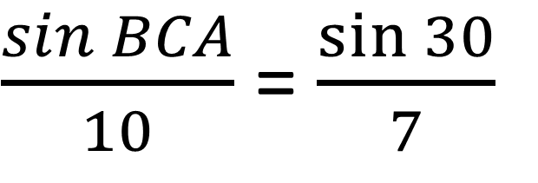
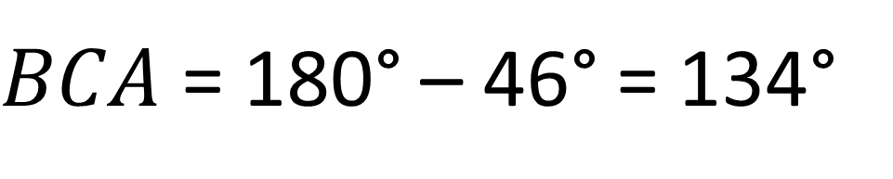
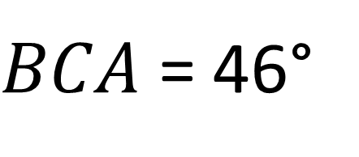
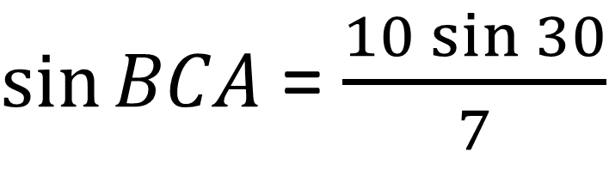
$\frac{\sin{BCA}}{10}$ = $\frac{\sin{30}}{7}$
$\sin{BCA}$ = $\frac{10\sin{30}}{7}$
$BCA$ = 46°
$BCA$ = 180° – 46° = 134°

Slide 5
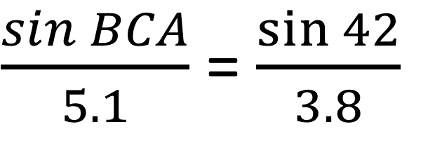
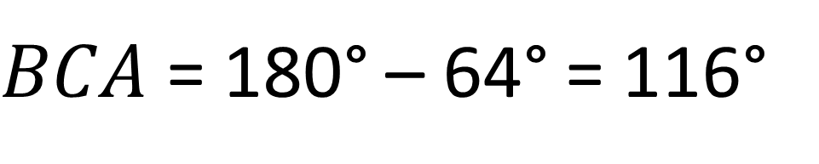
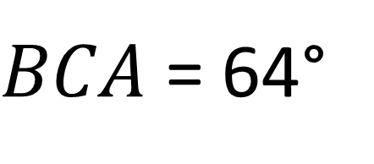
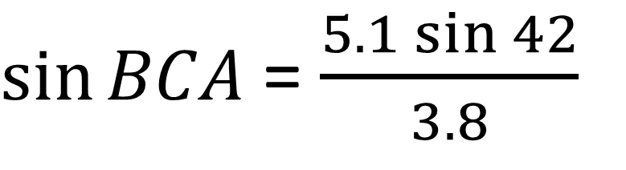
$\frac{\sin{BCA}}{5.1}$ = $\frac{\sin{42}}{3.8}$
$\sin{BCA}$ = $\frac{5.1\sin{42}}{3.8}$
$BCA$ = 64°
$BCA$ = 180° – 64° = 116°

Slide 6
Obtuse Angle = 180°– Acute Angle

