Slide 1
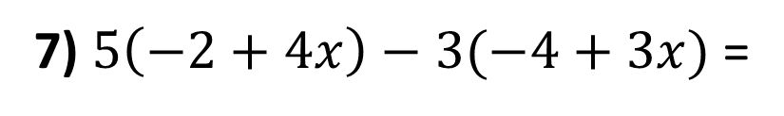
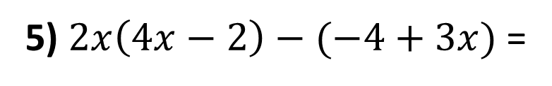
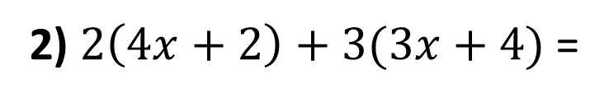
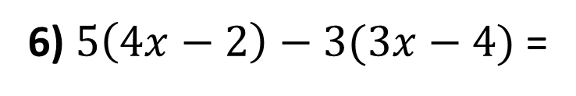
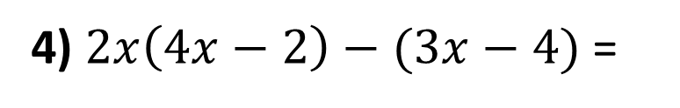
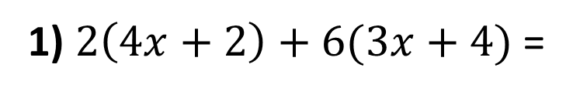
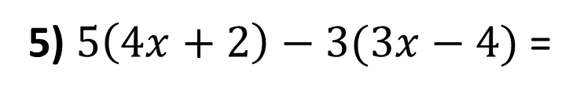
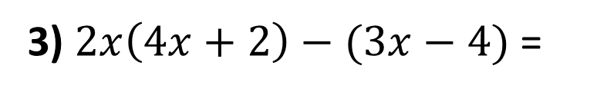
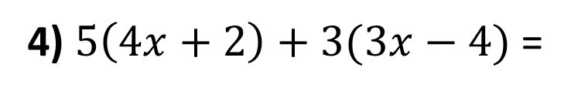
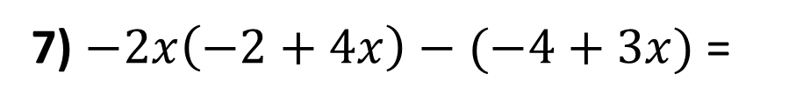
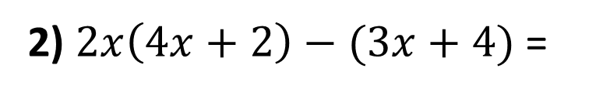
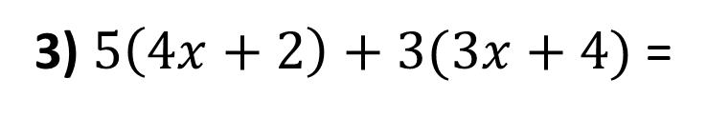
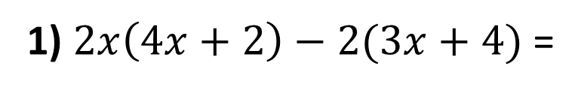
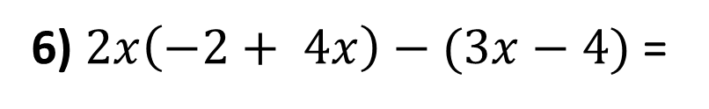
Expand and simplify the following:
Foundation
Higher
1) $2\left(4x+2\right)+6(3x+4)$ =
1) $2x\left(4x+2\right)−2(3x+4)$ =
2) $2\left(4x+2\right)+3(3x+4)$ =
2) $2x\left(4x+2\right)−(3x+4)$ =
3) $5\left(4x+2\right)+3(3x+4)$ =
3) $2x\left(4x+2\right)−(3x−4)$ =
4) $5\left(4x+2\right)+3(3x−4)$ =
4) $2x\left(4x−2\right)−(3x−4)$ =
5) $5\left(4x+2\right)−3(3x−4)$ =
5) $2x\left(4x−2\right)−(−4+3x)$ =
6) $5\left(4x−2\right)−3(3x−4)$ =
6) $2x\left(−2+ 4x\right)−(3x−4)$ =
7) $5\left(−2+4x\right)−3(−4+3x)$ =
7) $−2x\left(−2+4x\right)−(−4+3x)$ =

Slide 2
ANSWERS

Slide 3
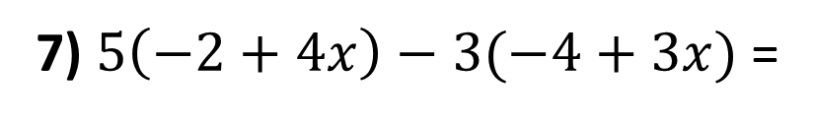


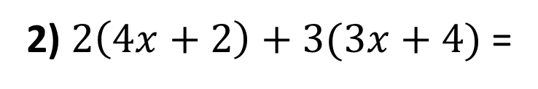

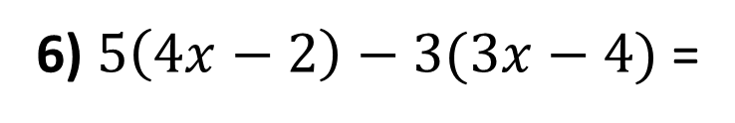


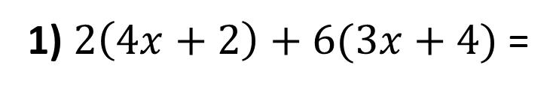


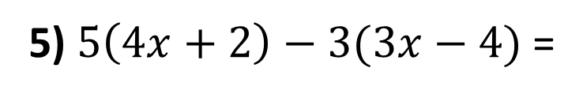

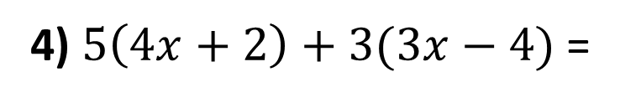



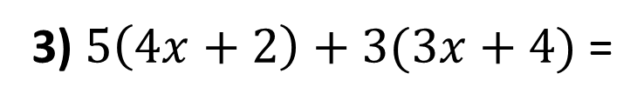



Expand and simplify the following:
1) $2\left(4x+2\right)+6(3x+4)$ =
$$8x+4+18x+24$$
$$=26x+28$$
2) $2\left(4x+2\right)+3(3x+4)$ =
$$8x+4+9x+12$$
$$=17x+16$$
3) $5\left(4x+2\right)+3(3x+4)$ =
$$20x+10+9x+12$$
$$=29x+22$$
4) $5\left(4x+2\right)+3(3x−4)$ =
$$20x+10+9x−12$$
$$=29x−2$$
5) $5\left(4x+2\right)−3(3x−4)$ =
$$20x+10−9x+12$$
$$=11x+22$$
6) $5\left(4x−2\right)−3(3x−4)$ =
$$20x−10−9x+12$$
$$=11x+2$$
7) $5\left(−2+4x\right)−3(−4+3x)$ =
$$−10+20x+12−9x$$
$$=11x+2$$

Slide 4
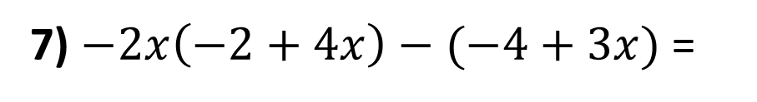

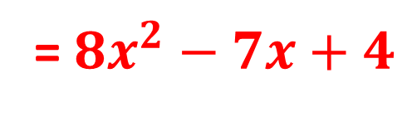
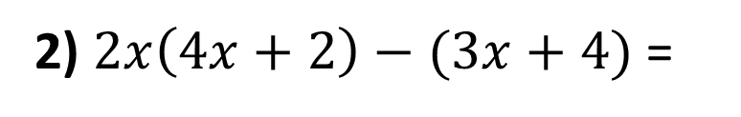

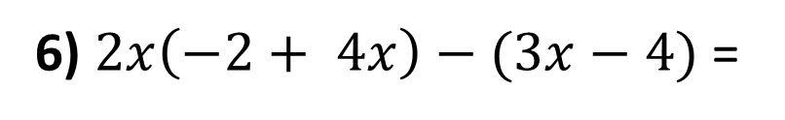
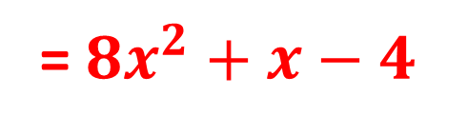

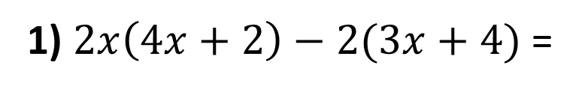
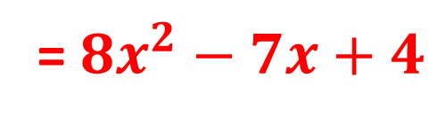
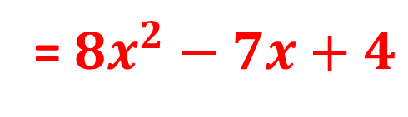
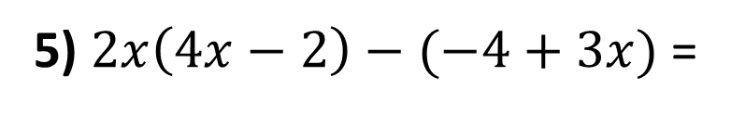

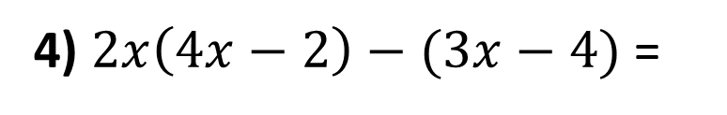

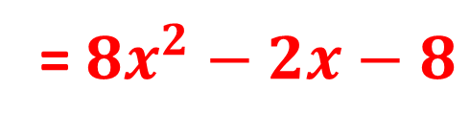

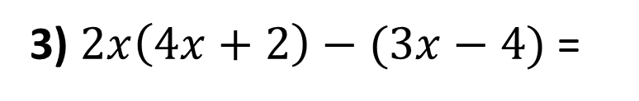


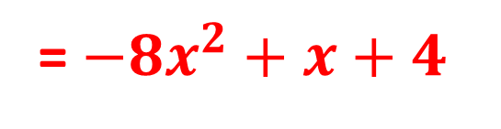
Expand and simplify the following:
1) $2x\left(4x+2\right)−2(3x+4)$ =
$$8x^{2}+4x−6x−8$$
= $8x^{2}−2x−8$
2) $2x\left(4x+2\right)−(3x+4)$ =
$$8x^{2}+4x−3x−4$$
= $8x^{2}+x−4$
3) $2x\left(4x+2\right)−(3x−4)$ =
$$8x^{2}+4x−3x+4$$
= $8x^{2}+x+4$
4) $2x\left(4x−2\right)−(3x−4)$ =
$$8x^{2}−4x−3x+4$$
= $8x^{2}−7x+4$
5) $2x\left(4x−2\right)−(−4+3x)$ =
$$8x^{2}−4x+4−3x$$
= $8x^{2}−7x+4$
6) $2x\left(−2+ 4x\right)−(3x−4)$ =
$$−4x+8x^{2}−3x+4$$
= $8x^{2}−7x+4$
7) $−2x\left(−2+4x\right)−(−4+3x)$ =
$$4x−8x^{2}+4−3x$$
= $−8x^{2}+x+4$

