Slide 1
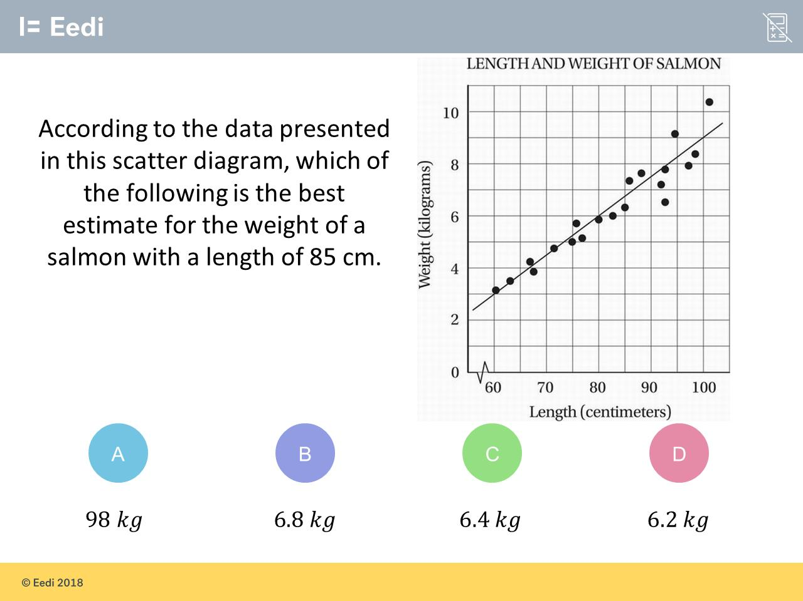
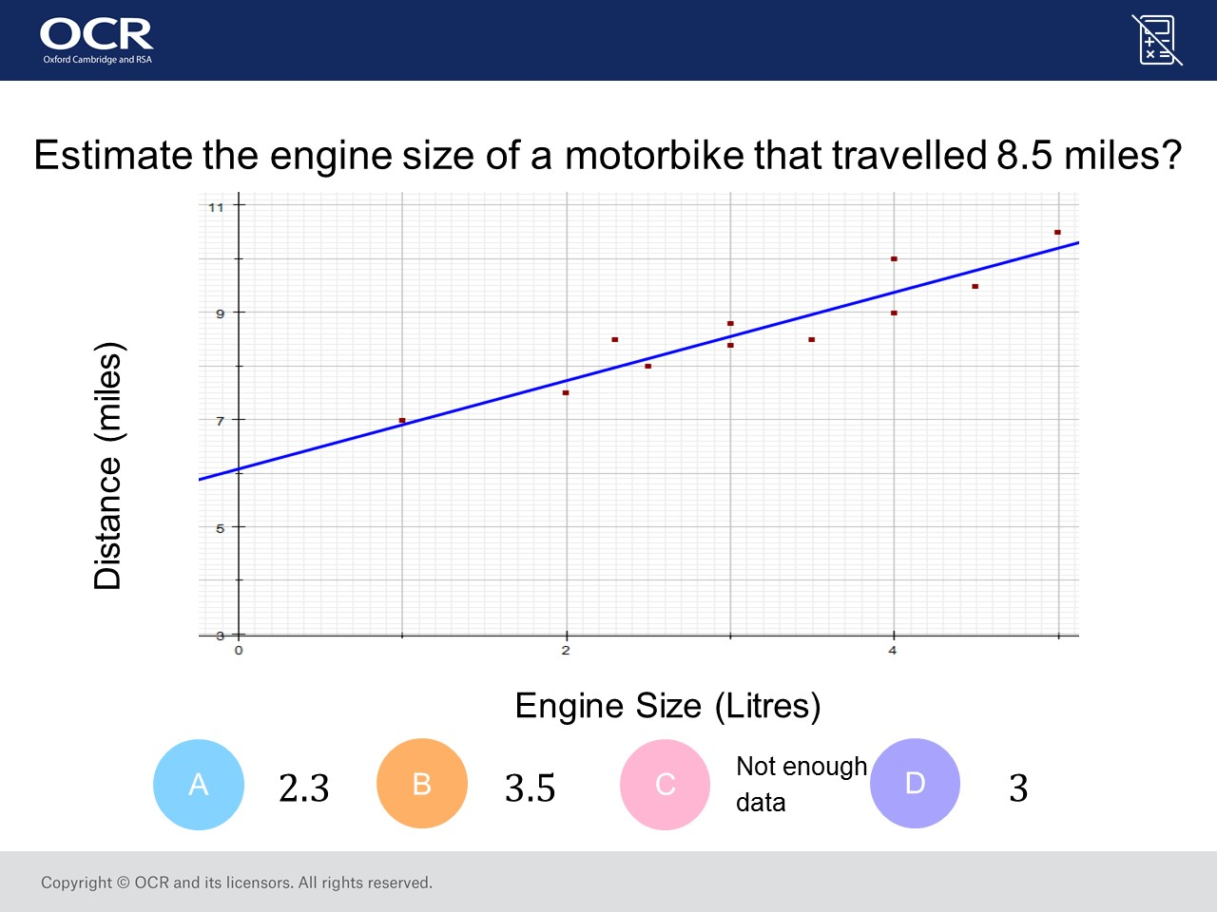
Worst answered question?
Most common wrong answer?

Slide 2
ANSWERS

Slide 3
Worst answered question?

Slide 4
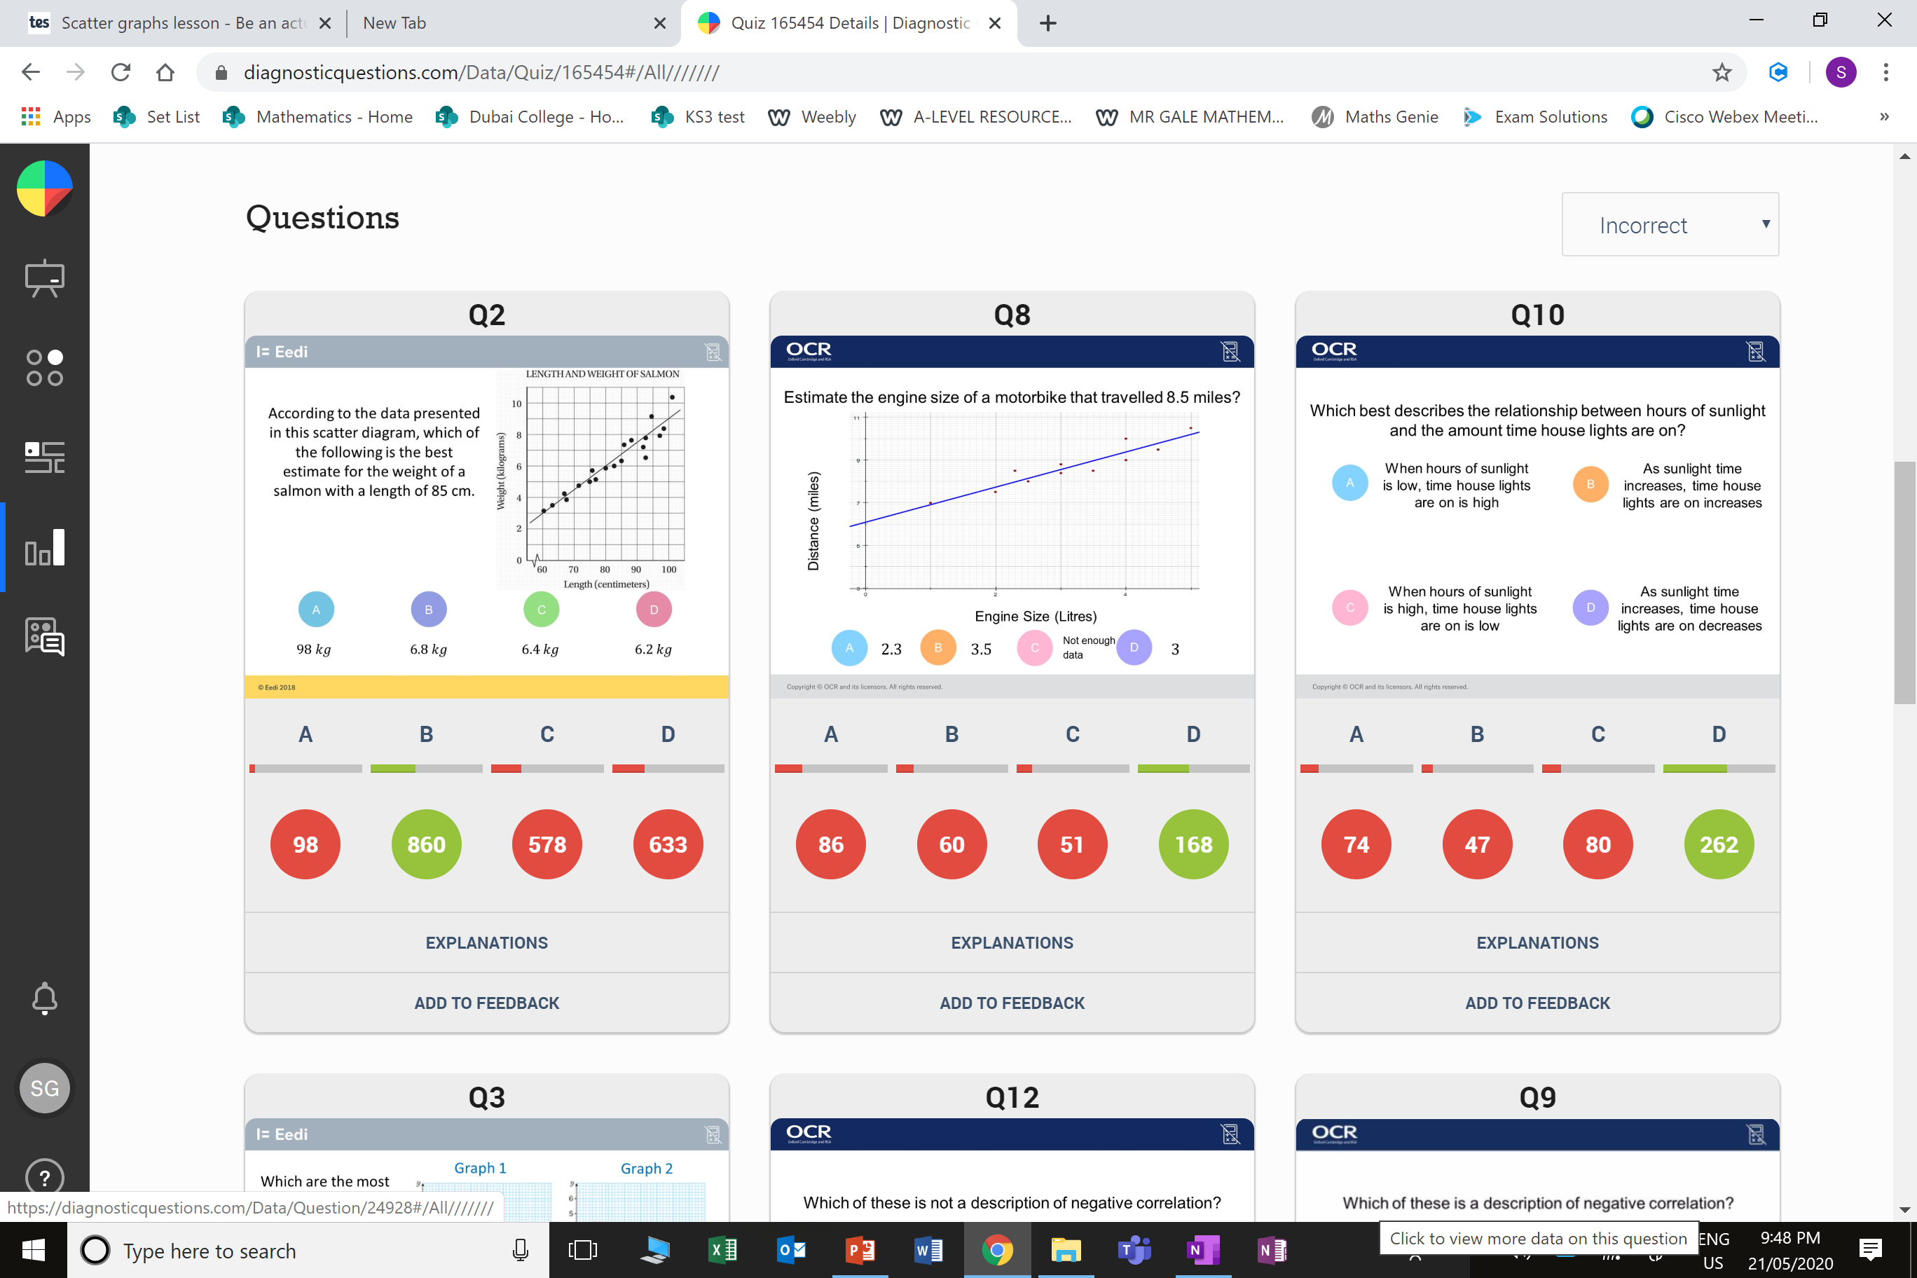
D
The student may
have found the
weight for the
data point with
length 85 cm.

Slide 5
A
They used 8 miles on the y axis instead of 8.5 miles.

