Slide 1
Normal Distribution
Hypothesis Testing
on Sample Mean
Chapter 3
(Part 7 of 7)

Slide 2

You have a population of children, with the below ages.
0
1
2
3
4
5
6
7
8
9
Population mean $=4.5$
Samples of the population are taken:
Sample 1:
Mean = 4.75
1
3
7
8
Sample 2:
Mean = 4.25
6
2
0
9
Sample 3:
Mean = 4.5
5
3
6
4

Slide 3
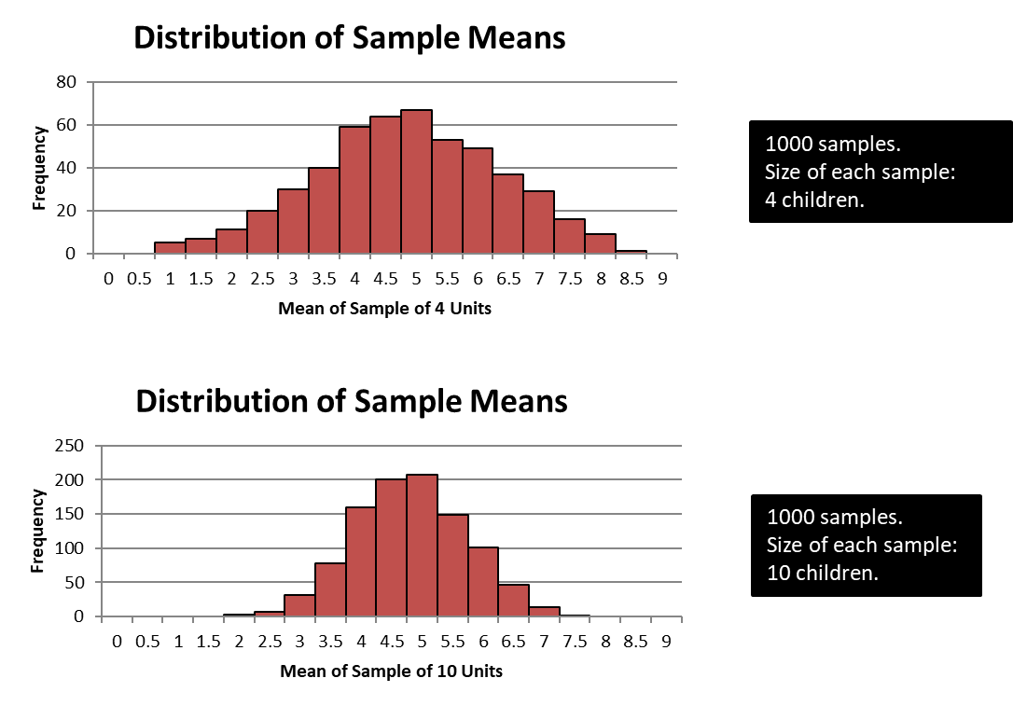
1000 samples.
Each sample 4 children.

Slide 4
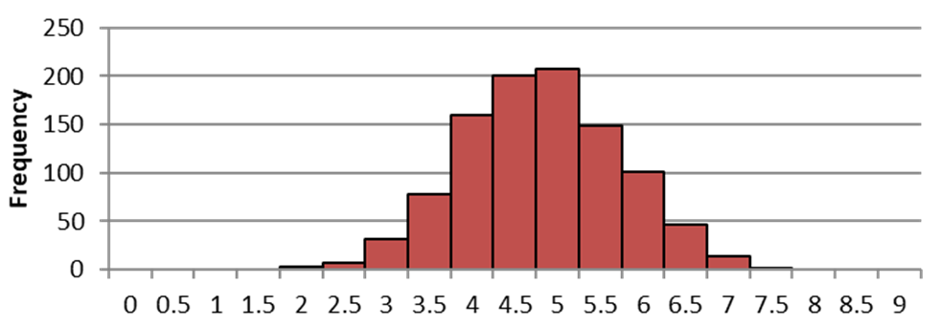
The sample size is changed (see below).
1000 samples.
Each sample 4 children.
Mean ≈ 4.5
1000 samples.
Each sample 10 children.
Mean ≈ 4.5

Slide 5
When you take a sample
from a normal distribution….
the mean stays the same.
the stand deviation changes.

Slide 6
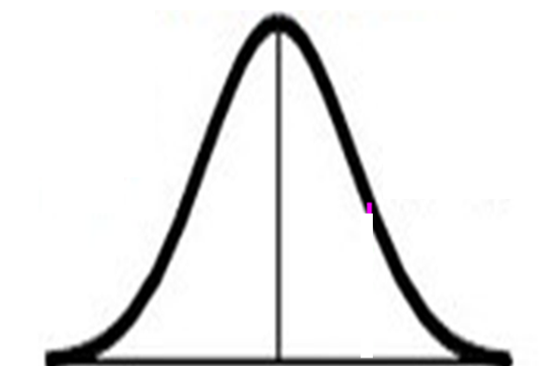
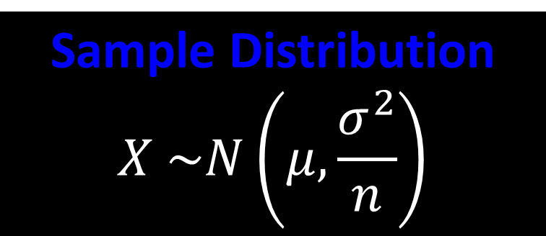


Population Distribution
$$X\sim N\left(μ,σ^{2}\right)$$
Sample Distribution
$$X \sim N\left(μ,\frac{σ^{2}}{n}\right)$$
Sample size = n
Standard deviation = $\sqrt{\frac{σ^{2}}{n}}$

Slide 7
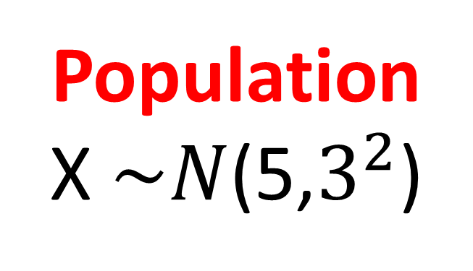
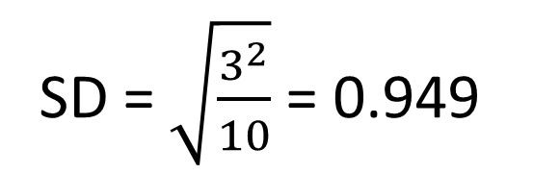

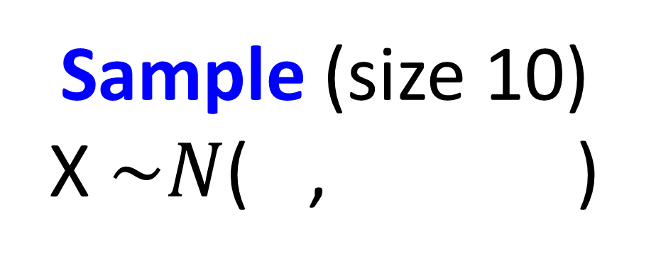
Population
X $\sim N$(5,$3^{2}$)
Sample (size 10)
X $\sim N$( 5,${0.949 }^{2}$)
5
${ 0.949}^{2}$
Mean = 5
SD = $\sqrt{\frac{3^{2}}{10}}$ = 0.949

Slide 8
Hypothesis Testing on Sample Mean
Step 1. State you hypotheses
Step 2. State you distribution for the sample
Step 3. Calculate the probability
(from the normal distribution)
of your sample result happening
Step 4. Compare this probability
with the significant level
Step 5. Accept or reject your hypotheses H_{o}

Slide 9
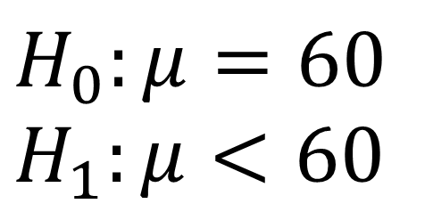

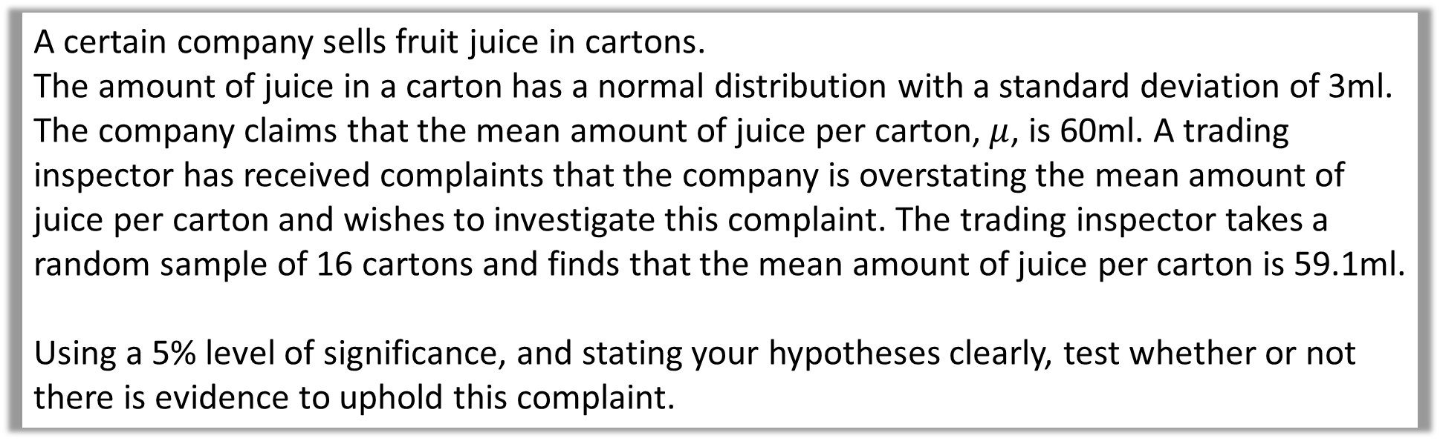
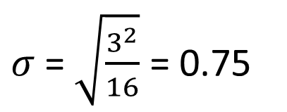
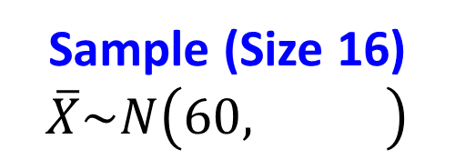
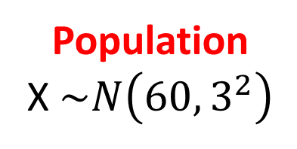
A certain company sells fruit juice in cartons.
The amount of juice in a carton has a normal distribution with a standard deviation of 3ml.
The company claims that the mean amount of juice per carton, $μ$, is 60ml. A trading inspector has received complaints that the company is overstating the mean amount of juice per carton and wishes to investigate this complaint. The trading inspector takes a random sample of 16 cartons and finds that the mean amount of juice per carton is 59.1ml.
Using a 5% level of significance, and stating your hypotheses clearly, test whether or not there is evidence to uphold this complaint.
Step 1: State your hypotheses
Step 2: State your distribution
for the sample
$$H_{0}:μ=60 \\ H_{1}:μ<60$$
Sample (Size 16)
$$\overline{X}\sim N\left({60, 0.75}^{2}\right)$$
Population
X $\sim N\left(60,3^{2}\right)$
$${0.75}^{2}$$
$σ$= $\sqrt{\frac{3^{2}}{16}}$ = 0.75

Slide 10
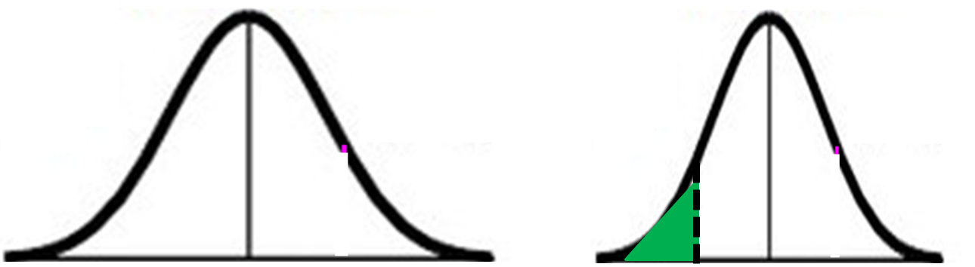

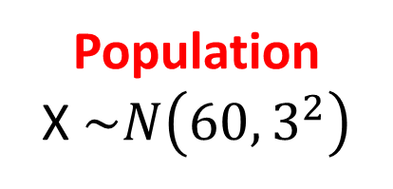

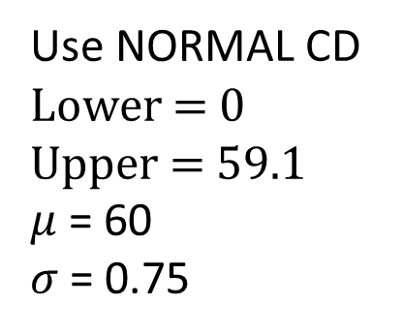
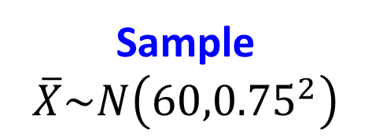
A certain company sells fruit juice in cartons.
The amount of juice in a carton has a normal distribution with a standard deviation of 3ml.
The company claims that the mean amount of juice per carton, $μ$, is 60ml. A trading inspector has received complaints that the company is overstating the mean amount of juice per carton and wishes to investigate this complaint. The trading inspector takes a random sample of 16 cartons and finds that the mean amount of juice per carton is 59.1ml.
Using a 5% level of significance, and stating your hypotheses clearly, test whether or not there is evidence to uphold this complaint.
Population
X $\sim N\left(60,3^{2}\right)$
Sample
$$\overline{X}\sim N\left({60,0.75}^{2}\right)$$
Step 3. Calculate the probability
of your sample result happening
Use NORMAL CD
Lower = 0
Upper = 59.1
$μ$ = 60
$σ$= 0.75
$$P\left(\overline{X}≤59.1\right)=$$
$$0.1151$$
60
59.1
60

Slide 11
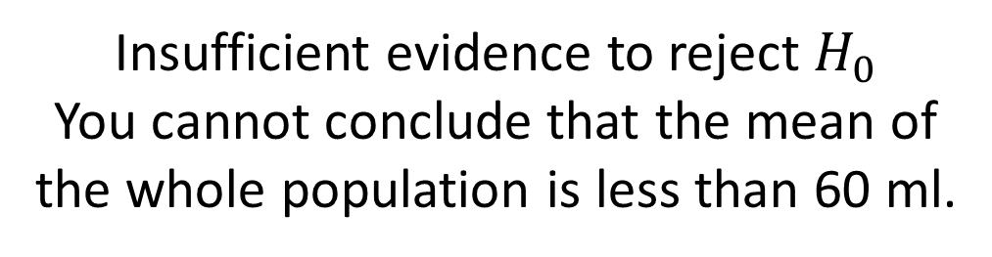

A certain company sells fruit juice in cartons.
The amount of juice in a carton has a normal distribution with a standard deviation of 3ml.
The company claims that the mean amount of juice per carton, $μ$, is 60ml. A trading inspector has received complaints that the company is overstating the mean amount of juice per carton and wishes to investigate this complaint. The trading inspector takes a random sample of 16 cartons and finds that the mean amount of juice per carton is 59.1ml.
Using a 5% level of significance, and stating your hypotheses clearly, test whether or not there is evidence to uphold this complaint.
Step 4. Compare this probability
with the significant level
Step 5. Accept or reject your hypotheses H_{o}
$0.1151>0.05$
Insufficient evidence to reject $H_{0}$
You cannot conclude that the mean of
the whole population is less than 60 ml.

Slide 12
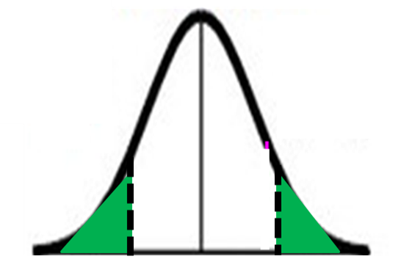
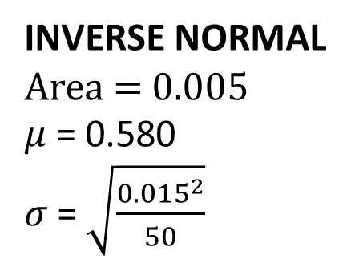
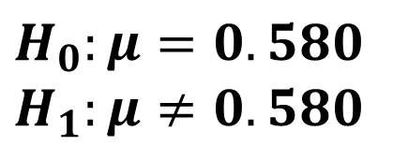
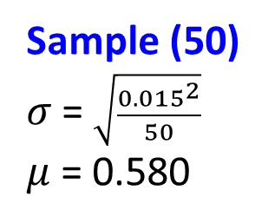
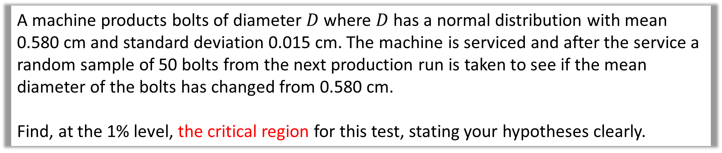

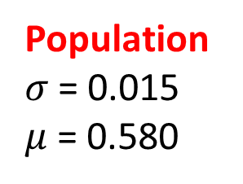
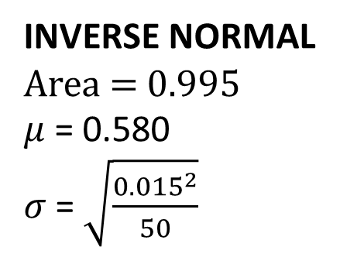

A machine products bolts of diameter $D$ where $D$ has a normal distribution with mean 0.580 cm and standard deviation 0.015 cm. The machine is serviced and after the service a random sample of 50 bolts from the next production run is taken to see if the mean diameter of the bolts has changed from 0.580 cm.
Find, at the 1% level, the critical region for this test, stating your hypotheses clearly.
$$H_{0}:μ=0.580$$
$$H_{1}:μ≠0.580$$
INVERSE NORMAL
Area = 0.005
$μ$ = 0.580
$σ$= $\sqrt{\frac{{0.015}^{2}}{50}}$
Lower Critical region
d $≤0.575$
Population
$σ$= 0.015
$μ$ = 0.580
Sample (50)
$σ$= $\sqrt{\frac{{0.015}^{2}}{50}}$
$μ$ = 0.580
INVERSE NORMAL
Area = 0.995
$μ$ = 0.580
$σ$= $\sqrt{\frac{{0.015}^{2}}{50}}$
0.580
0.580
0.5%
0.5%
Upper Critical region
d $≥0.585$

