Slide 1
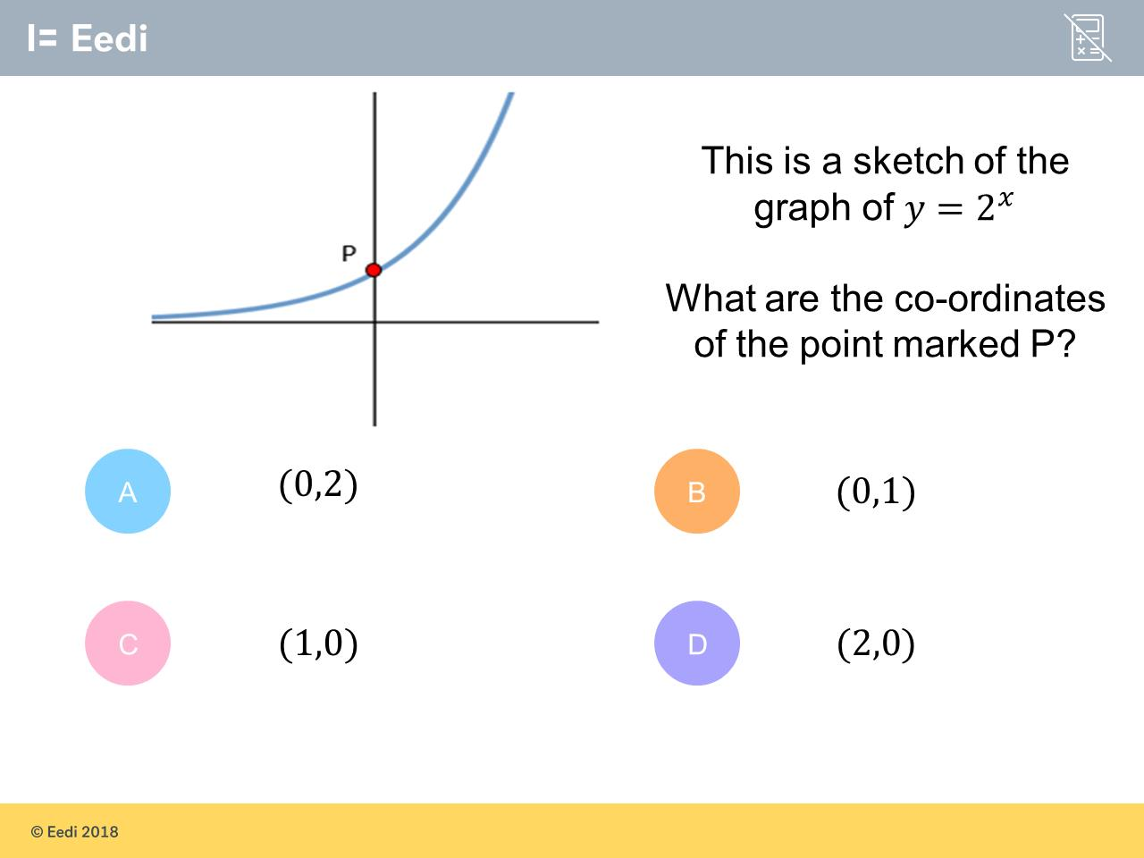
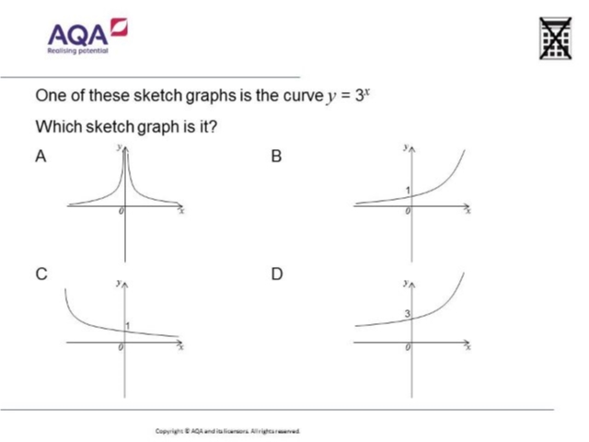
Worst answered question?
Most common wrong answer?

Slide 2
ANSWERS

Slide 3
Worst answered question?

Slide 4
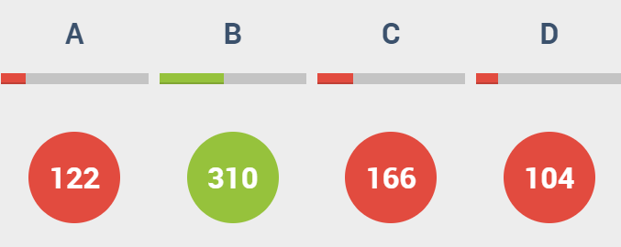
C
They did a decay graph rather than a growth graph.

Slide 5
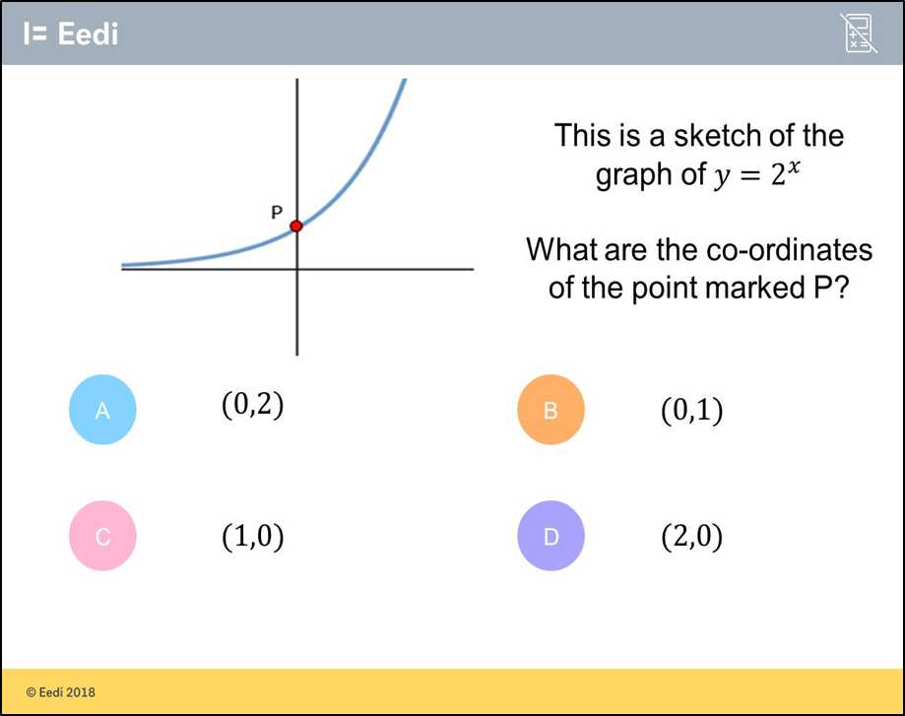
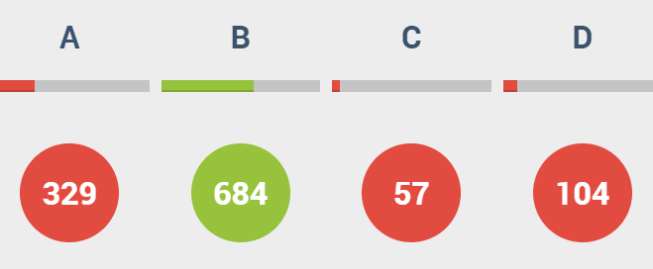
A
The student may believe that 2⁰ = 2.

