Slide 1
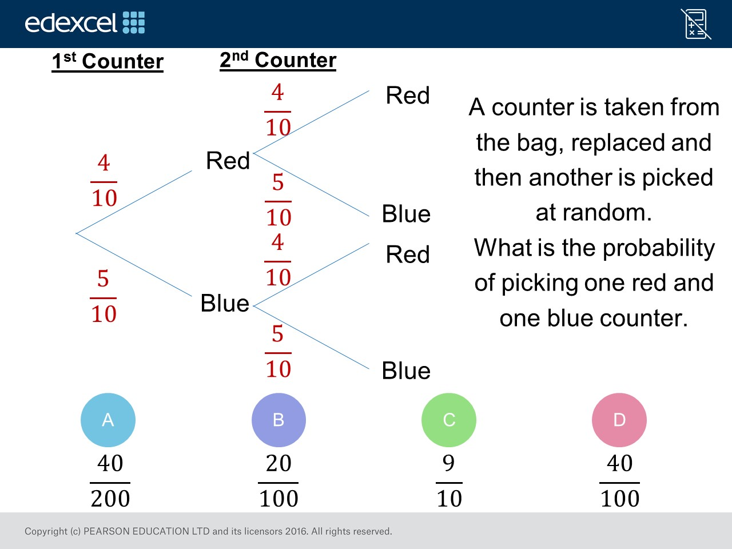
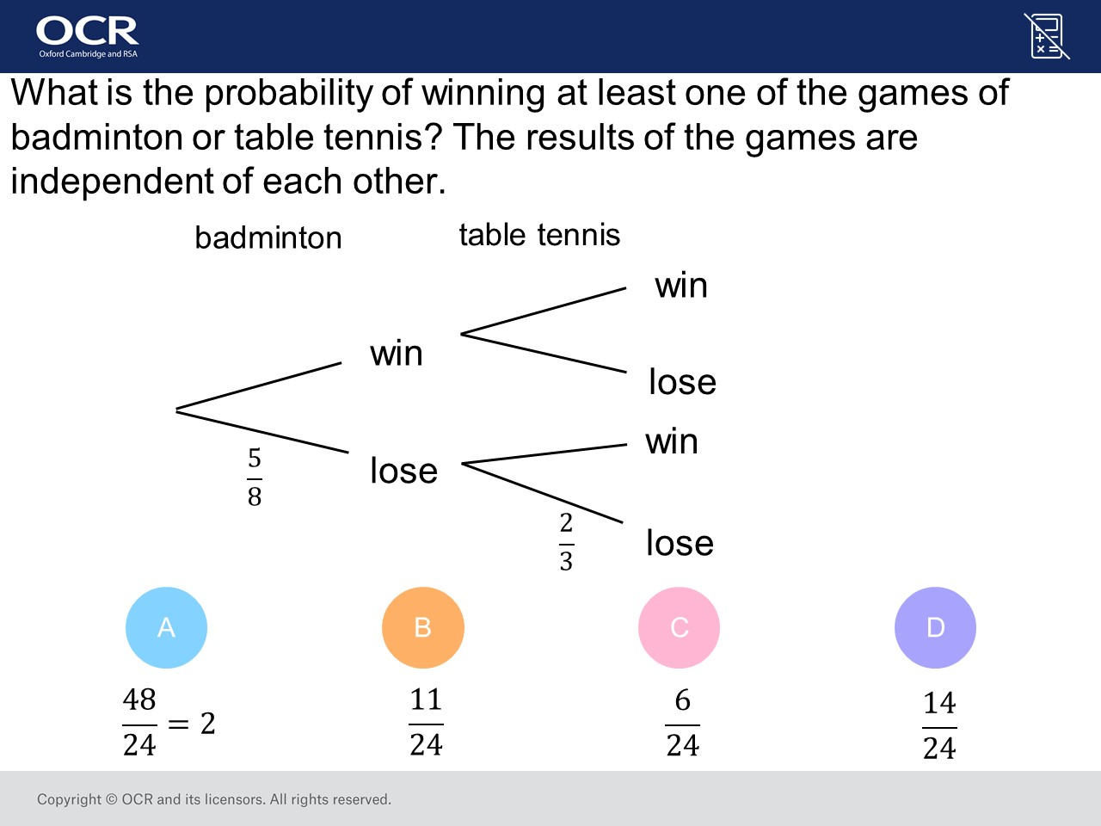
Worst answered question?
Most common wrong answer?

Slide 2
ANSWERS

Slide 3
Worst answered question?

Slide 4
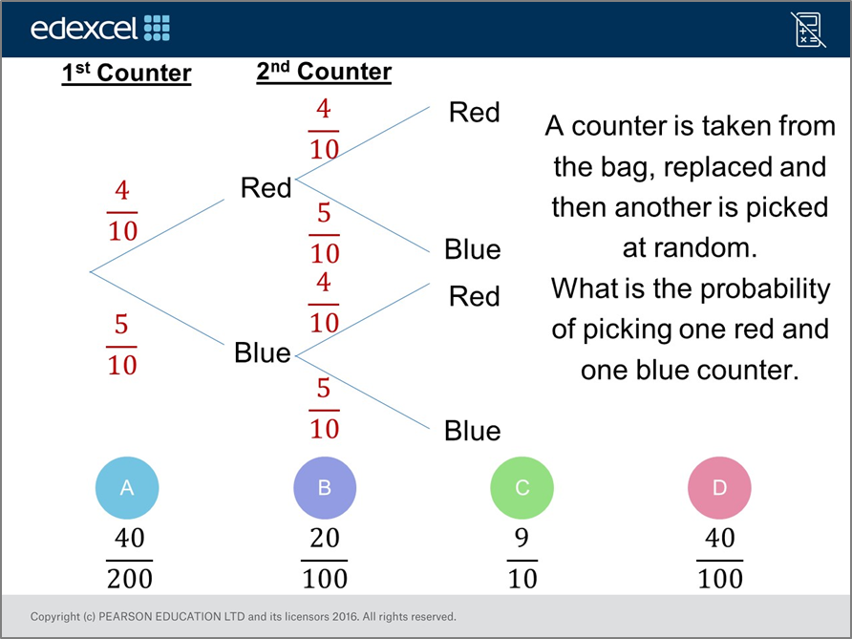

B
The worked out
P(RB) but forgot about P(BR).

Slide 5
C
They have found the
P(WL)
and did not add the
P(LW).

