Slide 1
Forces and Motions
Pulleys - Vertical and Horizontal
SUVAT
Chapter 10
(Part 9 of 9)

Slide 2
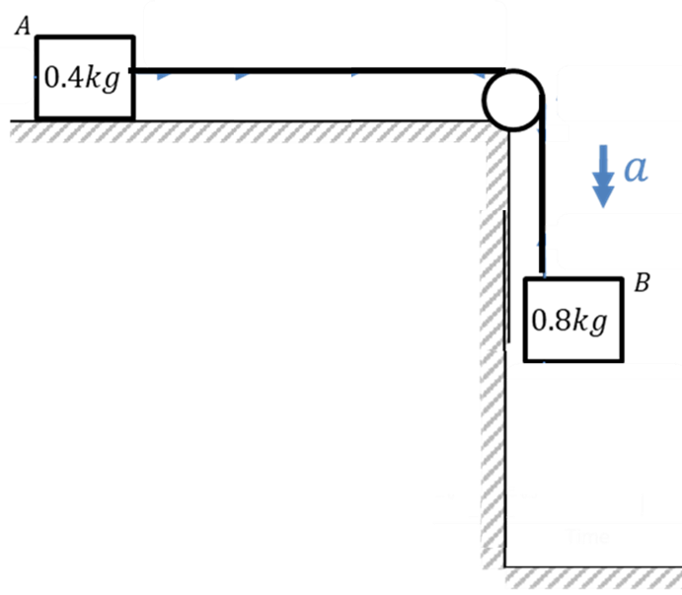
Smooth Surface so No Resistance Force

Slide 3
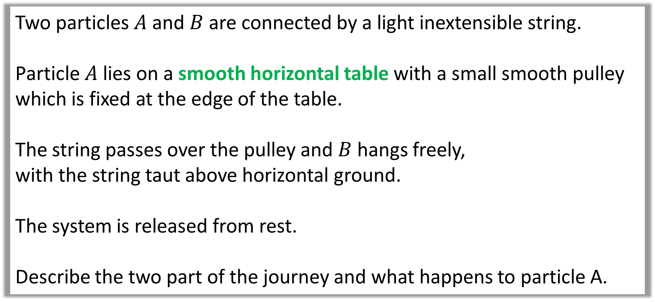
Two particles $A$ and $B$ are connected by a light inextensible string.
Particle $A$ lies on a smooth horizontal table with a small smooth pulley which is fixed at the edge of the table.
The string passes over the pulley and $B$ hangs freely,
with the string taut above horizontal ground.
The system is released from rest.
Describe the two part of the journey and what happens to particle A.

Slide 4
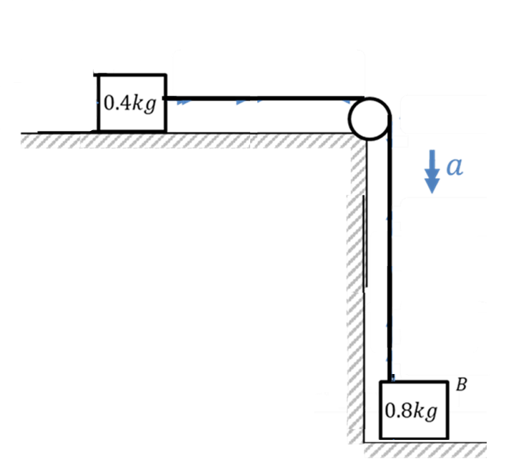
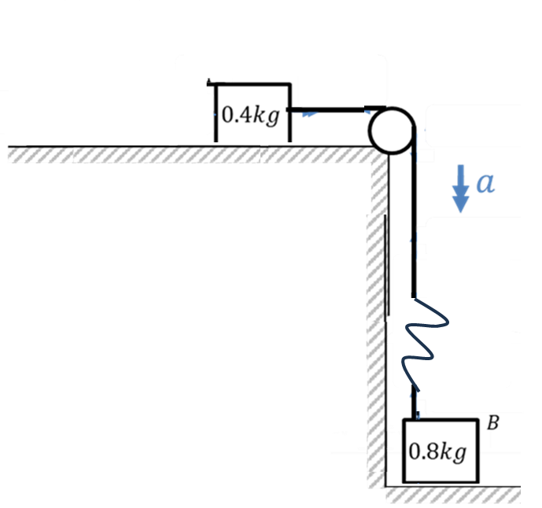


Slide 5
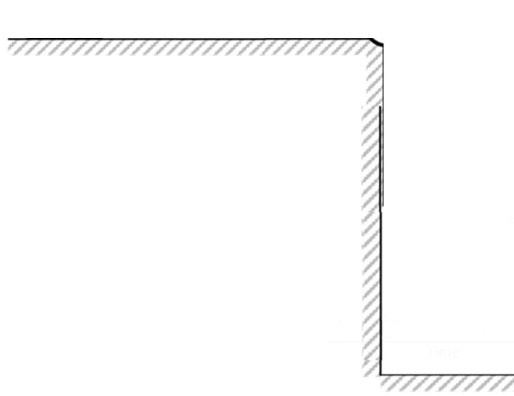
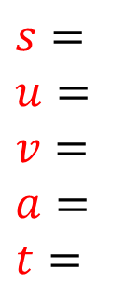
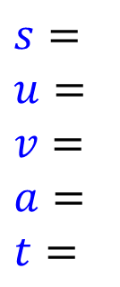

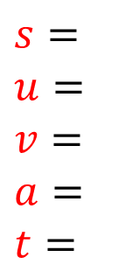
$$s=$$
$u=$
$$v=$$
$$a=$$
$t=$
$$s=$$
$u=$
$$v=$$
$$a=$$
$t=$
Smooth Surface
Constant Acceleration
Increasing Speed
Smooth Surface
No Acceleration
Constant Speed
$$s=$$
$u=$
$$v=$$
$$a=$$
$t=$
$$s=$$
$d=$
$$t=$$

Slide 6
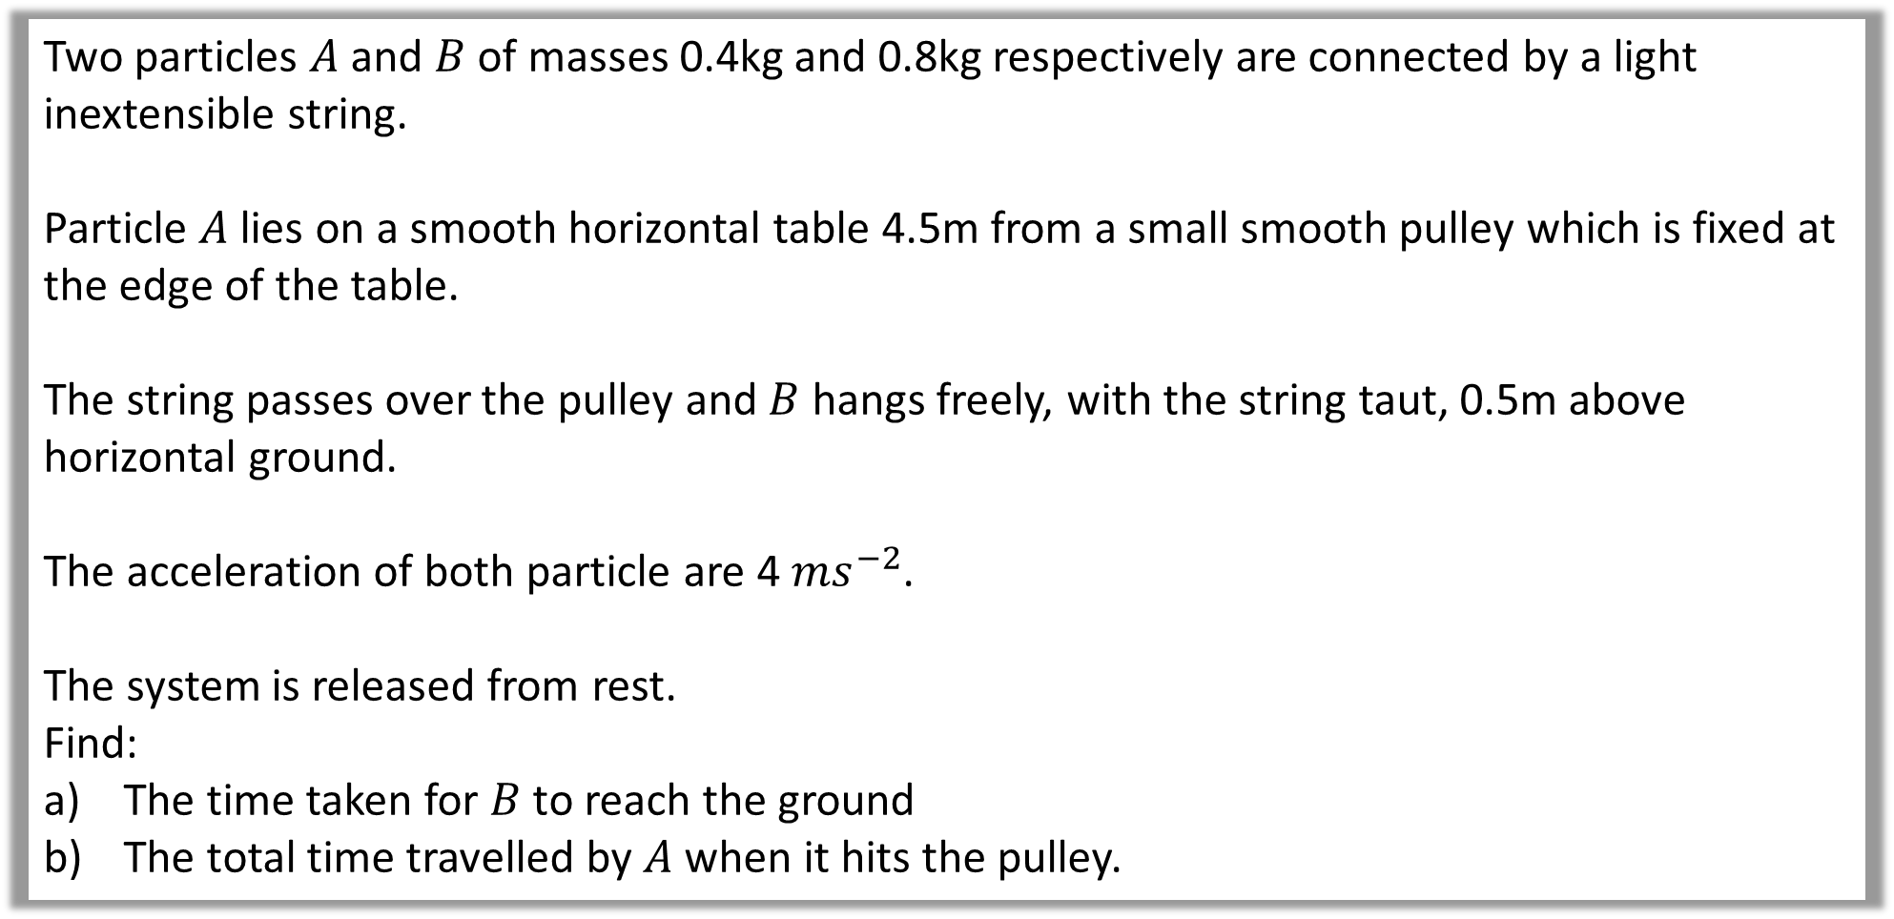
Question A
Two particles $A$ and $B$ of masses 0.4kg and 0.8kg respectively are connected by a light inextensible string.
Particle $A$ lies on a smooth horizontal table 4.5m from a small smooth pulley which is fixed at the edge of the table.
The string passes over the pulley and $B$ hangs freely, with the string taut, 0.5m above horizontal ground.
The acceleration of both particle are 4 ${ms}^{−2}$.
The system is released from rest.
Find:
The time taken for $B$ to reach the ground
The total time travelled by $A$ when it hits the pulley.

Slide 7

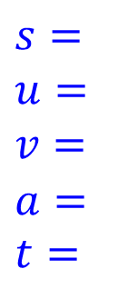
















Total Time
= 2 + 0.5
= 2.5 secs
$$0.5$$
$$s=$$
$$u=$$
$$v=$$
$$a=$$
$t=$
$$s=$$
$$u=$$
$$v=$$
$$a=$$
$t=$
$$4.5$$
$$0$$
$$2$$
$$2$$
$$2$$
$$4$$
$$0$$
$$v=u+at$$
$$t=2$$
$$v=0+4(0.5)$$
$$s=0.5$$
$u=0$
$$v=$$
$$a=4$$
$t=$
$$v=2$$
$$s=ut+\frac{1}{2}at^{2}$$
$$0.5=\frac{1}{2}(4)t^{2}$$
$$t=0.5$$

Slide 8
Rough Surface so there is a Resistance Force

Slide 9
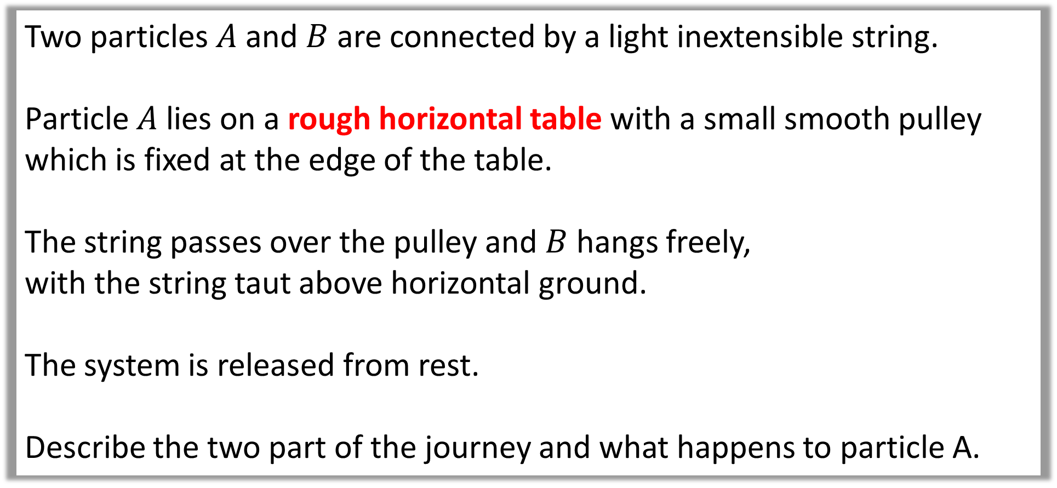
Two particles $A$ and $B$ are connected by a light inextensible string.
Particle $A$ lies on a rough horizontal table with a small smooth pulley which is fixed at the edge of the table.
The string passes over the pulley and $B$ hangs freely,
with the string taut above horizontal ground.
The system is released from rest.
Describe the two part of the journey and what happens to particle A.

Slide 11

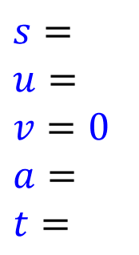
$$s=$$
$u=$
$$v=$$
$$a=$$
$t=$
$$s=$$
$u=$
$$v=0$$
$$a=$$
$t=$
Rough Surface
Constant Acceleration
Increasing Speed
Rough Surface
Deceleration
Decreasing Speed
$$s=$$
$u=$
$$v=$$
$$a=$$
$t=$

Slide 12
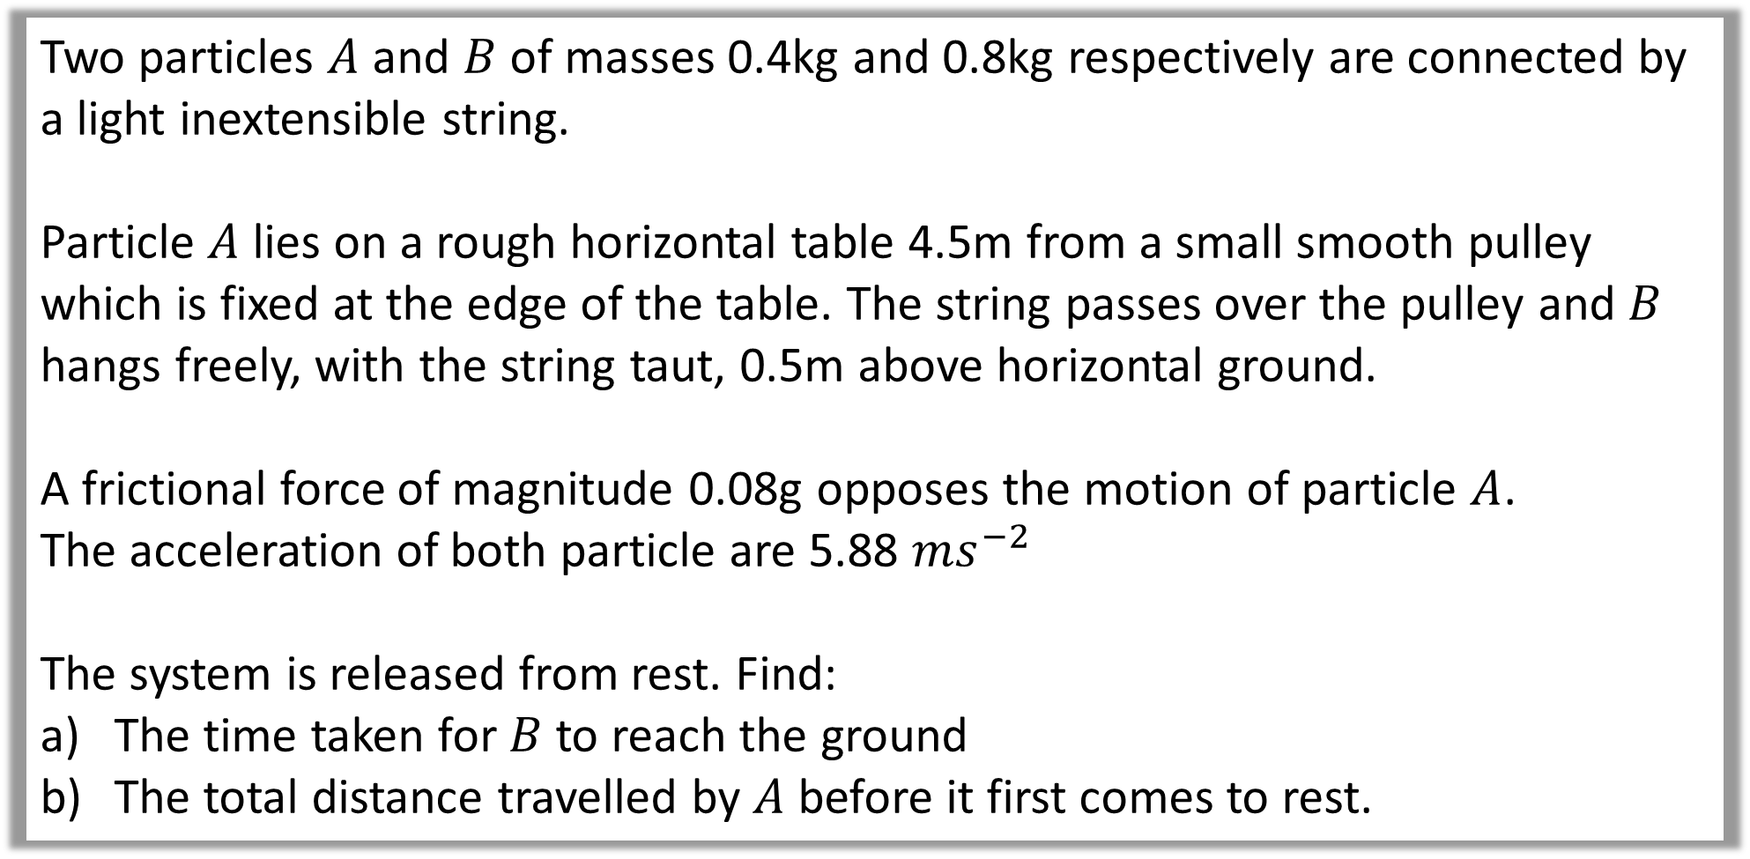
Question B
Two particles $A$ and $B$ of masses 0.4kg and 0.8kg respectively are connected by a light inextensible string.
Particle $A$ lies on a rough horizontal table 4.5m from a small smooth pulley which is fixed at the edge of the table. The string passes over the pulley and $B$ hangs freely, with the string taut, 0.5m above horizontal ground.
A frictional force of magnitude 0.08g opposes the motion of particle $A$.
The acceleration of both particle are 5.88 ${ms}^{−2}$
The system is released from rest. Find:
The time taken for $B$ to reach the ground
The total distance travelled by $A$ before it first comes to rest.

Slide 13
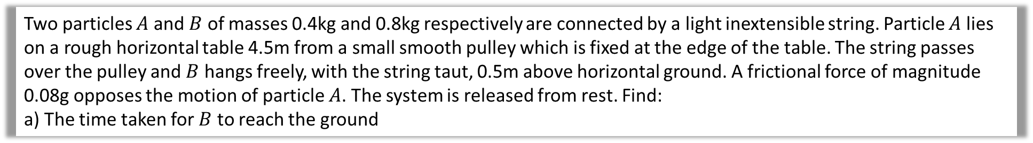



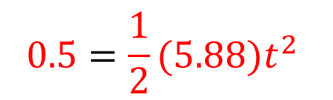

Two particles $A$ and $B$ of masses 0.4kg and 0.8kg respectively are connected by a light inextensible string. Particle $A$ lies on a rough horizontal table 4.5m from a small smooth pulley which is fixed at the edge of the table. The string passes over the pulley and $B$ hangs freely, with the string taut, 0.5m above horizontal ground. A frictional force of magnitude 0.08g opposes the motion of particle $A$. The system is released from rest. Find:
a) The time taken for $B$ to reach the ground
a.
$$s=ut+\frac{1}{2}at^{2}$$
$$s=0.5$$
$u=0$
$$v=$$
$$a=5.88$$
$t=$
$$0.5=\frac{1}{2}(5.88)t^{2}$$
$$0.412$$
$$t=0.412$$

Slide 14











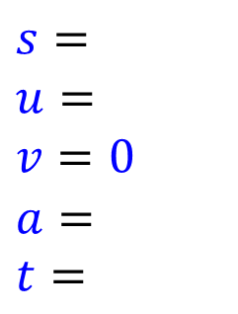
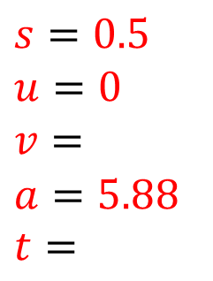


b.
The total distance travelled by $A$ before it first comes to rest.
$$s=0.5$$
$u=0$
$$v=$$
$$a=5.88$$
$t=$
$$s=$$
$u=$
$$v=0$$
$$a=$$
$t=$
Total Distance
= 0.5 + 1.49
= 1.99 m
$$2.42$$
$$−1.96$$
$$0.412$$
$$v=u+at$$
$$F=ma$$
$$v=0+5.88(0.412)$$
$$0 − 0.08g=0.4a$$
$$s=0.5$$
$u=0$
$$v=$$
$$a=5.88$$
$t=$
$$v=2.42$$
$$a=−1.96$$
$$v^{2}=u^{2}+2as$$
$$0.412$$
$$s=1.49m$$

