Slide 1
LO: Exponential
Numbers

Slide 2
Investigation 1:
Prize A or Prize B?

Slide 3
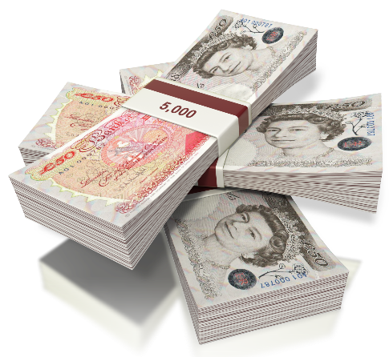
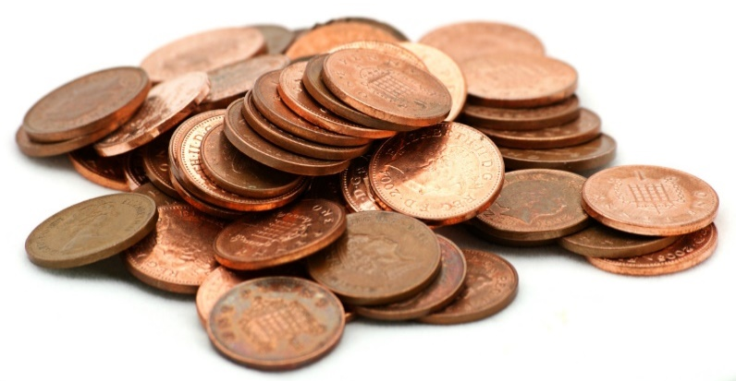
You have won a prize!
Which prize do you want?
Prize A
£100 for the first day,
£200 for the second day,
£300 for the third day,
and so on.
Prize B
1 pence for the first day,
2 pence for the second day,
4 pence for the third day,
and so on.

Slide 4
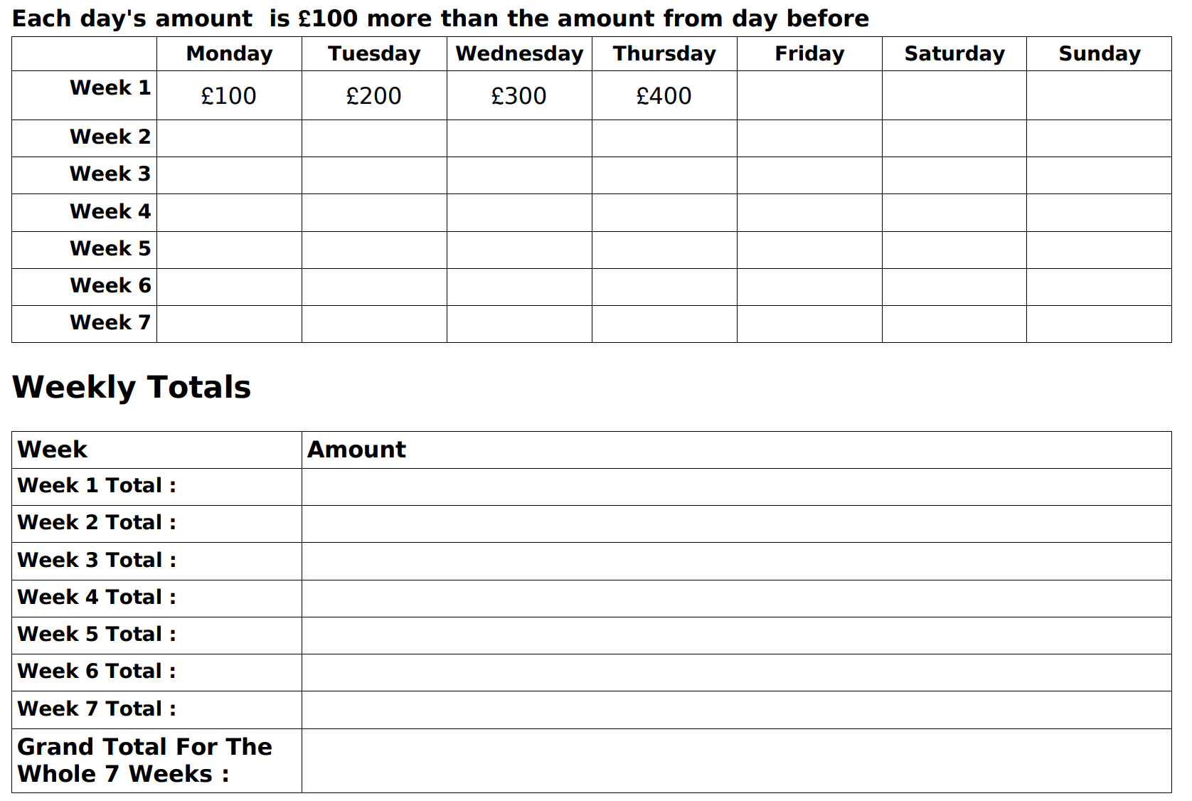

Slide 5
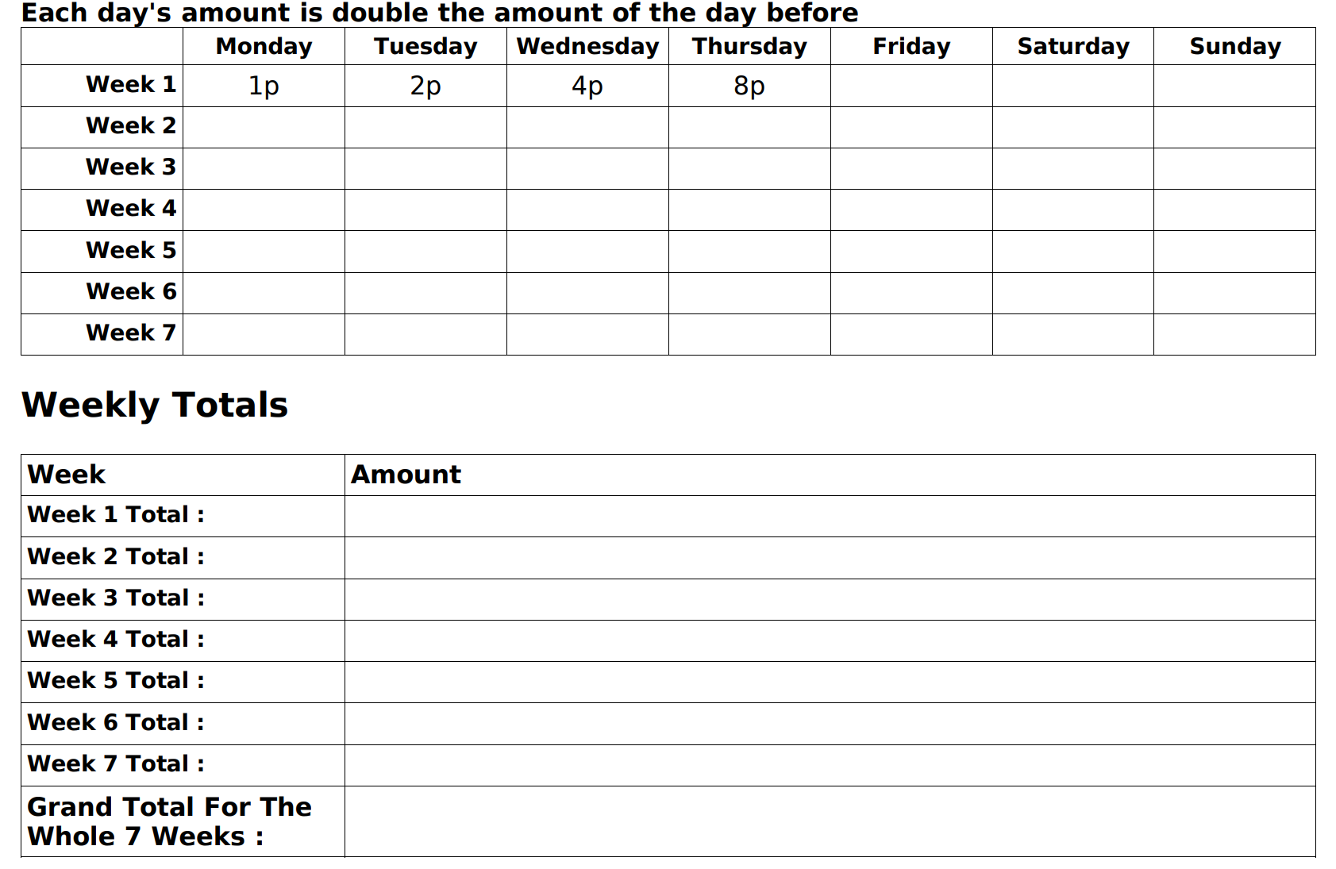

Slide 6
Investigation 2:
Emperor and the Rice?

Slide 7

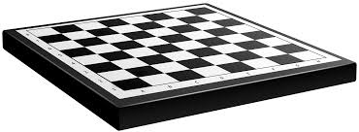
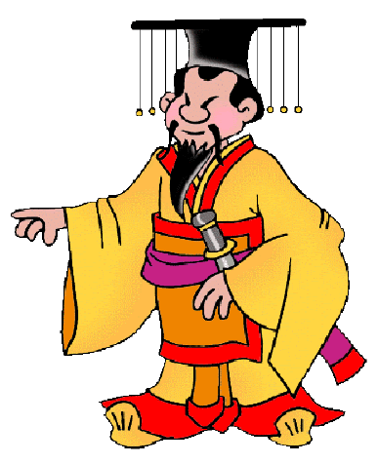
When the inventor of the game of chess
showed it to the emperor of India, the emperor was so impressed, that he said to the man "Name your reward!“.
The man responded,
"Oh emperor, my wishes are simple,.
give me one grain of rice for the first square of the chessboard and double the number of grains for the next square.“
The emperor agreed, amazed that the man had asked for such
a small reward - or so he thought.

Slide 8
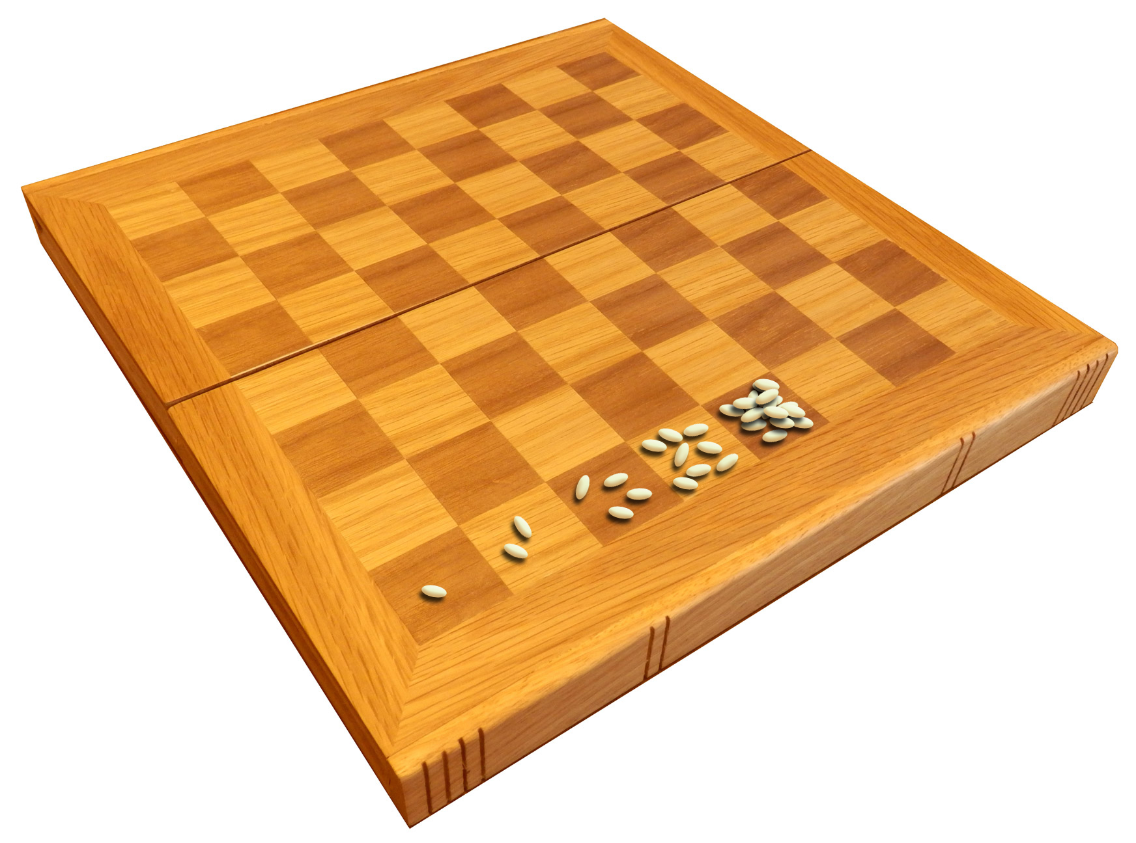
How many grains
of rice would there be on square 64?

Slide 9
