Slide 1
LO: What is
a formula?

Slide 2
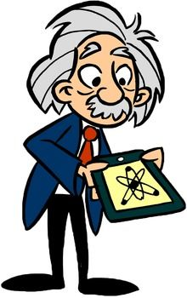
Who is this famous person?
Albert Einstein
Born:
14 March 1879 in Germany
Died:
8 April 1955 (aged 76) in USA

Slide 3
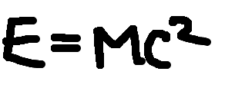
What formula was he famous for?

Slide 4
What does this well know
formula calculate?
A = lw
Area of a Rectangle
Area = Length x Width

Slide 5
What does this well know
formula calculate?
P = 2l + 2w
Perimeter of a Rectangle
Perimeter = 2 x Length + 2 x Width

Slide 6
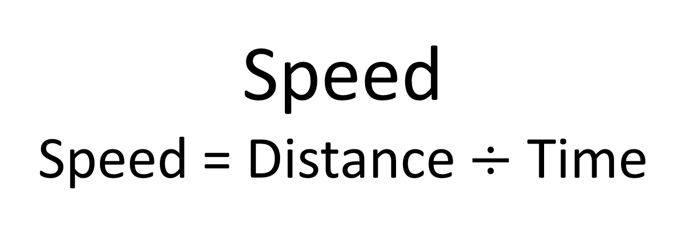
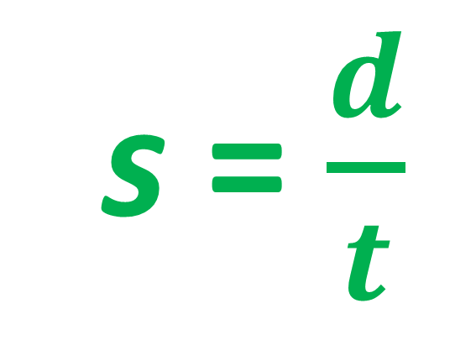
What does this well know
formula calculate?
s = $\frac{d}{t}$
Speed
Speed = Distance $÷$ Time

Slide 7
What does this well know
formula calculate?
F = 1.8C + 32
Fahrenheit
Fahrenheit = 1.8 x Celsius + 32

Slide 8
What is an Expression?
What is an Equation?
What is a Formula?
What is an Identity?

Slide 9
Expression | No Equals | 2x + 1
Equations | Equals and one unknown | 2x + 1 = 3x – 5
Formulae | Equals and many unknowns | E = mc²
Identity | Triple Equals RHS is identical to LHS | 2a ≡ a + a
What is an Equation?
What is a Formula?
What is an Identity?

Slide 10
Expression | No Equals | 2x + 1
Equations | Equals and one unknown | 2x + 1 = 3x – 5
Formulae | Equals and many unknowns | E = mc²
Identity | Triple Equals RHS is identical to LHS | 2a ≡ a + a
What is a Formula?
What is an Identity?

Slide 11
Expression | No Equals | 2x + 1
Equations | Equals and one unknown | 2x + 1 = 3x – 5
Formulae | Equals and many unknowns | E = mc²
Identity | Triple Equals RHS is identical to LHS | 2a ≡ a + a
What is an Identity?

Slide 12
Expression | No Equals | 2x + 1
Equations | Equals and one unknown | 2x + 1 = 3x – 5
Formulae | Equals and many unknowns | E = mc²
Identity | Triple Equals RHS is identical to LHS | 2a ≡ a + a

Slide 13
Expression, Equation,
Formula or Identity?
8x + 2
Expression

Slide 14
Expression, Equation,
Formula or Identity?
8x + 2 = 10
Equations

Slide 15
Expression, Equation,
Formula or Identity?
A = 8x + 2
Formula

Slide 16
Expression, Equation,
Formula or Identity?
2A = 8x + 2
Formula

Slide 17
Expression, Equation,
Formula or Identity?
8x + 4 ≡ 4(2x + 1)
Identity

Slide 18
Expression, Equation,
Formula or Identity?
4 = 3A + 8
Equation

Slide 19
Expression, Equation,
Formula or Identity?
3A + B
Expression

Slide 20
Expression, Equation,
Formula or Identity?
8B + C = A
Formula

