Slide 1
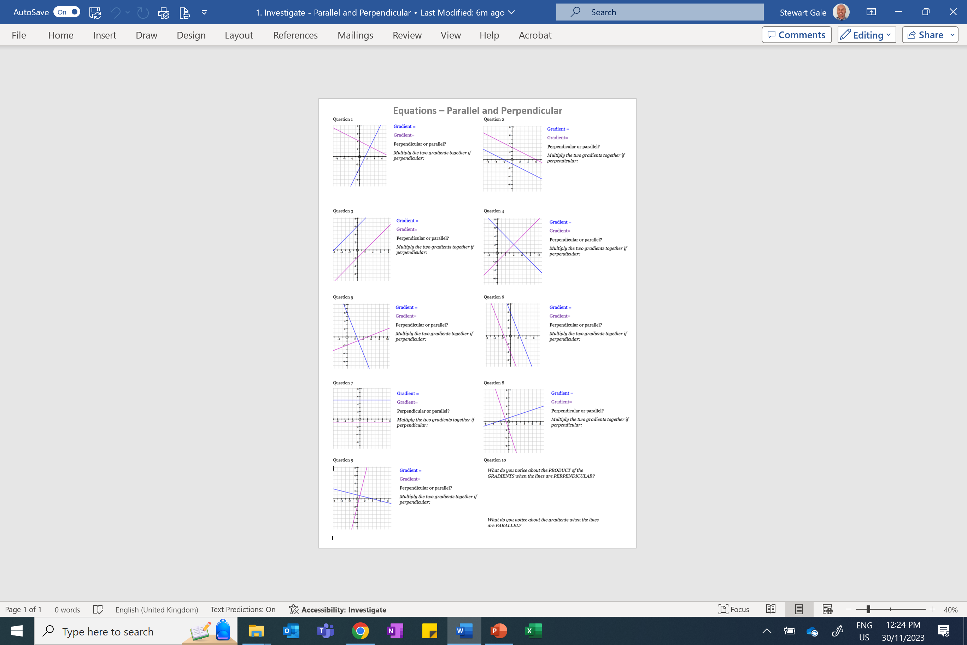
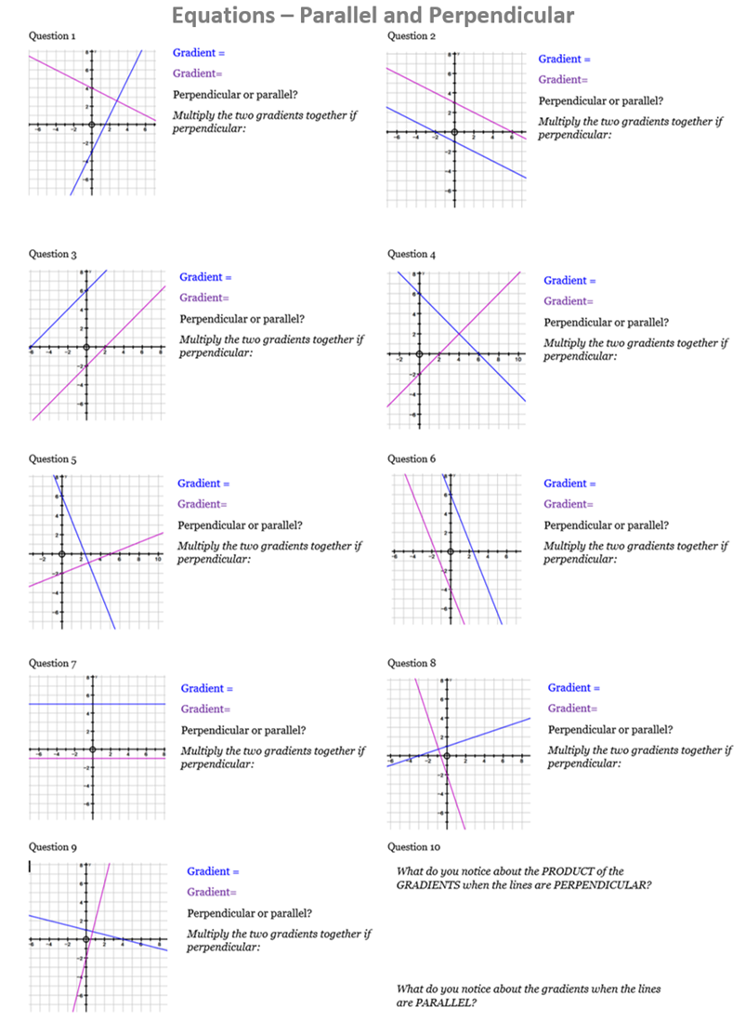

Slide 2
ANSWERS

Slide 3
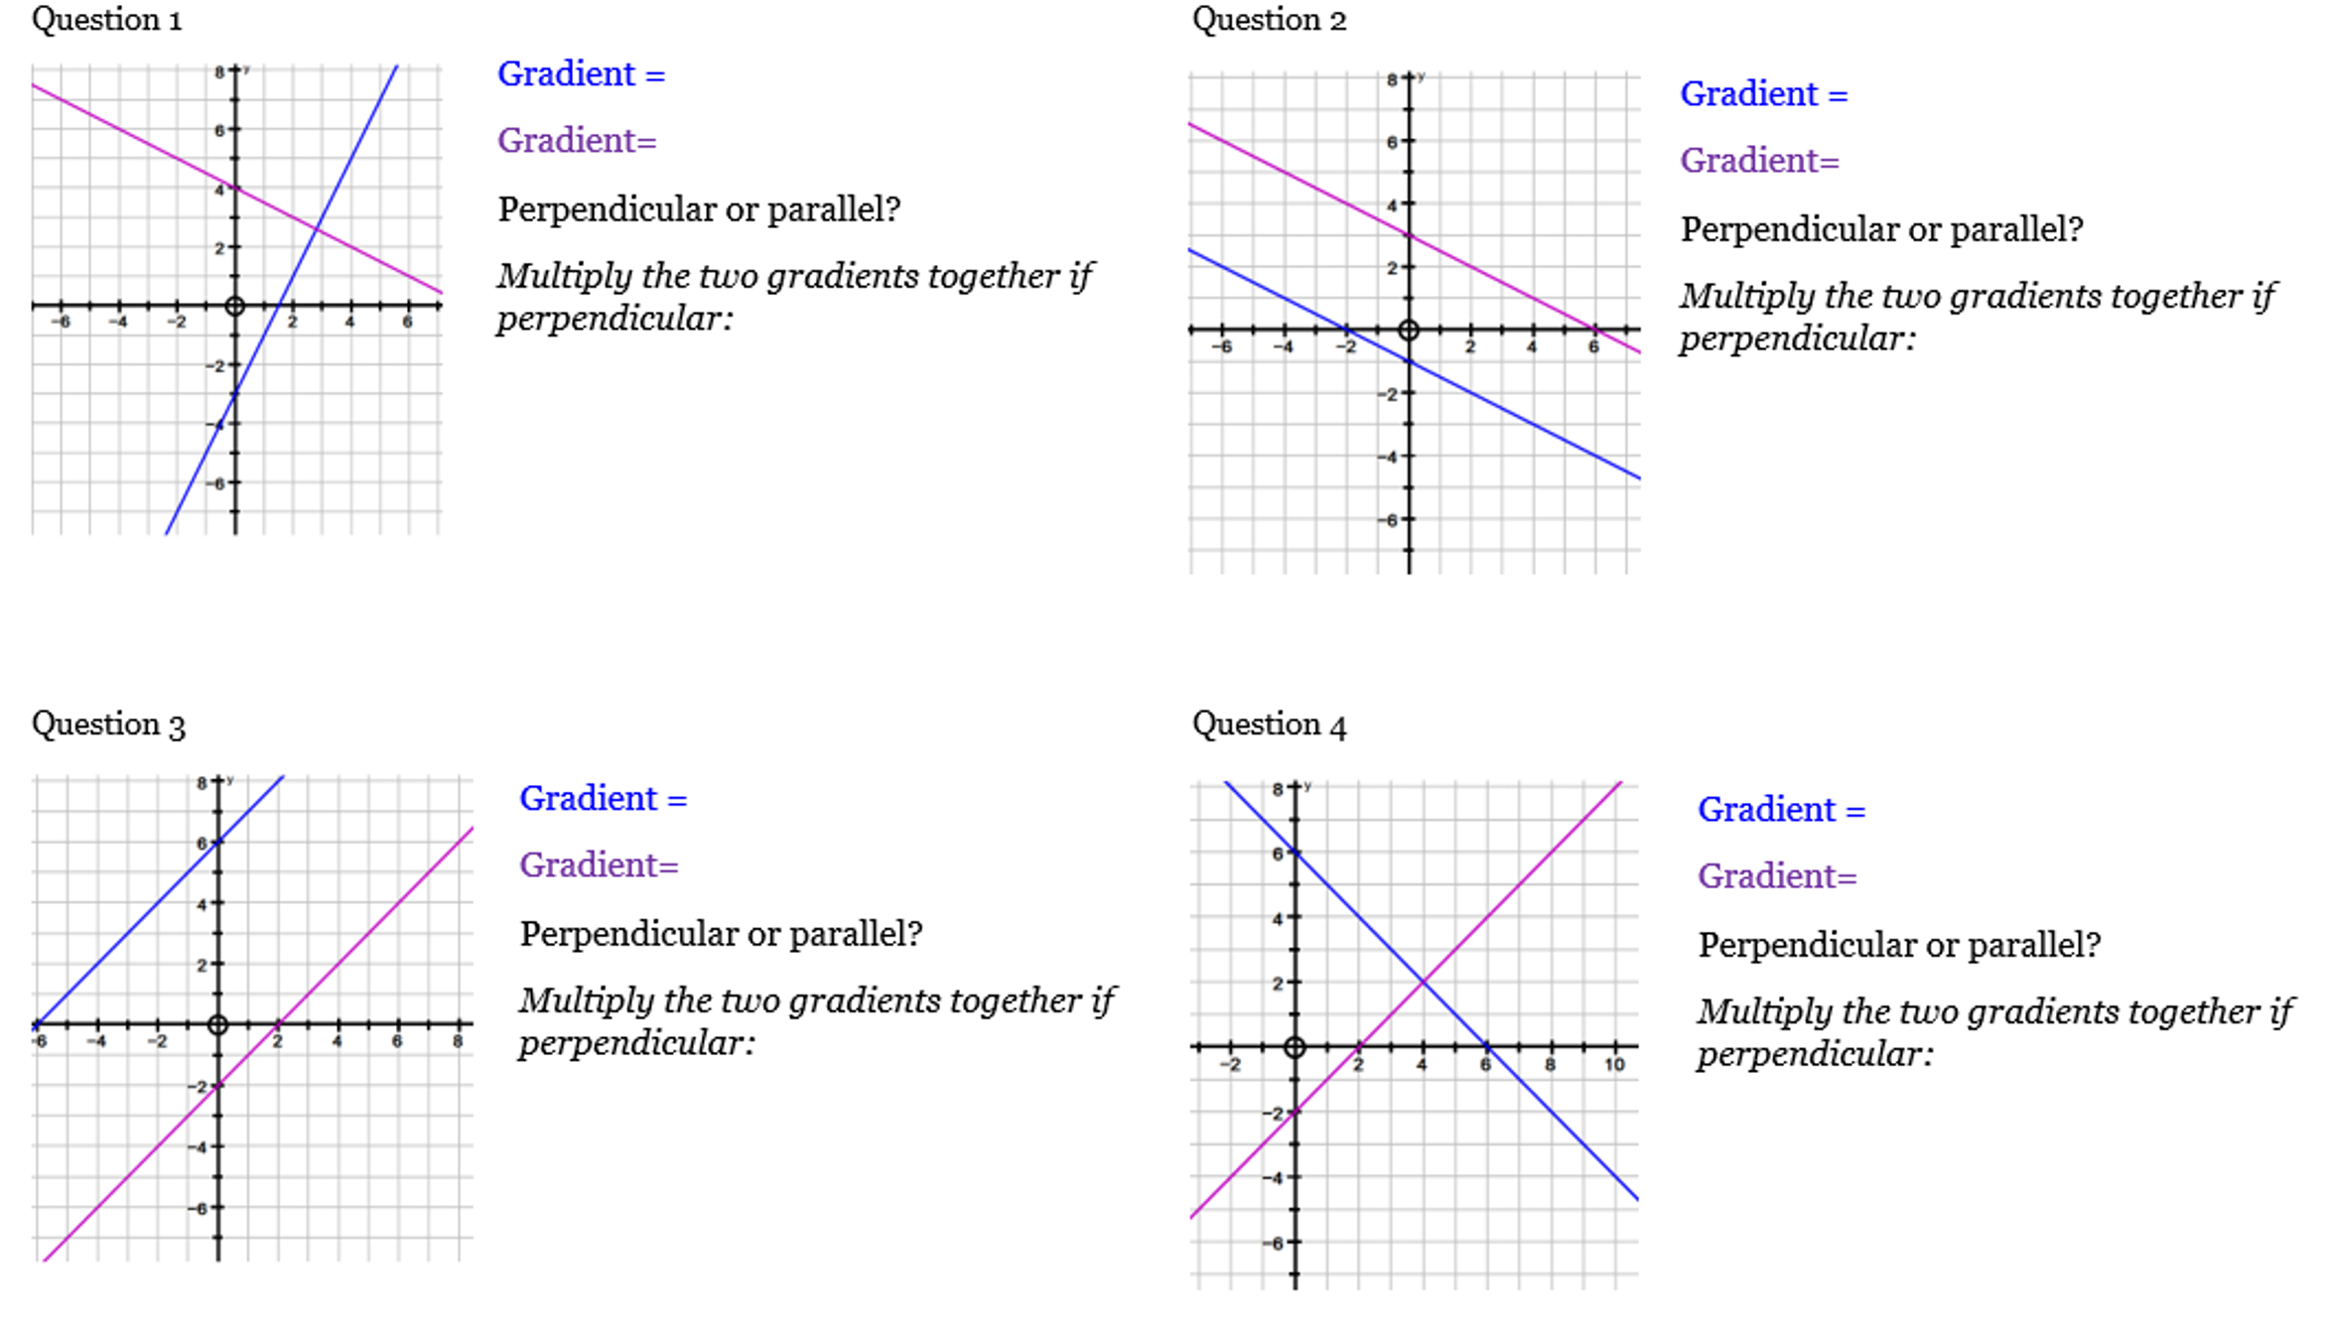

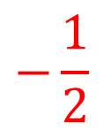
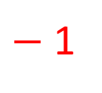

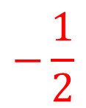
$$−\frac{1}{2}$$
2
$$−\frac{1}{2}$$
$$−\frac{1}{2}$$
1
$−$1
1
1

Slide 4
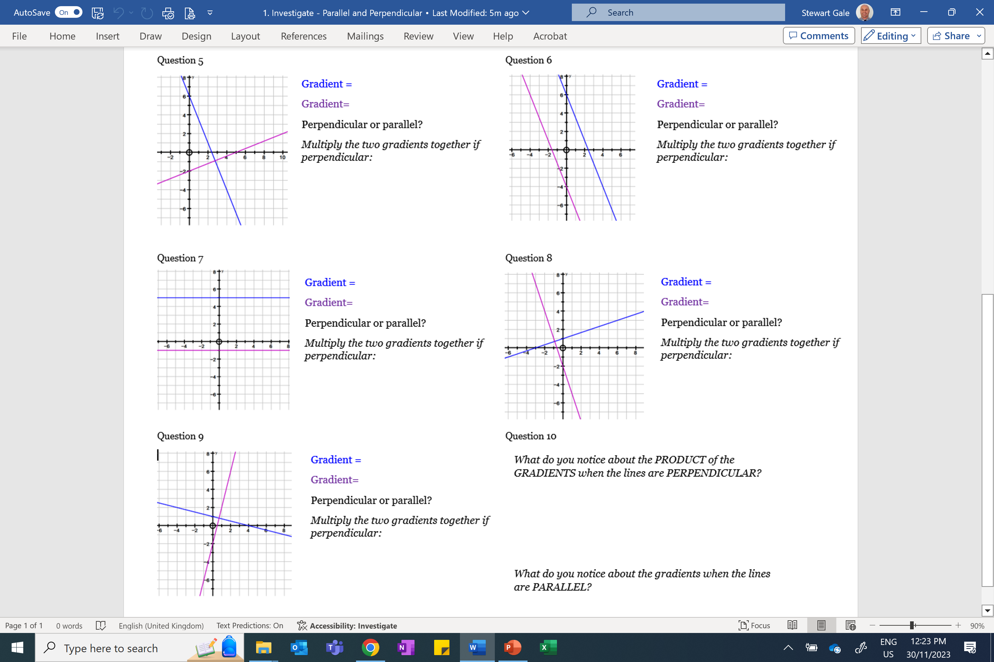

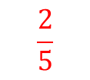

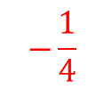
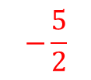


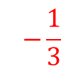
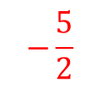


$$−\frac{5}{2}$$
$$−\frac{5}{2}$$
$$\frac{2}{5}$$
$$−\frac{5}{2}$$
$$0$$
$$−\frac{1}{3}$$
$$0$$
$$−3$$
$$−\frac{1}{4}$$
$$4$$

Slide 5
