Slide 1
Normal Distribution
Normal Cumulative
Distribution
Chapter 3
(Part 2 of 7)

Slide 2
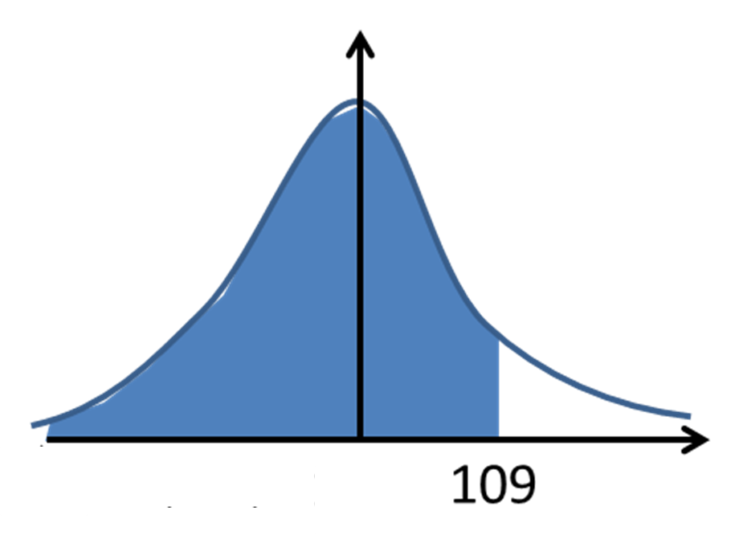
Normal Cumulative Distribution
A cumulative distribution gives the
running total of the probability up to a given value.
P (X < 109) = Blue Area

Slide 3
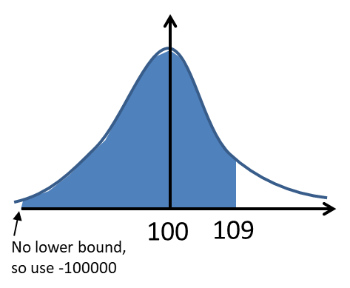

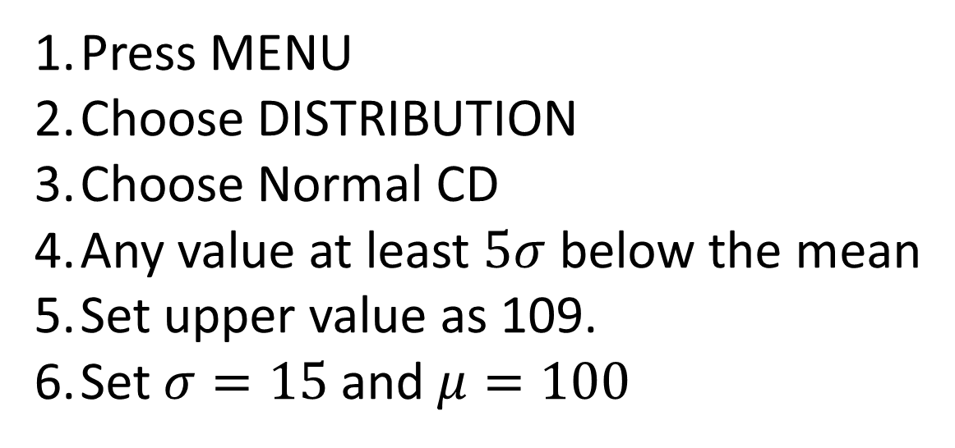
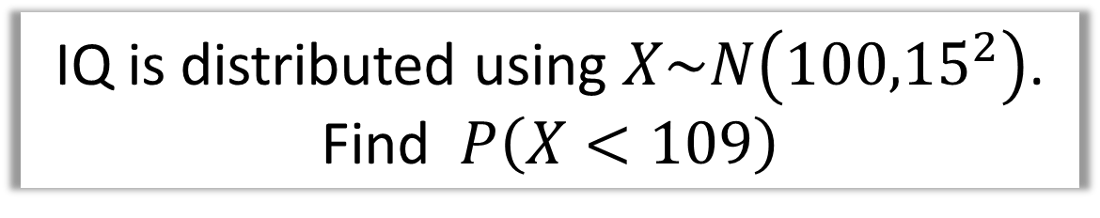
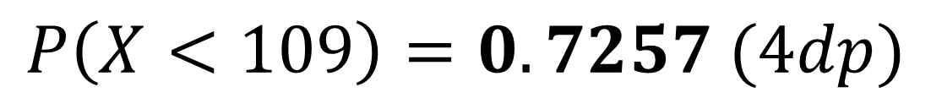
Normal Distribution – Using a Calculator
IQ is distributed using $X\sim N\left({100,15}^{2}\right)$.
Find $P\left(X<109\right)$
Press MENU
Choose DISTRIBUTION
Choose Normal CD
Any value at least $5σ$ below the mean
Set upper value as 109.
Set $σ=15$ and $μ=100$
$$P\left(X<109\right)=0.7257 (4dp)$$

Slide 4
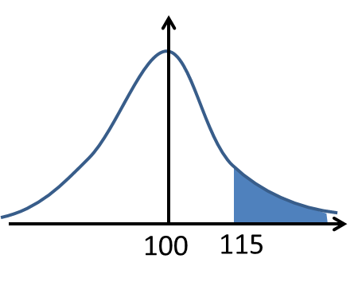
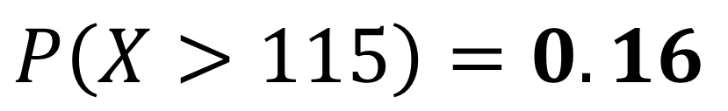
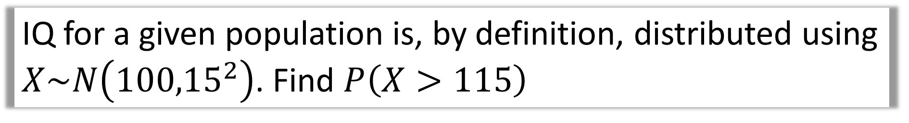
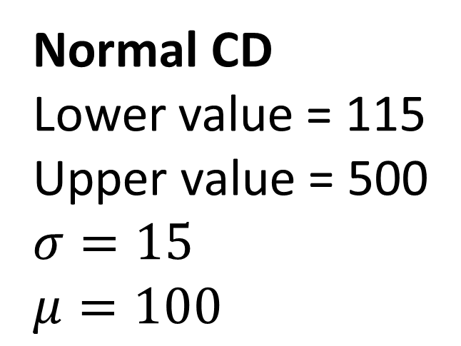
IQ for a given population is, by definition, distributed using $X\sim N\left({100,15}^{2}\right)$. Find $P\left(X>115\right)$
Normal CD
Lower value = 115
Upper value = 500
$σ=15$
$$μ=100$$
$$P\left(X>115\right)=0.16$$

Slide 5
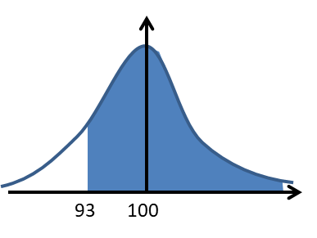
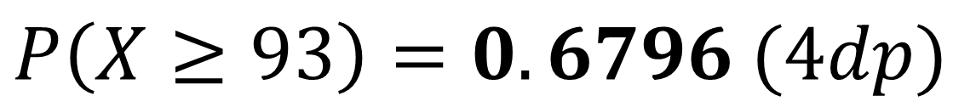
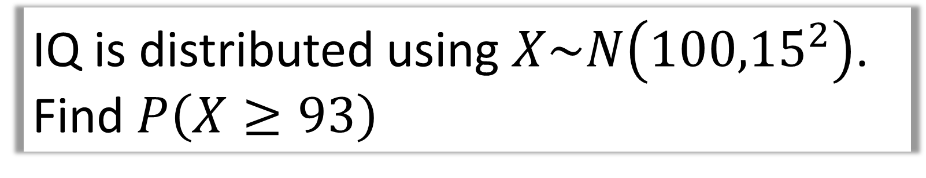
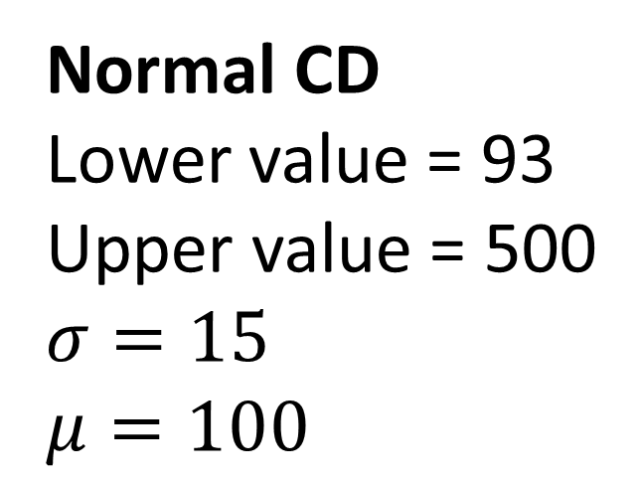
IQ is distributed using $X\sim N\left({100,15}^{2}\right)$.
Find $P\left(X≥93\right)$
Normal CD
Lower value = 93
Upper value = 500
$σ=15$
$$μ=100$$
$$P\left(X≥93\right)=0.6796 (4dp)$$

Slide 6
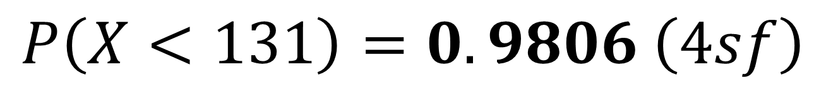
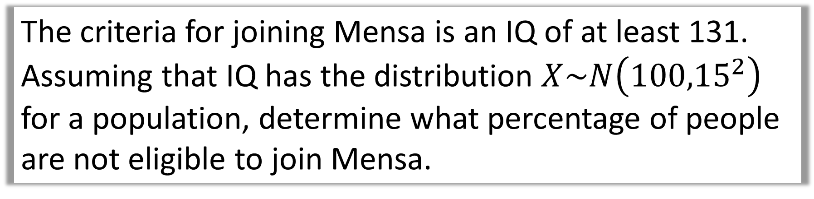
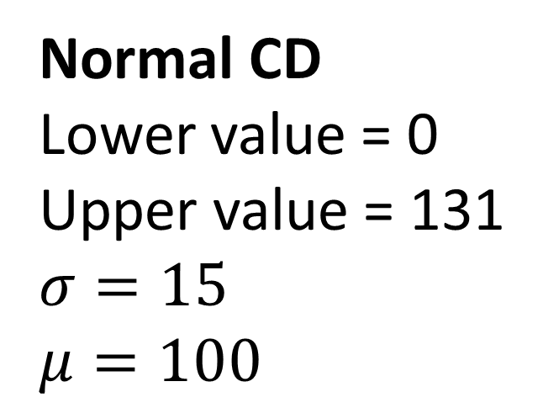
The criteria for joining Mensa is an IQ of at least 131.
Assuming that IQ has the distribution $X\sim N\left({100,15}^{2}\right)$
for a population, determine what percentage of people
are not eligible to join Mensa.
Normal CD
Lower value = 0
Upper value = 131
$σ=15$
$$μ=100$$
$$P\left(X<131\right)=0. 9806 \left(4sf\right)$$

Slide 7
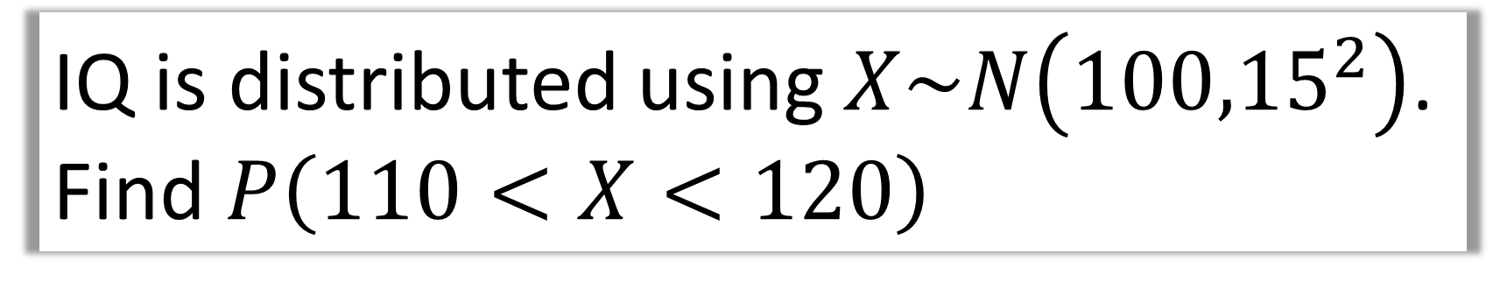
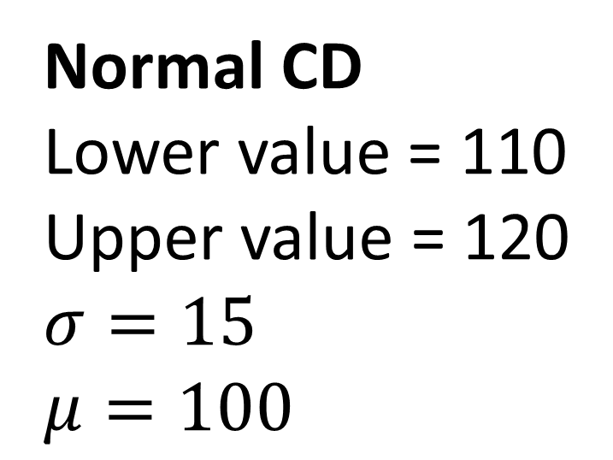
IQ is distributed using $X\sim N\left({100,15}^{2}\right)$.
Find $P\left(110<X<120\right)$
Normal CD
Lower value = 110
Upper value = 120
$σ=15$
$$μ=100$$
$$P\left(110<X<120\right)=0.1613 (4dp)$$

