Slide 1
LO: Rotating Shapes

Slide 2
What is a rotation?
A rotation turns a shape
around a point.
This point is know as
the centre of rotation.

Slide 3
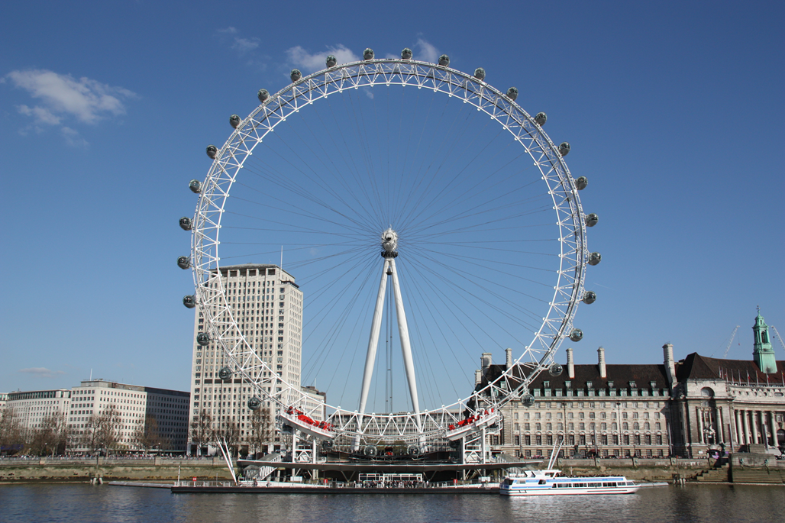
Rotation or Not?
Rotation

Slide 4
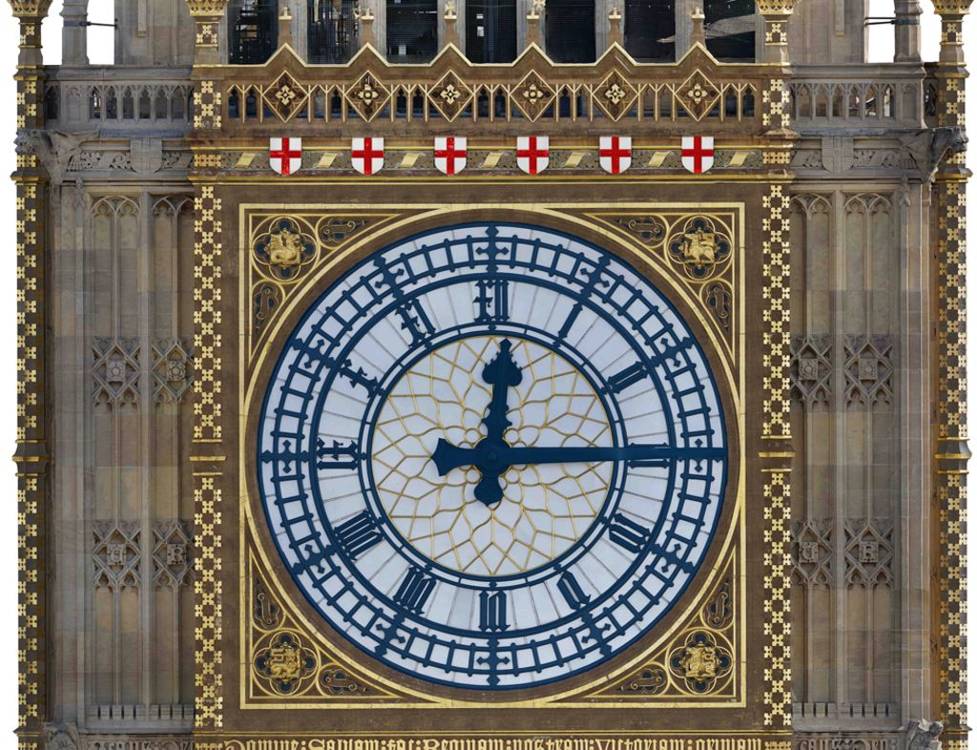
Rotation or Not?
Rotation

Slide 5
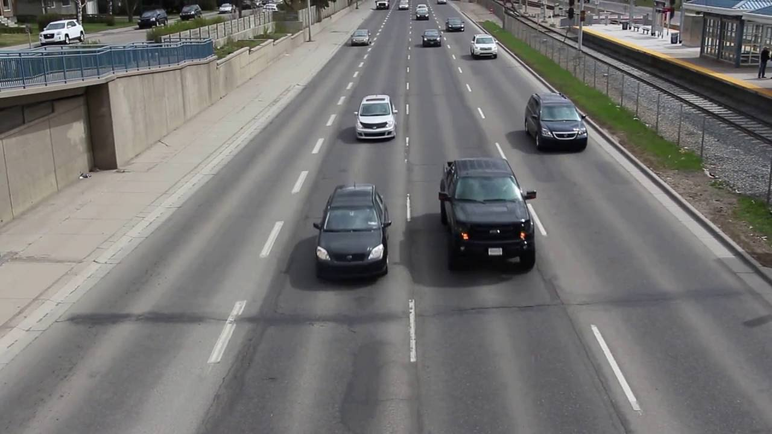
Rotation or Not?
Not

Slide 6
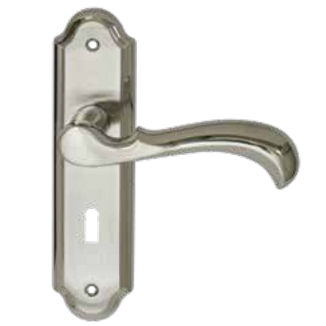
Rotation or Not?
Rotation

Slide 7

Rotation or Not?
Not

Slide 8
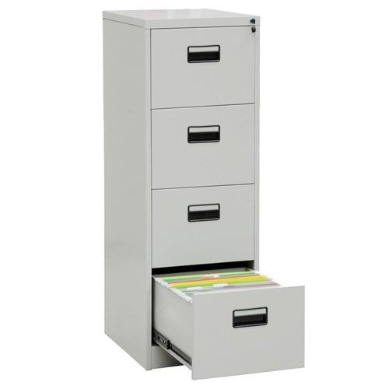
Rotation or Not?
Not

Slide 9
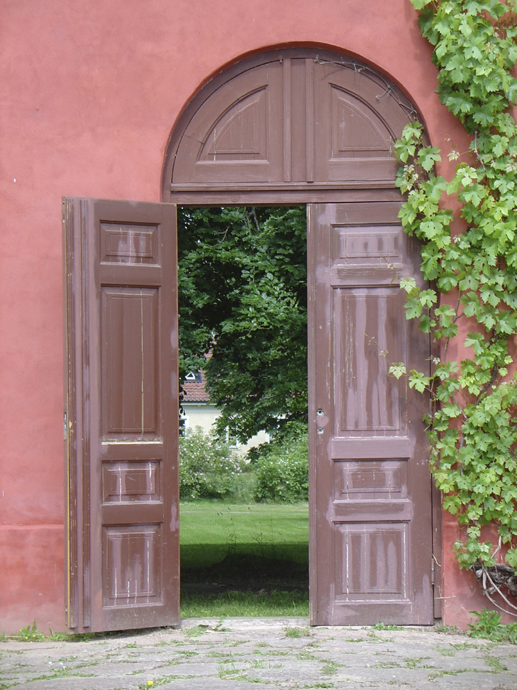
Rotation or Not?
Rotation

Slide 10
How would you describe the following rotation?
Rotate
90˚
Clockwise
about (0,0)

Slide 11
How would you describe the transformation that maps B to A?
Rotate
90˚
Anti-Clockwise
about (0,0)
B
A

Slide 12
Describe the following transformation.
Rotate
90˚
Anti-Clockwise
about (0,0)

Slide 13
Describe the following transformation.
Rotate
180˚
about (0,0)

Slide 14
Describe the following transformation.
Rotate
180˚
about (0,0)

Slide 15
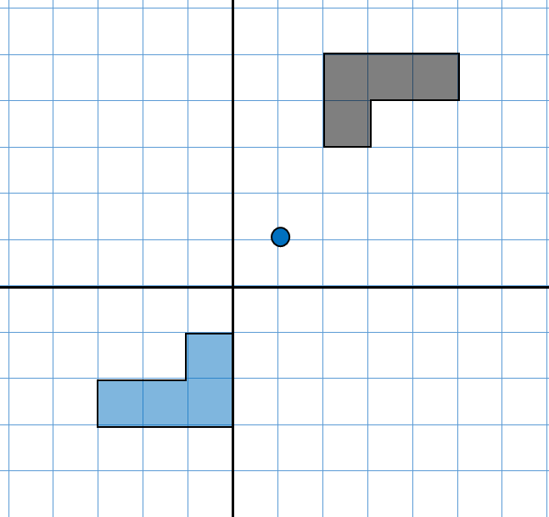
Describe the transformation that maps A to B
A
?
Rotation
?
180°
?
(1,1)
Describe the transformation that maps B to A
B
?
Rotation
180°
?
(1,1)
?

Slide 16
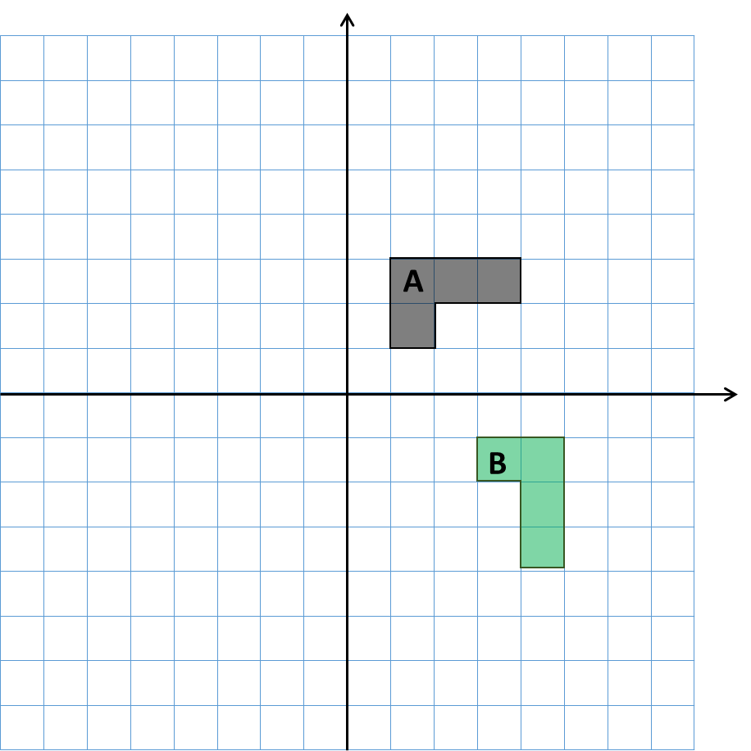
Describe the transformation that maps A to B
Rotation
?
90° Clockwise
?
(1,-1)
?
Describe the transformation that maps B to A
?
Rotation
90° Anti-clockwise
?
(1,-1)
?

Slide 17
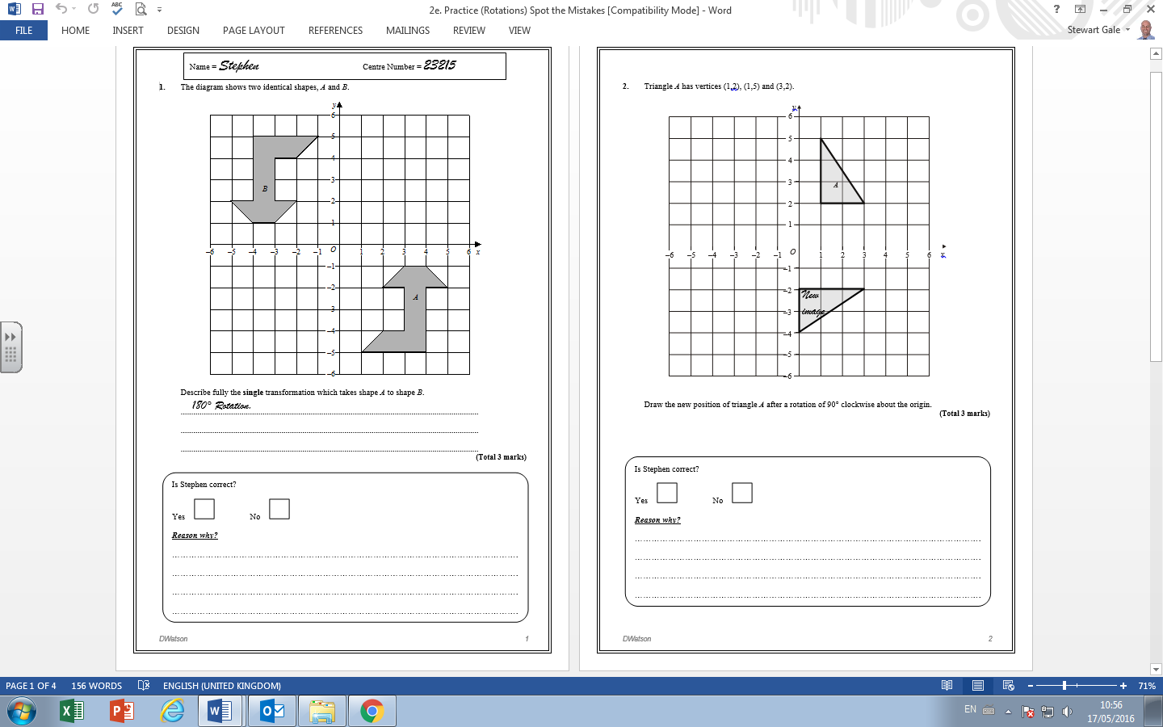

SPOT THE MISTAKES
No centre of rotation

Slide 18

SPOT THE MISTAKES
He has not rotated it about the origin.

Slide 19
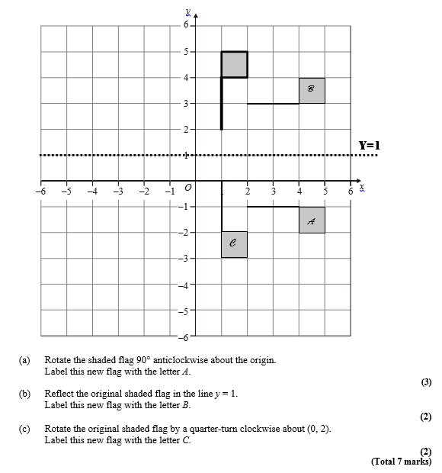
SPOT THE MISTAKES
a) correct
b) he reflected A and not the original
c) he has reflected it in the y = 1

