Slide 1
Trig Functions
Prove and Equations
Chapter 6
(Part 2 of 4)

Slide 2
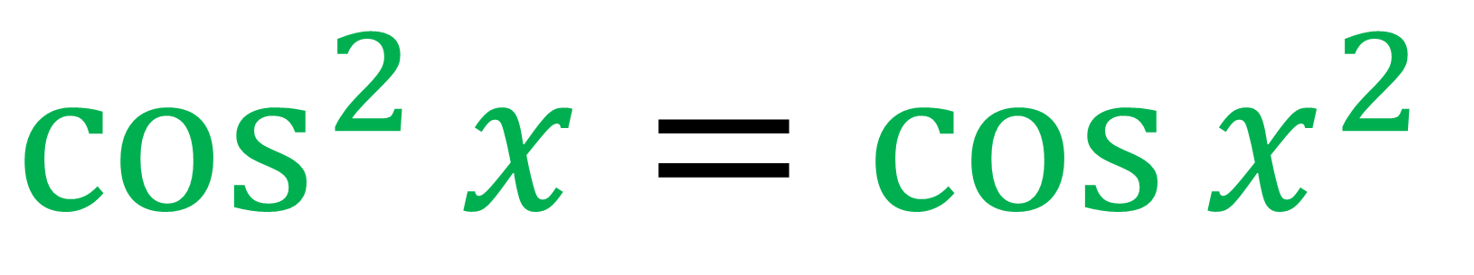
Ture or False?
$$\cos^{2}{x={\cos{x}}^{2} }$$
False

Slide 3
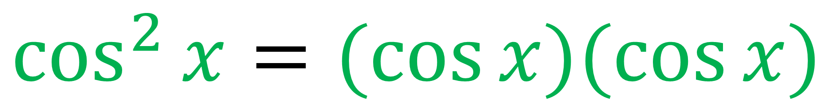
Ture or False?
$$\cos^{2}{x=(\cos{x)(\cos{x)}}}$$
True

Slide 4
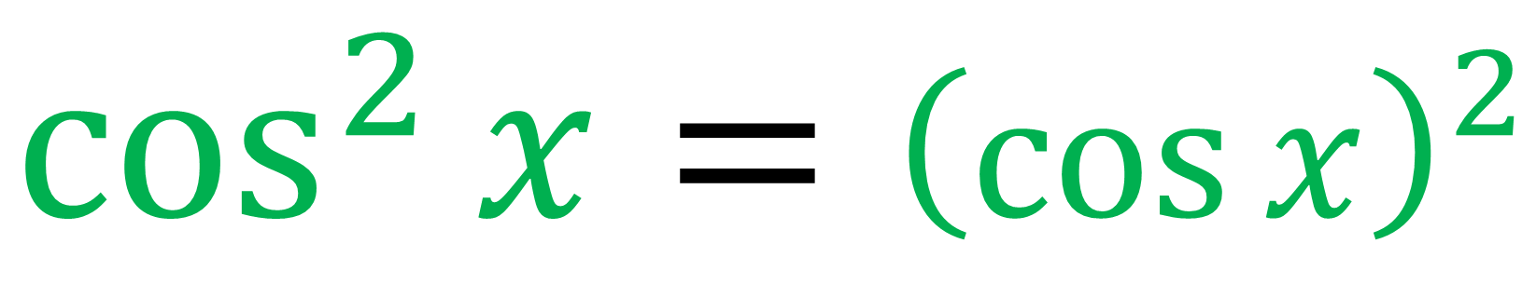
Ture or False?
$$\cos^{2}{x={\left(\cos{x}\right)}^{2}}$$
True

Slide 5
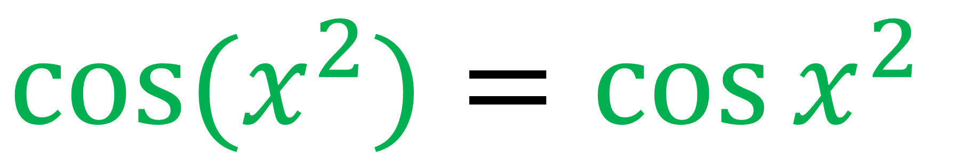
Ture or False?
$${\cos{(x}}^{2}){={\cos{x}}^{2} }$$
True

Slide 6
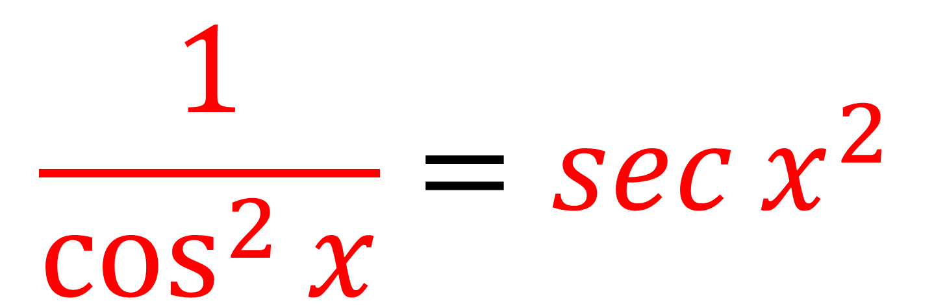
Ture or False?
$$\frac{1}{\cos^{2}{x}}=\sec{x^{2}}$$
False

Slide 7
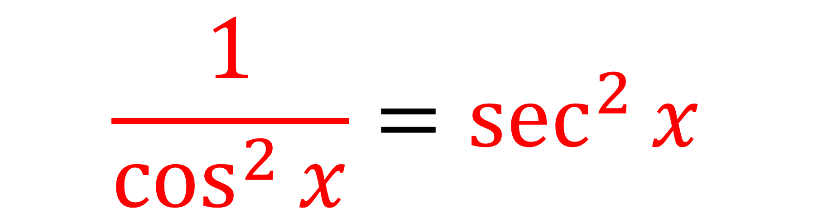
Ture or False?
$$\frac{1}{\cos^{2}{x}}=\sec^{2}{x}$$
True

Slide 8
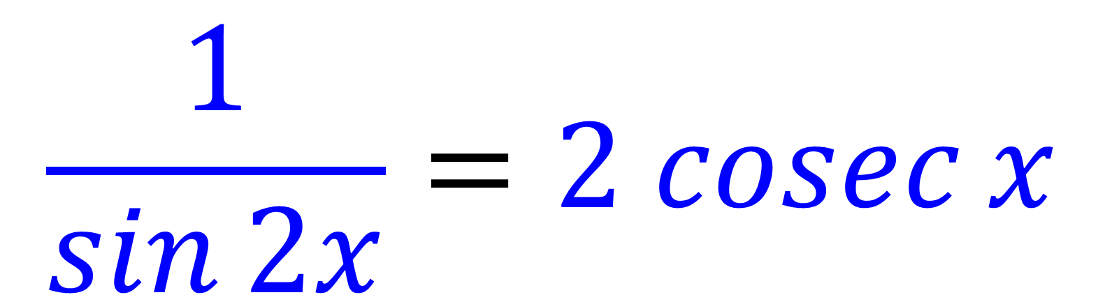
Ture or False?
$$\frac{1}{\sin{2x}}=2 cosec{x}$$
False

Slide 9
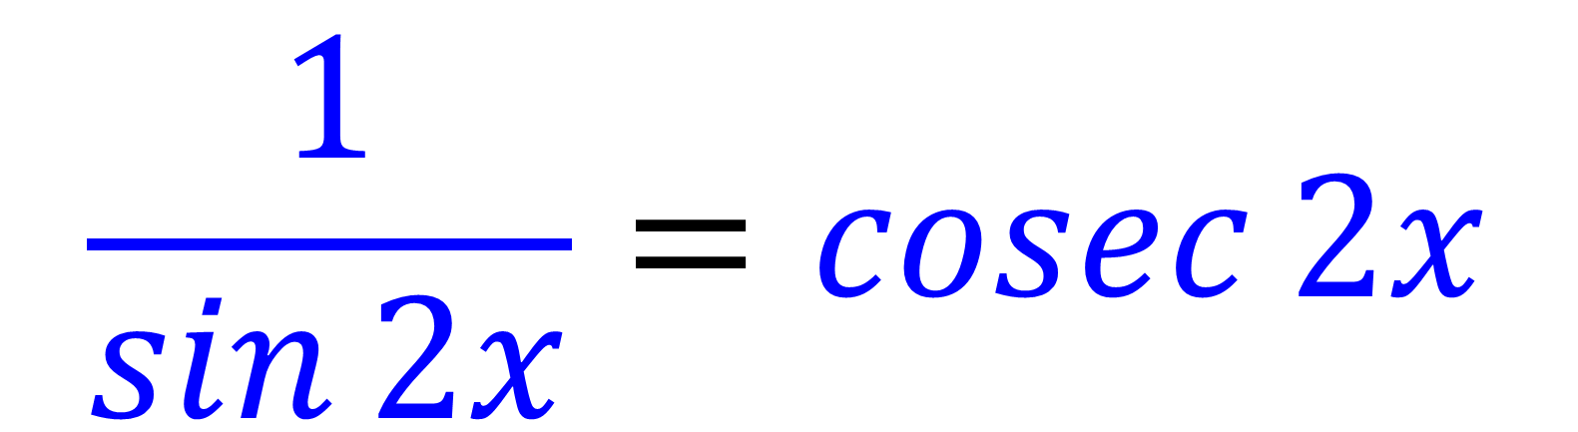
Ture or False?
$$\frac{1}{\sin{2x}}=\operatorname{cosec}{2x}$$
True

Slide 10
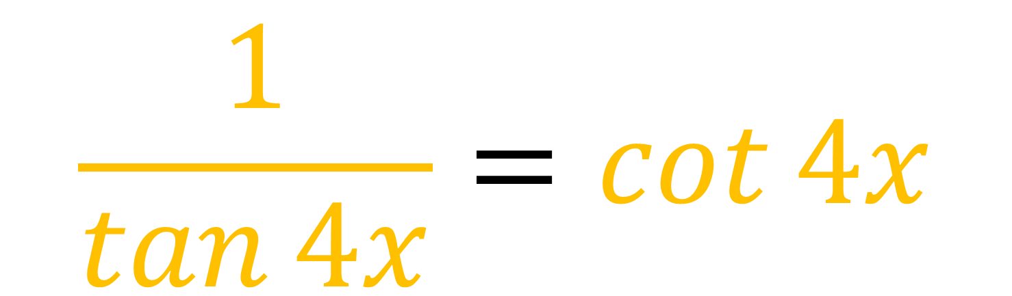
Ture or False?
$$\frac{1}{\tan{4x}}=\cot{4x}$$
True

Slide 11
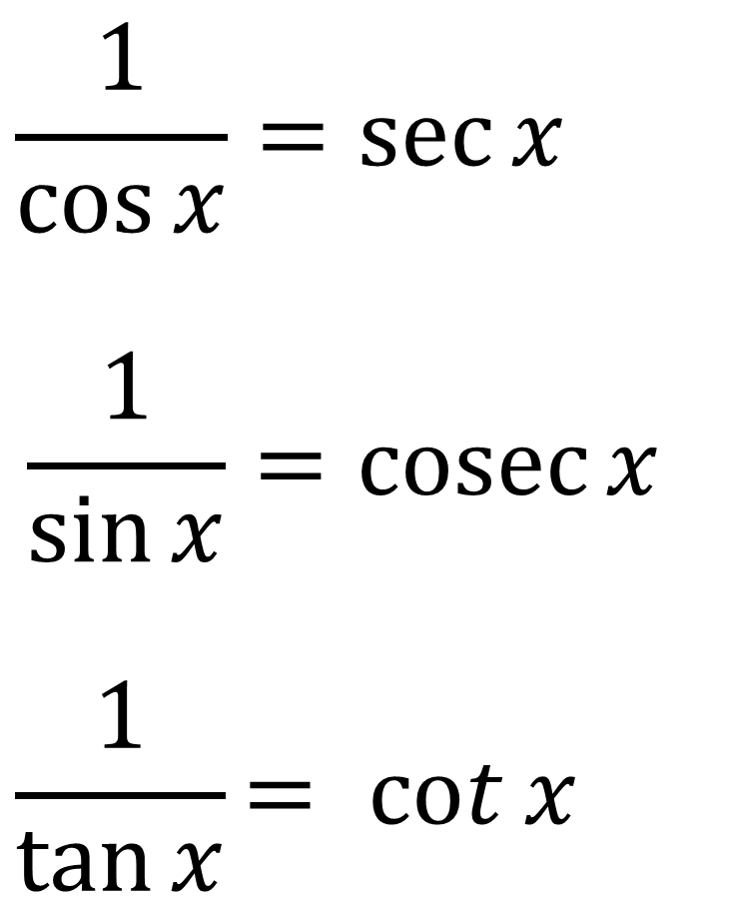
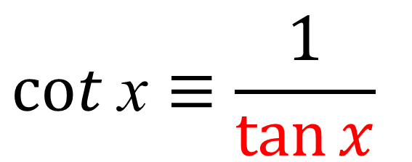
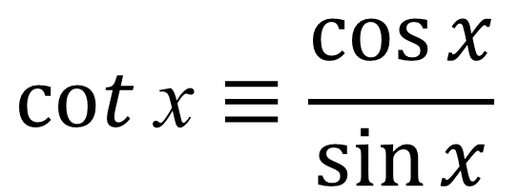
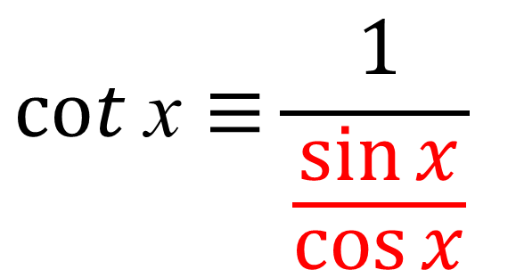
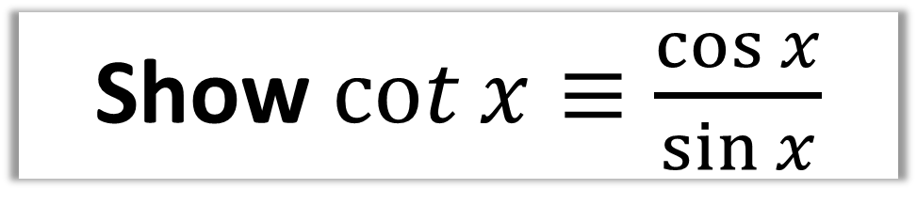
Show$\cot{x≡\frac{\cos{x}}{\sin{x}}}$
$$cot \text{x}≡\frac{1}{\tan{x}}$$
$$cot \text{x}≡\frac{1}{\frac{\sin{x}}{\cos{x}}}$$
$$cot \text{x}≡\frac{\cos{x}}{\sin{x}}$$

Slide 12
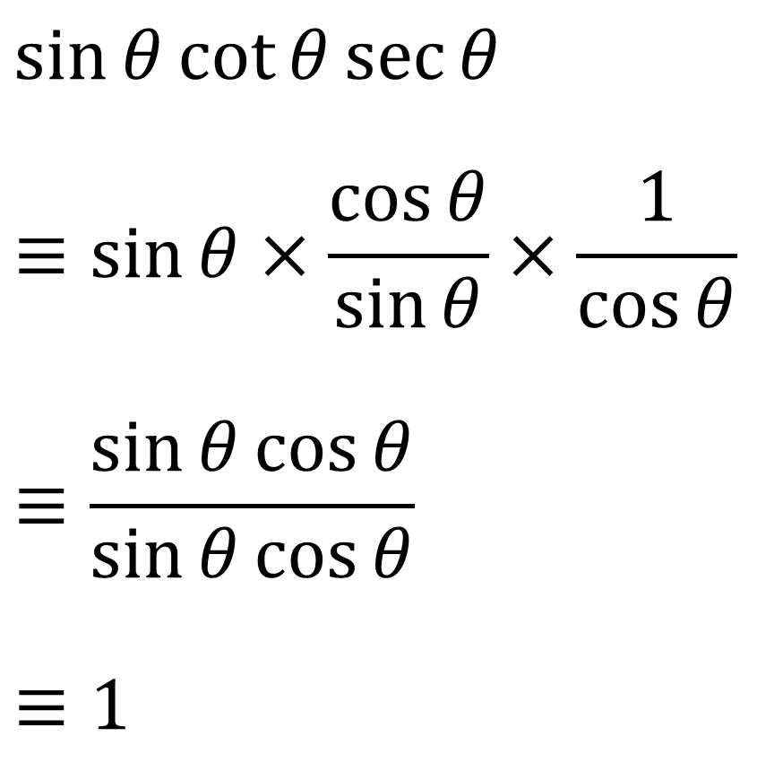
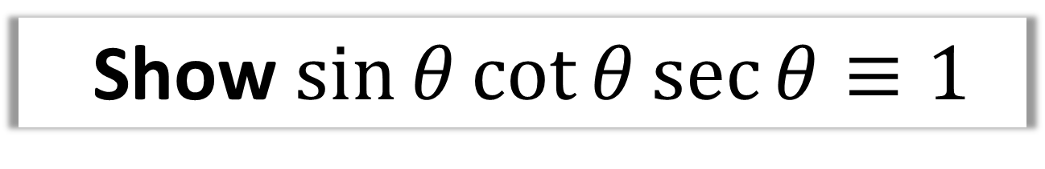
Show $\sin{θ}\cot{θ}\sec{θ}≡1$
$$\sin{θ}\cot{θ}\sec{θ}$$
$$≡\sin{θ}×\frac{\cos{θ}}{\sin{θ}}×\frac{1}{\cos{θ}}$$
$$≡\frac{\sin{θ}cos{θ}}{\sin{θ\cos{θ}}}$$
$$≡1$$

Slide 13
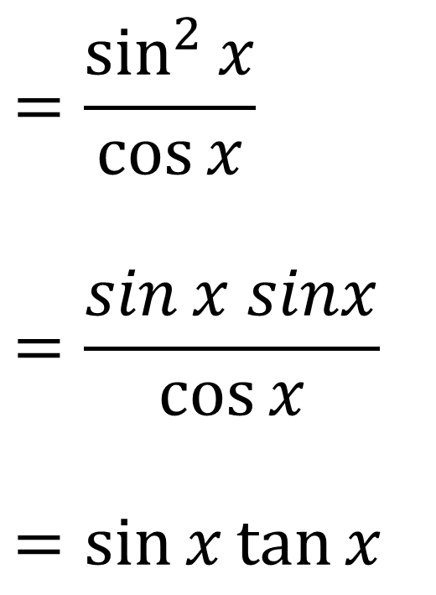
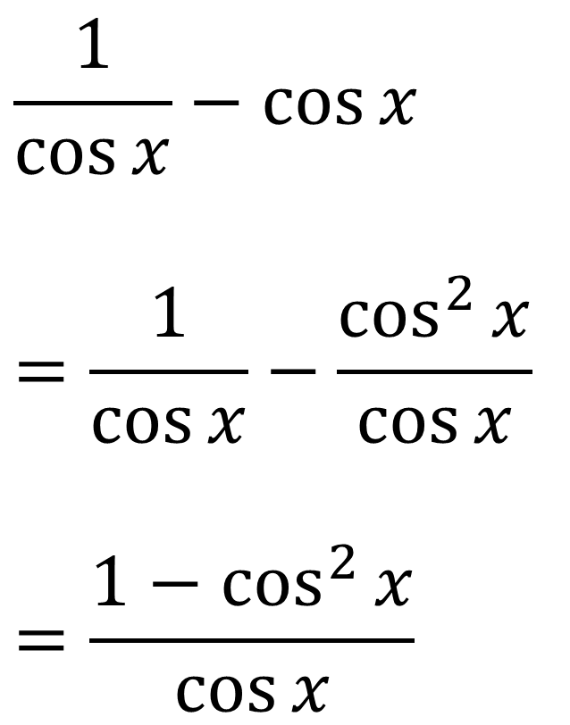
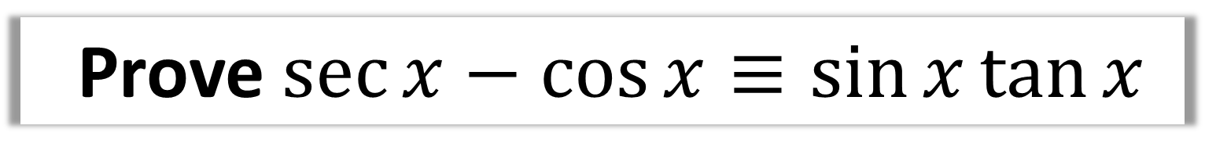
Prove $\sec{x}−\cos{x}≡\sin{x}\tan{x}$
$$\frac{1}{\cos{x}}−\cos{x}$$
$$=\frac{1}{\cos{x}}−\frac{\cos^{2}{x}}{\cos{x}}$$
$$=\frac{1−\cos^{2}{x}}{\cos{x}}$$
$$=\frac{\sin^{2}{x}}{\cos{x}}$$
$$=\frac{\sin{x sinx}}{\cos{x}}$$
$$=\sin{x}\tan{x}$$

Slide 14
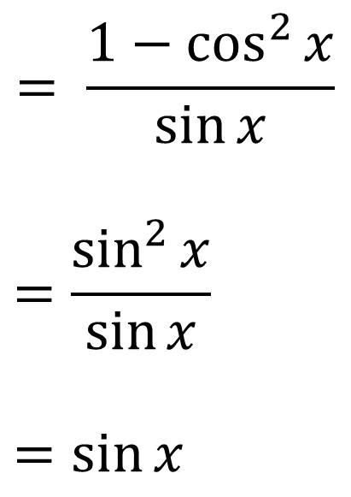
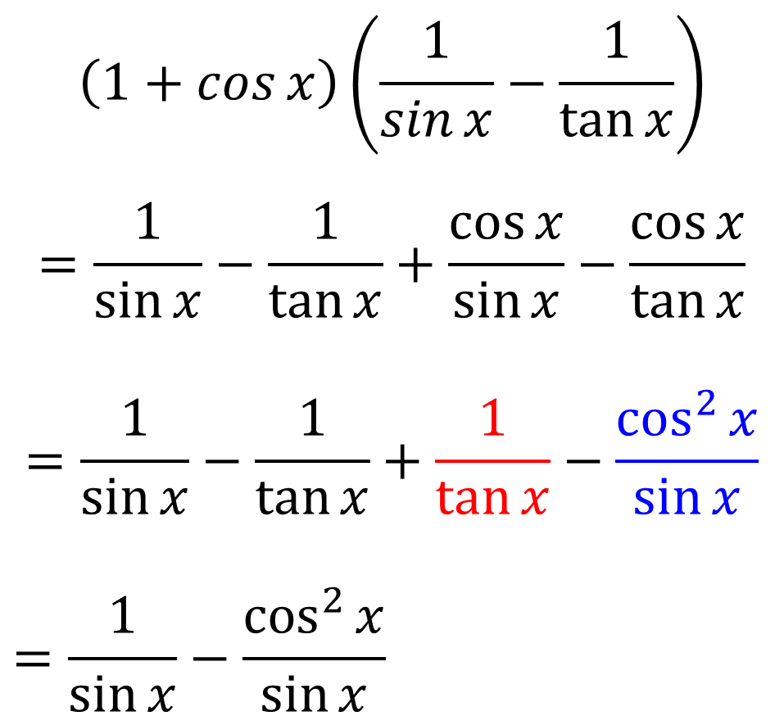
Prove $\left(1+\cos{x}\right)\left(\operatorname{cosec}{x}−\cot{x}\right)≡\sin{x}$
$$\left(1+\cos{x}\right)\left(\frac{1}{\sin{x}}−\frac{1}{\tan{x}}\right)$$
$$=\frac{1}{\sin{x}}−\frac{1}{\tan{x}}+\frac{\cos{x}}{\sin{x}}−\frac{\cos{x}}{\tan{x}}$$
$$=\frac{1}{\sin{x}}−\frac{1}{\tan{x}}+\frac{1}{\tan{x}}−\frac{\cos^{2}{x}}{\sin{x}}$$
$$=\frac{1}{\sin{x}}−\frac{\cos^{2}{x}}{\sin{x}}$$
$$= \frac{1−\cos^{2}{x}}{\sin{x}}$$
$$=\frac{\sin^{2}{x}}{\sin{x}}$$
$$=\sin{x}$$

Slide 15

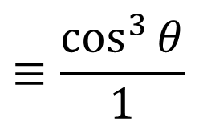
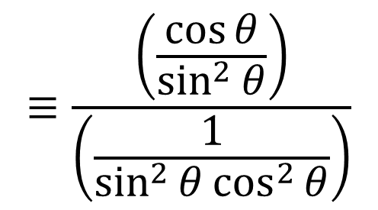
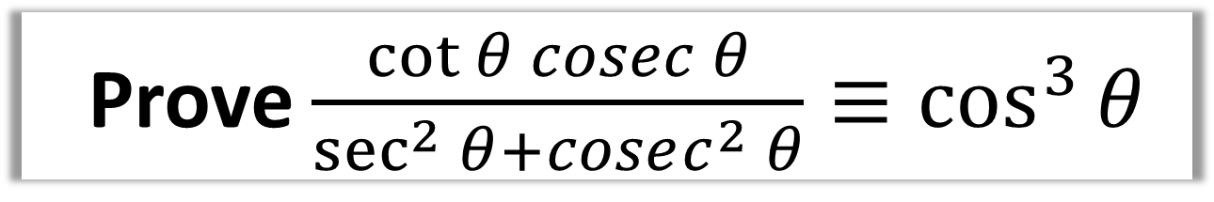
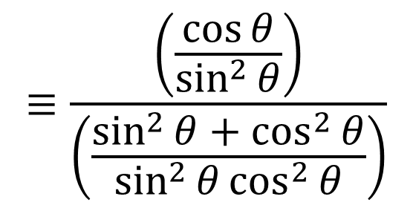
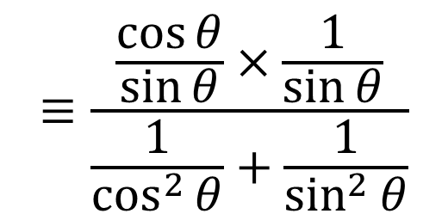
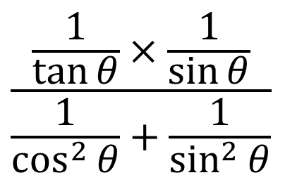
Prove $\frac{\cot{θ} cosec θ}{\sec^{2}{θ}+cosec^{2} θ}≡\cos^{3}{θ}$
$$≡\frac{\left(\frac{\cos{θ}}{\sin^{2}{θ}}\right)}{\left(\frac{\sin^{2}{θ}+\cos^{2}{θ}}{\sin^{2}{θ}\cos^{2}{θ}}\right)}$$
$$\frac{\frac{1}{\tan{θ}}×\frac{1}{\sin{θ}}}{\frac{1}{\cos^{2}{θ}}+\frac{1}{\sin^{2}{θ}}}$$
$$≡\frac{\left(\frac{\cos{θ}}{\sin^{2}{θ}}\right)}{\left(\frac{1}{\sin^{2}{θ}\cos^{2}{θ}}\right)}$$
$$≡\frac{\frac{\cos{θ}}{\sin{θ}}×\frac{1}{\sin{θ}}}{\frac{1}{\cos^{2}{θ}}+\frac{1}{\sin^{2}{θ}}}$$
$$≡\frac{\cos^{3}{θ}}{1}$$
$$≡\cos^{3}{θ}$$

Slide 16
Solving Equations involving
sec, cosec and cot.
When asked to solve equations involving sec, cosec, cot
you need to look to write the equation
in terms of sin, cos or tan.

Slide 17
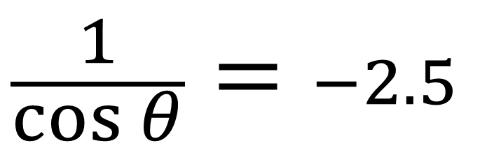
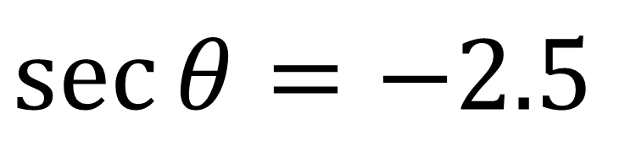
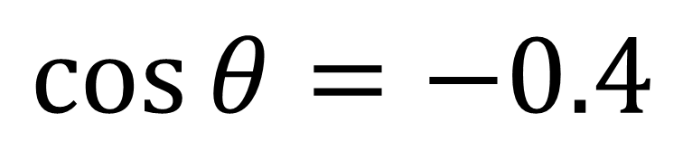
Write the following equation
in terms of sin, cos or tan.
$$\sec{θ}=−2.5$$
$$\frac{1}{\cos{θ}}=−2.5$$
$$\cos{θ}=−0.4$$

Slide 18
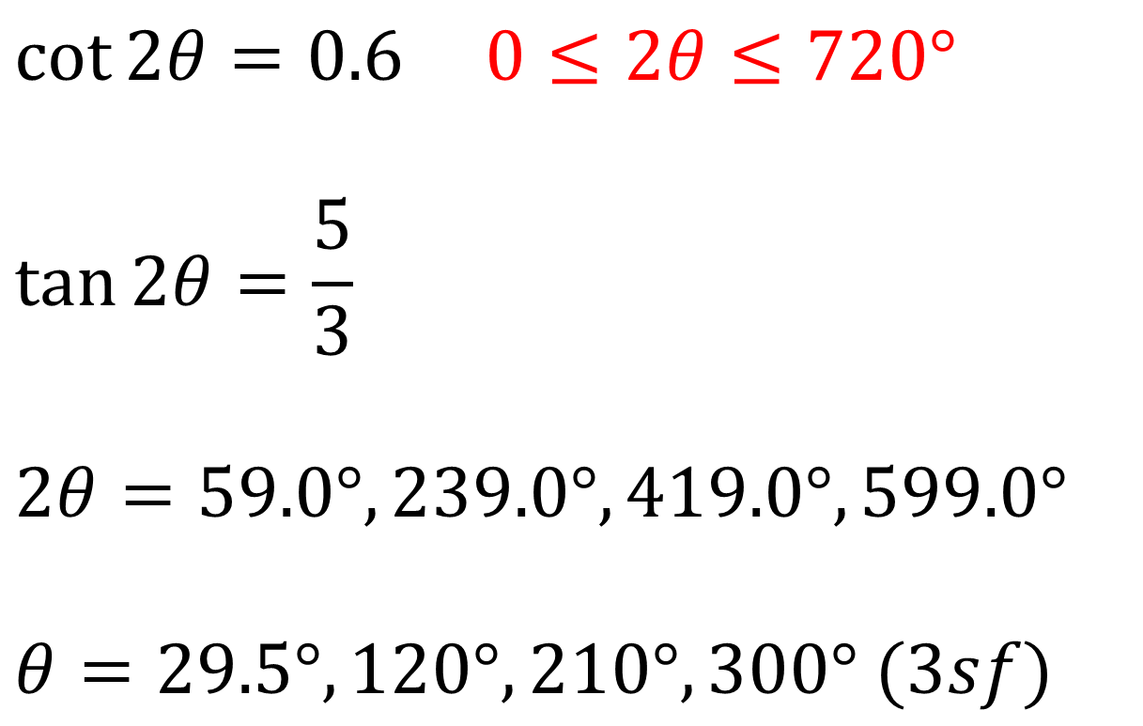
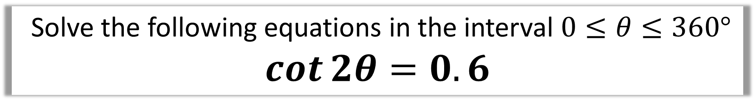
Solve the following equations in the interval $0≤θ≤360°$
$$\cot{2θ}=0.6$$
$$\cot{2θ}=0.6 0≤2θ≤720°$$
$$\tan{2θ}=\frac{5}{3}$$
$$2θ=59.0°, 239.0°, 419.0°, 599.0°$$
$$θ=29.5°, 120°, 210°, 300° (3sf)$$

Slide 19
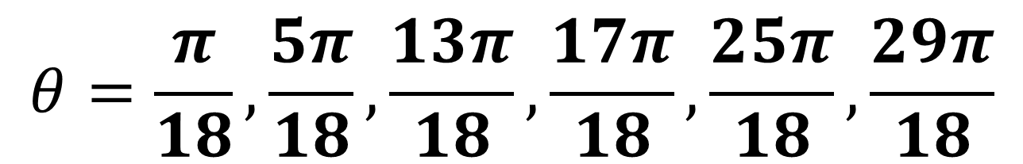
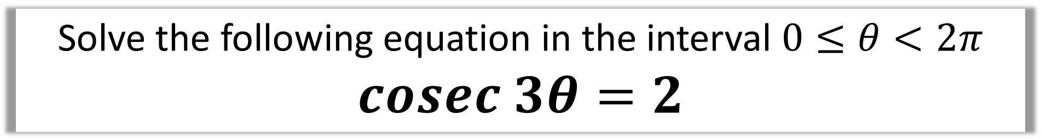
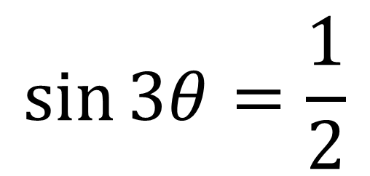
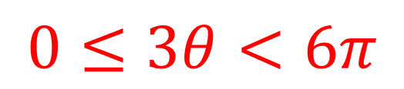
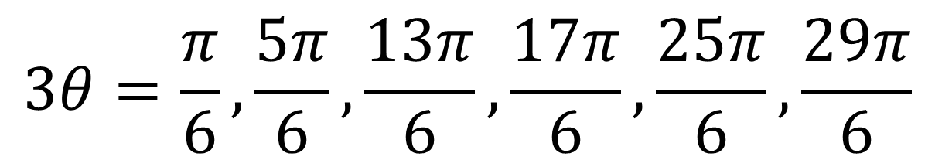
Solve the following equation in the interval $0≤θ<2π$
$$cosec 3θ=2$$
$$0≤3θ<6π$$
$$\sin{3θ}=\frac{1}{2}$$
$$3θ=\frac{π}{6}, \frac{5π}{6}, \frac{13π}{6}, \frac{17π}{6},\frac{25π}{6}, \frac{29π}{6}$$
$$θ=\frac{π}{18}, \frac{5π}{18}, \frac{13π}{18}, \frac{17π}{18},\frac{25π}{18}, \frac{29π}{18}$$

Slide 20
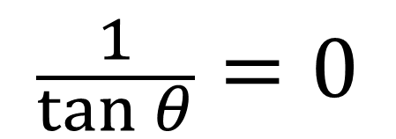
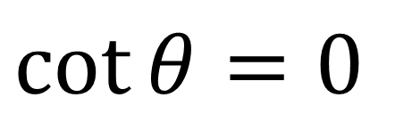
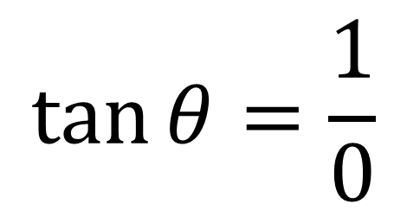
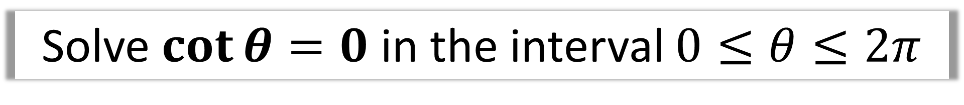
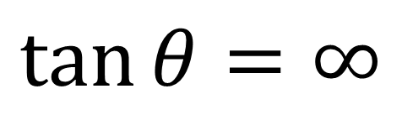
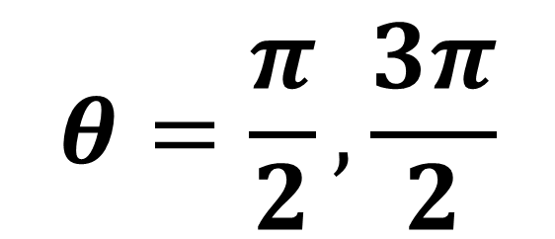
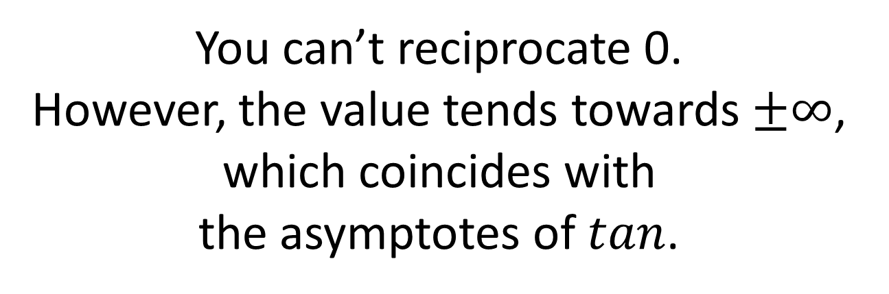
Solve $\cot{θ}=0$ in the interval $0≤θ≤2π$
$$\cot{θ}=0$$
You can’t reciprocate 0.
However, the value tends towards $±∞$,
which coincides with
the asymptotes of $tan$.
$$\frac{1}{\tan{θ}}=0$$
$$\tan{θ}=\frac{1}{0}$$
$$θ=\frac{π}{2}, \frac{3π}{2}$$
$$\tan{θ}=∞$$

