Slide 1
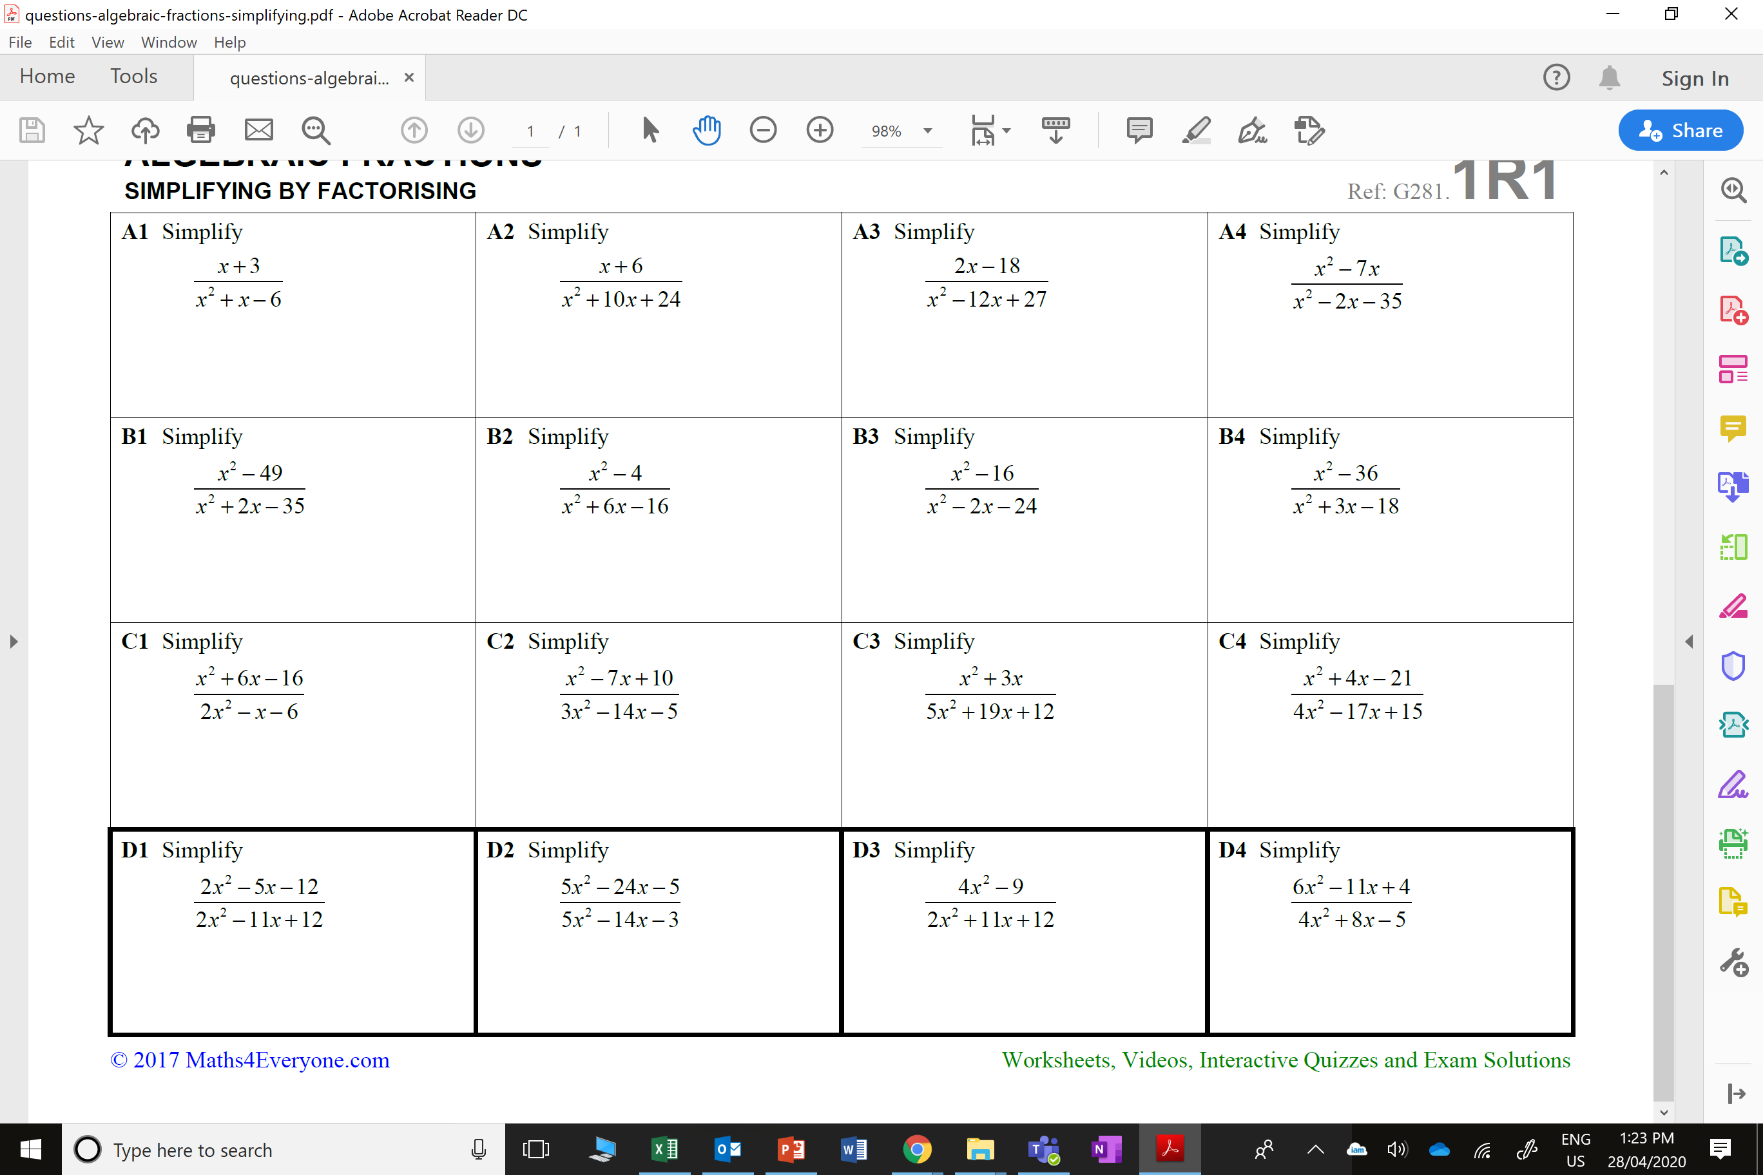
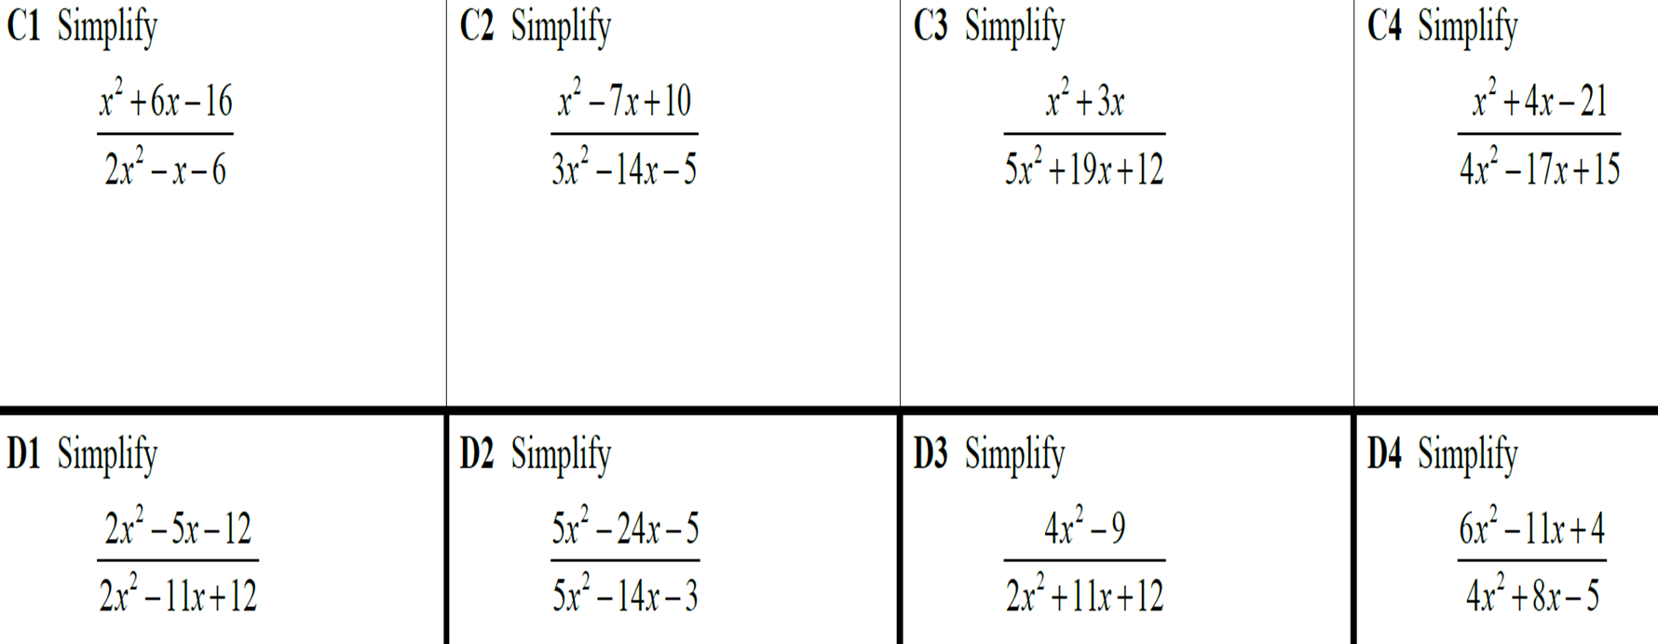
Simplify the algebraic fractions.

Slide 2
ANSWERS

Slide 3
