Slide 1
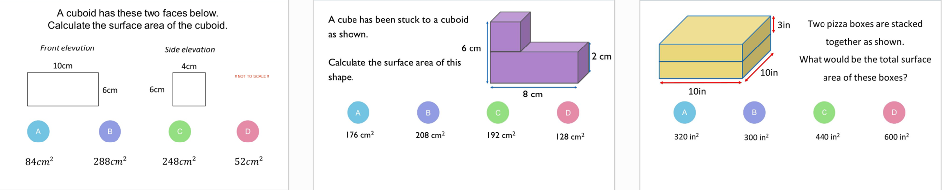
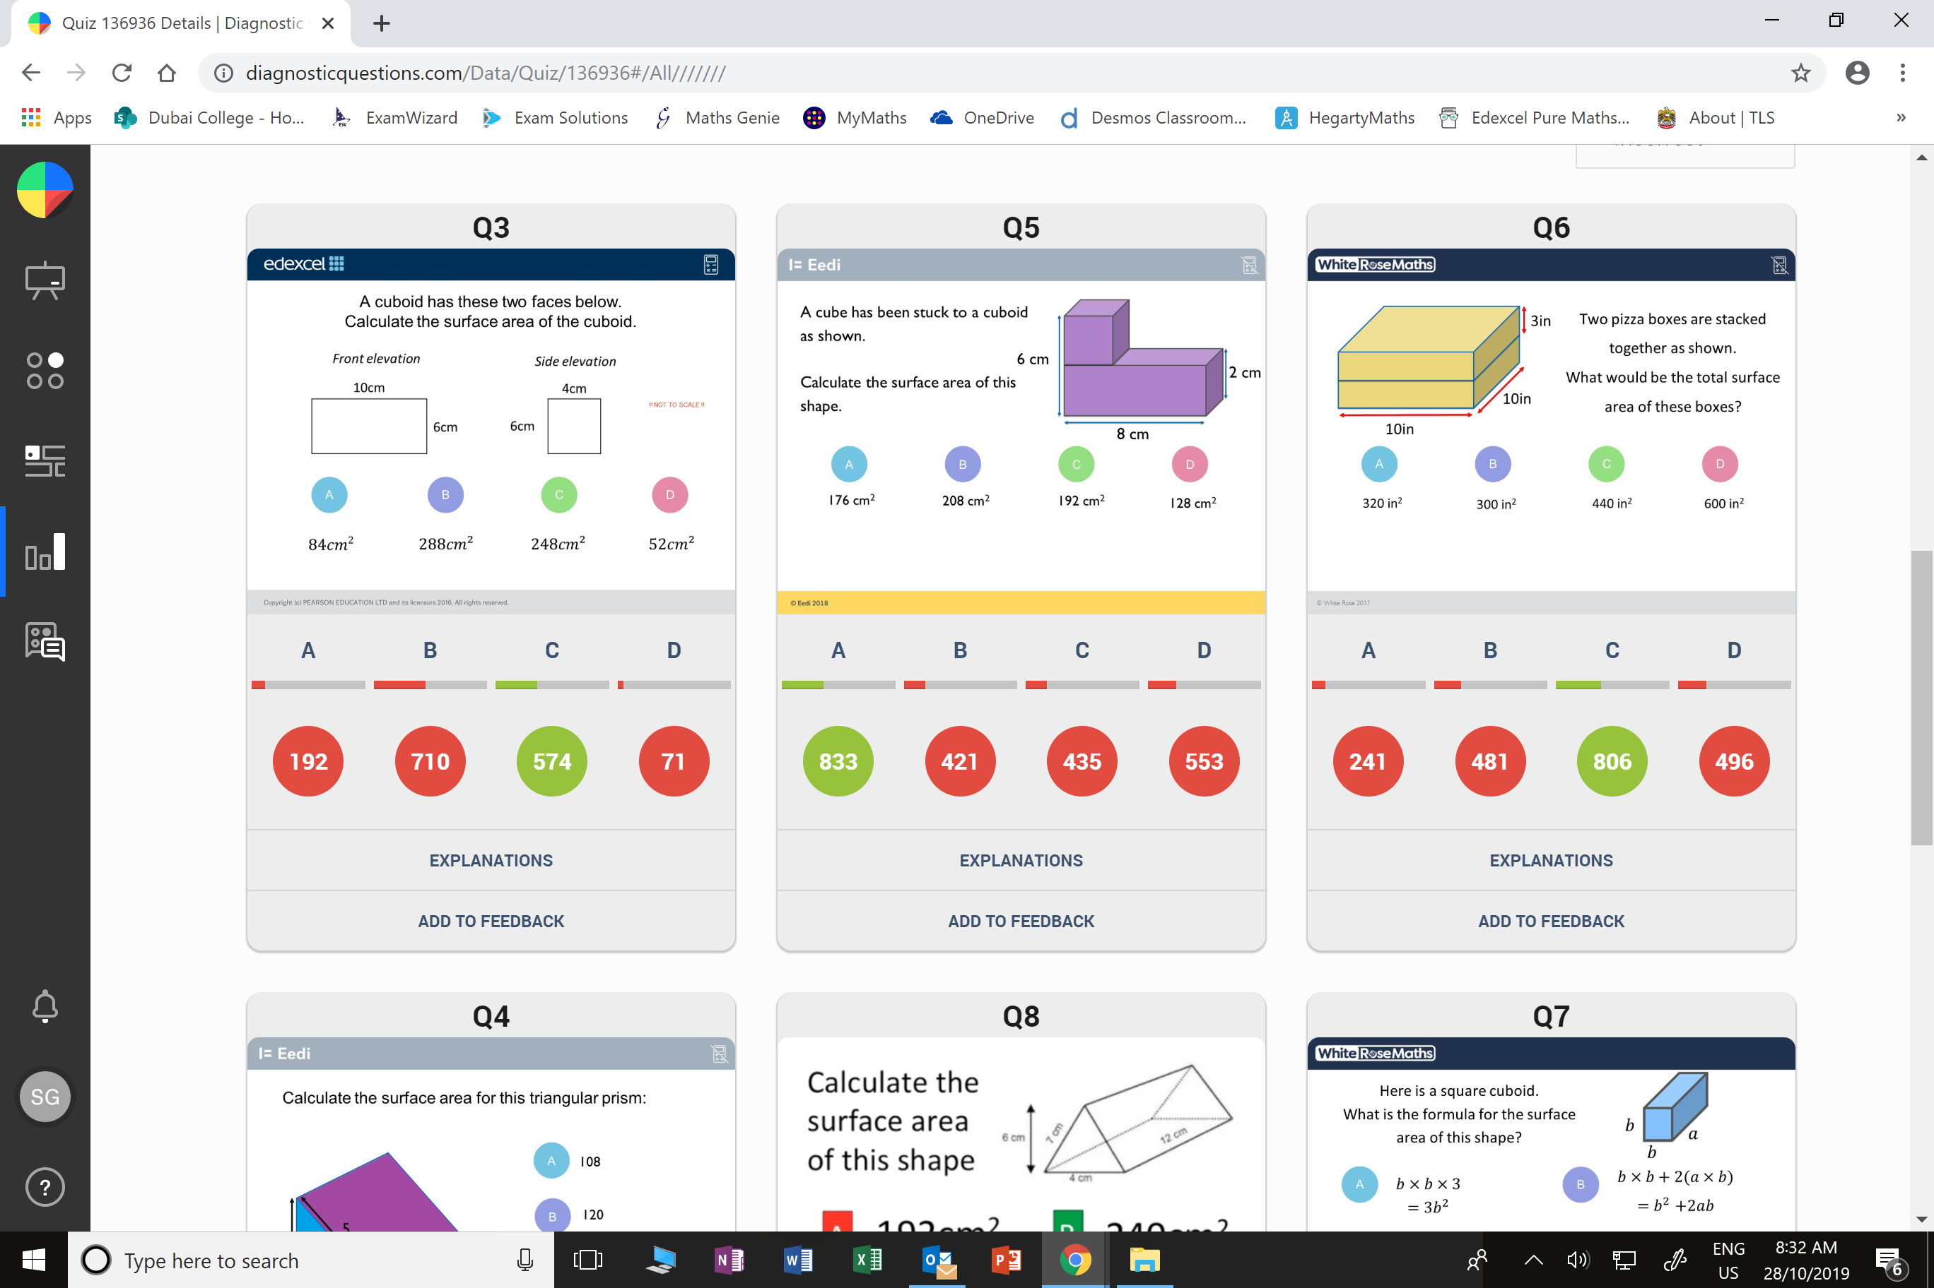
Worst answered question?
Most common wrong answer?

Slide 2
ANSWERS

Slide 3
Worst answered question?
Most common wrong answer?

Slide 4
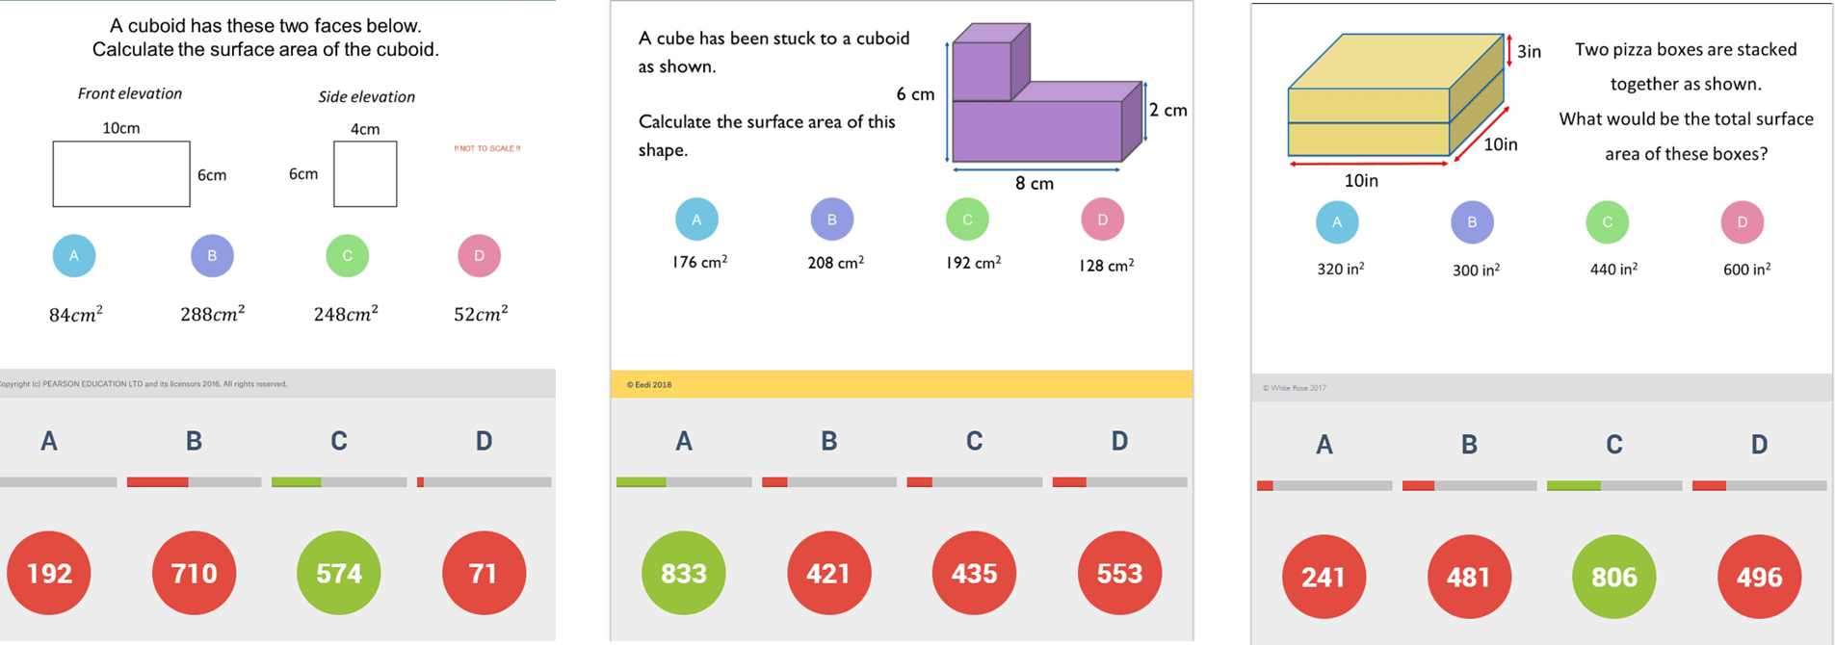
B
60 x 4 = 240
24 x 2 = 48
Surface Area = 288

Slide 5
D
The student has found the volume, rather than the surface area.

