Slide 1
FM: Equation of a Tangent to a Circle

Slide 2
tangent
radius
The tangent is perpendicular to the radius
(at the point of intersection).

Slide 3
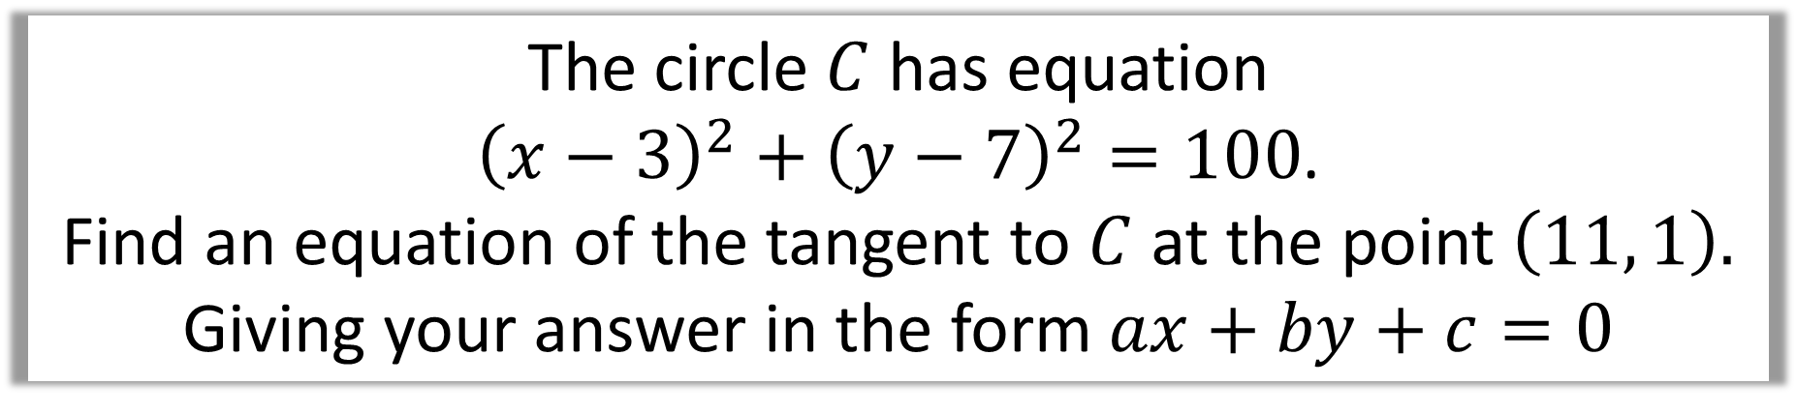
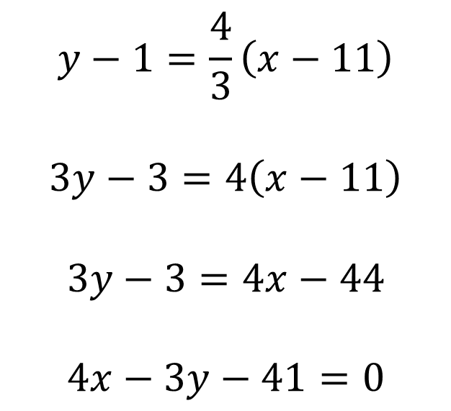
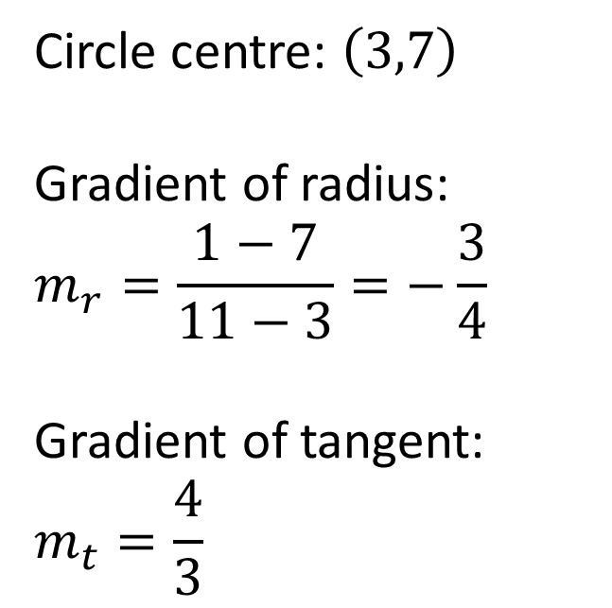
The circle $C$ has equation
${\left(x−3\right)}^{2}+{\left(y−7\right)}^{2}=100$.
Find an equation of the tangent to $C$ at the point $\left(11, 1\right).$
Giving your answer in the form $ax+by+c=0$
Circle centre: $\left(3,7\right)$
Gradient of radius:
$$m_{r}=\frac{1−7}{11−3}=−\frac{3}{4}$$
Gradient of tangent:
$$m_{t}=\frac{4}{3}$$
$$y−1=\frac{4}{3}\left(x−11\right)$$
$$3y−3=4\left(x−11\right)$$
$$3y−3=4x−44$$
$$4x−3y−41=0$$

Slide 4
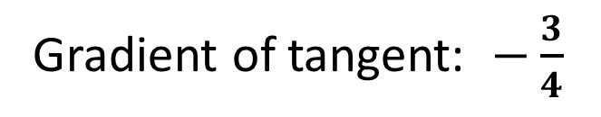

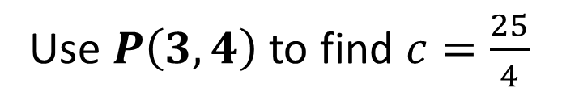
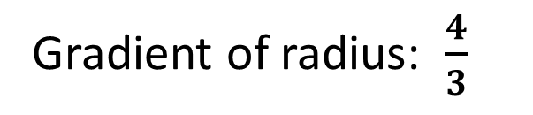
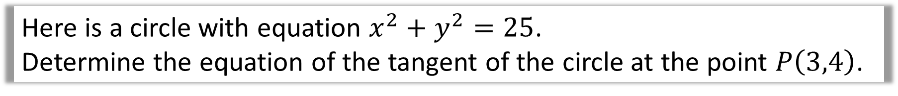
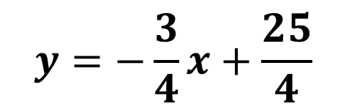

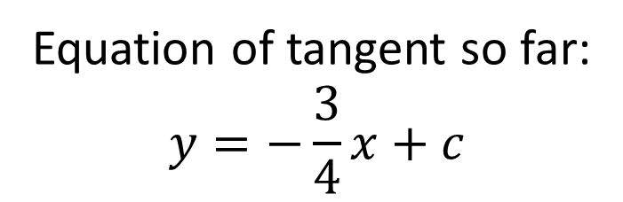
Here is a circle with equation $x^{2}+y^{2}=25$.
Determine the equation of the tangent of the circle at the point $P\left(3,4\right)$.
Gradient of radius: $\frac{4}{3}$
$$P\left(3,4\right)$$
Gradient of tangent: $−\frac{3}{4}$
$$x$$
-5
5
Equation of tangent so far:
$$y=−\frac{3}{4}x+c$$
$$y=−\frac{3}{4}x+\frac{25}{4}$$
-5
Use $P\left(3,4\right)$ to find $c=\frac{25}{4}$

Slide 5
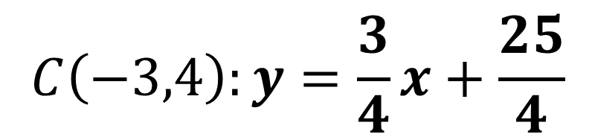

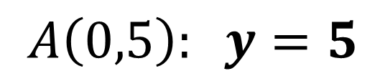
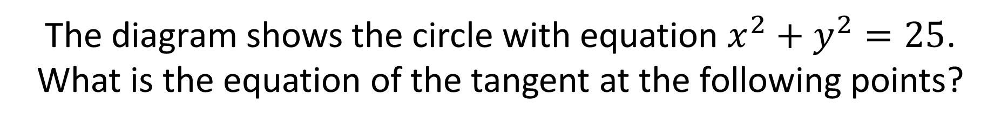



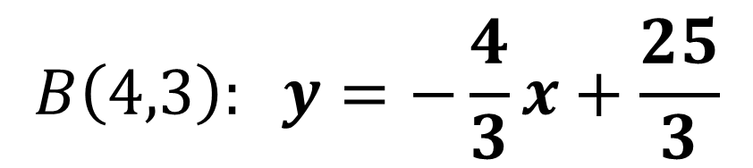
The diagram shows the circle with equation $x^{2}+y^{2}=25$.
What is the equation of the tangent at the following points?
$$A\left(0,5\right)$$
$$A\left(0,5\right): y=5$$
5
$$C\left(−3,4\right)$$
$$B\left(4,3\right)$$
$$B\left(4,3\right): y=−\frac{4}{3}x+\frac{25}{3}$$
-5
5
$$x$$
$$C\left(−3,4\right):y=\frac{3}{4}x+\frac{25}{4}$$
-5

