Slide 1
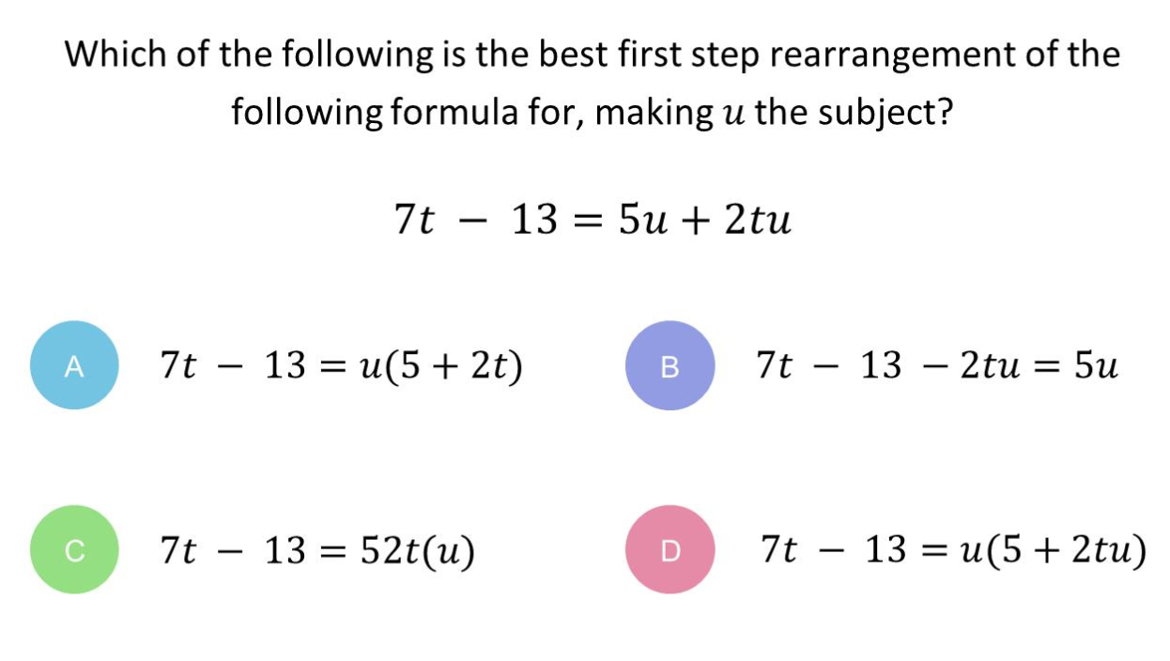
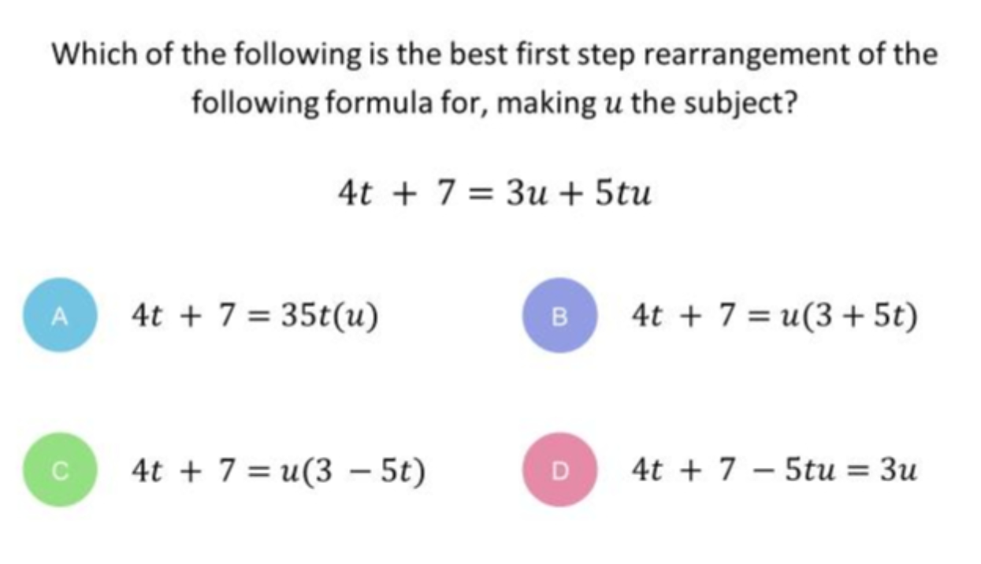
Which question had the lowest percentage of correct answers?
For each question,
what was the most common wrong answer?

Slide 2
ANSWERS

Slide 3
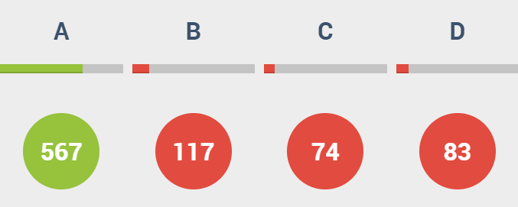
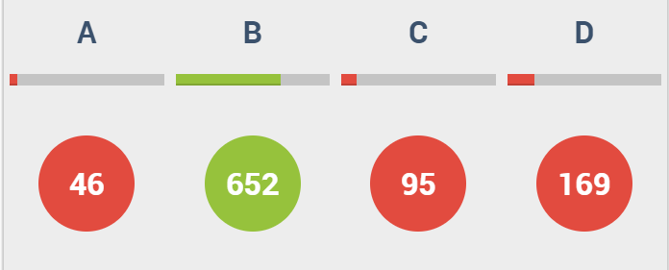
Which question had the lowest percentage of correct answers?

Slide 4
B
U appears on both sides.

Slide 5
D
The student has not recognised that you need to take u
out as a factor.

