Slide 1
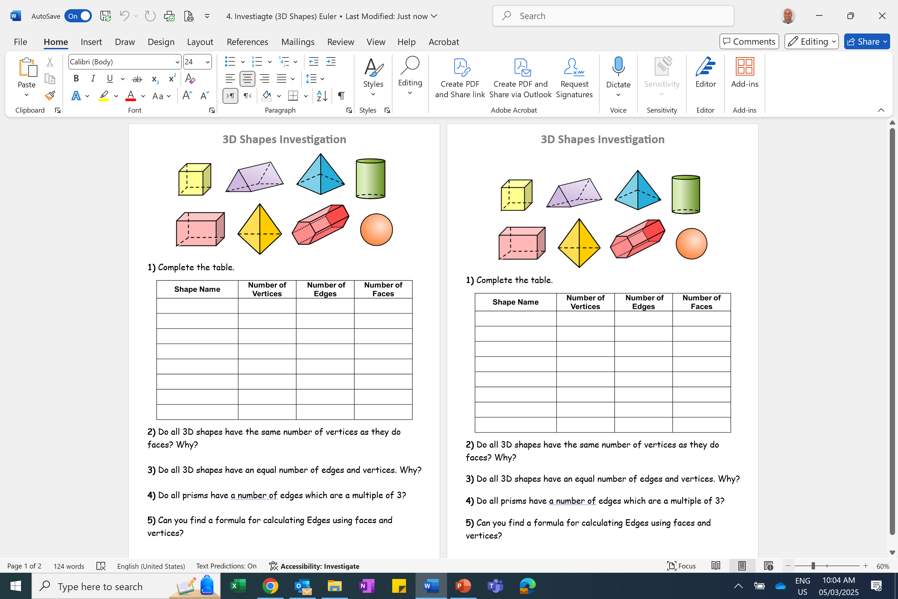
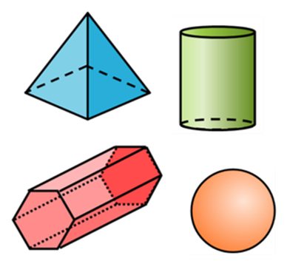

Slide 2
ANSWERS

Slide 3
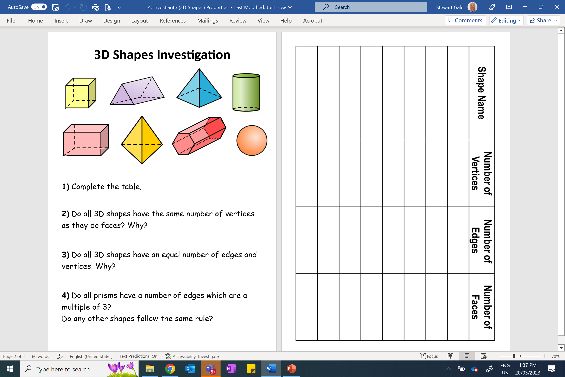
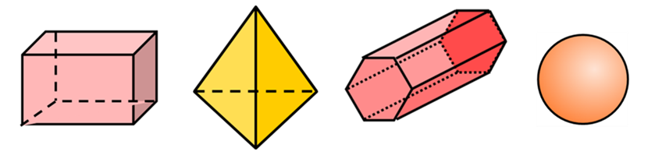
Cube
8
12
6
Cuboid
8
12
6
Triangular Prism
6
9
5
Tetrahedron
4
6
4
Hexagonal Prism
12
18
8
Cylinder
0
2
3
Square based Pyramid
5
8
5
Sphere
0
0
1

Slide 4
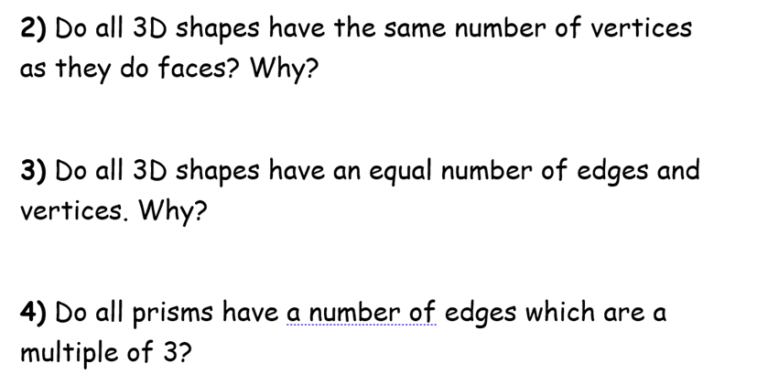
No
No
No

Slide 5
3D Shape | Faces | Vertices | Edges
Cube | 6 | 8 | 12
Cuboids | 6 | 8 | 12
Square base pyramid | 5 | 5 | 8
Tetrahedron | 4 | 4 | 6
Hexagonal prism | 8 | 12 | 18
Triangular prism | 5 | 6 | 9
E = V + F – 2

Slide 6
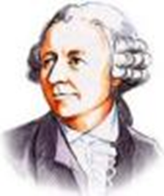
A Swiss Mathematician discovered a special relationship about faces, edges and vertices.
This discovery is now known as Euler’s Theorem.
Leonhard Euler (1707-1783)
Euler was the most prolific mathematical writer
of all time, finding time (even with his 13 children) to publishing over 800 papers in his lifetime.

