Slide 1
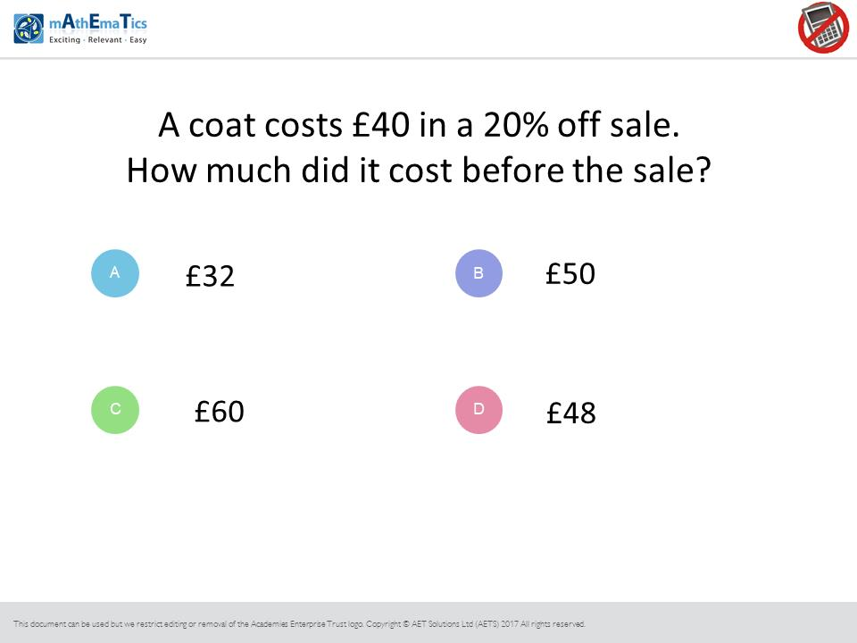
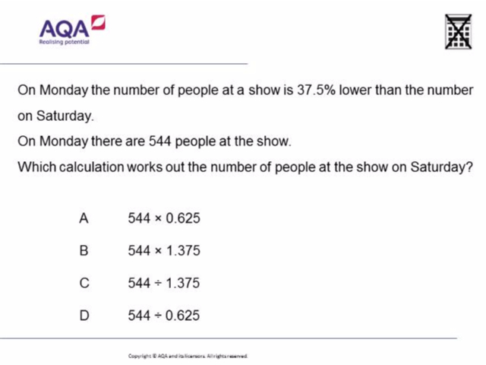
Worst answered question?
Most common wrong answer?

Slide 2
ANSWERS

Slide 3
÷
÷
Worst answered question?

Slide 4
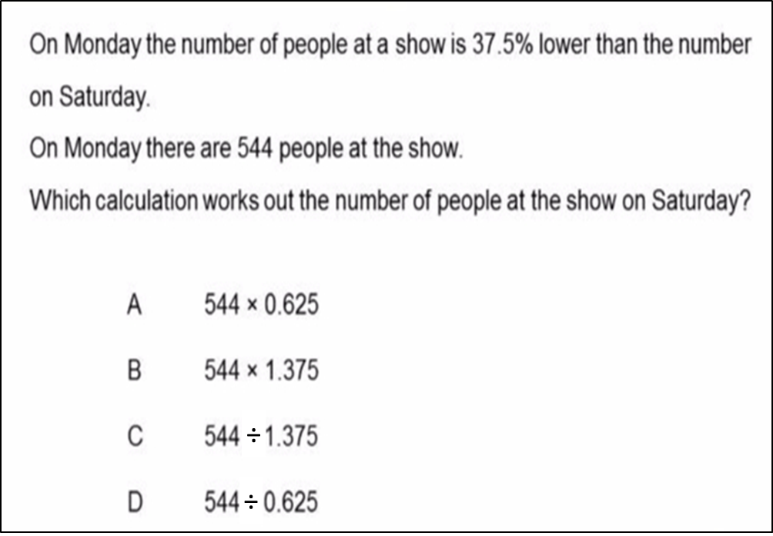
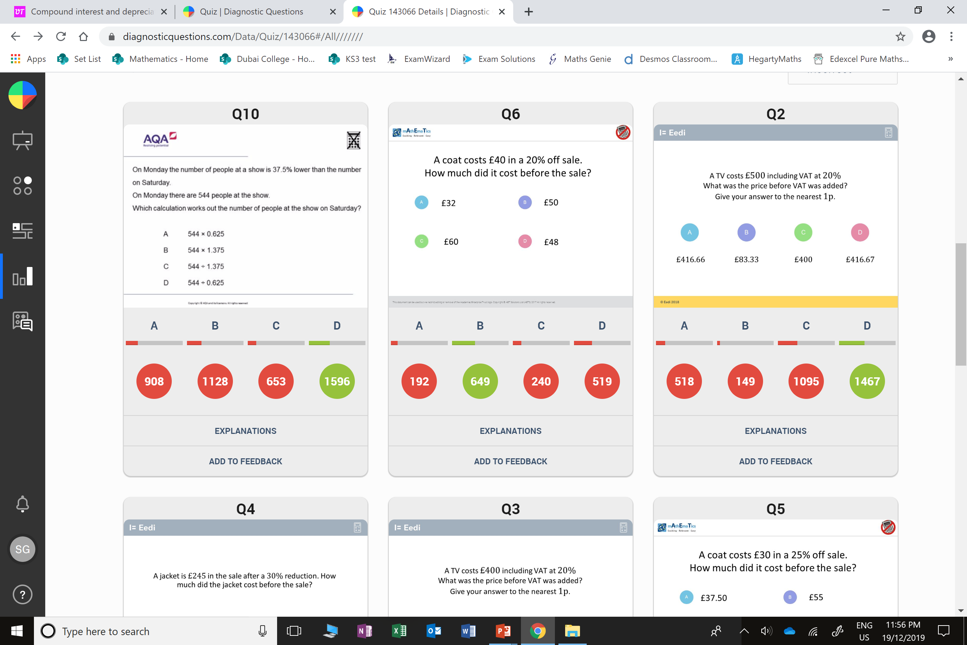
B
They did a percentage increase not a
reverse percentage.

Slide 5
D
They did a percentage increase not a
reverse percentage.

