Slide 1
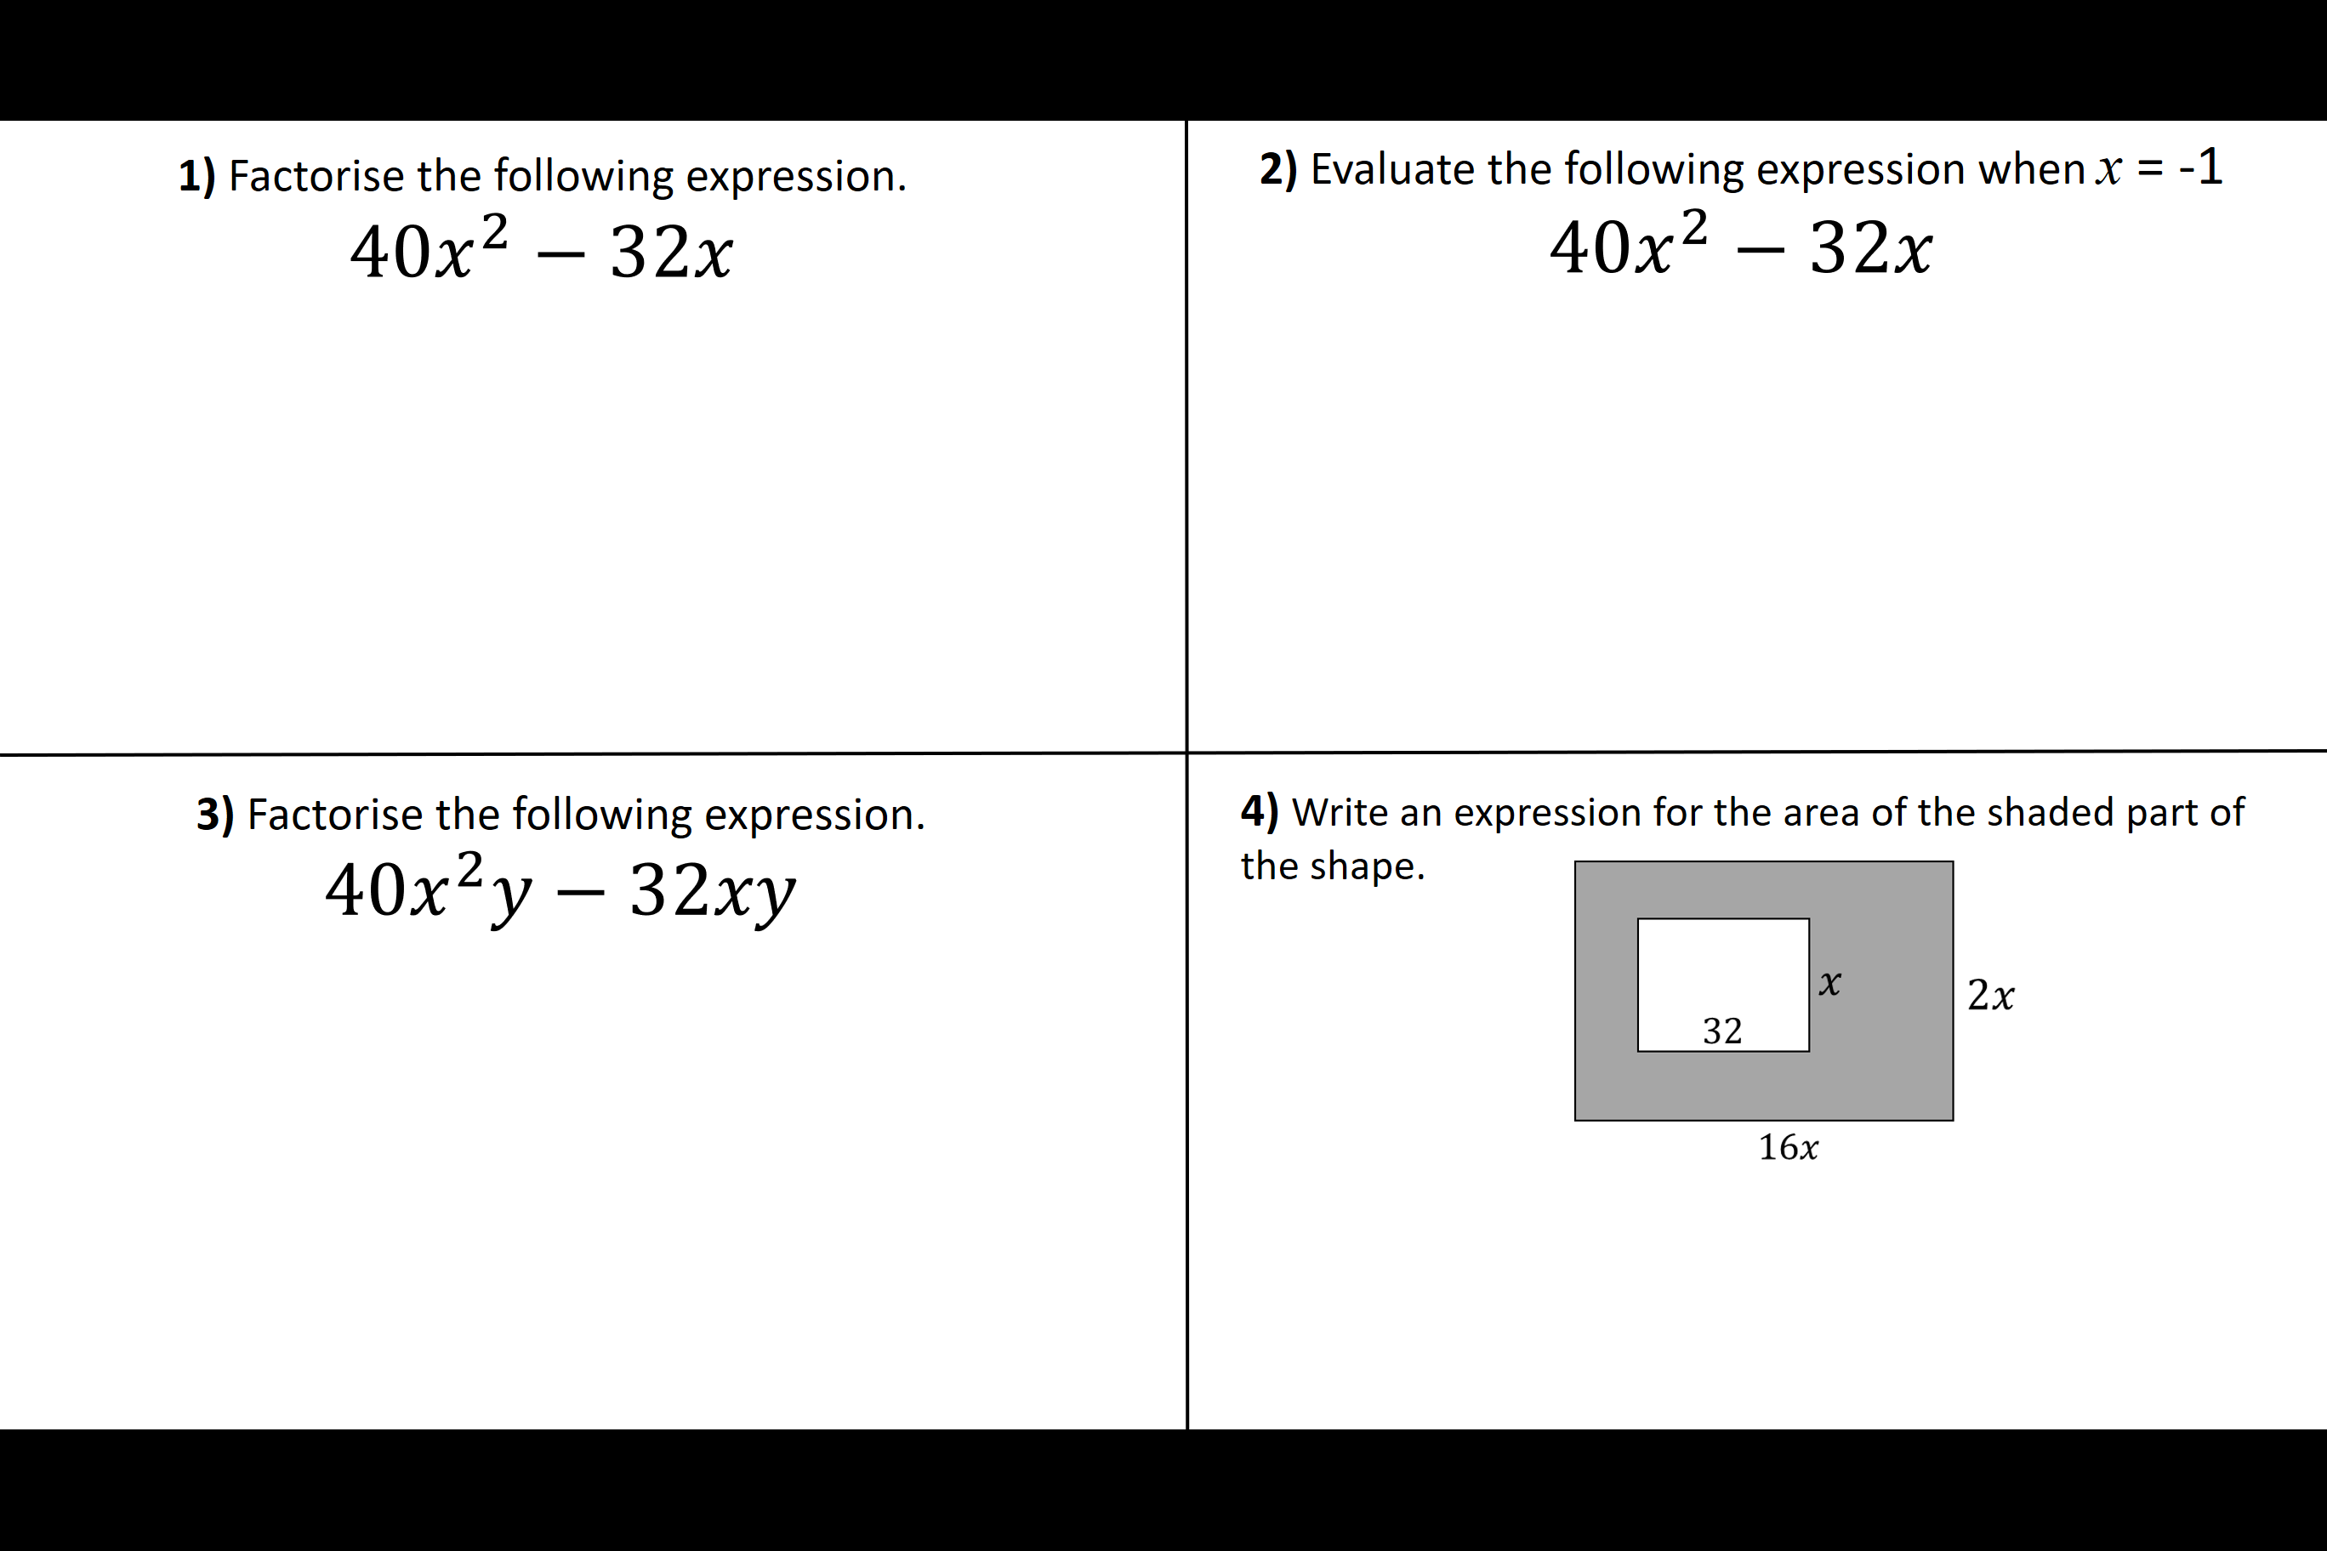
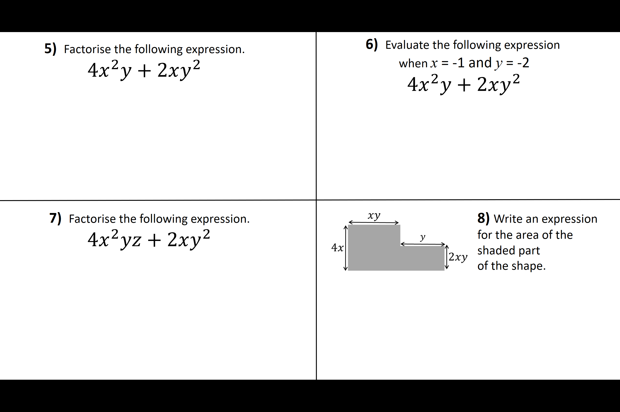

Slide 2
ANSWERS

Slide 3
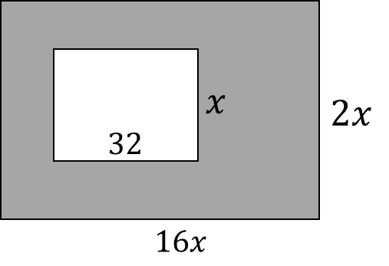
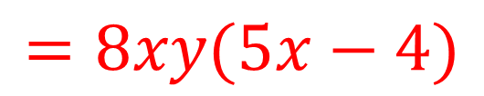
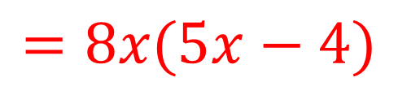
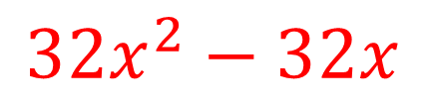
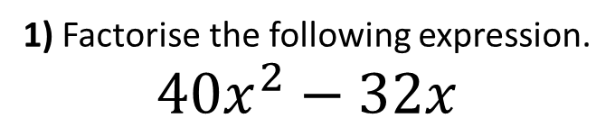
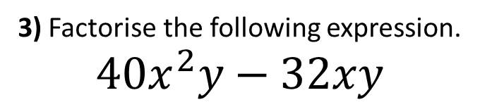
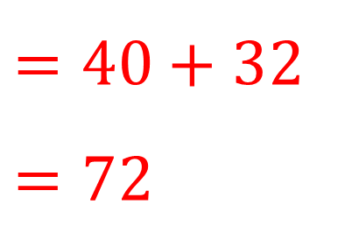
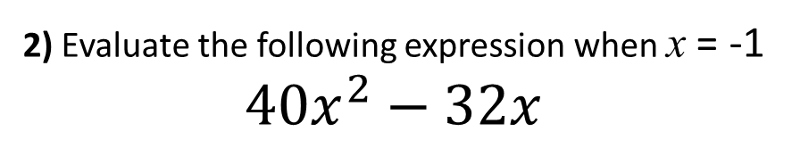
1) Factorise the following expression.
$$40x^{2}−32x$$
2) Evaluate the following expression when x = -1
$$40x^{2}−32x$$
$=40$ + 32
$$=72$$
$$=8x(5x−4)$$
3) Factorise the following expression.
$$40x^{2}y−32xy$$
4) Write an expression for the area of the shaded part of the shape.
$$=8xy(5x−4)$$
$$32x^{2}−32x$$

Slide 4
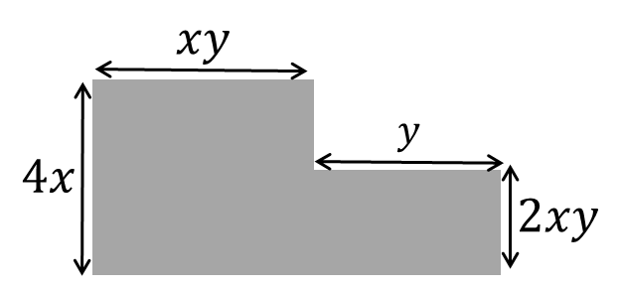
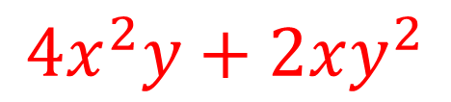
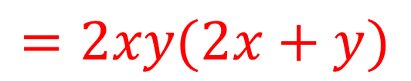
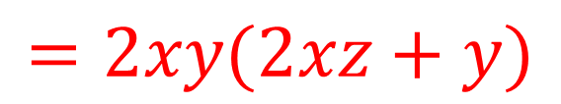
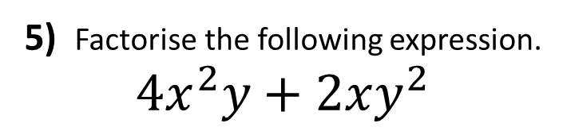
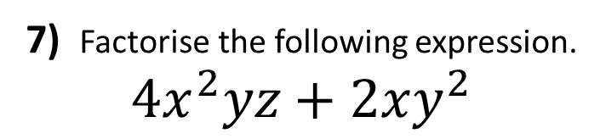
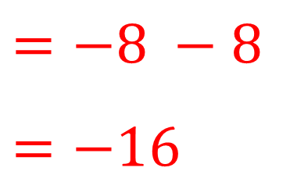
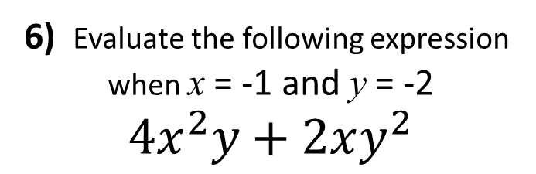
5) Factorise the following expression.
$$4x^{2}y+2xy^{2}$$
6) Evaluate the following expression
when x = -1 and y = -2
$$4x^{2}y+2xy^{2}$$
$$=2xy(2x+y)$$
$$=−8 −8$$
$$=−16$$
7) Factorise the following expression.
$$4x^{2}yz+2xy^{2}$$
8) Write an expression for the area of the shaded part
of the shape.
$$=2xy(2xz+y)$$
$$4x^{2}y+2xy^{2}$$

