Slide 1
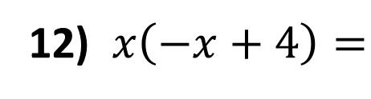
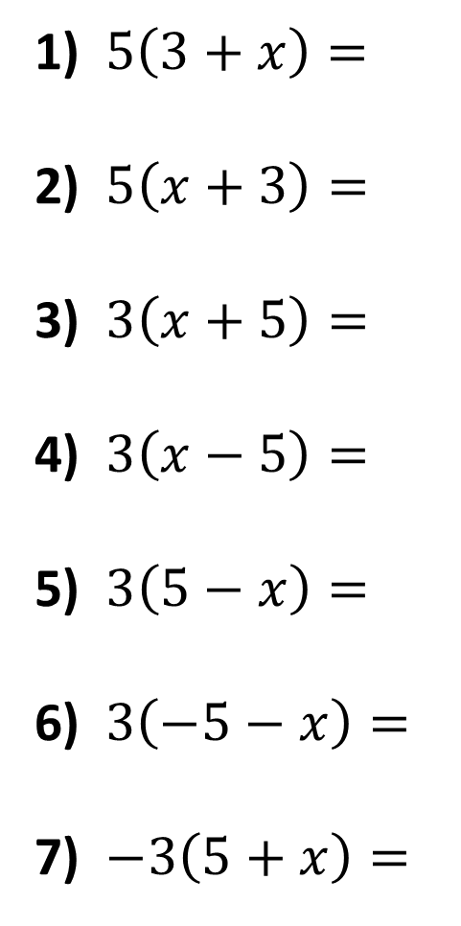
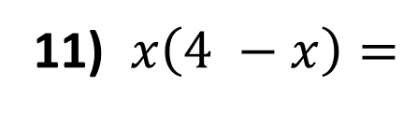
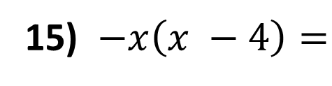
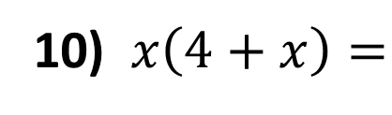
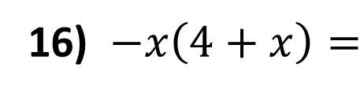
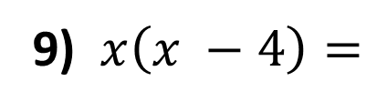
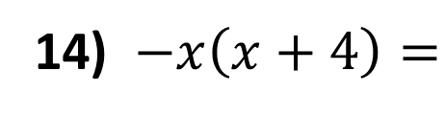
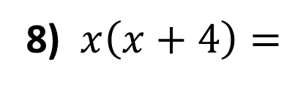
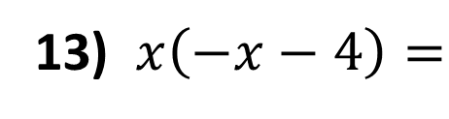
Expand the following brackets.
8) $x\left(x+4\right)=$
1) $5\left(3+x\right)=$
2) $5\left(x+3\right)=$
3) $3\left(x+5\right)=$
4) $3\left(x−5\right)=$
5) $3\left(5−x\right)=$
6) $3\left(−5−x\right)=$
7) $−3\left(5+x\right)=$
9) $x\left(x −4\right)=$
10) $x\left(4+x\right)=$
11) $x\left(4 −x\right)=$
12) $x\left(−x+4\right)=$
13) $x\left(−x−4\right)=$
14) $−x\left(x+4\right)=$
15) $−x\left(x −4\right)=$
16) $−x\left(4+x\right)=$

Slide 2
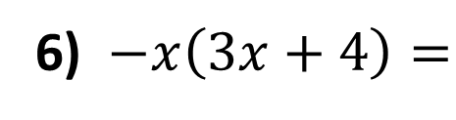
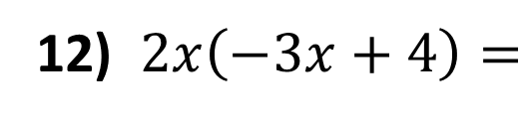
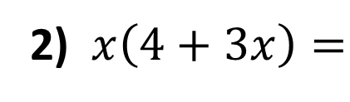
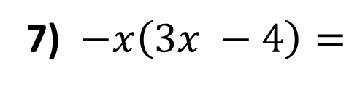
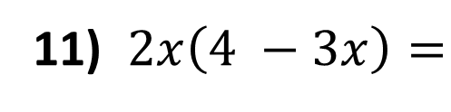
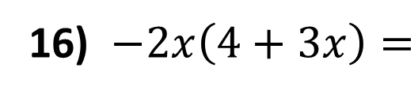
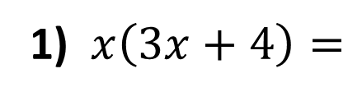
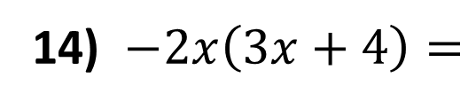
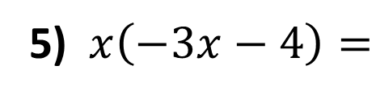
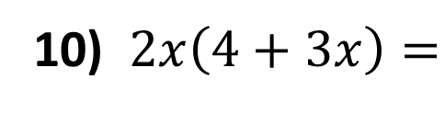
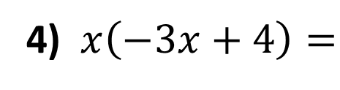
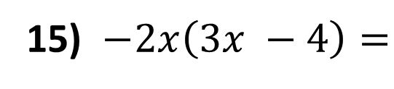
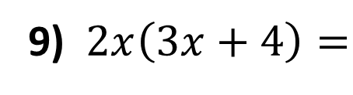
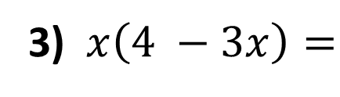
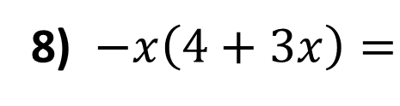
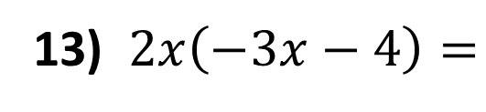
Expand the following brackets.
1) $x\left(3x+4\right)=$
9) $2x\left(3x+4\right)=$
2) $x\left(4+3x\right)=$
10) $2x\left(4+3x\right)=$
3) $x\left(4 −3x\right)=$
11) $2x\left(4 −3x\right)=$
4) $x\left(−3x+4\right)=$
12) $2x\left(−3x+4\right)=$
5) $x\left(−3x−4\right)=$
13) $2x\left(−3x−4\right)=$
6) $−x\left(3x+4\right)=$
14) $−2x\left(3x+4\right)=$
7) $−x\left(3x −4\right)=$
15) $−2x\left(3x −4\right)=$
8) $−x\left(4+3x\right)=$
16) $−2x\left(4+3x\right)=$

Slide 3
ANSWERS

Slide 4

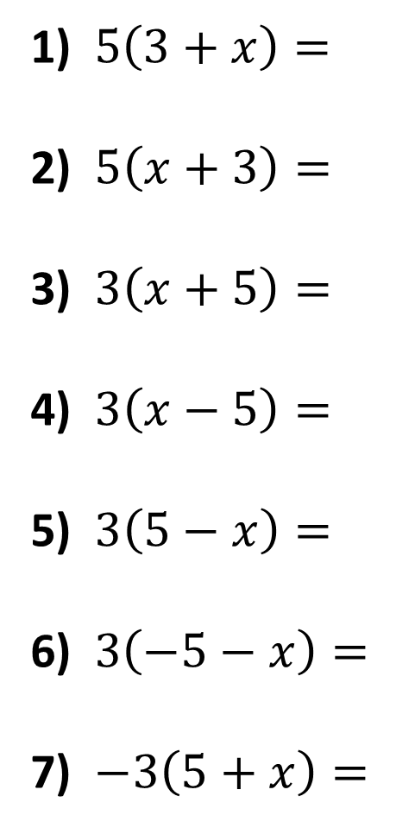






Expand the following brackets.
1) $5\left(3+x\right)=$
2) $5\left(x+3\right)=$
3) $3\left(x+5\right)=$
4) $3\left(x−5\right)=$
5) $3\left(5−x\right)=$
6) $3\left(−5−x\right)=$
7) $−3\left(5+x\right)=$
$$15+5x$$
$$5x+15$$
$$3x+15$$
$$3x−15$$
$$15−3x$$
$$−15−3x$$
$$−15−3x$$

Slide 5

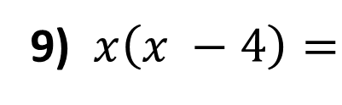
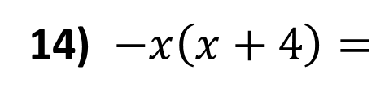


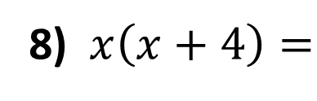
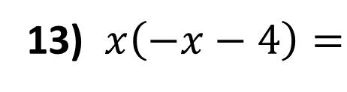
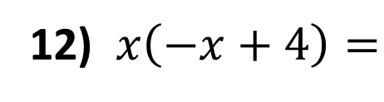
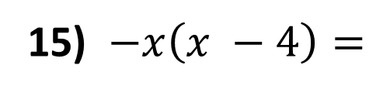



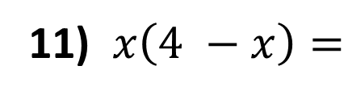

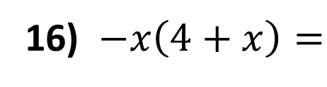


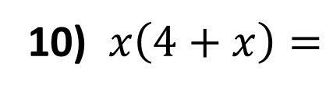
8) $x\left(x+4\right)=$
$$x2+4x$$
9) $x\left(x −4\right)=$
$$x2 −4x$$
10) $x\left(4+x\right)=$
$$4x+ x2$$
11) $x\left(4 −x\right)=$
$$4x − x2$$
12) $x\left(−x+4\right)=$
$$−x2 +4x$$
13) $x\left(−x−4\right)=$
$$−x2 −4x$$
14) $−x\left(x+4\right)=$
$$−x2 −4x$$
15) $−x\left(x −4\right)=$
$$−x2 +4x$$
16) $−x\left(4+x\right)=$
$$−4x − x2$$

Slide 6
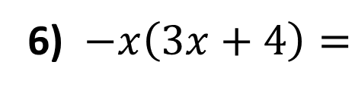

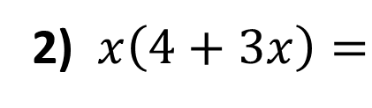
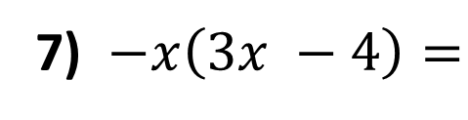


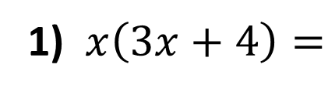

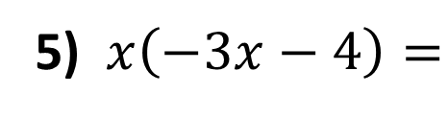

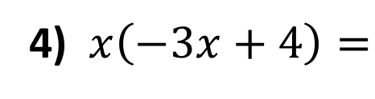


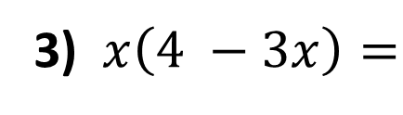
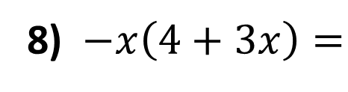

Expand the following brackets.
1) $x\left(3x+4\right)=$
$$3x2+4x$$
2) $x\left(4+3x\right)=$
$$4x+3x2$$
3) $x\left(4 −3x\right)=$
$$4x −3x2$$
4) $x\left(−3x+4\right)=$
$$−3x2 +4x$$
5) $x\left(−3x−4\right)=$
$$−3x2 −4x$$
6) $−x\left(3x+4\right)=$
$$−3x2 −4x$$
7) $−x\left(3x −4\right)=$
$$−3x2 +4x$$
8) $−x\left(4+3x\right)=$
$$−4x −3x2$$

Slide 7
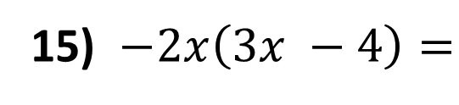


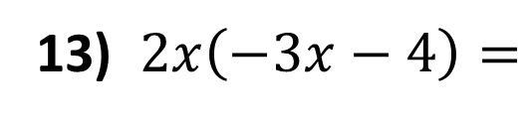


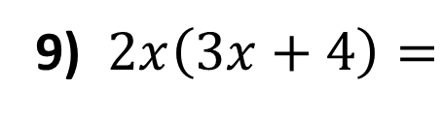


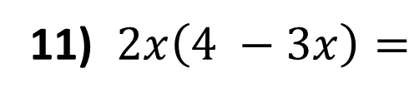

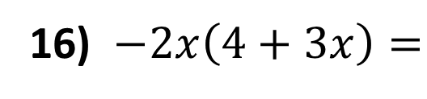
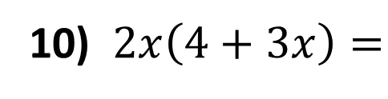


9) $2x\left(3x+4\right)=$
$$6x2+8x$$
10) $2x\left(4+3x\right)=$
$$8x+6x2$$
11) $2x\left(4 −3x\right)=$
$$8x −6x2$$
12) $2x\left(−3x+4\right)=$
$$−6x2 +8x$$
13) $2x\left(−3x−4\right)=$
$$−6x2 −8x$$
14) $−2x\left(3x+4\right)=$
$$−6x2 −8x$$
15) $−2x\left(3x −4\right)=$
$$−6x2 +8x$$
16) $−2x\left(4+3x\right)=$
$$−8x −6x2$$

