Slide 1
FM: Solving Trigonometric
Equations

Slide 2
Solving Trigonometric Equations
The way you find solutions
to a trigonometric equation depends on the trig function.
(sin, cos or tan)

Slide 3
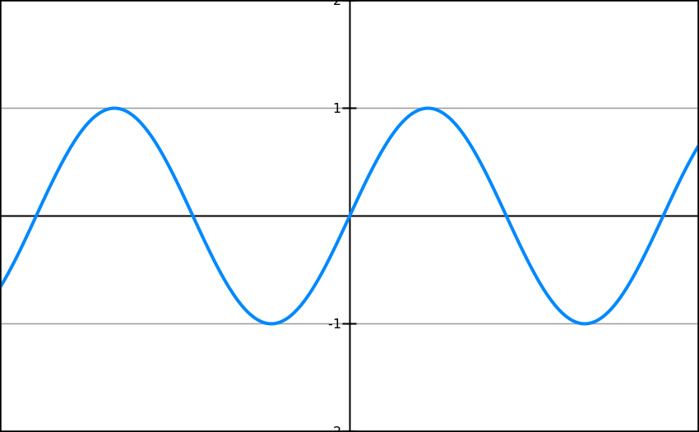

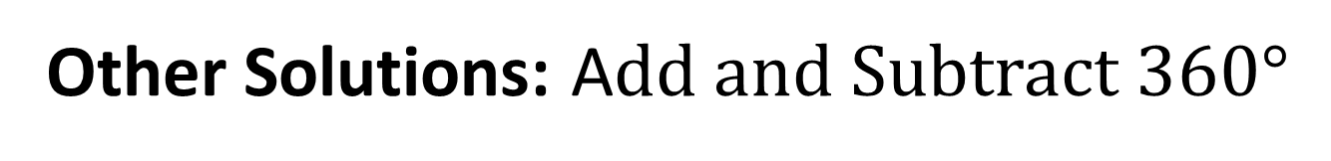

Sin Equations
Solution 1
Solution 2
1 cycle
1st Solution: $θ=\sin^{−1}\left(y\right)$
2nd Solution: $180°− Solution 1$
Other Solutions: Add and Subtract 360$°$

Slide 4
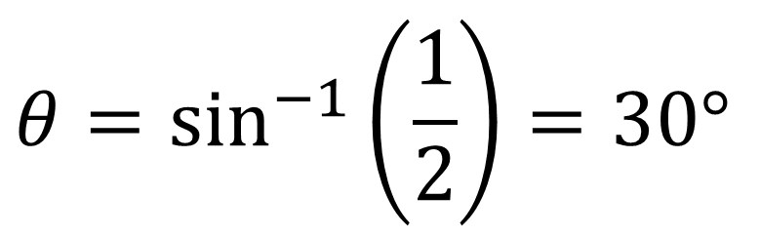
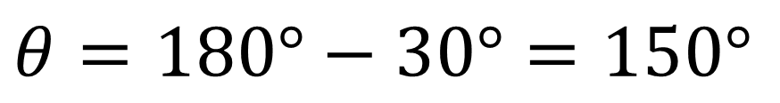
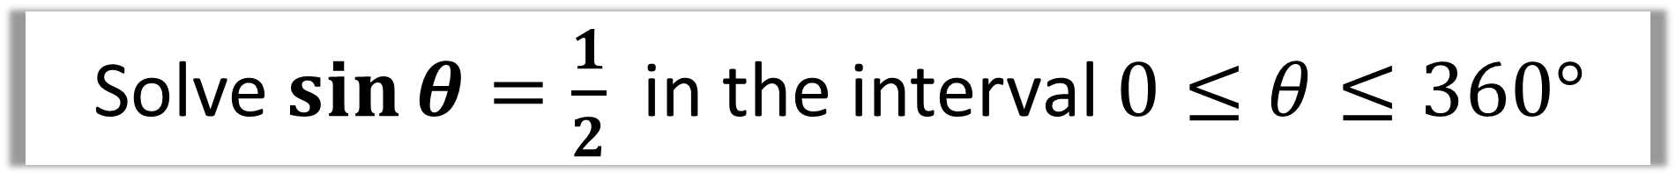
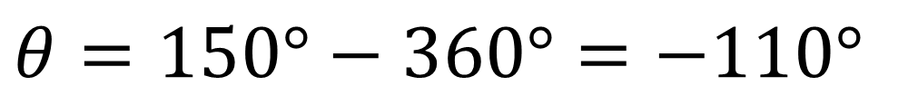
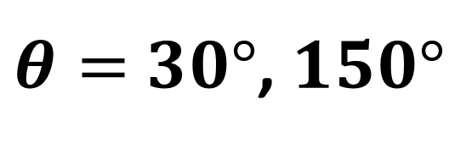
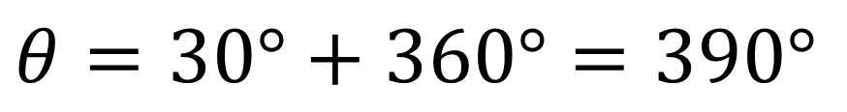
Solve$\sin{θ}=\frac{1}{2}$ in the interval $0≤θ≤360°$
$$θ=\sin^{−1}\left(\frac{1}{2}\right)=30°$$
Solution 1
Solution 2
$$θ=180°−30°=150°$$
$$θ=30°+360°=390°$$
$$θ=150°−360°=−110°$$
$θ=$ $30°$, $150°$

Slide 5
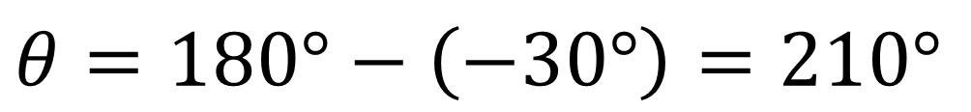
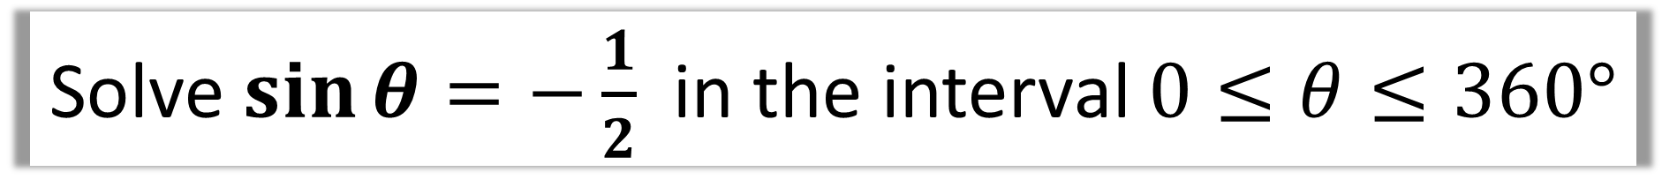
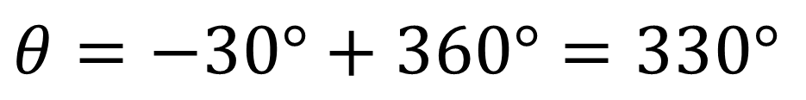
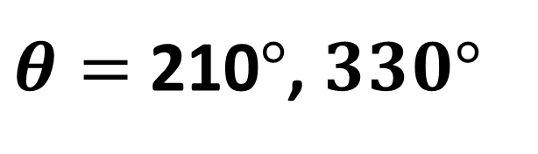
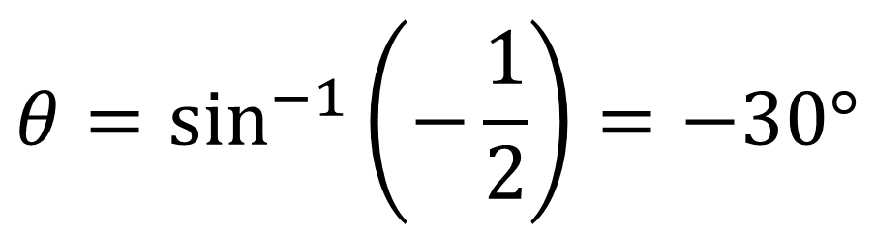
Solve $\sin{θ}=−\frac{1}{2}$ in the interval $0≤θ≤360°$
$$θ=\sin^{−1}\left(−\frac{1}{2}\right)=−30°$$
Solution 1
Solution 2
$$θ=180°−\left(−30°\right)=210°$$
$$θ=−30°+360°=330°$$
$θ=$ 210$°$, $330°$

Slide 6
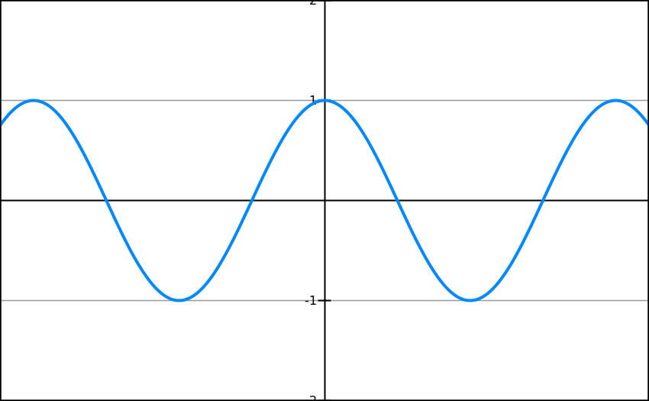


Cos Equations
Solution 1
Solution 2
1 cycle
1st Solution: $θ=\cos^{−1}\left(y\right)$
2nd Solution: $360°− Solution 1$
Other Solutions: Add and Subtract 360$°$

Slide 7
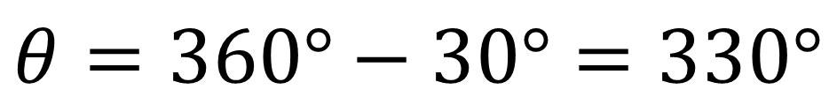
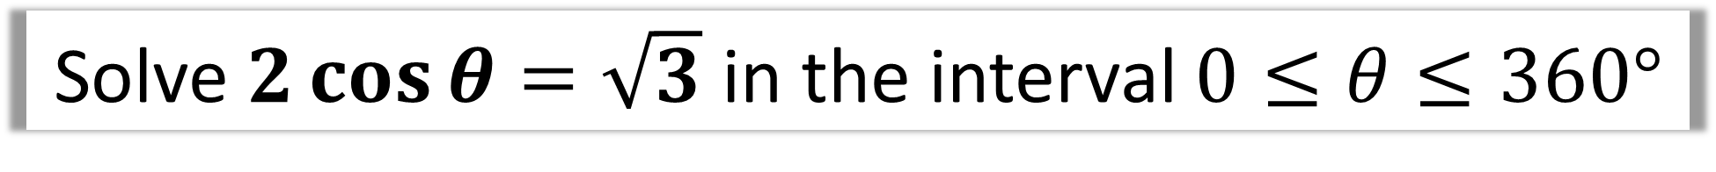
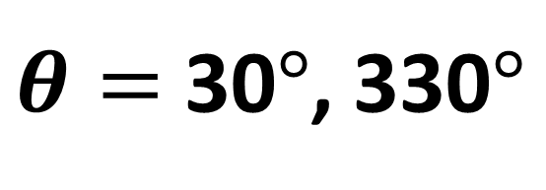
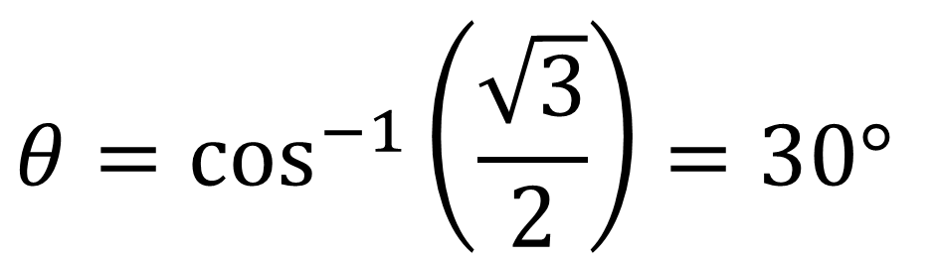
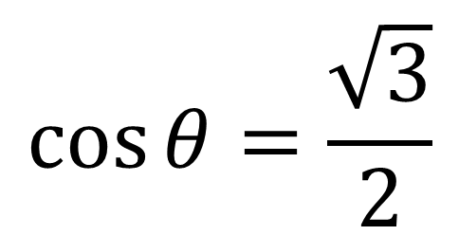
Solve $2\cos{θ}=\sqrt{3}$ in the interval $0≤θ≤360°$
$$\cos{θ=\frac{\sqrt{3}}{2}}$$
$$θ=\cos^{−1}\left(\frac{\sqrt{3}}{2}\right)=30°$$
Solution 1
Solution 2
$$θ=360°−30°=330°$$
$θ=$ 30$°$, 330$°$

Slide 8
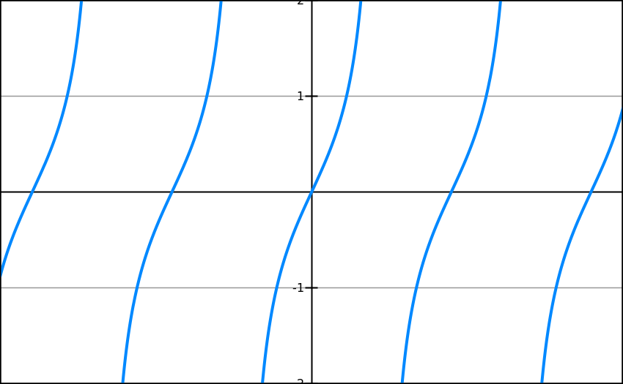
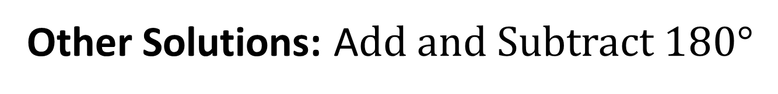

Tan Equations
Solution 1
1 cycle
1st Solution: $θ=\tan^{−1}\left(y\right)$
Other Solutions: Add and Subtract 180$°$

Slide 9
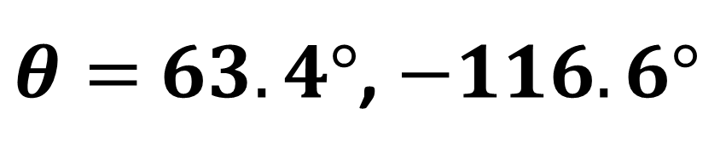
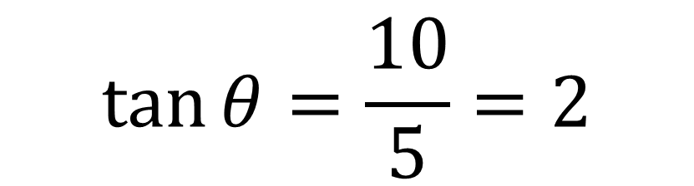
Solve $5\tan{θ}=10$ in the interval $−180°≤θ<180°$
$$\tan{θ}=\frac{10}{5}=2$$
$$θ=\tan^{−1}{(2})=63.4° (1dp)$$
Solution 1
$$θ=63.4°−180°=−116.6° \left(1dp\right)$$
$θ=$ $63.4°$, $−116.6°$

Slide 10



Solving Trigonometric Equations
Solution 1: $θ=\sin^{−1}\left(y\right)$
Solution 2: $θ=180°−Solution 1$
All other solutions: ± 360°
Solution 1: $θ=\cos^{−1}\left(y\right)$
Solution 2: $θ=360°−Solution 1$
All other solutions: ± 360°
Solution 1: $θ=\tan^{−1}\left(y\right)$
All other solutions: ± 180°

