Slide 1
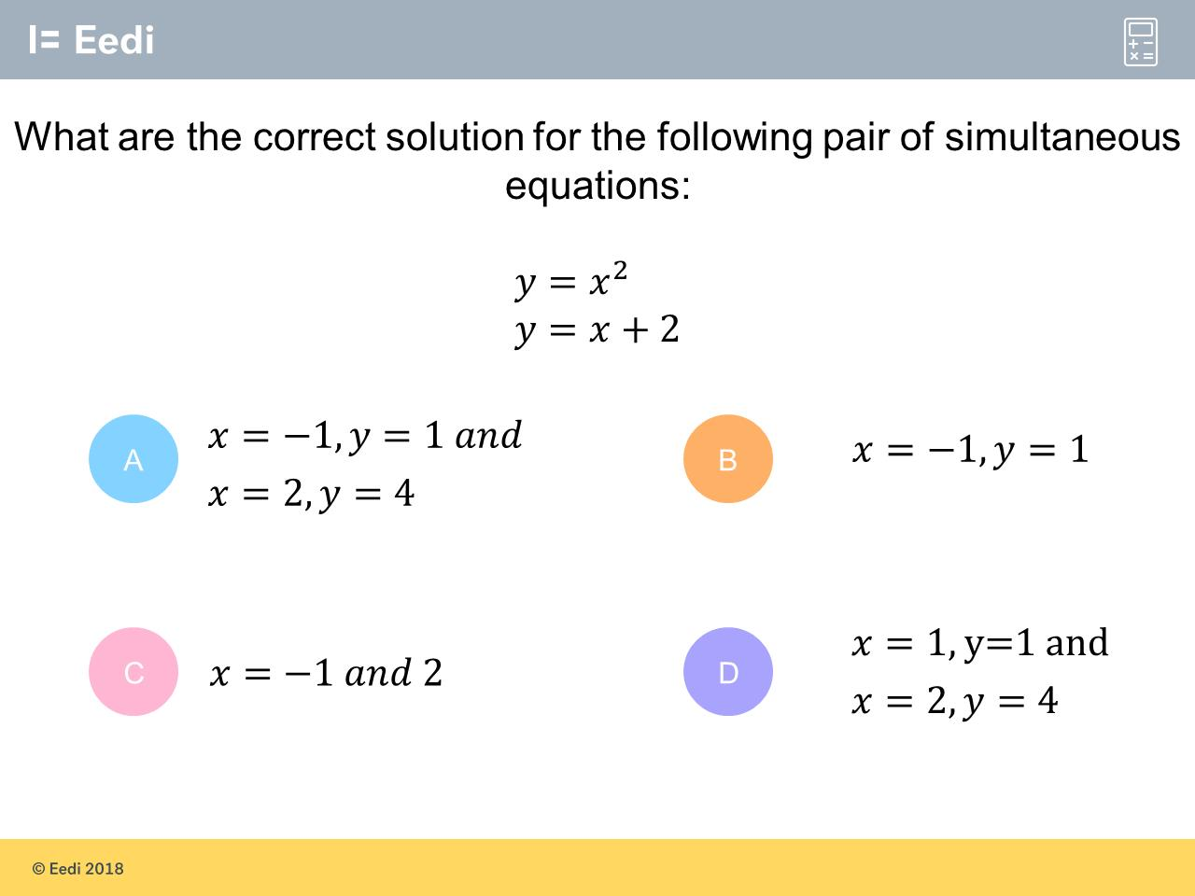
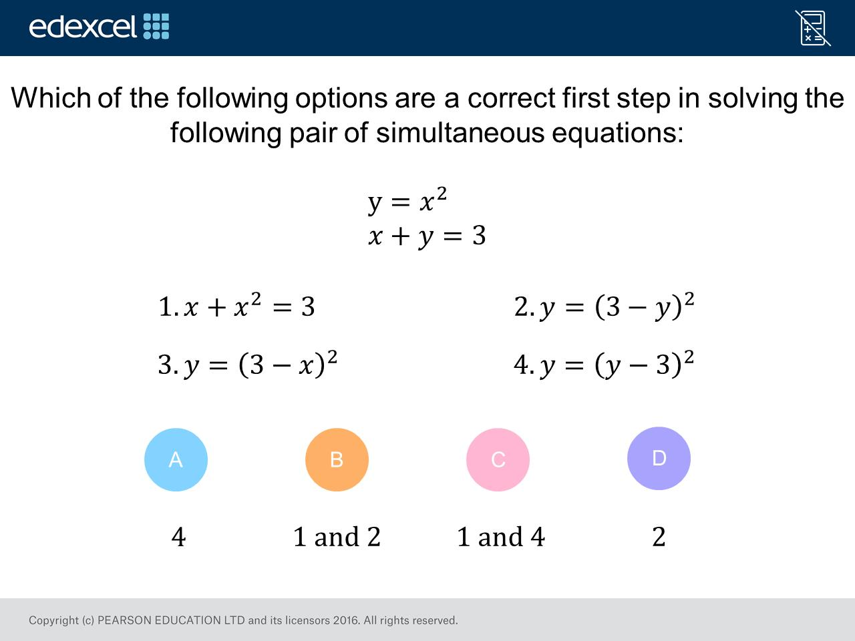
Worst answered question?
Most common wrong answer?

Slide 2
ANSWERS

Slide 3
Worst answered question?

Slide 4
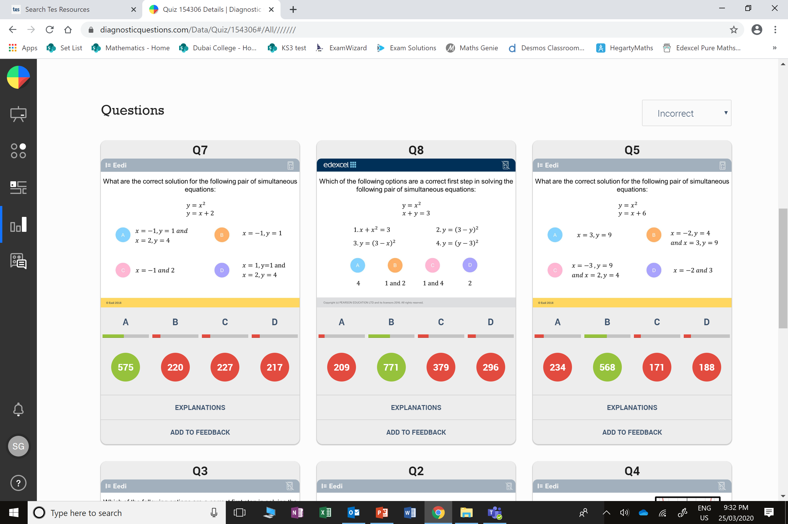
B
They only found one set of solutions.

Slide 5
C
They put option 4, because they rearranged the
x + y = 3
Incorrectly.

