Slide 1
Modelling in Mechanics
Constructing a Model
Chapter 8
(Part 1 of 4)

Slide 2
Constructing a Model
Mechanics deals with the motion of an object.
You construct a model of a real-life situation.
Then Describe the motion of the object using an equation or graph.

Slide 3
The solution to a mathematical model should be
interpreted in the context
of the original problem.

Slide 4
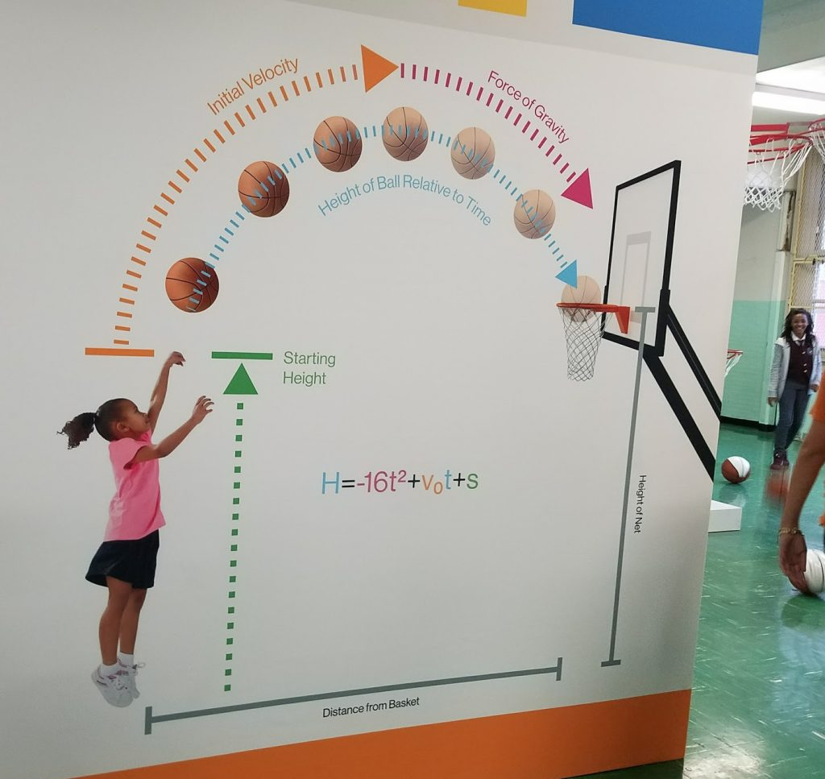

Slide 5
The motion of a basketball can be
modelled using the equation:
h = 2 + 1.1t – 0.1t²
What is the height when the basketball is released?
2 metres
What is the height when t = 0.5?
2.525 metres

Slide 6
h = 2 + 1.1t – 0.1t²
What is the height when t = 15?
– 4 metres
Comment on the validity of this prediction.
The ball cannot be 4 metre below ground!
So the model is not valid when t = 15

