Slide 1
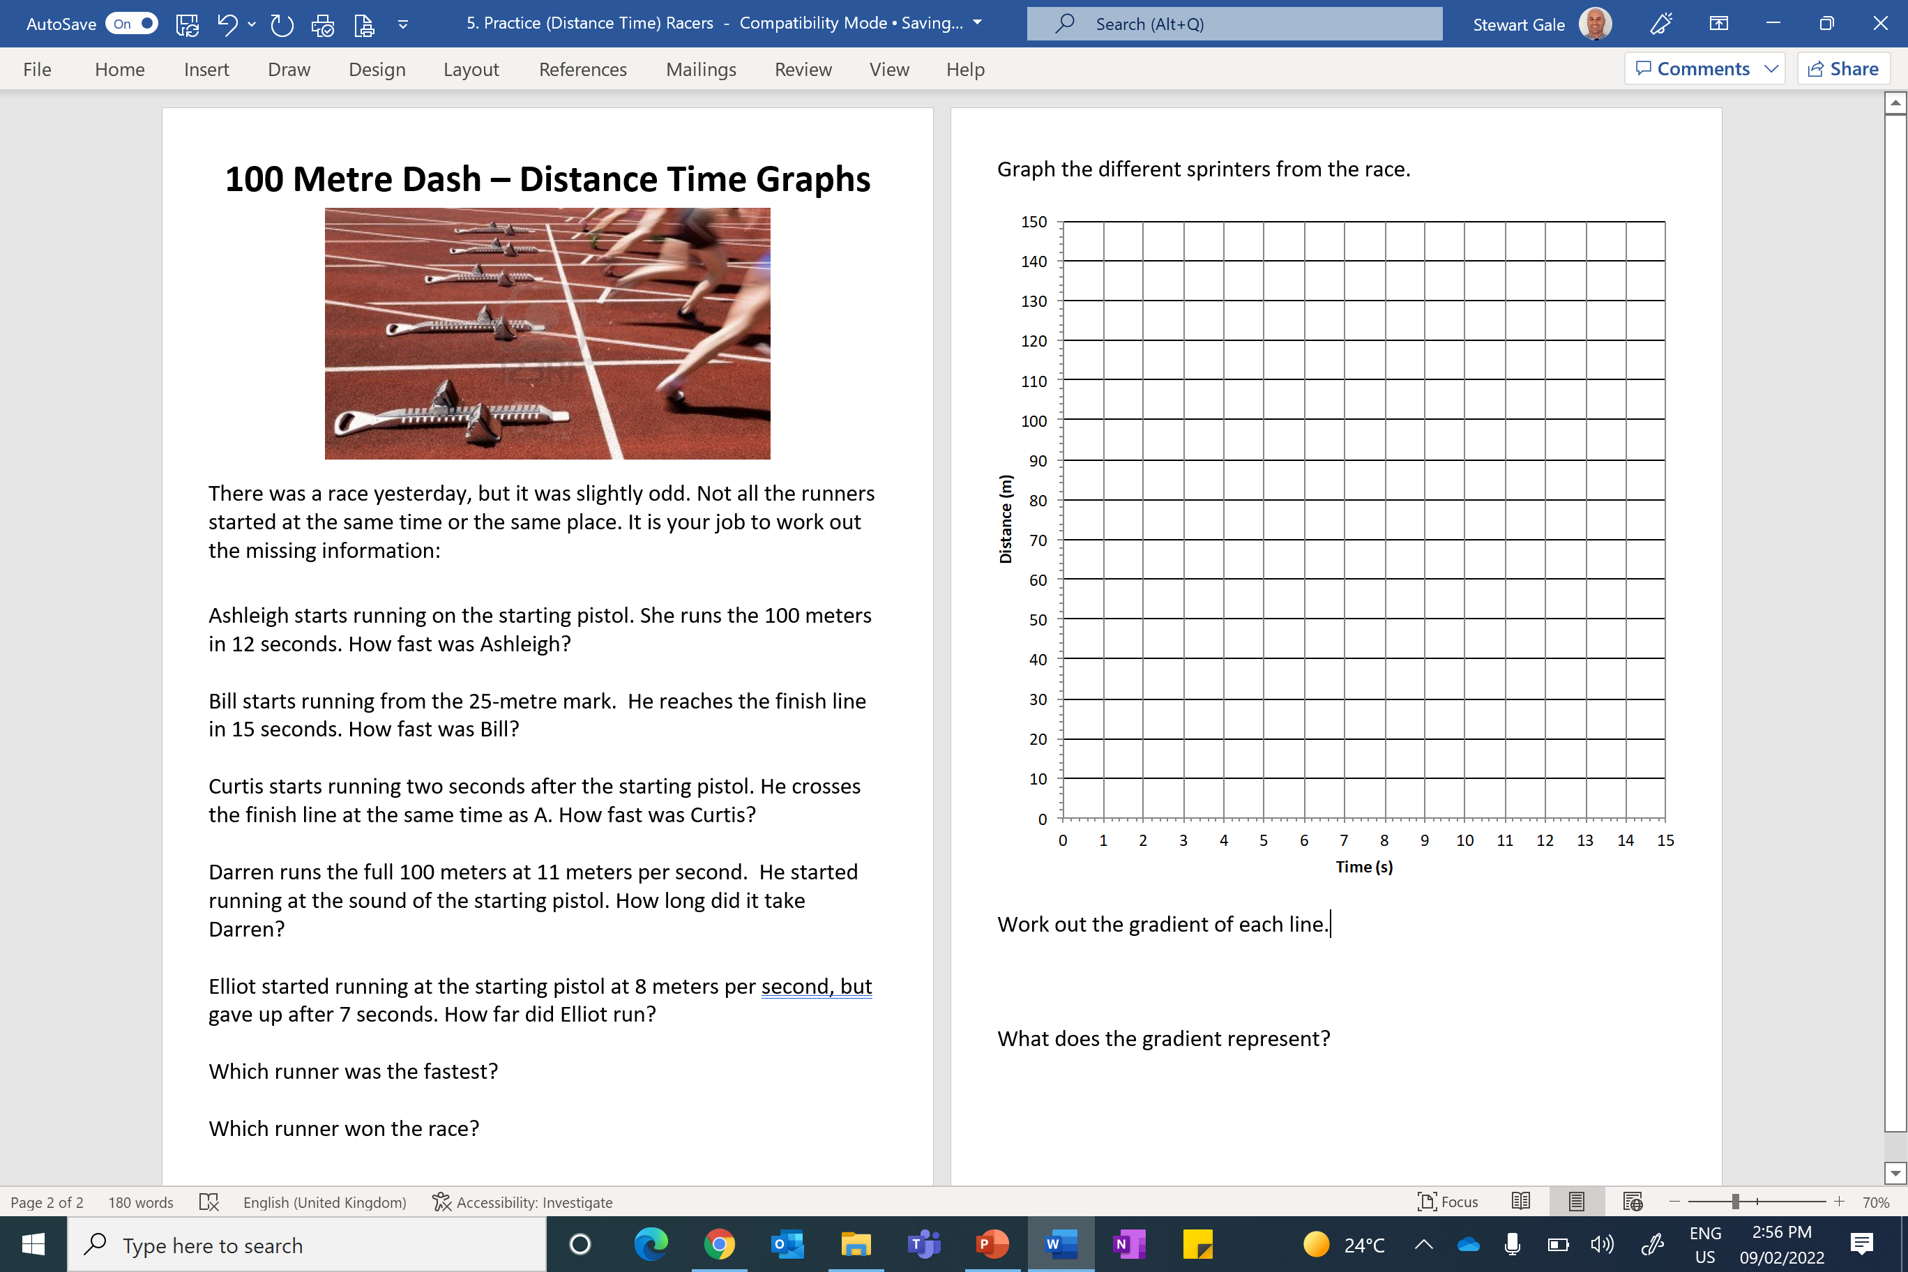

Slide 2
ANSWERS

Slide 3
A starts running on the starting pistol.
She runs the 100 meters in 12 seconds.
How fast was A?
B starts running from the 25 meter mark.
He reaches the finish line in 15 seconds.
How fast was B?
C starts running two seconds after the starting pistol.
He crosses the finish line at the same time as A.
How fast was C?
D runs the full 100 meters at 11 meters per second.
He started running at the sound of the starting pistol.
How long did it take D?
E started running at the starting pistol at 8 meters per second,
but gave up after 7 seconds. How far did E run?
100 m every 12 seconds
8.3 meters per seconds
75 m every 15 seconds
5 meters per seconds
100 m every 10 seconds
10 meters per seconds
9.0909…. seconds
56 meters

Slide 4
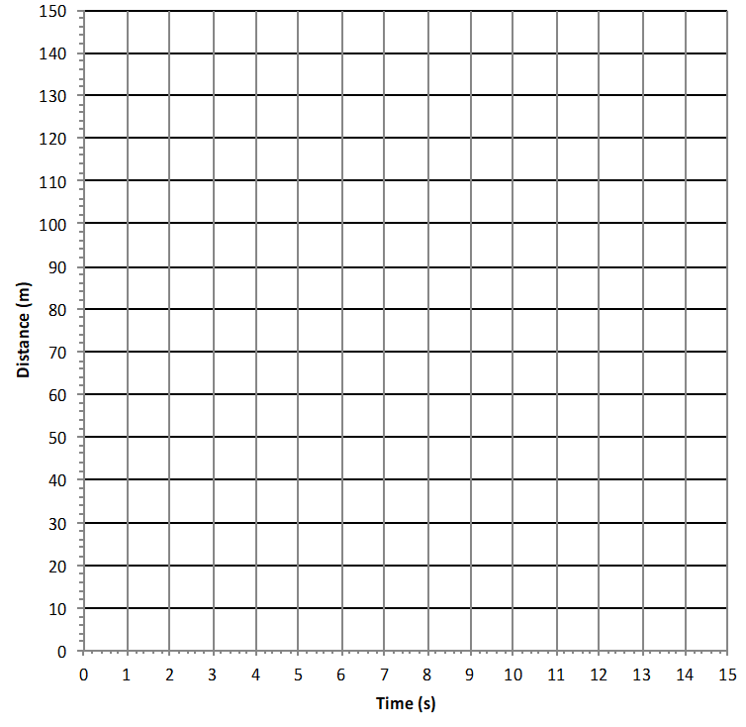
D
A
C
B
E

