Slide 1
LO: Area of a Triangle
(Trigonometry Formula)

Slide 2
What's the area of the triangle?
6m
5m
8m
Area = 20cm²

Slide 3
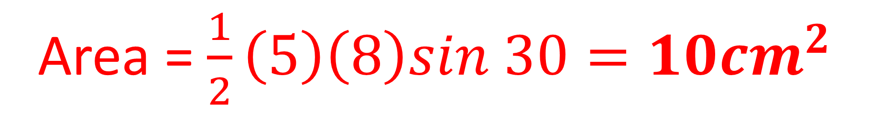
What's the area of the triangle?
5m
30˚
8m
Area = $\frac{1}{2}\left(5\right)\left(8\right)sin 30=10{cm}^{2}$

Slide 4

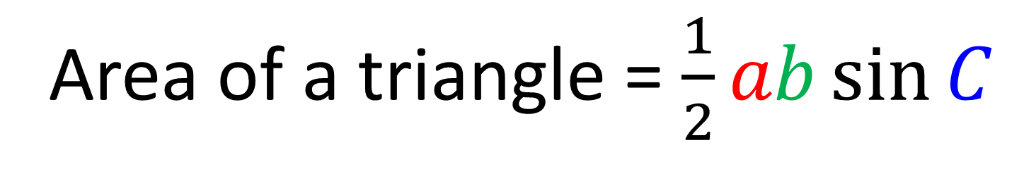

Area of a triangle = $\frac{1}{2}ab\sin{C}$
Area of a triangle = $\frac{1}{2}ac\sin{B}$
Area of a triangle = $\frac{1}{2}bc\sin{A}$

Slide 5
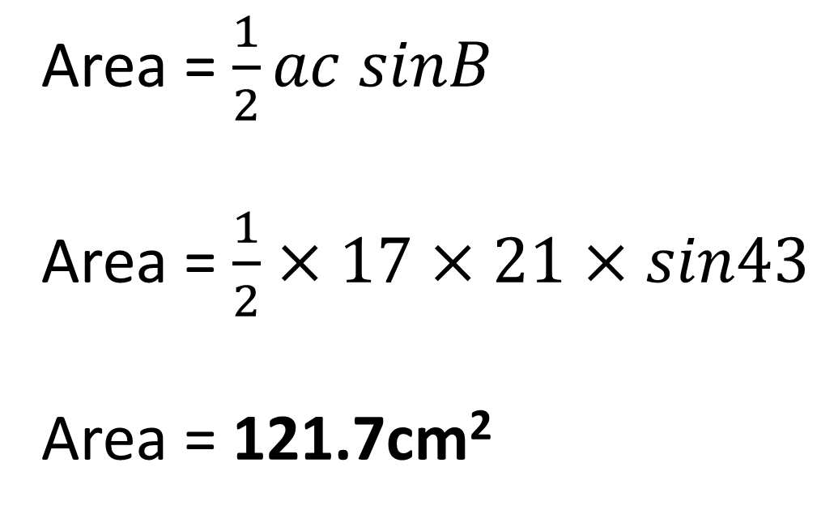

Calculate the area of the triangle.
Give you answer to 1 decimal place.
A
Area = $\frac{1}{2}ac sinB$
Area = $\frac{1}{2}×17×21×sin43$
Area = 121.7cm²
21cm
$${43}^{o}$$
C
B
17cm

Slide 6
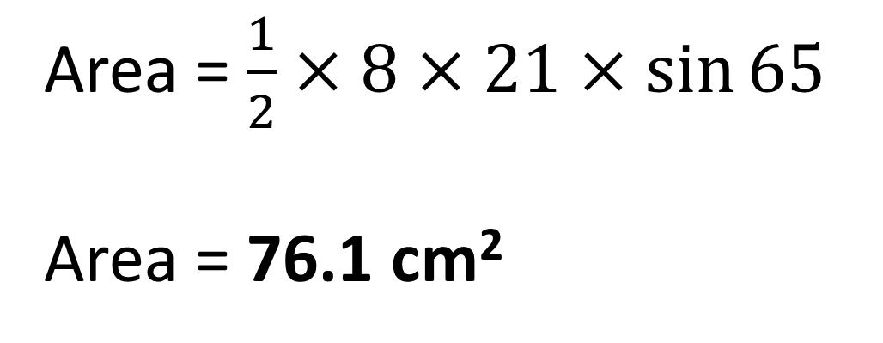

Calculate the area of the triangle.
Give you answer to 1 decimal place.
A
Area = $\frac{1}{2}×8×21×\sin{65}$
Area = 76.1 cm²
8cm
$${65}^{o}$$
C
B
21cm

Slide 7
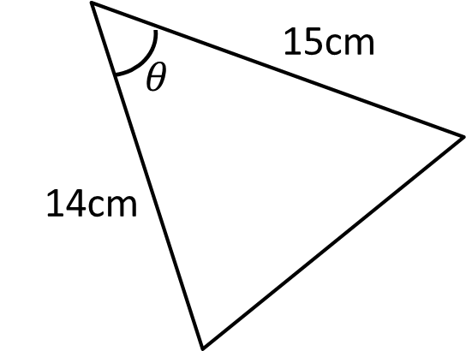
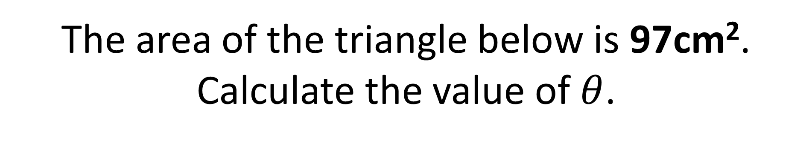
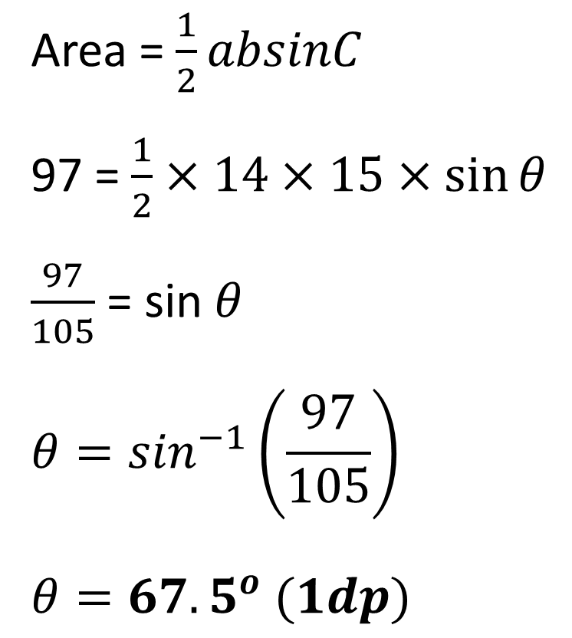
The area of the triangle below is 97cm².
Calculate the value of $θ$.
Area = $\frac{1}{2}absinC$
97 = $\frac{1}{2}×14×15×\sin{θ }$
$\frac{97}{105}$ = sin$θ$
$$θ=\sin^{−1}\left(\frac{97}{105}\right)$$
$$θ={67.5}^{o} (1dp)$$

Slide 8
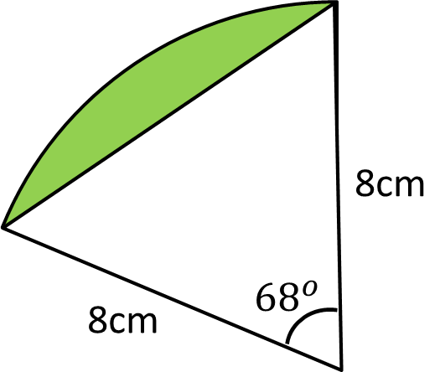
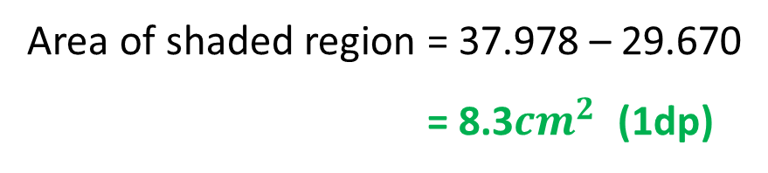
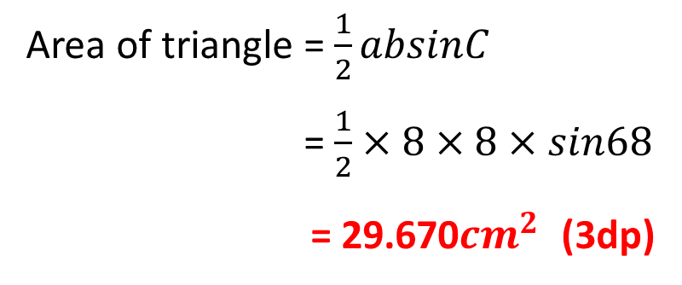
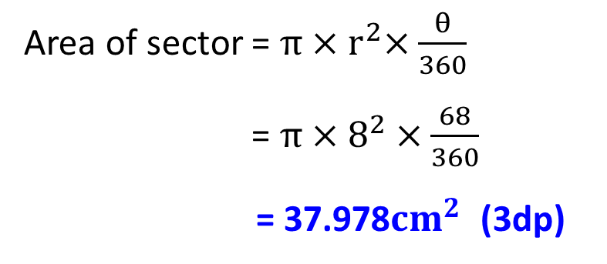
Calculate the area of the shaded section.
Area of sector = $π{×r}^{2}×\frac{θ}{360}$
Area of sector = $π×8^{2}×\frac{68}{360}$
Area of sector = 37.978${cm}^{2}$ (3dp)
Area of triangle = $\frac{1}{2}absinC$
Area of triangle = $\frac{1}{2}×8×8×sin68$
Area of triangle = 29.670${cm}^{2}$ (3dp)
Area of shaded region = 37.978 – 29.670
Area of shaded region = 8.3${cm}^{2}$ (1dp)

