Slide 1
Radians
Sector Area
Chapter 5
(Part 3 of 5)

Slide 2

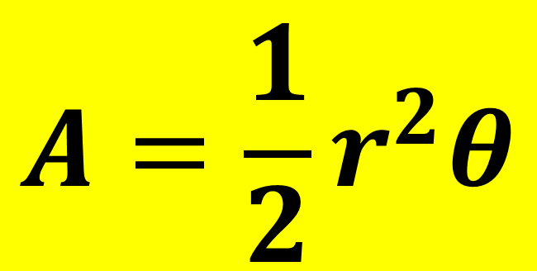

Radians – Area of a Sector
$$r$$
$$θ$$
$$A=\frac{1}{2}r^{2}θ$$

Slide 3
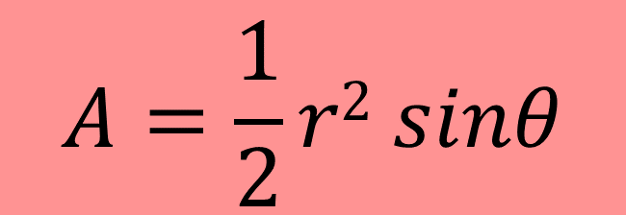
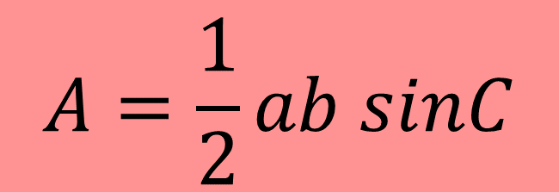



Radians – Area of a Triangle
$$A=\frac{1}{2}ab sinC$$
$$r$$
$$θ$$
$$r$$
$$A=\frac{1}{2}r2 sinθ$$

Slide 4


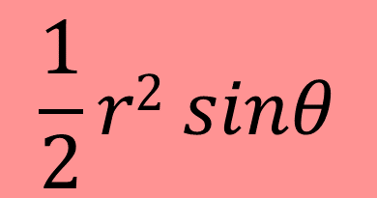
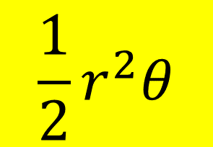

Radians - Segment Area
$$r$$
$$θ$$
$$r$$
$$\frac{1}{2}r^{2}θ$$
-
$$\frac{1}{2}r2 sinθ$$
=
Area of Segment

Slide 5
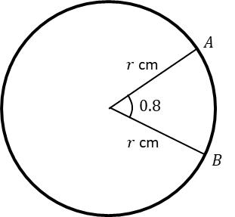
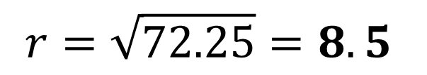
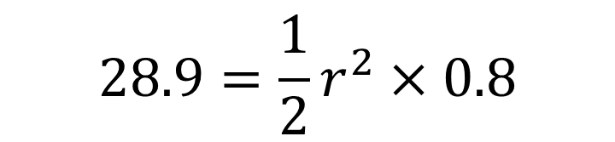
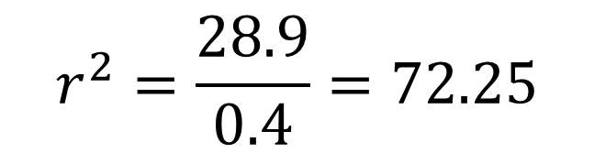
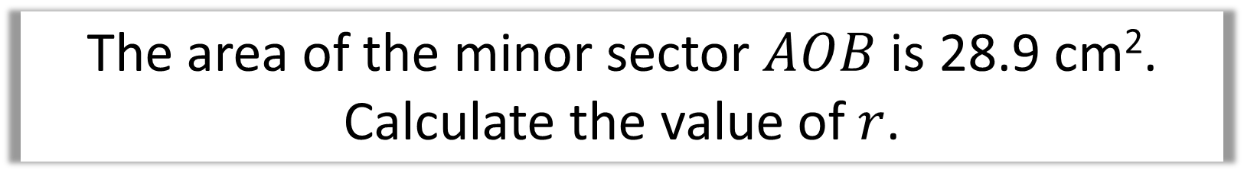

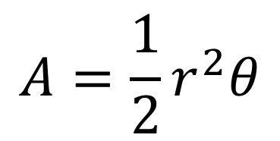
The area of the minor sector $AOB$ is 28.9 cm².
Calculate the value of $r$.
$$A=\frac{1}{2}r^{2}θ$$
$$28.9=\frac{1}{2}r^{2}×0.8$$
$$28.9=0.4r^{2}$$
$$r^{2}=\frac{28.9}{0.4}=72.25$$
$$r=\sqrt{72.25}=8.5$$

Slide 6
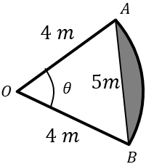
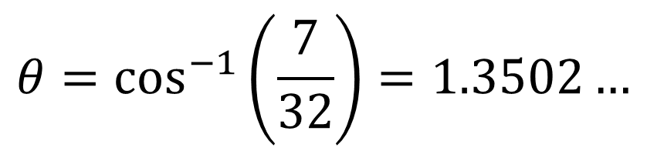

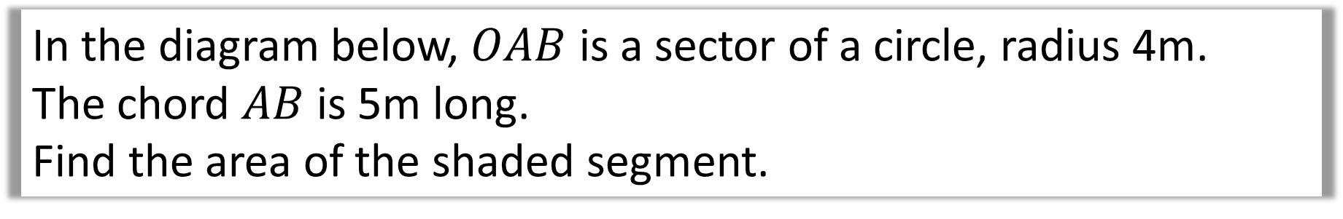

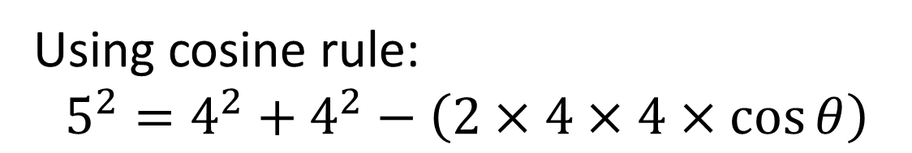
In the diagram below, $OAB$ is a sector of a circle, radius 4m.
The chord $AB$ is 5m long.
Find the area of the shaded segment.
Using cosine rule:
$$5^{2}=4^{2}+4^{2}−\left(2×4×4×\cos{θ}\right)$$
$$25=32−32\cos{θ}$$
$$32\cos{θ}=7$$
$$θ=\cos^{−1}\left(\frac{7}{32}\right)=1.3502…$$

Slide 7

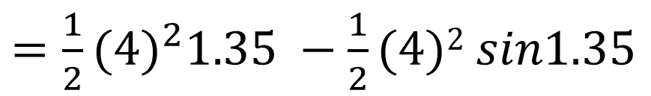
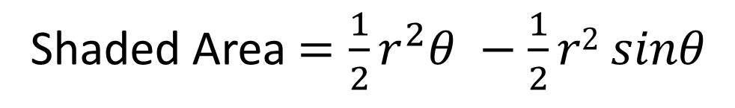
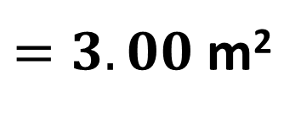
In the diagram below, $OAB$ is a sector of a circle, radius 4m.
The chord $AB$ is 5m long.
Find the area of the shaded segment.
Shaded Area $=\frac{1}{2}r^{2}θ −$ $\frac{1}{2}r2 sinθ$
$=\frac{1}{2}{(4)}^{2}1.35 −$ $\frac{1}{2}(4)2 sin1.35$
$=10.8−$ $7.8$
$=3.00$ m²

Slide 8
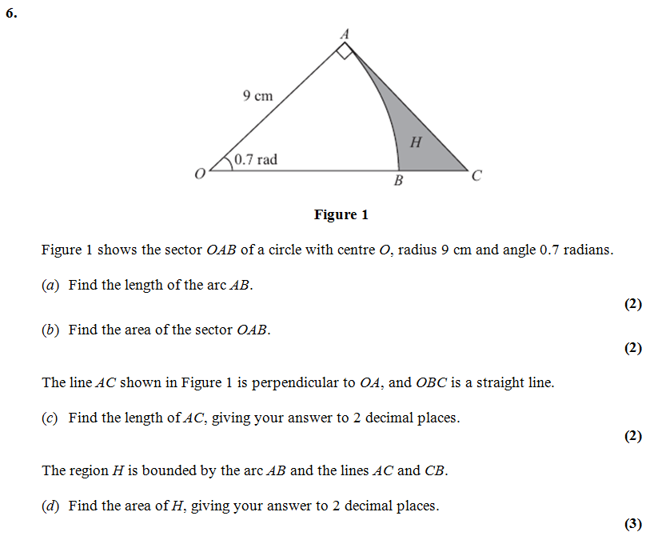

Slide 9
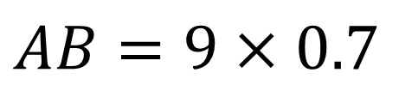
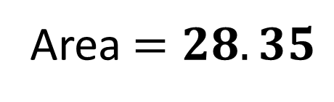
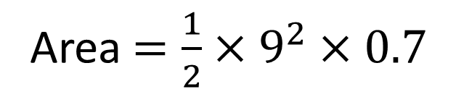
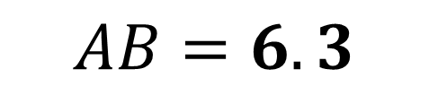
a)
$$AB=9×0.7$$
$$AB=6.3$$
b)
Area $=\frac{1}{2}×9^{2}×0.7$
Area $=28.35$

Slide 10
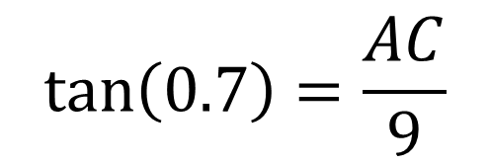


c)
$$\tan\left(0.7\right)=\frac{AC}{9}$$
$$AC=9\tan\left(0.7\right)$$
$$AC=7.58$$

Slide 11
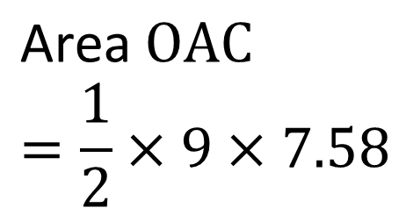
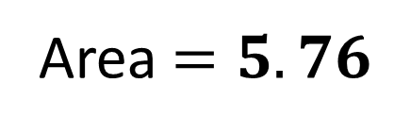
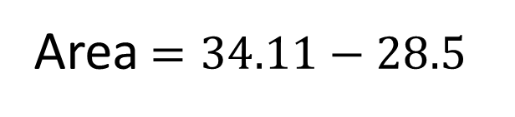

d)
$$\text{Area} OAC=\frac{1}{2}×9×7.58$$
$$=34.11$$
Area $=34.11−28.5$
Area $=5.76$

