Slide 1
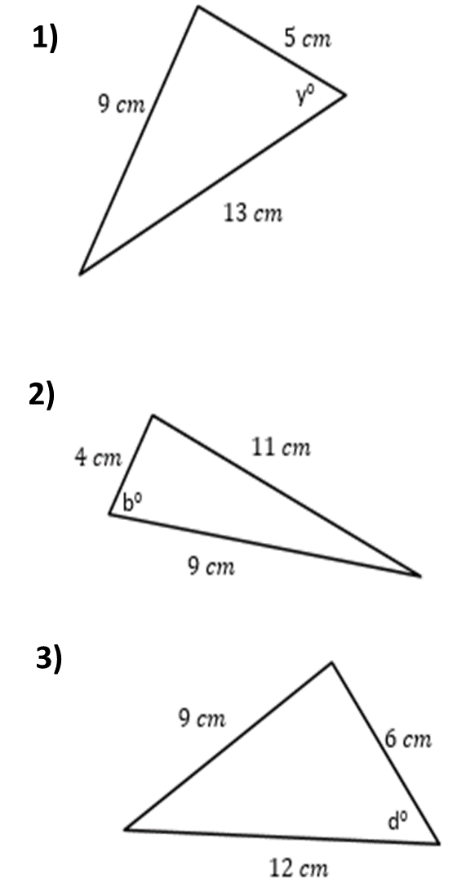
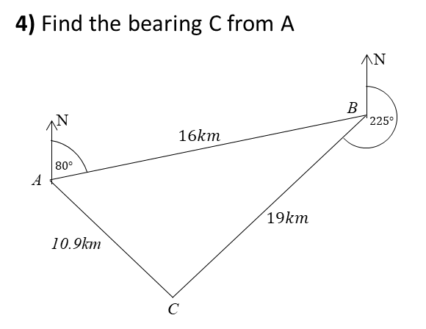

Slide 2
ANSWERS

Slide 3
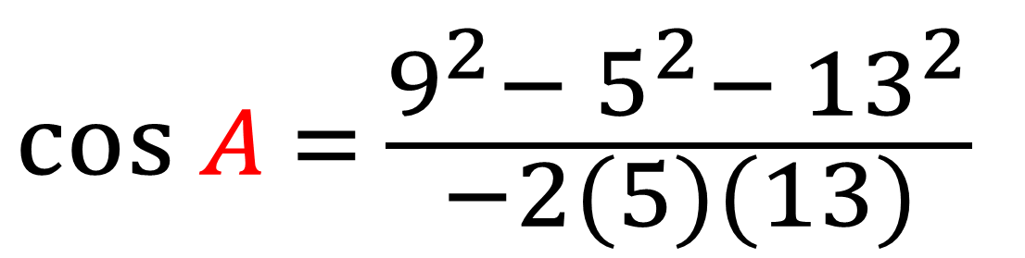
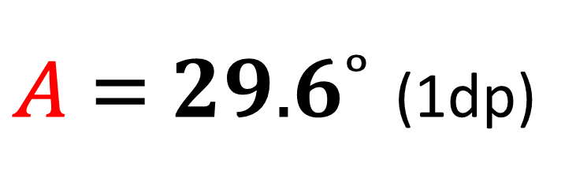
$$\cos{A} = \frac{9^{2}{− 5}^{2}− {13}^{2}}{−2(5)(13)}$$
$A = 29.6˚$ (1dp)

Slide 4
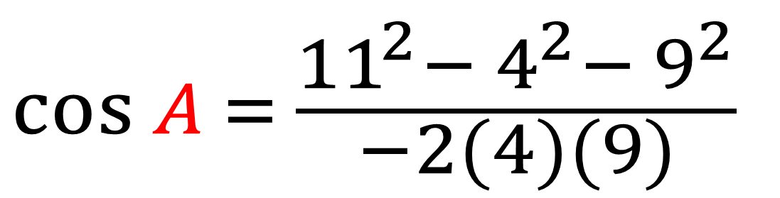
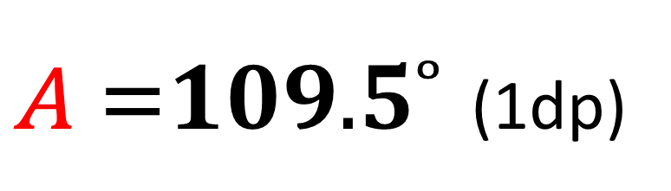
$$\cos{A} = \frac{{11}^{2}{− 4}^{2}− 9^{2}}{−2(4)(9)}$$
$A =109.5˚$ (1dp)

Slide 5


$$\cos{A} = \frac{9^{2}{− 12}^{2}− 6^{2}}{−2(12)(6)}$$
$A = 46.6˚$ (1dp)

Slide 6
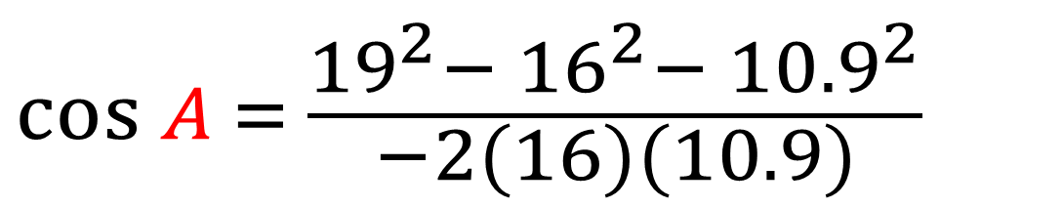
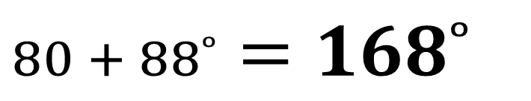

$$\cos{A} = \frac{{19}^{2}{− 16}^{2}− {10.9}^{2}}{−2(16)(10.9)}$$
$A = 88˚$
$$80 + 88˚=168˚$$

