Slide 1
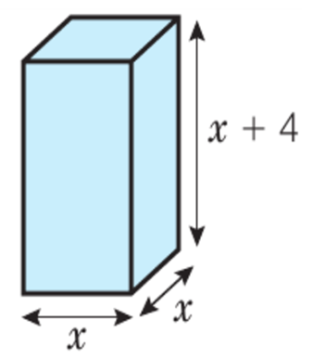
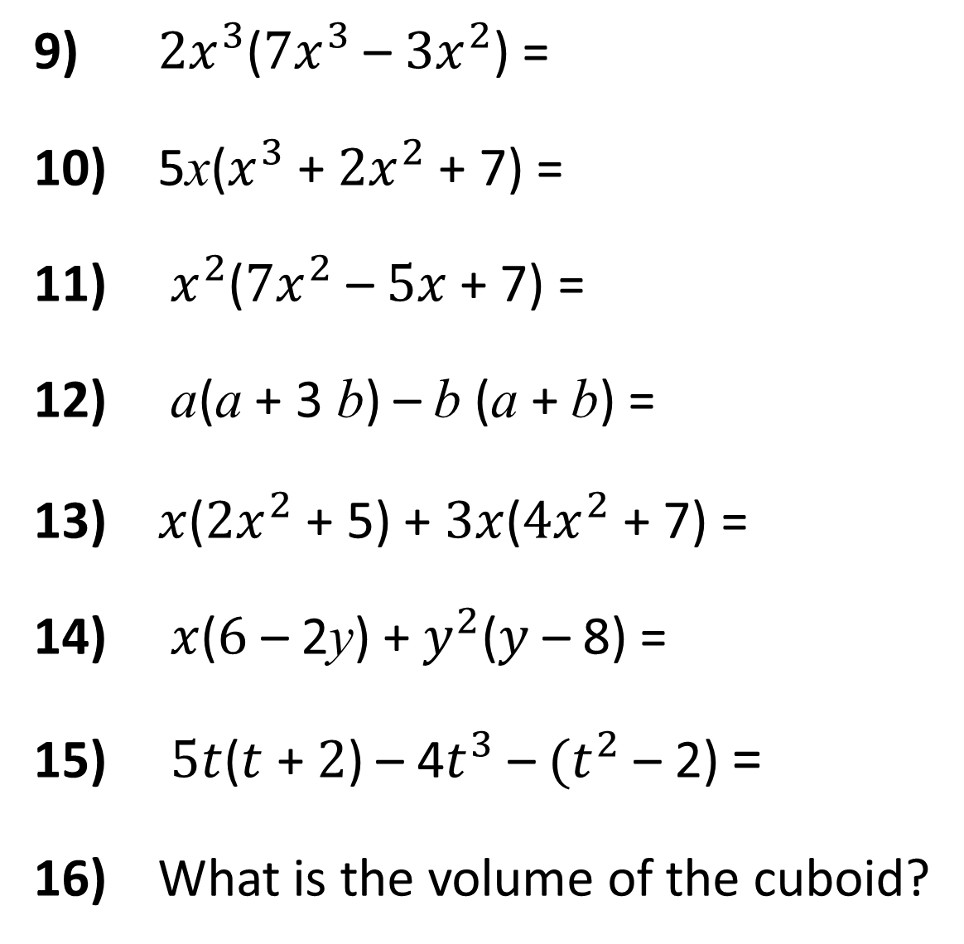
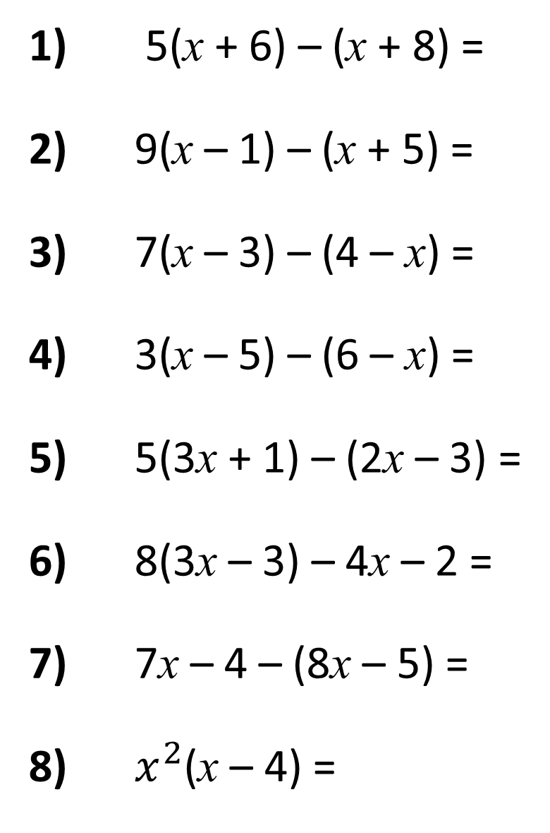
1) 5(x + 6) – (x + 8) =
2) 9(x – 1) – (x + 5) =
3) 7(x – 3) – (4 – x) =
4) 3(x – 5) – (6 – x) =
5) 5(3x + 1) – (2x – 3) =
6) 8(3x – 3) – 4x – 2 =
7) 7x – 4 – (8x – 5) =
8) $x^{2}$(x – 4) =
9) ${2x}^{3}$(${7x}^{3}$ – ${3x}^{2}$) =
10) 5x($x^{3}$ + ${2x}^{2}$ + 7) =
11) $x^{2}$(${7x}^{2}$ – $5x$ + 7) =
12) a(a + 3 b) – b (a + b) =
13) $x$(${2x}^{2}$ + 5) + $3x$(${4x}^{2}$ + 7) =
14) $x$($6$ – 2y) + $y^{2}$($y$ – 8) =
15) $5t$($t$ + $2$) – 4$t^{3}$ – ${(t}^{2}$ – 2) =
16) What is the volume of the cuboid?

Slide 2
ANSWERS

Slide 3
1) 5(x + 6) – (x + 8)
2) 9(x – 1) – (x + 5)
3) 7(x – 3) – (4 – x)
4) 3(x – 5) – (6 – x)
= 5x + 30 – x – 8
= 4x + 22
= 9x – 9 – x – 5
= 8x – 14
= 7x – 21 – 4 + x
= 8x – 25
= 3x – 15 – 6 + x
= 4x – 21

Slide 4
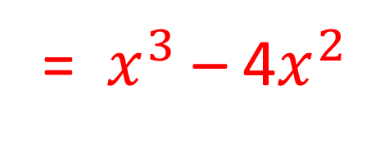
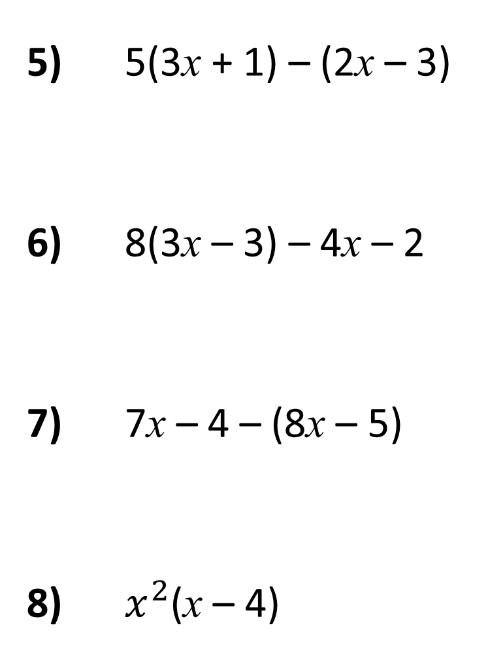
5) 5(3x + 1) – (2x – 3)
6) 8(3x – 3) – 4x – 2
7) 7x – 4 – (8x – 5)
8) $x^{2}$(x – 4)
= 15x + 5 – 2x + 3
= 13x + 8
= 24x – 24 – 4x – 2
= 20x – 26
= 7x – 4 – 8x + 5
= 1 – x
= $x^{3}$ – 4$x^{2}$

Slide 5
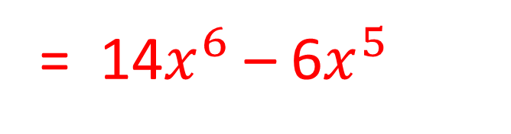
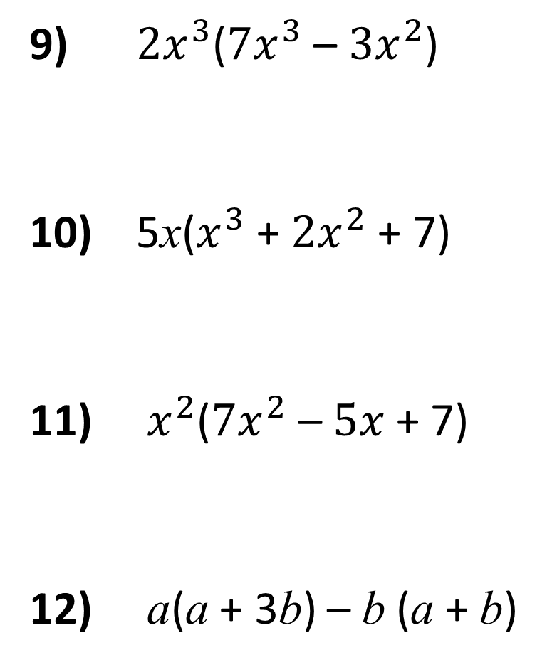
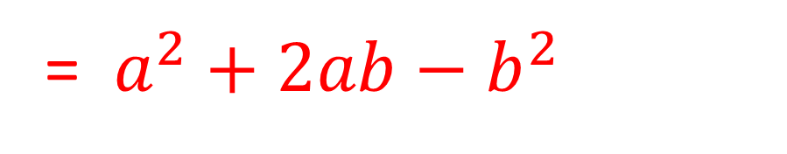
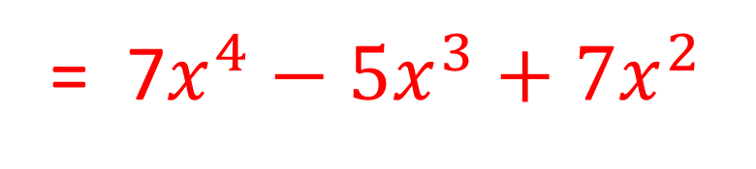
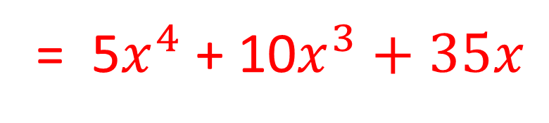
9) ${2x}^{3}$(${7x}^{3}$ – ${3x}^{2}$)
10) 5x($x^{3}$ + ${2x}^{2}$ + 7)
11) $x^{2}$(${7x}^{2}$ – $5x$ + 7)
12) a(a + 3b) – b (a + b)
= 14$x^{6}$ – 6$x^{5}$
= 5$x^{4}$ + 10$x^{3}+35x$
= 7$x^{4}−5x^{3}+7x^{2}$
= $a^{2}+2ab−b^{2}$

Slide 6
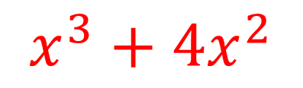
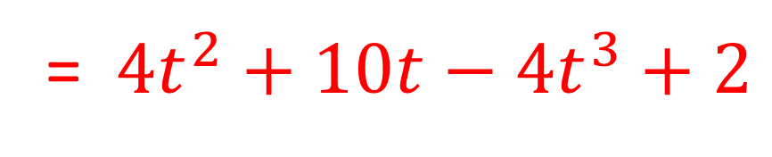
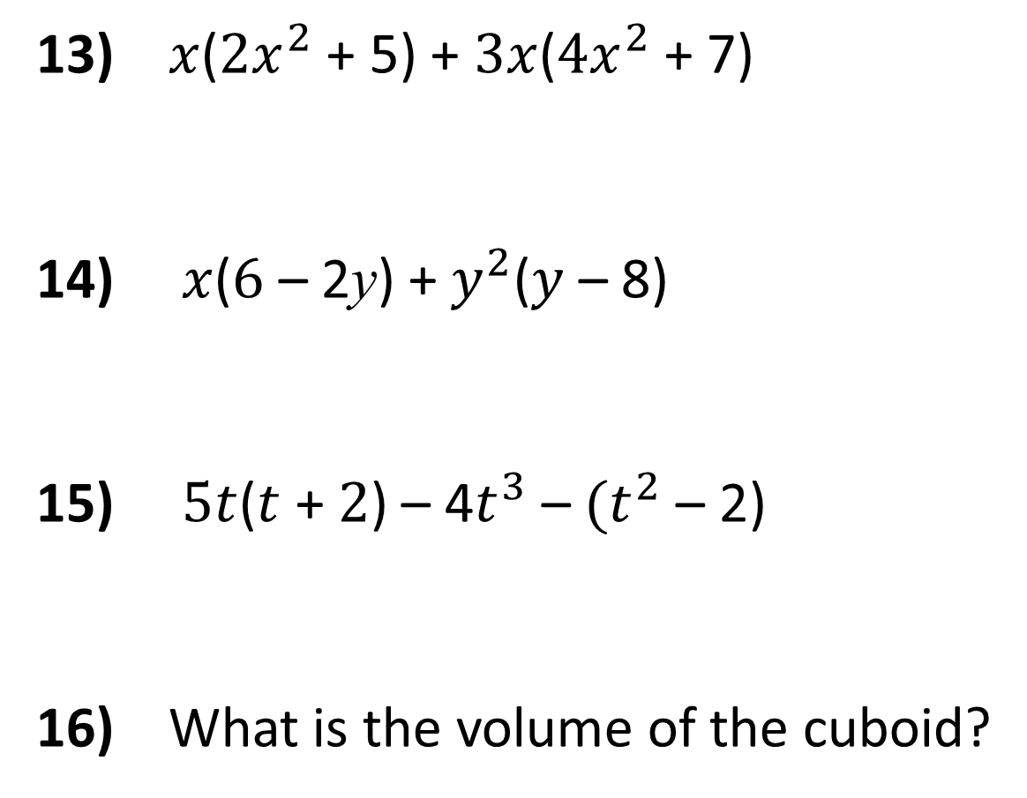
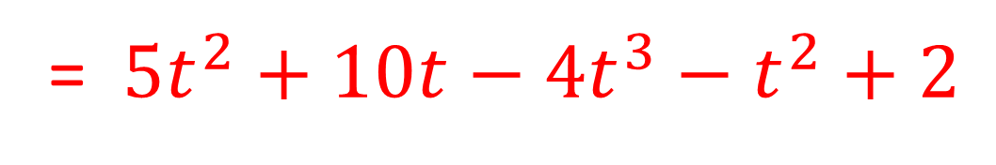
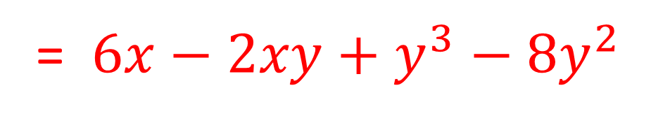
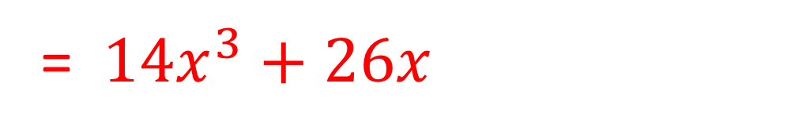
13) $x$(${2x}^{2}$ + 5) + $3x$(${4x}^{2}$ + 7)
14) $x$($6$ – 2y) + $y^{2}$($y$ – 8)
15) $5t$($t$ + $2$) – 4$t^{3}$ – ${(t}^{2}$ – 2)
16) What is the volume of the cuboid?
= ${14x}^{3}+26x$
= $6x−2xy+y^{3}−8y^{2}$
= ${5t}^{2}+10t−4t^{3}−t^{2}+2$
= ${4t}^{2}+10t−4t^{3}+2$
$$x^{3}+{4x}^{2}$$

